Slide 1
Fine-mapping of QTL using high-density SNP genotypes

Slide 2
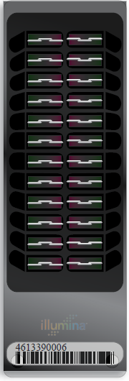
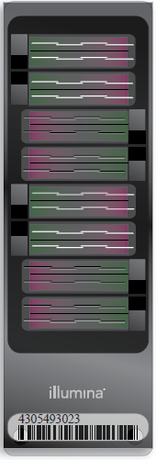
Illumina genotyping arrays
BovineSNP50
54,001 SNPs (version 1)
54,609 SNPs (version 2)
BovineHD
777,962 SNPs
BovineLD
6,909 SNPs
Allows for additional SNPs (e.g., GeneSeek Genomic Profiler)
BovineSNP50 v2
BovineHD
BovineLD
Notes:
2

Slide 3
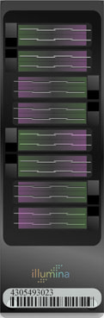
Bovine High-Density Bead Chip (HD)
778K SNP chosen to
Be evenly spaced
Include some Y-specific SNP
Include mitochondrial SNP
Utilize across-breed information
Fine mapping of QTL
Enhanced performance in Zebu cattle

Slide 4
Estimation of marker effects
Predict traditional PTA using phenotypes and pedigree
Compute SNP effects using deregressed PTA weighted by reliability
Bayes A-type model
Regress small effects to mean
Allow large effects to grow

Slide 5
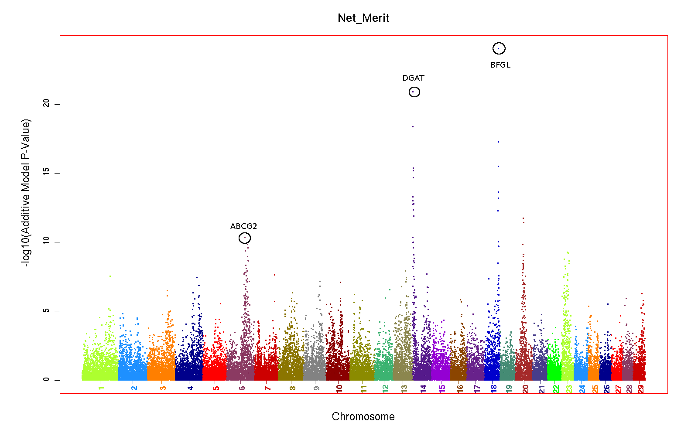
We got right to the point…
Cole, J.B. et al. 2009. Distribution and location of genetic effects for dairy traits. ICAR Tech Ser. 13:355–360.

Slide 6
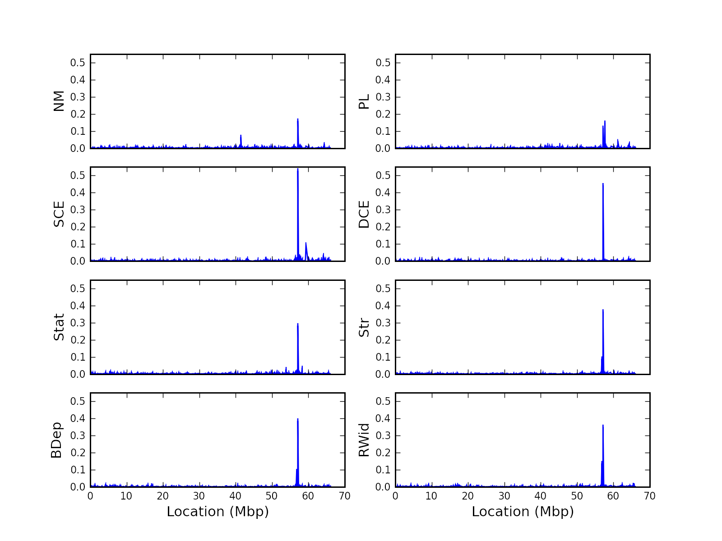
…and found some interesting things
ARS-BFGL-NGS-109285
Cole, J.B., VanRaden, P.M., O'Connell, J.R., Van Tassell, C.P., Sonstegard, T.S., Schnabel, R.D., Taylor, J.F., and Wiggans, G.R. 2009/ Distribution and location of genetic effects for dairy traits. J. Dairy Sci. 92(6):2931–2946.

Slide 7
Is luck better than skill?
ARS-BFGL-NGS-109285 at 57,895,121 Mb on BTA18
Signal consistent in HD data
Intronic to a putative CD33-related Siglec gene
This region is gene-rich
Many Siglecs involved in leptin signaling
Also affects gestation length
Maltecca, C., Gray, K. A., Weigel, K. A., Cassady, J. P., Ashwell, M. 2011. A genome-wide association study of direct gestation length in US Holstein and Italian Brown populations. Animal Genetics 42:1365-2052.

Slide 8
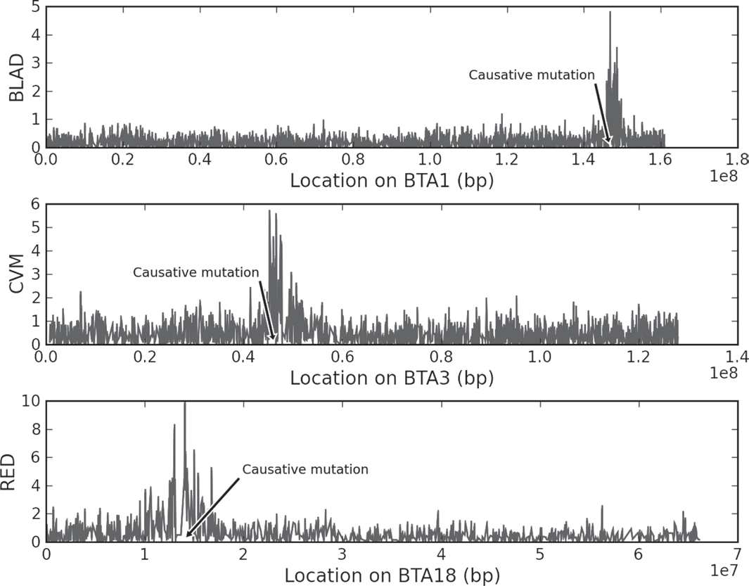
50k SNP are good for regions, not genes
Cole et al. 2009. J. Dairy Sci. 92(6):2931–2946.

Slide 9
Simple strategy
Compute SNP effects for trait of interest
Look for peaks
Perform bioinformatics on regions under interesting peaks
NCBI/Ensembl
Bovine Gene Atlas
Bovine QTLdb

Slide 10
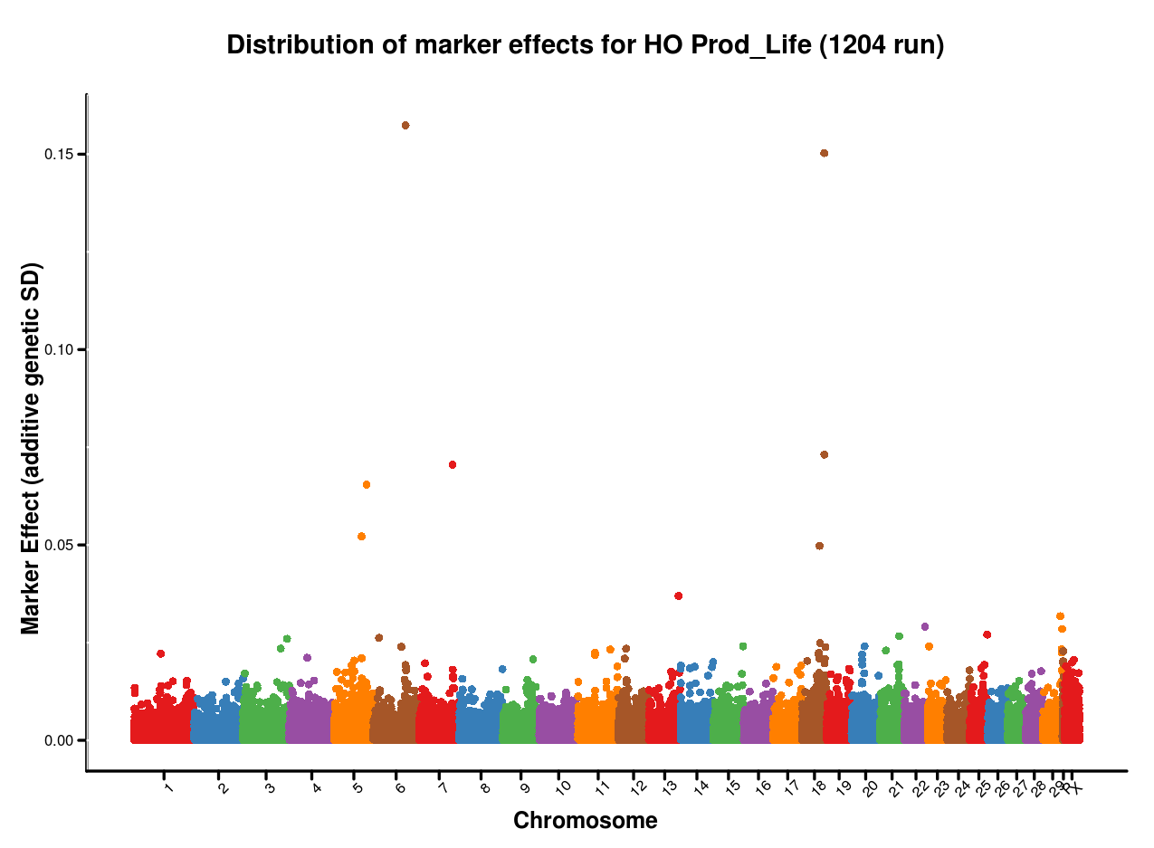
Can we look at every peak?

Slide 11
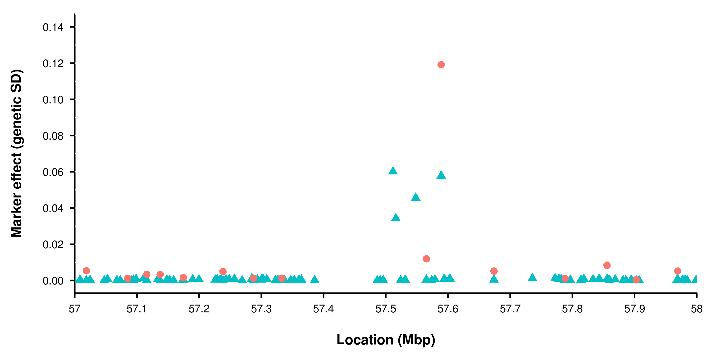
Are 777k SNP better than 50k?
VanRaden, P.M., Null, D.J., Sargolzaei, M., Wiggans, G.R., Tooker, M.E., Cole, J.B., Sonstegard, T.S., Connor, E.E., Winters, M., van Kaam, J.B.C.H.M., Van Doormaal, B.J., Faust, M.A., and Doak, G.A. Genomic imputation and evaluation using high density Holstein genotypes. J. Dairy Sci. (Submitted).

Slide 12
Case studies
Identification of causal variants associated with two haplotypes related to fertility
Discovery and validation of HH1 in U.S. Holstein cattle
Discovery and validation of JH1 in U.S. Jersey cattle
Fine-mapping of the Weaver locus

Slide 13
Recessive defect discovery
Check for homozygous haplotypes
7 to 90 expected but none observed
5 of top 11 are potentially lethal
3.1% to 3.7% lower conception rates
Some slightly higher stillbirth rates
Confirmed Brachyspina same way

Slide 14
Novel haplotypes affecting fertility
Name | Chrom-osome | Loca-tion | Carrier Freq | Earliest Known Ancestors
 | BTA | Mbase | %
HH1 | 5 | 62-68 | 4.5 | Pawnee Farm Arlinda Chief
HH2 | 1 | 93-98 | 4.6 | Willowholme Mark Anthony
HH3 | 8 | 92-97 | 4.7 | Glendell Arlinda Chief, Gray View Skyliner
JH1 | 15 | 11-16 | 23.4 | Observer Chocolate Soldier
BH1 | 7 | 42-47 | 14.0 | West Lawn Stretch Improver
VanRaden, P.M., Olson, K.M., Null, D.J., and Hutchison, J.L. 2011. Harmful recessive effects on fertility detected by absence of homozygous haplotypes. J. Dairy Sci. 94(12):6153–6161.

Slide 15
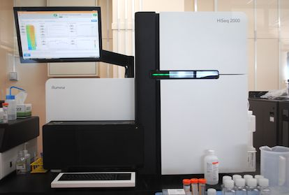
Economics of Next Generation Sequencing
Bovine genome = 2.85 billion bases
30X Coverage = about 90 billion bases
1 run on HiSeq2000 = 600 billion bases
20 animals sequenced to 30X coverage in 9 days (2 x 100 bp reads)
Cost about €19,600

Slide 16
HH1 in Holstein cattle
75 SNPs spanning 7 Mbp on Bos taurus chromosome 5
Traced to Pawnee Farm Arlinda Chief
Very popular bull
>16,000 daughters
>500,000 granddaughters
>2 million recorded great-granddaughters

Slide 17

Sequencing and haplotype reconstruction
*
Chief
Elevation
*
*
*
Mark
Valiant
Ivanhoe
Chief
Pat Son Elevation Chris
Starbuck
Royal Cedar Oak Hanna
Ked Mark Justine
Chairman
To Mar Wayne Hay
Blackstar
Juror
*
= Eight bulls in study derived from purchased semen- ~30X seq. coverage
= Four bulls used to identify
mutation causative for HH1
= Previously sequenced-6X on 454 Roche

Slide 18
Locating HH1 causal variant
Original75 SNP HH1 haplotype
Refined 38 SNP haplotype
Reference
genome
C/T

Slide 19
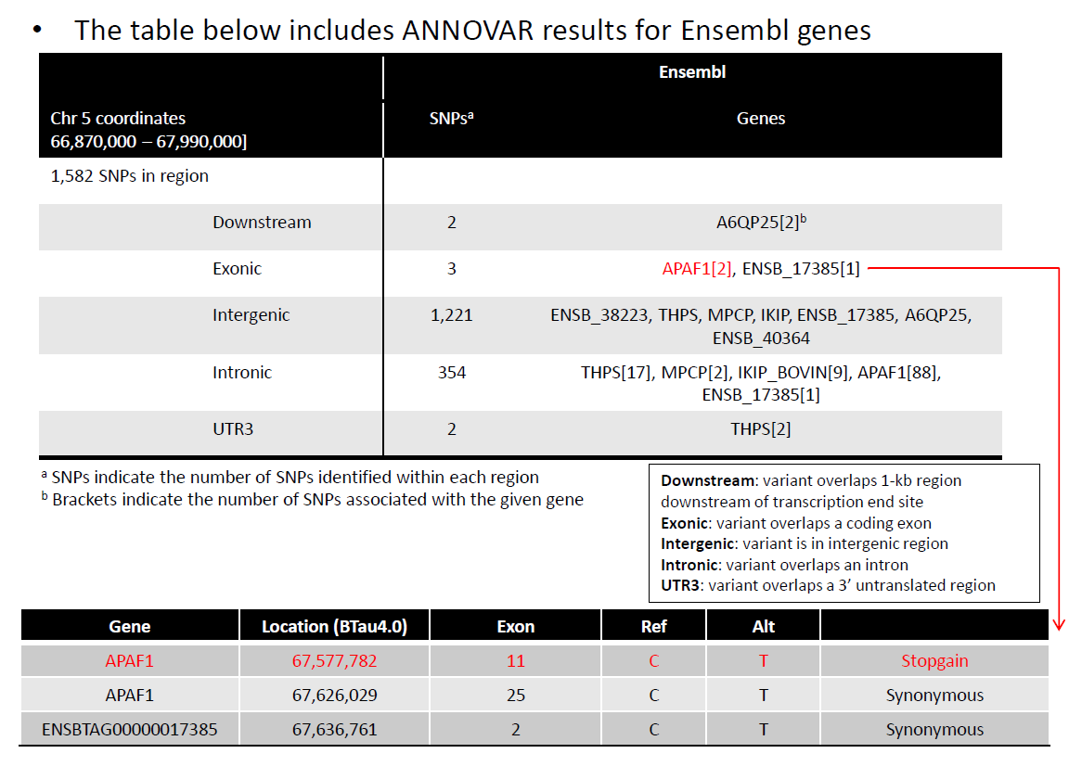
Sequence analysis of HH1 SNP

Slide 20
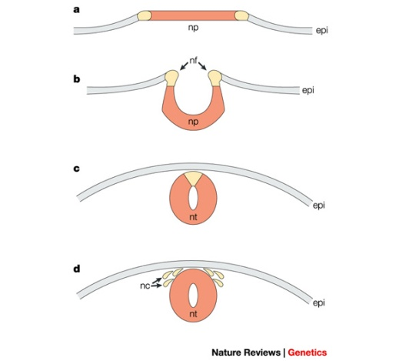
Annotation of mutated gene
APAF1 - Bos taurus apoptotic peptidase activating factor 1
ATP binding factor
Gene expression for APAF1 in murine development begins between 7 and 9 d in heart, mesenchyme, periderm, and primitive intestine (Muller et al., 2005)
Gene knockout of APAF1 in mice leads to embryonic lethality (Muller et al., 2005)
Proteins required for this pathway/cascade are important for neural tube closure in vivo

Slide 21
SNP validation in HH1 interval
Designed Sequenome 24 assays for 12 SNP in the HH1 interval
Encompasses all SNP for coding, 3’ UTR, and downstream regions – and 5 other SNP covering all other genes in the interval
Tested wide diversity of haplotypes for HH1 region – use SNP50 DNA archive

Slide 22
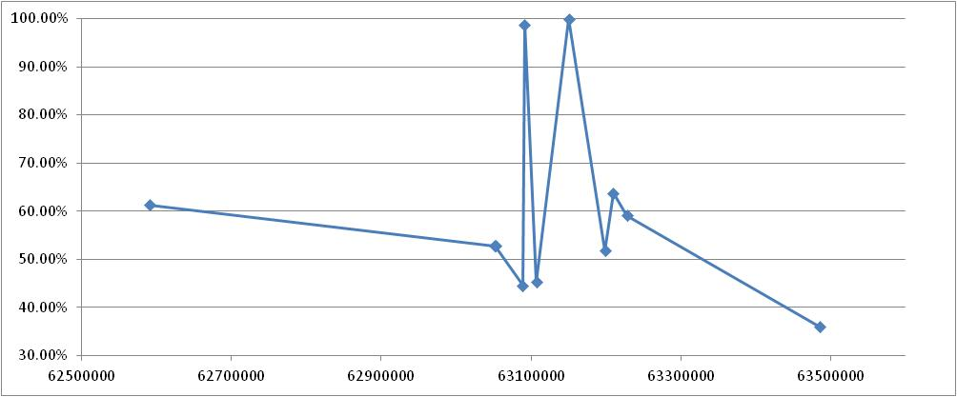
Concordance of genotype to HH1 status
Exonic SNP
1.2% false positives at intron SNP
Concordance to HH1 haplotypes (12, 32)
One Mbp Interval
Genome Coordinates UMD3.1

Slide 23
HH1 - Conclusions
HH1 Haplotype 12 100% concordant with heterozygosity at one exonic SNP location (N=486)
HH1 Haplotype 32 100% concordant with het status at same exonic SNP location (N=11)
Other 256 non-carrier animals for HH1 interval were homozygous normal at this exonic SNP
One intronic SNP was 98.8% concordant to HH1 carrier status
No other individual SNP were viable candidates
Based on collaborative work with Harris Lewin

Slide 24
NGS sequencing of JH1 carrier animals
naab | otherhap | otherfreq | ANIM_NAME | byr
014JE00244 | 8 | 2.07073 | MEADOWAY CHERRY GARCIA | 1990
007HO06417 | 13 | 2.10855 | AMES CHOCOLATE SURVILLE | 1978
008JE00361 | 14 | 0.48222 | GCG BRASS PRINCE | 1985
008JE00266 | 38 | 0.27421 | FAIRWAY MORGAN KREMLIN-ET | 2004
008JE00230 | 45 | 4.51967 | GATES SKY LINE CONGA-ET | 1993
007JE00657 | 49 | 0.53896 | PEARLMONT HALLMARK CATAMOUNT- | 2002
014JE00411 | 75 | 0.01891 | GABYS FAIR ROCK-ET | 2000
011JE00762 | 80 | 0.12292 | CLOVER FARMS TACO SUPREME | 2001
007JE00254 | 91 | 0.69024 | WILSONVIEW ARTISTIC ROMEO | 2005
200JE07039 | 117 | 0.06619 | BUSHLEA BROOK BIESTAR | 1999
Sequencing run included Chocolate Soldier (JH1 founder) and Oman (for HH3)
30X coverage of whole genome per animal
Funded by American Jersey Cattle Association
Found 38 candidate SNP in 492 kbp interval

Slide 25
SNP Validation in JH1 Interval
Designed 30 Sequenom assays for 15 unique SNP in the JH1 interval
Only 1 SNP in a gene
Stopgain mutation in CWC15 spliceosome-associated protein
Not expressed in every bovine tissue
Test all JH1 carriers in the SNP50 repository
185 normal, 546 carriers

Slide 26
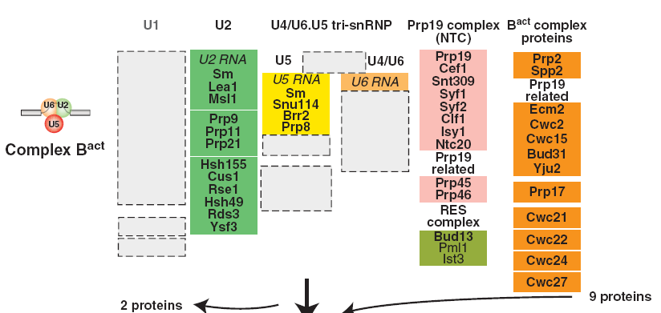
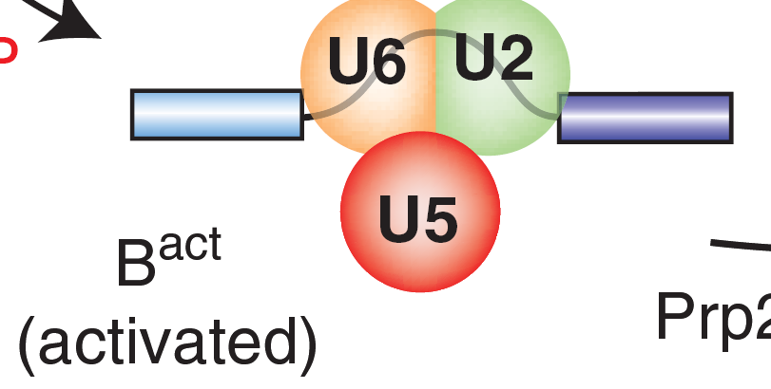
Spliceosome structure and CWC15
Will and Lührmann. 2011.
Spliceosome structure and
Function. Cold Spring
Harb Perspect Biol.

Slide 27
JH1 - SNP Validation Results
JH1 Haplotype 99.3% concordant with CWC15 stopgain mutation
5 non-concordant samples
False negative JH1 haplotypes (2 cases)
DNA misplating? Retest samples
2 other SNP in complete LD with JH1-CWC15 stopgain
Working with Jersey to complete an independent validation

Slide 28
Annotation is a big problem
Function of CWC15 in the bovine is unknown
CWC15 ortholog in mice, mED1, expressed in early embryos (Duan et al., 2010)
No analagous studies in large mammals
Funding
Time
Perceived impact

Slide 29
Preliminary fine-mapping of Weavers
35,353 SNP on BTA4
69 Brown Swiss bulls with HD genotypes
20 cases and 49 controls
No affected animals!
Microsatellite-mapped to the interval 43.2–51.2 cM
Phenotype based on name

Slide 30
Preliminary sliding-window analysis

Slide 31
HD analysis and NGS
GWAS with Bovine HD
20 carrier and 50 controls
Collaboration with Italian consortium
Refined historic interval from 46-56Mb to 48-53Mb on BTA4
Weaver similar to ALS in humans
18 annotated genes in interval
7 of them interact with major gene responsible for heritable ALS
NGS performed on a pool of 10 Normal and 10 Carriers resulting in ~30x coverage
117 SNV in the Weaver locus,
1 synonymous, 3 non-synonymous
Test all SNP

Slide 32
Validation of Weavers
5 Sequenom multiplexes tested 114 SNV
715 Brown Swiss, 26 Carora, 4 Angus, 4 Holstein, 4 Jersey, 3 Senepol, 3 Herefords
Phenotype mapping refined locus to 35 SNP
The test is accurate
5 Carora carriers based upon the 35 SNP
Multiple ‘assumed normal’ BS are carriers/affected
A few BS diagnosed normals were carriers
Found 1 Holstein heterozygous for the right 30 SNP and homozygous normal for the left 5 SNP
Related (6.25%) to BSUSA000000183023 (MEADOW VIEW MATT ALEX) who is a confirmed Weaver carrier

Slide 33
Future application of NGS sequencing
Researchers Catalog Loss-of-Function Variants in Human Protein-Coding Genes
NEW YORK (GenomeWeb News) – A Wellcome Trust Sanger Institute and Yale University-led team has sifted through data from three 1000 Genomes Project pilot efforts to find a set of authentic loss-of-function variants in the human genome.
"Each of us can be walking around with at least 20 genes basically inactivated," the study's first author, Daniel MacArthur, told GenomeWeb Daily News.
If this is true for humans, then is it true for cattle???

Slide 34
Conclusions
Targeted resequencing is effective
Genotyping-by-sequencing can identify loss-of-function mutations
Functional studies of protein function in vivo are needed
New precision mating strategies should be developed

Slide 35
Acknowledgements
AIPL, Beltsville, MD (USDA-ARS)
George Wiggans and Tabatha Cooper
BFGL, Beltsville, MD (USDA-ARS)
Larry Shade
George Liu, Derek Bickhart. Rueben Anderson, Sasho A.
Steve Schroeder
Alicia Beavers
University of Illinois, Urbana-Champaign
Denis Larkin
Meat Animal Research Center, Clay Center, NE (USDA-ARS)
Tim Smith, Tara McDaneld, John Keele

