Slide 1

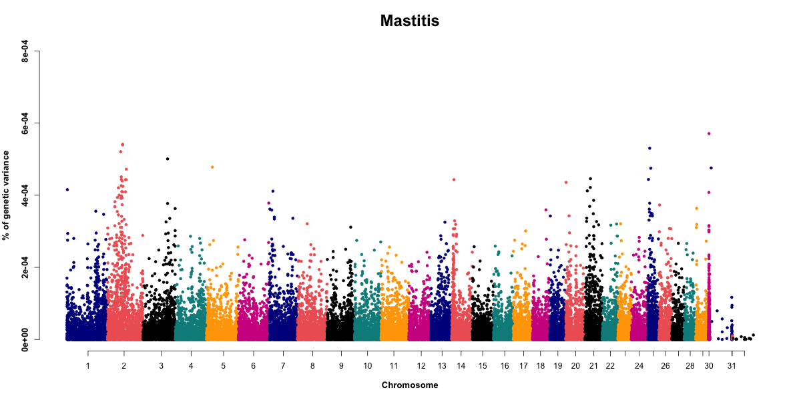
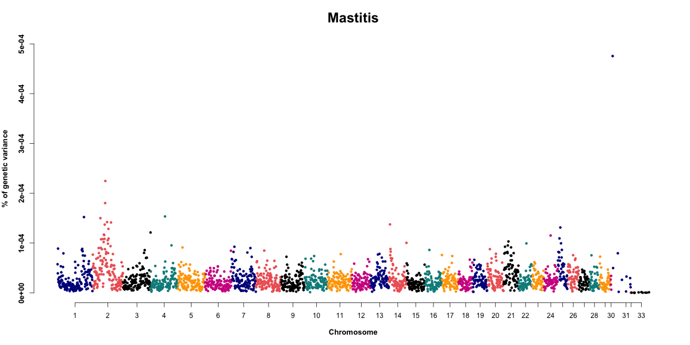




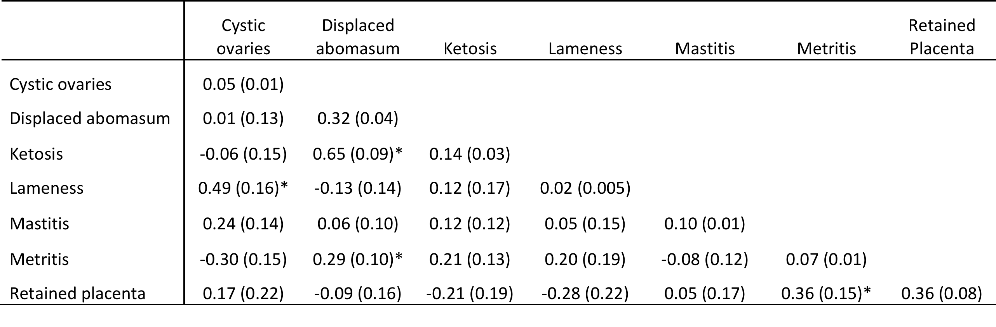
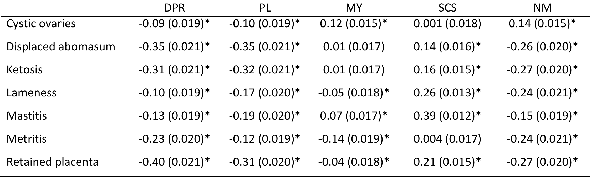
Genomic evaluation of low-heritability traits: dairy cattle health as a model
John B. Cole^{1,*}, Kristen L. Parker Gaddis², Francesco Tiezzi², John S. Clay³, and Christian Maltecca²
¹Animal Improvement Programs Laboratory, Agricultural Research Service, USDA, Beltsville, MD, USA
²Department of Animal Science, College of Agriculture and Life Sciences, North Carolina State University, Raleigh, NC, USA
³Dairy Records Management Systems, Raleigh, NC, USA
*Corresponding author: john.cole@ars.usda.gov
Introduction
Results and discussion
Genetic selection has been very successful when applied to traits of moderate to high heritability, but progress has been slow for traits with low heritabilities. The problem is further compounded when novel traits are considered because data needed to calculate high-reliability PTA generally are not available. A combination of producer-recorded health event data and SNP genotypes may permit the routine calculation of PTA with reasonable reliabilities for health traits.
Multiple-trait genomic heritabilities ranged from 0.02 for lameness to 0.36 for retained placenta (Table 1).
Table 1 Estimated heritabilities (SD) on the diagonal with estimated genetic correlations below the diagonal from multiple-trait genomic-based analysis with first parity records.
Objectives
The objective of this study was to perform genomic analyses on producer-recorded health data for disorders commonly encountered by dairy cows in the US. Genome-wide association studies were performed to identify regions of the genome associated with these health problems.
* Genetic correlations significant at P < 0.05.
Sire reliabilities increased on average by about 12% when genomic data were included (Table 2).
Table 2 Average reliabilities of sire PTA computed with pedigree information and genomic information.
Methods
Variance components and PTA were computed for several health traits (cystic ovaries, displaced abomasum, ketosis, lameness, mastitis, metritis, and retained placenta). Traditional single- and multiple trait models (st-BLUP and mt-BLUP) were fit using only pedigree and phenotypic information. Pedigree, phenotypic, and genomic data were combined in single- and multiple-trait analyses using a single-step procedure (st-ssBLUP and mt-ssBLUP). Models included fixed parity and year-season effects, and random herd-year and sire effects.
Following data quality edits, the first-parity dataset included 134,226 records from 12,893 sires and 13,534 maternal grandsires (MGS), and the later-parity dataset had 174,069 records from parities two through five for 100,635 cows from 11,481 sires and 11,716 MGS. Genotypes were available from 7,883 sires for 37,713 SNP.
Analyses used ASReml v3.0 (st-BLUP) or the BLUPF90 family of programs from the University of Georgia (all others). st-ssBLUP results from the Georgia programs were used for GWAS with single SNP or 1 Mbp windows.
¹ Unproven sires considered sires with less than 10 daughters.
² Proven sires considered sires with at least 10 daughters.
³ The increase in mean reliability calculated as the difference in overall mean reliability between the blended model and the traditional (pedigree data only) model.
Genetic correlations of health with fitness traits were significant in most cases (Table 3).
Table 3 Approximate genetic correlations (SE) between fitness traits and results from pedigree-based analysis with first parity records .
* Genetic correlations significant at P < 0.05.
The GWAS for clinical mastitis highlighted several genomic regions that should be investigated (Figure 1).
Conclusions
1 Mbp sliding-window results
Single-SNP results
Health traits were lowly heritable, making consistent, long-term goals essential for genetic improvement.
Selection for fewer disease events will have a favorable impact on fertility, longevity, and economic merit because of desirable genetic correlations.
Individual SNP and sliding windows explained only small proportions of genetic variance.
Acknowledgments
Figure 1 Manhattan plot for clinical mastitis using st-ssBLUP.

