Slide 1
Genome-wide association study of fertility traits in dairy cattle using high-density single nucleotide polymorphism marker panels

Slide 2
Introduction
Increased production associated with decreased fertility
Decreased fertility associated with increased culling
Expensive problem to manage
  Each lost pregnancy costs ~$550 (De Vries 2006)

Slide 3
Materials & Methods
Traits:
  Daughter pregnancy rate (DPR)
  Heifer conception rate (HCR)
  Cow conception rate (CCR)
  Trivariate analysis (e.g., VanRaden et al., 2014)
Deregressed PTA from National Dairy Database

Slide 4
Materials & Methods
SNP chips
  Illumina Bovine SNP50 BeadChip (50K)
  BovineHD Genotyping BeadChip (HD)
After editing
  60,671 markers included in 50K analysis
  312,614 markers included in HD analysis
Populations (n = 25,000)
  Cows only
  Bulls only
  Bulls and cows

Slide 5
Materials & Methods
GWAS
  GEMMA version 0.94 (GWAS)
Enrichment analyses
  SNP assigned to closest gene with 25 kbp on the UMD3.1 assembly
  GO (GOstats) & DAVID, MeSH (meshr)
    Conducted in R version 3.2.1
  Cytoscape (version 3.2.1)
  Enrichment Map (version 2.0.1)

Slide 6
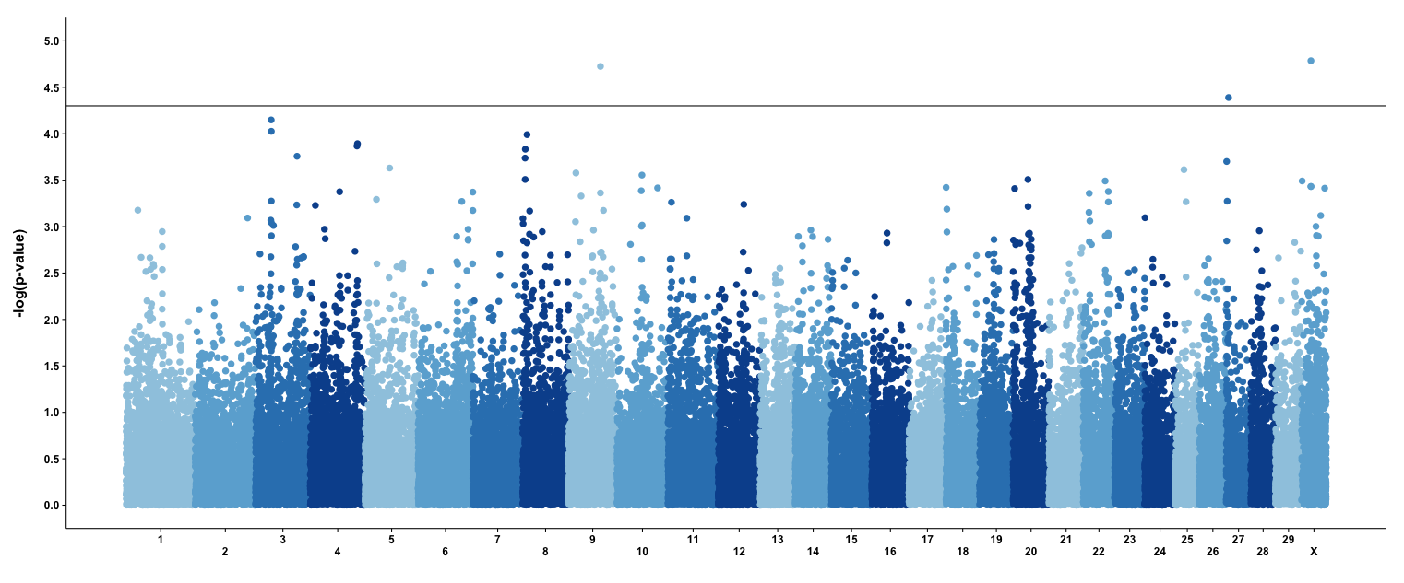
Results – Bull GWAS
CCR – 50K

Slide 7
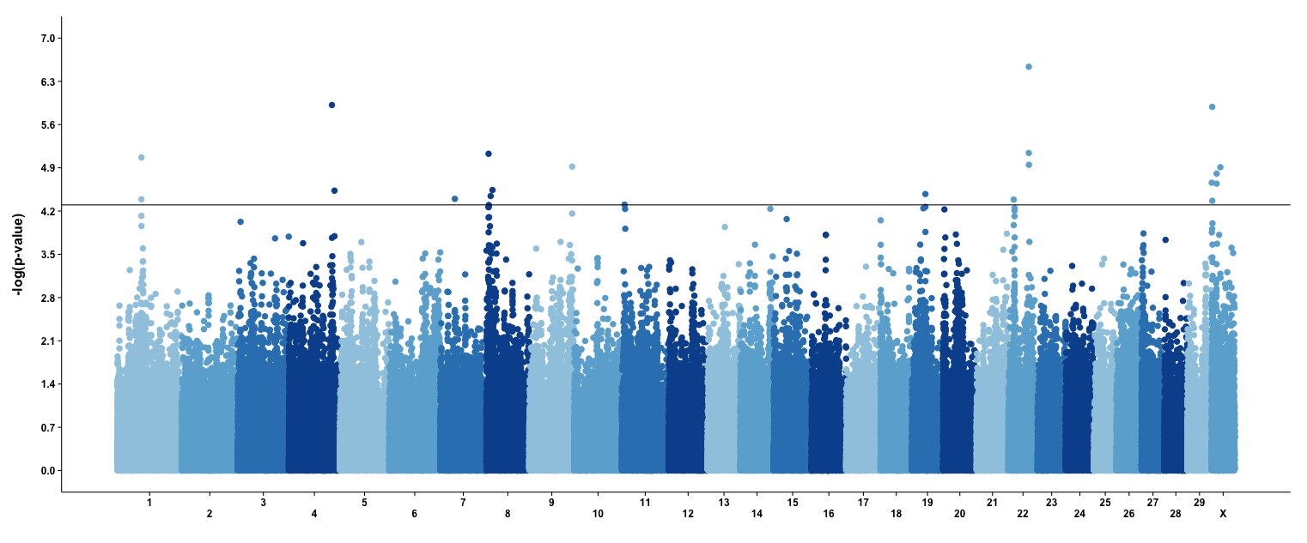
Results – Bull GWAS
CCR – HD
HD analysis able to pick up peaks that were not identified with the 50K chip

Slide 8
Results – Bull GWAS
Genes significant in HD GWAS and previous studies
CCR
BTA22 | APPL1 | Adaptor protein, phosphotyrosine interaction, PH domain & leucine zipper containing 1
DPR
BTA3 | PER2 | Period-circadian clock 2
HCR
BTA3 | PER2 | Period-circadian clock 2
BTA11 | LTBP1 | Latent transforming growth factor beta binding protein
TRIVARIATE
BTA1 | ITGB5 | Integrin, beta 5
BTA2 | CALCRL | Calcitonin receptor-like
Notes:
With previous citations related to fertility/growth/health/etc.

Slide 9
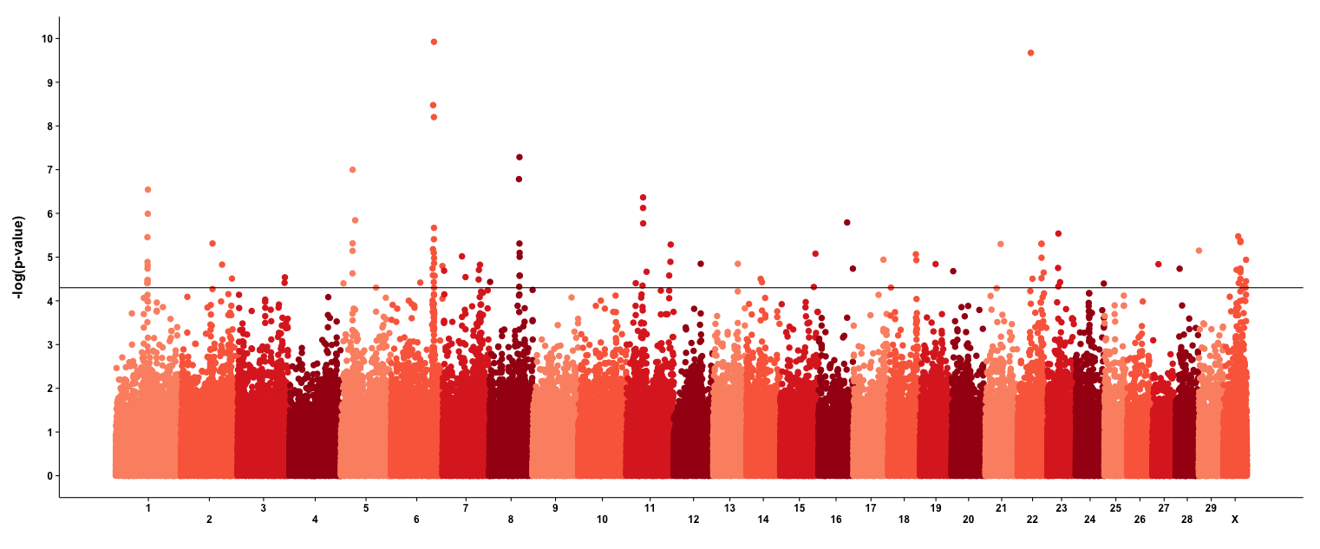
Results – Cow GWAS
CCR – HD

Slide 10
Results – Cow GWAS
TRIVARIATE
BTA1 | ST6GAL1 | ST6 beta-galactosamide alpha-2,6-sialyltransferase 1
BTA2 | FN1 | fibronectin 1
BTA5 | ATP5G2 | ATP synthase, H+ transporting, mitochondrial Fo complex, subunit C2 (subunit 9)
BTA6 | GC | group-specific component (vitamin D binding protein)
BTA16 | NR5A2 | nuclear receptor subfamily 5, group A, member 2
BTA17 | LIF | leukemia inhibitory factor
BTA17 | OSM | oncostatin M
BTA17 | KDM2B | lysine (K)-specific demethylase 2B
BTA18 | CEACAM1 | carcinoembryonic antigen-related cell adhesion molecule 1
BTA18 | HPN | hepsin
BTA23 | CLIC5 | chloride intracellular channel 5
BTA28 | VDAC2 | voltage-dependent anion channel 2
BTA29 | CDKN1C | cyclin-dependent kinase inhibitor 1C (p57, Kip2)
Notes:
With previous citations related to fertility/growth/health/etc.
CEA family – member of immunoglobulin superfamily, which consists of CEA-related cell adhesion molecules and pregnancy specific glycoprotein subgroups -> involvement in fetal-maternal conflict processes expressed in the fetal trophoblast
GC – has been implicated as possible mutation related to susceptibility to clinical mastitis; encodes the main carrier protein of Vitamin D in plasma (Gc-globulin)

Slide 11
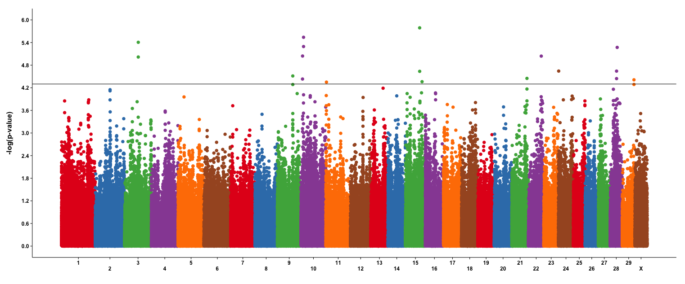
Results – Bull & Cow GWAS
CCR – HD
The combined population GWAS also showed peaks that were not identified with only cows or only bulls

Slide 12
Results – New QTL from Cow & Bull GWAS
CCR
BTA10 | PDE8B | Phosphodiesterase 8B
… | … | …
… | … | …
… | … | …
… | … | …
… | … | …
… | … | …
… | … | …
… | … | …
… | … | …
… | … | …
… | … | …
Notes:
With previous citations related to fertility/growth/health/etc.
CEA family – member of immunoglobulin superfamily, which consists of CEA-related cell adhesion molecules and pregnancy specific glycoprotein subgroups -> involvement in fetal-maternal conflict processes expressed in the fetal trophoblast
GC – has been implicated as possible mutation related to susceptibility to clinical mastitis; encodes the main carrier protein of Vitamin D in plasma (Gc-globulin)

Slide 13
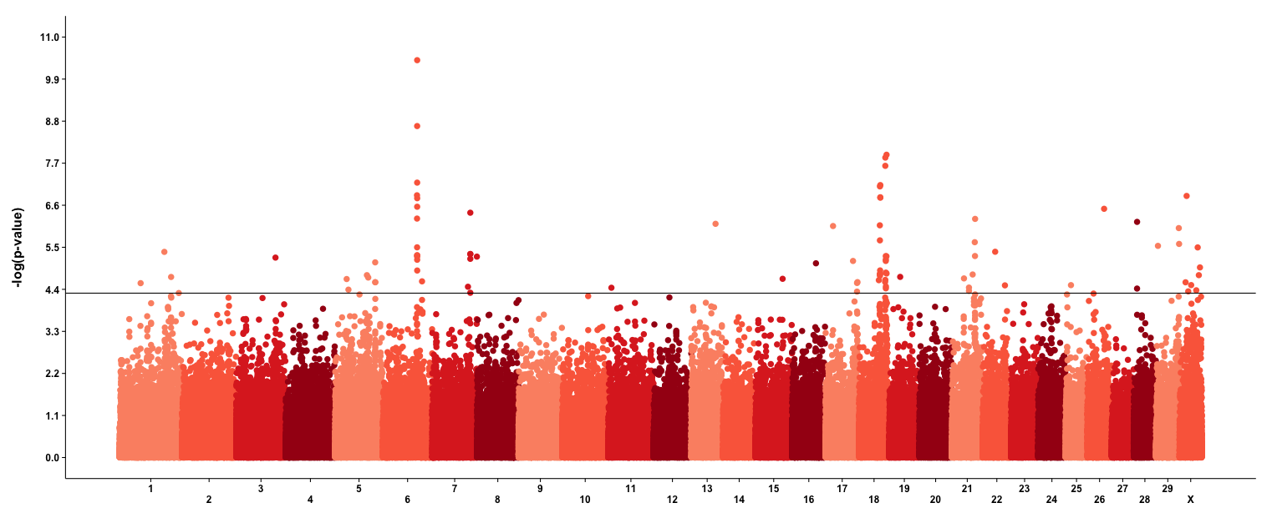
Results – Consistent signals across traits
DPR – HD

Slide 14
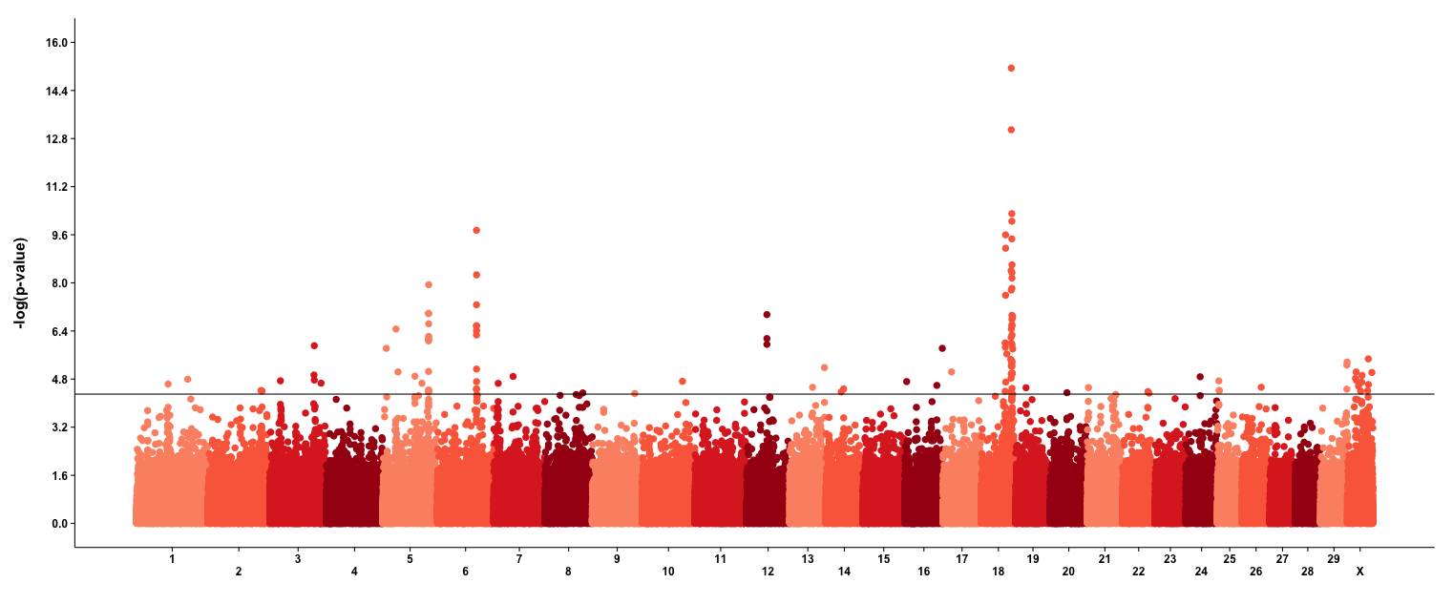
Results – Consistent signals across traits
HCR – HD

Slide 15
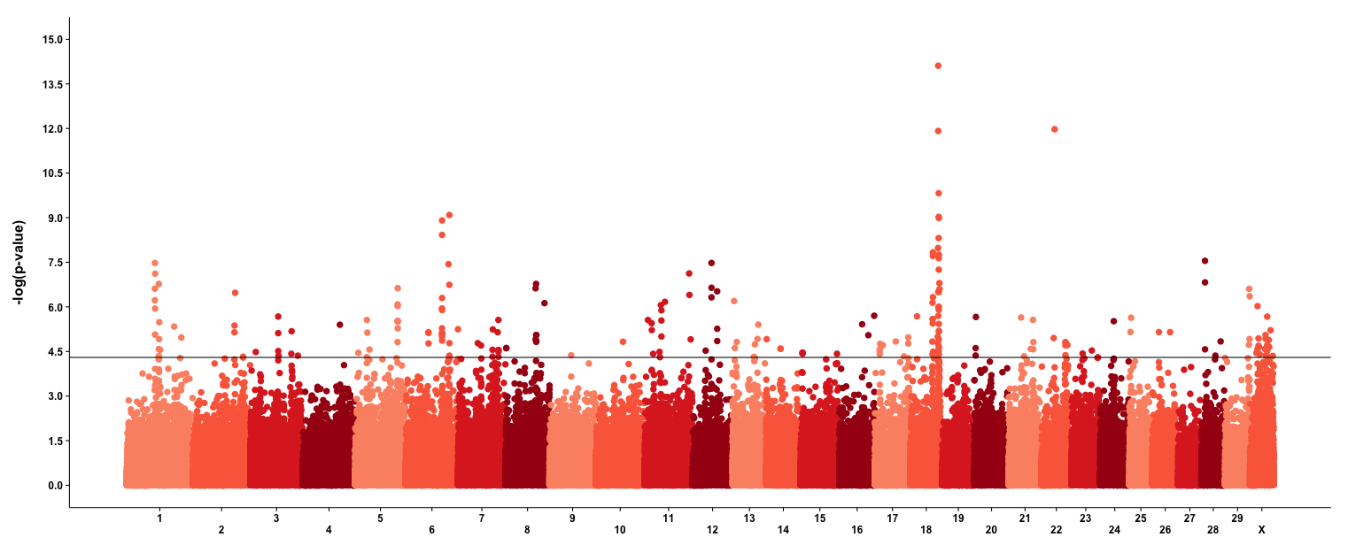
Results – Consistent signals across traits
Trivariate – HD

Slide 16
Gene Ontology Enrichment
Gene ontology (GO) enrichment analysis attempts to identify biological functions shared by a group of genes (Ashburner et al., 2000)
Genes of interest (P < 0.05 in the GWAS) compared against a background set (all annotated genes within 25 kb of a SNP)
GO enrichment analysis performed using DAVID (Huang et al., 2009a, b)
Notes:
HD

Slide 17
GO Results - Bulls
Positive regulation of acrosome reaction (GO:2000344)
Nervous system development (GO:0007399)
Embryonic placenta development (GO:001892)
Embryonic heart tube development (GO:0035050)
Developmental maturation (GO:0021700)
Notes:
HD

Slide 18
GO Results – Bulls & Cows
Positive regulation of acrosome reaction (GO:2000344)
Ovarian follicle development (GO:0001541)
Mating behavior (GO:0007617)
Ovulation cycle (GO:0042698)
Activation of meiosis involved in egg
  activation (GO:0060466)
Notes:
HD

Slide 19
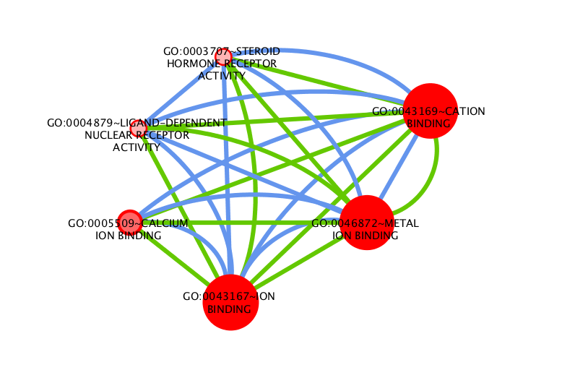
Common GO Network
Networks identified in both bull and cow analyses

Slide 20
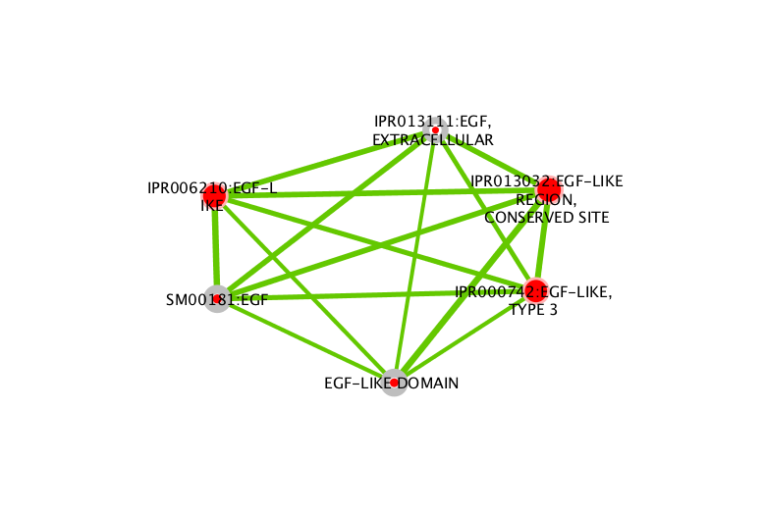
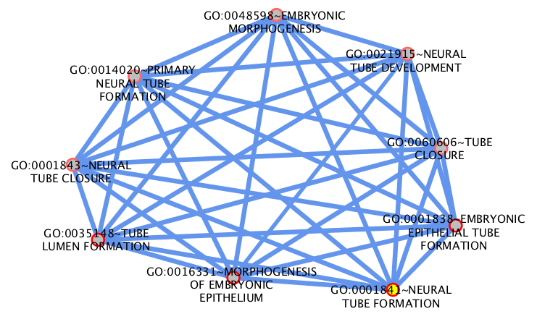
Results
GO enrichment map – bulls compared to cows
Networks identified in only bull analyses
(Bulls, HD, trivariate)
Networks identified in only cow analyses
(Cows, HD, CCR)

Slide 21
MeSH Term Enrichment
Medical subject headings (MeSH) vocabulary associates terms with articles in MEDLINE that are then mapped to genes (e.g., Morota et al., 2015)
Genes of interest (P > 0.05 in the GWAS) compared against a background set (all annotated genes within 25 kb of a SNP)
MeSH enrichment analysis performed using meshr (Tsuyuzaki et al., 2015)
Notes:
HD

Slide 22
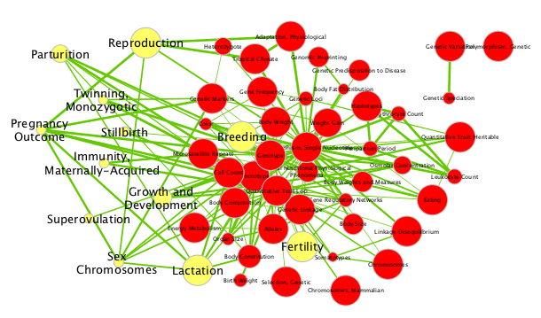
Results
MeSH – Cows, DPR, Phenomena & Processes

Slide 23
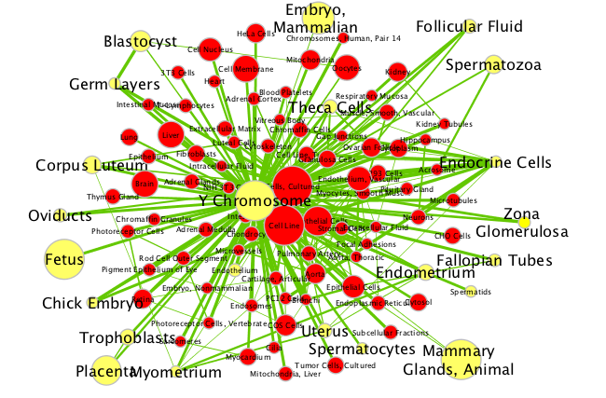
Results
MeSH – Bulls, CCR, Anatomy

Slide 24
Discussion
50K QTL also identified using HD data
Different QTL identified using different training sets (e.g., bull vs. cow)
Multivariate results consistent with univariate analyses
GO and MeSH enrichment analyses confirm that GWAS correctly identifying genes associated with fertility

Slide 25
Conclusions
Key processes involved in fertility include
  Oocyte maturation and development
  Ovulation, mating behavior, and fertilization
  Embryonic development
How do we include networks in selection programs?
  Selection for functional units rather than single genes

Slide 26
Acknowledgments
The Council on Dairy Cattle Breeding (Bowie, MD) provided data used in this study under USDA Nonfunded Cooperative Agreement 58-1245-3-228N.
This research was supported by:
  USDA-NIFA AFRI Grant No. 2013-68004-20365, “Improving Fertility of Dairy Cattle Using Translational Genomics”
  USDA-ARS project 1265-31000-101-05, “Improving Genetic Predictions in Dairy Animals Using Phenotypic and Genomic Information”

Slide 27

Questions?
http://gigaom.com/2012/05/31/t-mobile-pits-its-math-against-verizons-the-loser-common-sense/shutterstock_76826245/

