Slide 1
Genomic selection for traits other than production in dairy cattle

Slide 2
Overview
Technology – What things can we measure?
Phenotypes – What things should we measure?
Applications – Why do we measure these things?

Slide 3
What things can we measure?

Slide 4
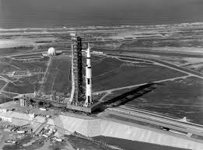

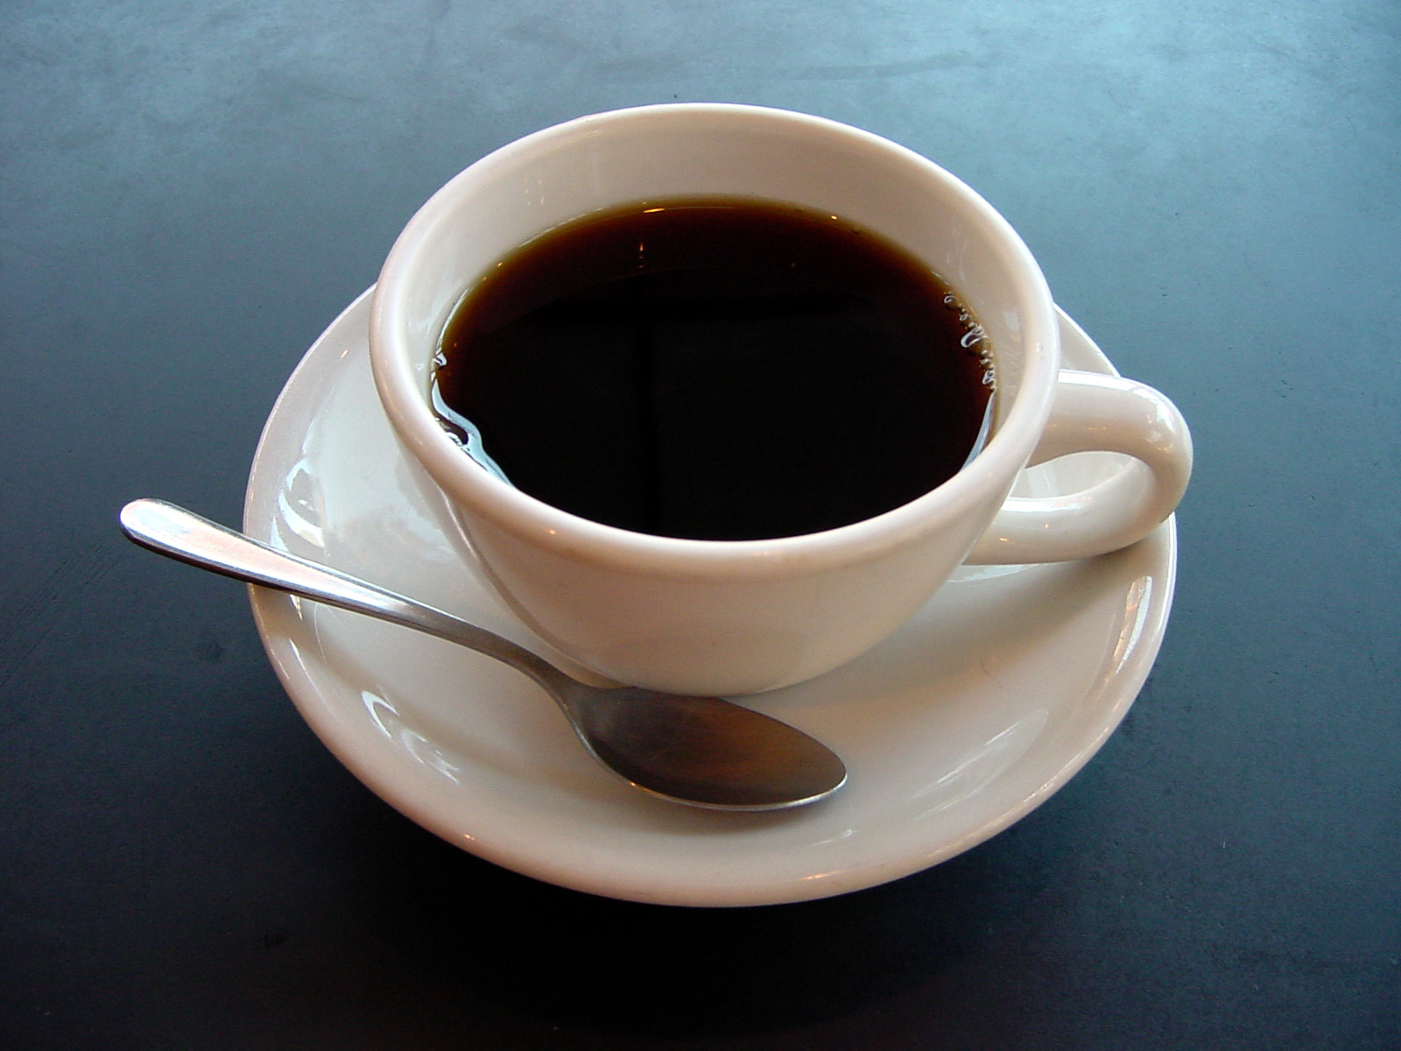
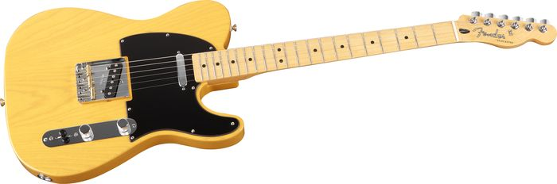
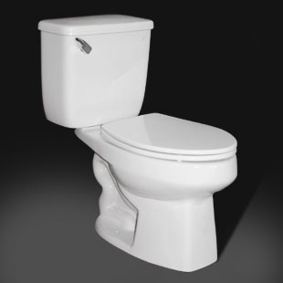
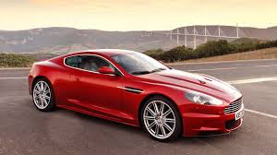
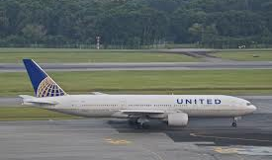
We all have our favorite technologies

Slide 5
Benefits of technology
Technologies provide benefits by making our work…
  Faster – More outputs are produced per unit of time.
  Cheaper – The cost of producing a unit of output decreases.
  Easier – Tasks require less physical or mental labor.
Notes:
5
5

Slide 6
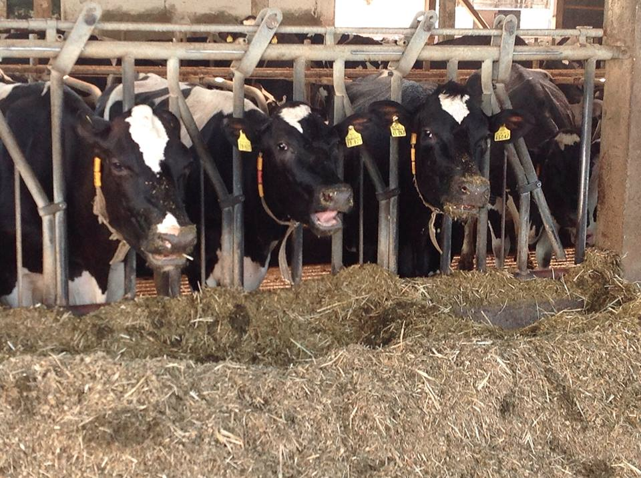
This is the age of precision
We now have technologies to monitor what goes into and what comes out of cows with great precision.
Inputs and outputs are inextricably linked.
We want the highest quality available at the possible lowest cost.
Notes:
6
6

Slide 7
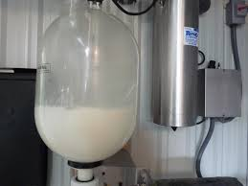
Advanced technology on my first farm…
Source: http://seasonalontariofood.blogspot.com/2011/04/visit-to-wooldrift-farm.html.

Slide 8
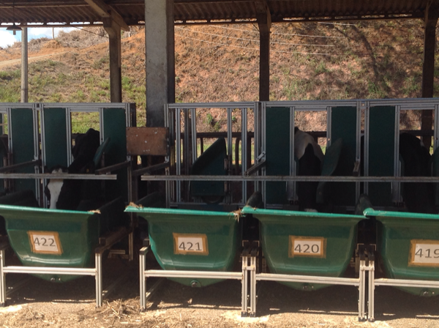
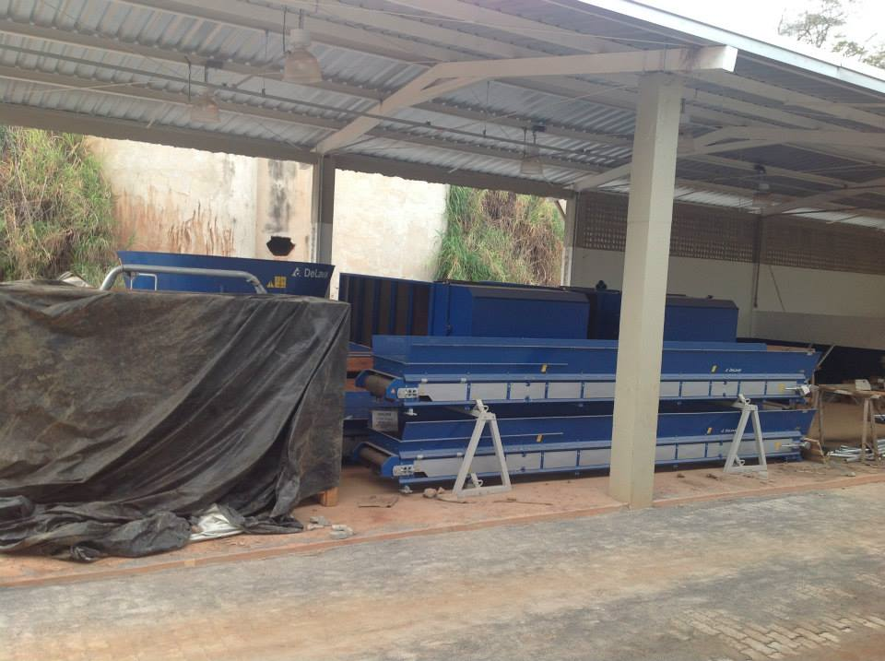
Feeding the dairy cow
Top: Automated system for weighing feed intake.
Bottom: Automated feeding system being installed at Embrapa Gado de Leite.

Slide 9
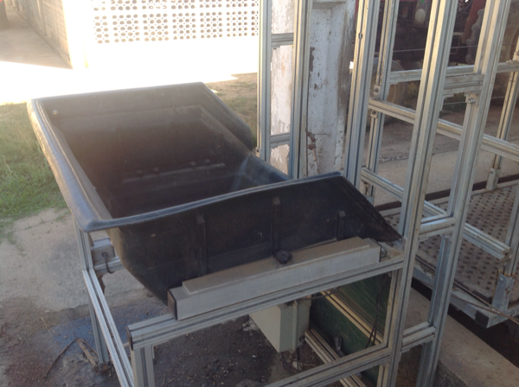
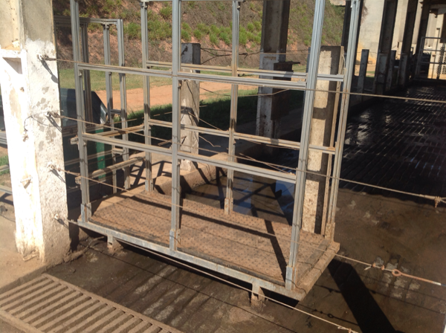
Watering the dairy cow
Top: Automated waterer with scale for measuring intake.
Bottom: Automated scale that weighs cows at the waterer.

Slide 10
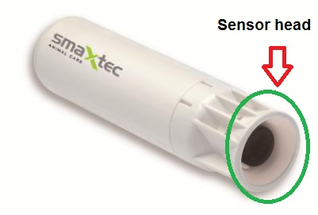
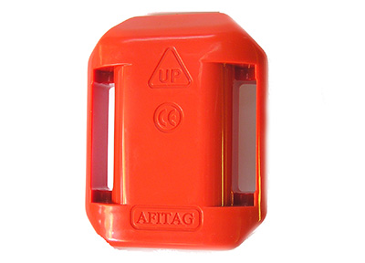
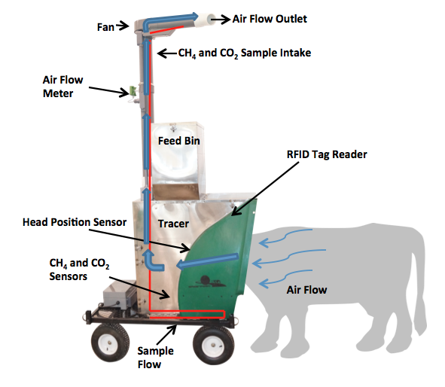
Monitoring the dairy cow
Source: http://support.smaxtec-animalcare.com/.
Source: http://www.afimilk.com/.
Source: http://c-lockinc.com/.

Slide 11
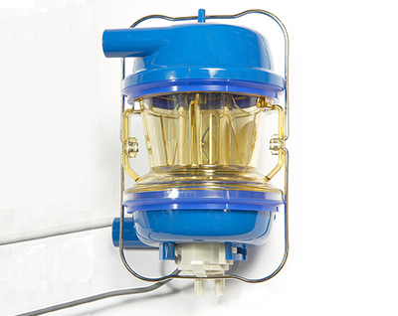
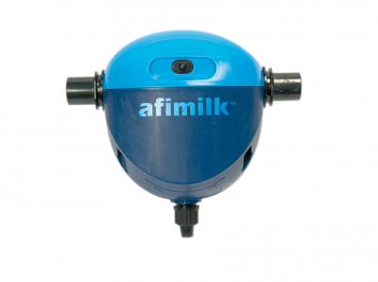
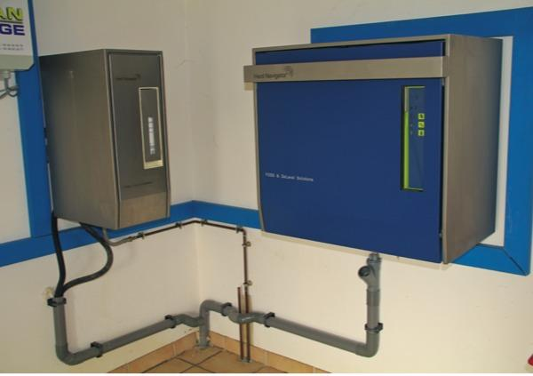
Milking the dairy cow
Source: http://www.afimilk.com/.
Source: http://www.afimilk.com/.
Manufacturers such as Afimilk and DeLaval provide intelligent milk meters, inline milk analysis sensors (e.g., AfiLab), and herd management systems (e.g., Herd Navigator).
Source: http://goo.gl/wu8YtR.

Slide 12
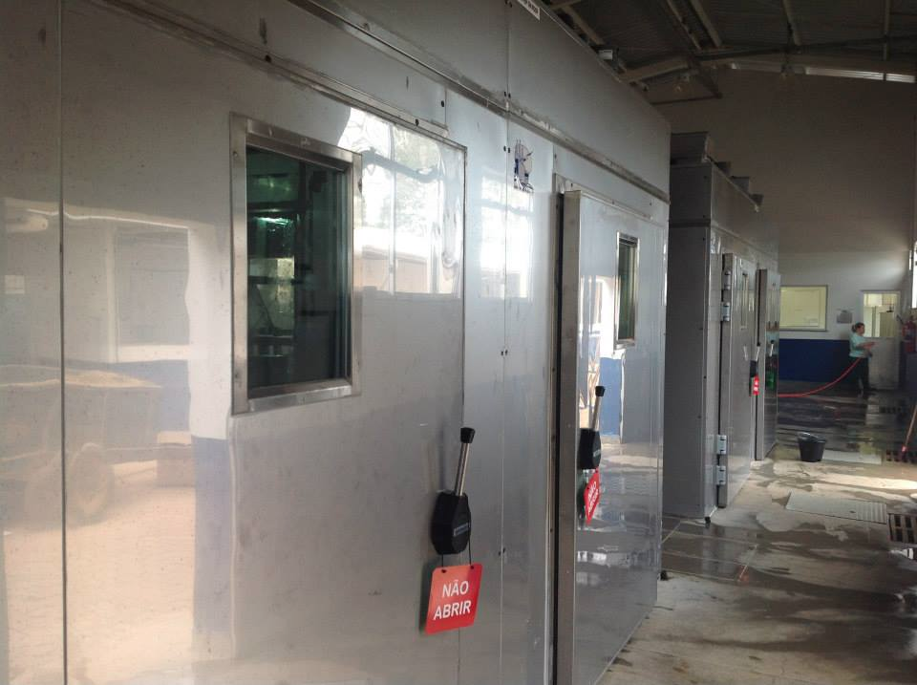
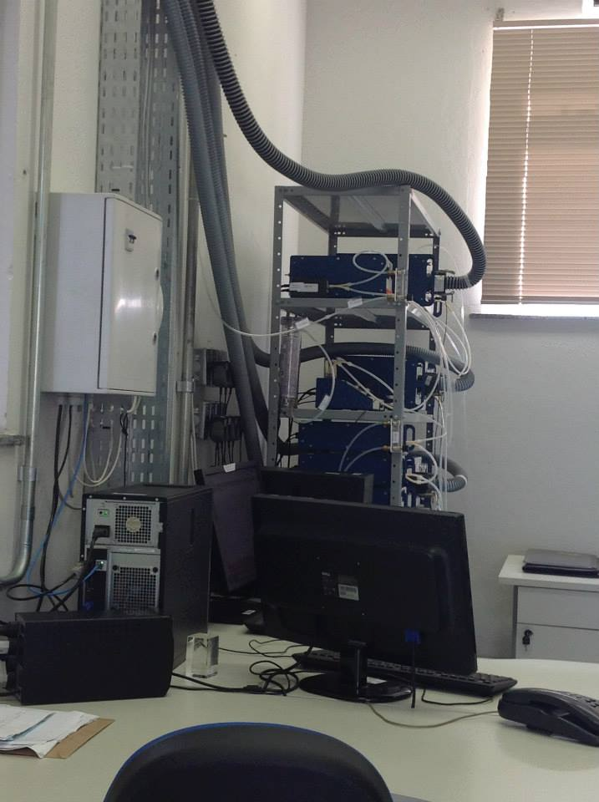
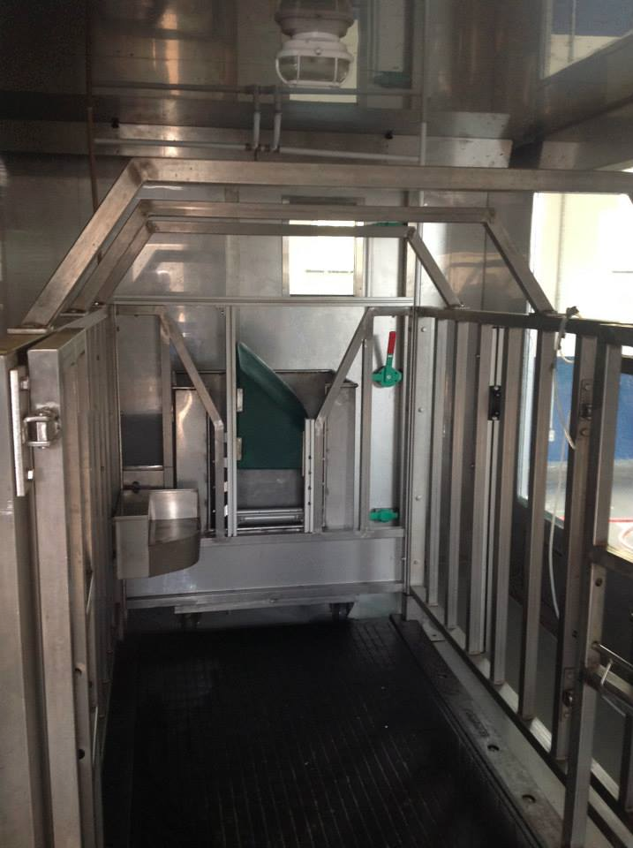
What else comes out of the cow?
Environment chambers at Embrapa Gado de Leite, Coronel Pacheco, MG, Brasil.

Slide 13
You don’t get something for nothing
New technologies often require considerable capital investment.
They sometimes fail to work as advertised, or do not deliver the promised gain.
The data are often most useful when combined with observations from many farms.
Notes:
13
13

Slide 14
What things should
we measure?

Slide 15
What traits are commonly recorded?
Group | N | Traits included
Calving | 4 | Direct & maternal calving ease, direct & maternal stillbirth
Conformation | 19 | Stature, chest width, body depth, angularity, rump angle, rump width, rear leg set, rear leg rear view, foot angle, fore udder, rear udder height, udder support, udder depth, teat placement, teat length, rear teat placement, overall conformation score, overall udder score, overall feet & leg score
Fertility | 5 | Heifer conception rate, days to first service, cow conception rate, services per conception, and days open
Longevity | 1 | Direct longevity
Production | 3 | Milk, fat, and protein yields
Udder health | 2 | Milk somatic cell count, clinical mastitis
Workability | 2 | Milking speed, temperament
Holstein traits evaluated by the International Bull Evaluation Service (https://wiki.interbull.org/public/CoP_chapter6?action=print&rev=16).

Slide 16
Selection indices now include many traits
Source: Miglior et al. (2012)

Slide 17
Some traits are underutilized
Some traits are commonly recorded, but not often genetically evaluated
  e.g., gestation length, milking speed, temperament
Breeding objectives differ across countries
  Not all traits equally valuable to all people
New phenotypes can supercede old ones
Notes:
17
17

Slide 18
Why do we need new phenotypes?
Changes in production economics
Technology enables collection of new phenotypes
Better understanding of biology
Recent review by Egger-Danner et al. (2015) in Animal

Slide 19
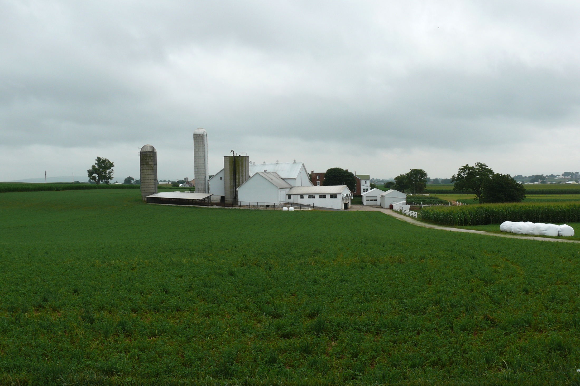
Sources of novel phenotypes
Barn: flooring type, bedding materials, density, weather data
Cow: body temperature, activity, rumination time, feed & water intake
Herdsmen/consultants: health events, foot/claw health, veterinary treatments
Parlor: yield, composition, milking speed, conductivity, progesterone, temperature
Silo/bunker: ration composition, nutrient profiles
Pasture: soil type/composition, nutrient composition
http://commons.wikimedia.org/wiki/File:Amish_dairy_farm_3.jpg

Slide 20
Desirable traits may have low heritabilities
P = G + E
The percentage of total variation attributable to genetics is small.
CA$: 0.07
DPR: 0.04
PL: 0.08
SCS: 0.12
The percentage of total variation attributable to environmental factors is large:
Feeding/nutrition
Housing
Reproductive management
Notes:
20
20

Slide 21
New phenotypes should add information
Novel phenotypes
include some
new information
Novel phenotypes
contain little
new information
high
Phenotypic correlation
with existing traits
Novel phenotypes
include much
new information
Novel phenotypes
contain some
new information
low
low
high
Genetic correlation with
existing traits

Slide 22
Cost of measurement vs. value to farmers
high
(milk yield)
(feed intake)
Value of phenotype
low
(conformation)
(greenhouse gas
emissions)
low
high
Cost of measurement

Slide 23
Some novel phenotypes studied recently
Claw health (Van der Linde et al., 2010)
Dairy cattle health (Parker Gaddis et al., 2013)
Embryonic development (Cochran et al., 2013)
Immune response (Thompson-Crispi et al., 2013)
Methane production (de Haas et al., 2011)
Milk fatty acid composition (Soyeurt et al., 2011)
Persistency of lactation (Cole et al., 2009)
Rectal temperature (Dikmen et al., 2013)
Residual feed intake (Connor et al., 2013)

Slide 24
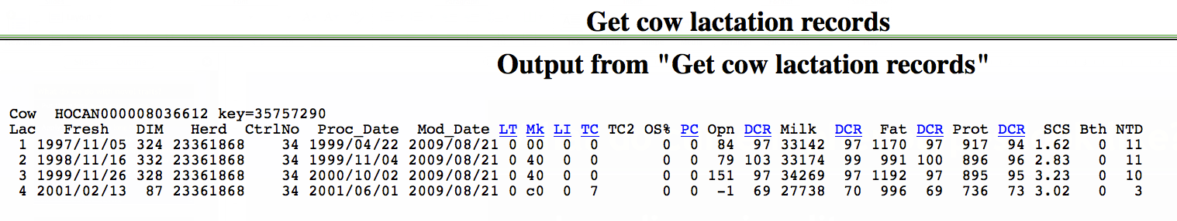
What do current phenotypes look like?
Low-dimensionality
  Usually few observations per lactation
  Close correspondence of phenotypes with values measured
  Easy transmission and storage
Notes:
24
24

Slide 25
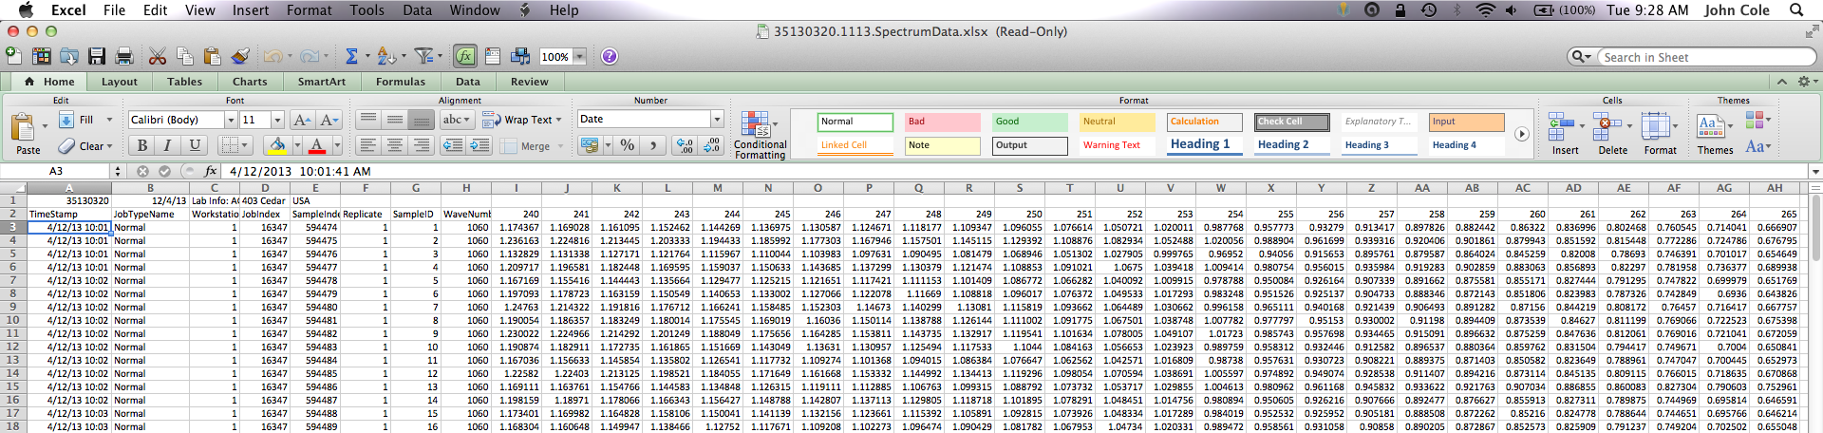
What do new phenotypes look like?
High dimensionality
  Ex.: MIR produces 1,060 points/obs.
  Disconnect between phenotype and measurement
  More resources needed for transmission, storage, and analysis

Slide 26
Who pays for new phenotypes?
Costs
  Labor and materials for recording
  Data transmission, storage, and processing
Benefits
  Farmers provide data and consume services
  Centers consume data and provide services
Notes:
26
26

Slide 27
Why do we measure
these things?

Slide 28
What can farmers do with novel traits?
Put them into a selection index
  Correlated traits are helpful
Apply selection for a long time
  There are no shortcuts
Collect phenotypes on many daughters
  Repeated records of limited value
  Genomics can increase accuracy
Notes:
28
28

Slide 29
What can data centers do with new traits?
Short-term – Benchmarking tools for herd management
Medium-term – Custom indices for herd management
  Additional types of data will be helpful
Long-term – Genetic evaluations
  Lots of data needed, which will take time
Notes:
29
29

Slide 30
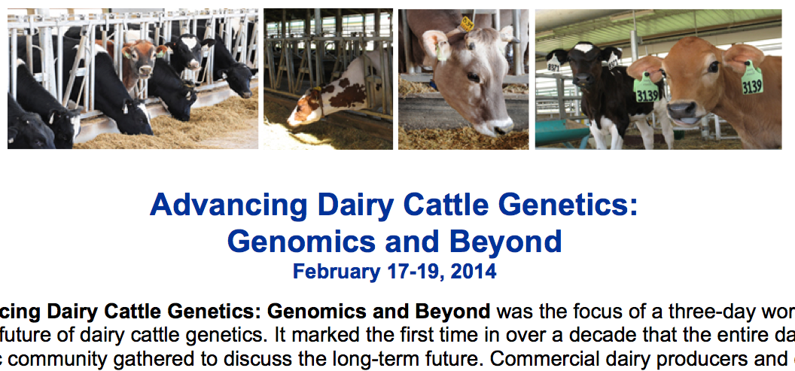
What do US dairy farmers want?
National workshop in Tempe, AZ in February 2014
  Producers, industry, academia, and government
Farmers want new tools
  Additional traits (novel phenotypes)
  Better management tools
Foot health and feed efficiency were of greatest interest

Slide 31
What do Spanish dairy farmers want?
It is important to ask farmers about their goals
There are many ways to achieve the same goal
  More cows? More milk? More profit per liter? Better longevity?
Changes in the industry can influence selection goals
  Major policy changes (end of quota)

Slide 32
Constructing phenotypes from genotypes
Prediction from correlated traits or phenotypes from reference herds
Haplotypes can be used when causal variants are not known
Causal variants can be used in place of markers
Specific combining abilities can combine additive and dominance effects

Slide 33
Example: Polled cattle
Polled cattle have improved welfare and increased economic value
polled haplotypes have low frequencies: 0.41% in BS, 0.93% in HO, and 2.22% in JE
Increasing haplotype frequency by index selection requires known status for all animals
Estimate gene content (GC) for all non-genotyped animals.

Slide 34
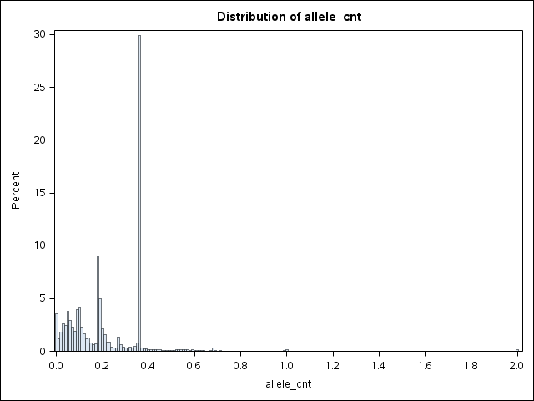
Gene content for polled in Jerseys
MAF = 2.5%
pp
Pp
PP

Slide 35
Other phenotypes may come from genotypes
Name | Chrome | Location (Mbp) | Carrier Freq | Earliest Known Ancestor
HH1 | 5 | 62-68 | 4.5 | Pawnee Farm Arlinda Chief
HH2 | 1 | 93-98 | 4.6 | Willowholme Mark Anthony
HH3 | 8 | 92-97 | 4.7 | Glendell Arlinda Chief, Gray View Skyliner
HH4 | 1 | 1.2-1.3 | 0.37 | Besne Buck
HH5 | 9 | 92-94 | 2.22 | Thornlea Texal Supreme
JH1 | 15 | 11-16 | 23.4 | Observer Chocolate Soldier
BH1 | 7 | 42-47 | 14.0 | West Lawn Stretch Improver
BH2 | 19 | 10-12 | 7.78 | Rancho Rustic My Design
AH1 | 17 | 65.9-66.2 | 26.1 | Selwood Betty’s Commander
For a complete list, see: http://aipl.arsusda.gov/reference/recessive_haplotypes_ARR-G3.html.

Slide 36
International challenges
National datasets are siloed
Recording standards differ between countries
  ICAR guidelines help here
Farmers are concerned about the security of their data
Many populations are small
  Low accuracies
  Small markets
Notes:
36
36

Slide 37
Conclusions
New technology is enabling the collection of novel phenotypes
Genotypes are routinely available for many animals for genomic selection
Genotypes can be used to construct phenotypes directly

Slide 38
Acknowledgments
Dan Null, Paul VanRaden, Curt Van Tassell, and George Wiggans, AGIL
Tom Lawlor, Holstein Association USA
Albert de Vries, University of Florida
AFRI grant 1245-31000-101-05, “Improving Fertility of Dairy Cattle Using Translational Genomics”

Slide 39

Questions?
http://gigaom.com/2012/05/31/t-mobile-pits-its-math-against-verizons-the-loser-common-sense/shutterstock_76826245/

