Slide 1
What should you expect from genomic selection?

Slide 2
Introduction
José Montero provided an excellent discussion of genomic selection in Spain
I am going to talk more generally about how genomics works, what can reasonably be expected from genomics, and some ways of using genomics

Slide 3
Overview
How does genomic selection work?
What can you expect from genomic selection?
How should you use genomics?

Slide 4
How does genomic
selection work?

Slide 5

How does genetic selection work?
ΔG = genetic gain each year
reliability = how certain we are about our estimate of an animal’s genetic merit (genomics ⬆)
selection intensity = how selective we are when making mating decisions (management can ⬆)
genetic variance = variation in the population due to genetics (we can’t really change this)
generation interval = time between generations (genomics ⬇)

Slide 6
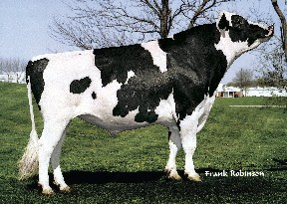

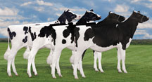
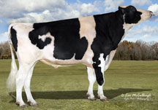
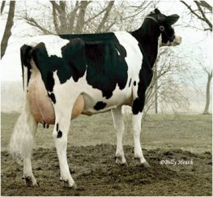
Genomic prediction of progeny test
0
1
2
3
4
5
  Select parents, transfer embryos to recipients
Calves born from DNA-selected parents
Bull receives progeny test
  Calves born and DNA tested
Reduce generation interval from 5 to 2 years

Slide 7
Holstein prediction accuracy
Trait | Bias* | Reliability (%) | Reliability gain (% points)
Milk (kg) | −80.3 | 69.2 | 30.3
Fat (kg) | −1.4 | 68.4 | 29.5
Protein (kg) | −0.9 | 60.9 | 22.6
Fat (%) | 0.0 | 93.7 | 54.8
Protein (%) | 0.0 | 86.3 | 48.0
Productive life (mo) | −0.7 | 73.7 | 41.6
Somatic cell score | 0.0 | 64.9 | 29.3
Daughter pregnancy rate (%) | 0.2 | 53.5 | 20.9
Sire calving ease | 0.6 | 45.8 | 19.6
Daughter calving ease | −1.8 | 44.2 | 22.4
Sire stillbirth rate | 0.2 | 28.2 | 5.9
Daughter stillbirth rate | 0.1 | 37.6 | 17.9
*2013 deregressed value – 2009 genomic evaluation

Slide 8
Reliabilities for young Holsteins*
9000
50K genotypes
8000
3K genotypes
7000
6000
5000
Number of animals
4000
3000
2000
1000
0
40
45
50
55
60
65
70
75
80
Reliability for PTA protein (%)
*Animals with no traditional PTA in April 2011

Slide 9
Why genomics works for dairy cattle
Extensive historical data available
Well-developed genetic evaluation program
Widespread use of AI sires
Progeny-test programs
High-value animals worth the cost of genotyping
Long generation interval that can be reduced substantially by genomics
Notes:
9

Slide 10
What to expect from
genomic selection

Slide 11
The four-pathway model
Young animals,
potential
parents
Actual
parents
Bulls to breed bulls (5% selected)
Bulls
Bulls to breed cows (20% selected)
Cows to breed bulls (2% selected)
Cows
Cows to breed cows (85% selected)

Slide 12
Genetic gain per year in each pathway
Pathway | Selection (%) | Traditional | Genomics
Sires of bulls | 5 | 0.313 | 0.880
Sires of cows | 20 | 0.175 | 0.600
Dams of bulls | 2 | 0.290 | 0.910
Dams of cows | 85 | 0.032 | 0.032
Total |  | 0.215 | 0.467
Source: Schaeffer (2006)

Slide 13
Parent ages of marketed Holstein bulls

Slide 14
Marketed Holstein bulls
Year entered AI | Traditional progeny- tested | Young genotyped | All bulls
2008 | 1,798 | 0 | 1,798
2009 | 1,909 | 337 | 2,246
2010 | 1,827 | 376 | 2,203
2011 | 1,441 | 467 | 1,908
2012 | 1,376 | 555 | 1,931

Slide 15
Genetic merit of marketed Holstein bulls
Average gain:
$85.60/year
Average gain:
$52.00/year
Average gain:
$19.77/year

Slide 16
Genetic choices
Before genomics:
  Proven bulls with daughter records (PTA)
  Young bulls with parent average (PA)
After genomics:
  Young animals with DNA test (GPTA)
  Reliability of GPTA ~70% compared to PA ~35% and PTA ~85% for Holstein NM$

Slide 17
Haplotypes affecting fertility
Rapid discovery of new recessive defects
  Large numbers of genotyped animals
  Affordable DNA sequencing
Determination of haplotype location
  Significant number of homozygous animals expected, but none observed
  Narrow suspect region with fine mapping
  Use sequence data to find causative mutation

Slide 18
A partial list of fertility haplotypes
Name | Chrome | Location (Mbp) | Carrier Freq | Earliest Known Ancestor
HH1 | 5 | 62-68 | 4.5 | Pawnee Farm Arlinda Chief
HH2 | 1 | 93-98 | 4.6 | Willowholme Mark Anthony
HH3 | 8 | 92-97 | 4.7 | Glendell Arlinda Chief, Gray View Skyliner
HH4 | 1 | 1.2-1.3 | 0.37 | Besne Buck
HH5 | 9 | 92-94 | 2.22 | Thornlea Texal Supreme
JH1 | 15 | 11-16 | 23.4 | Observer Chocolate Soldier
BH1 | 7 | 42-47 | 14.0 | West Lawn Stretch Improver
BH2 | 19 | 10-12 | 7.78 | Rancho Rustic My Design
AH1 | 17 | 65.9-66.2 | 26.1 | Selwood Betty’s Commander
For a complete list, see: http://aipl.arsusda.gov/reference/recessive_haplotypes_ARR-G3.html.

Slide 19
Haplotypes to track known recessives
Recessive | Haplotype | Chromo-some | Tested animals (no.) | Concord- ance (%) | New carriers (no.)
BLAD | HHB | 1* | 11,782 | 99.9 | 314
CVM | HHC | 3* | 13,226 | — | 2,716
DUMPS | HHD | 1* | 3,242 | 100.0 | 3
Mule foot | HHM | 15* | 87 | 97.7 | 120
Horned | HHP | 1 | 345 | — | 2,050
Red coat color | HHR | 18* | 4,137 | — | 5,927
SDM | BHD | 11* | 108 | 94.4 | 108
SMA | BHM | 24* | 568 | 98.1 | 111
Weaver | BHW | 4 | 163 | 96.3 | 32
*Causative mutation known

Slide 20
Impact on breeders
Haplotype and gene tests can be used selection and mating programs
A small number of elite breeders are investing heavily in genomics
About 30% of young males have been genotyped directly by breeders since April 2013
Prices for top genomic heifers can be very high (e.g., €250,000)

Slide 21
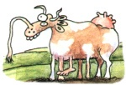
Impact on dairy producers
General
  Reduced generation interval
  Increased rates of genetic gain
  Greater inbreeding/homozygosity?

Slide 22
Impact on dairy producers (continued)
Sires
  Higher average genetic merit of available bulls
  More rapid increase in genetic merit for all traits
  Larger choice of bulls in terms of traits and semen price
  Greater use of young bulls

Slide 23
How should you use
genomic selection?

Slide 24
Genotyping is very popular

Slide 25


Can you afford genomic testing?
Number of SNP 9K 50K 800K
U.S. Price €32 €92 €184
International price €41 €100 €192

Slide 26
Four ways to use use genomics
Animal ID and parentage verification
  Is this the animal that I think it is?
Early culling decisions
  Am I raising the right animals?
Mate selection
  How do I produce the best calves?
Identification of elite cows

Slide 27
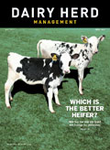
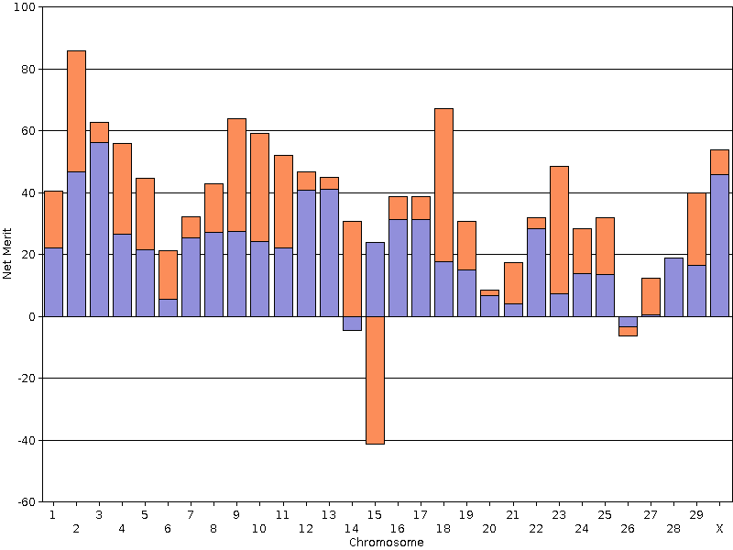
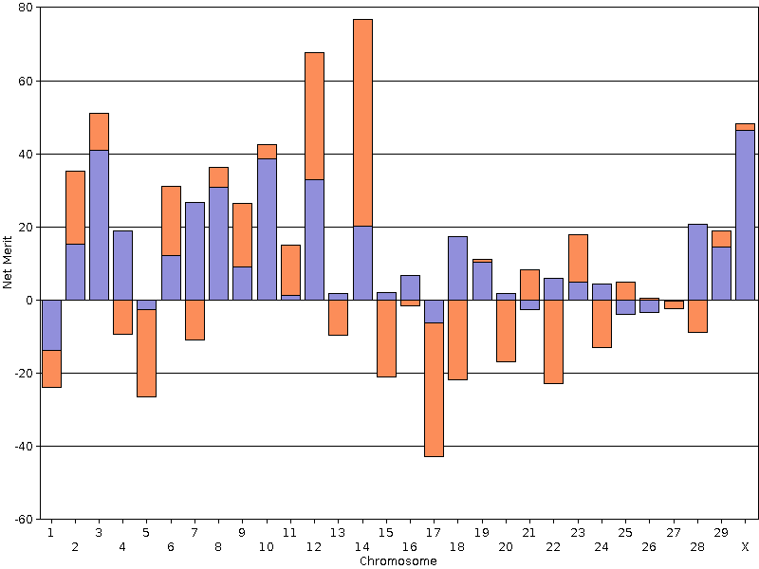
Now we know which heifer is best
The best has a PTA NM$ of +684 and a REL of 80%.
PLANET has 4,168 genotyped daughters – which one do you want in your herd?
The worst has a PTA NM$ of -121 and a REL of 76%.

Slide 28
46 US Holsteins – unknown parents
Genetic Merit for NM$
Without any pedigree information, they all appear the same!

Slide 29
46 US Holsteins – genotyped
Genetic Merit for NM$

Slide 30
The poorest animals can be culled
Genetic Merit for NM$

Slide 31

Identify your elite animals
When you genotype your
cows you will know which
animals to contract as bull
dams
You will also know which embryos from a flush are the good ones and bad ones
The sale of elite genetics can supplement your income from milk sales
http://vet.tufts.edu/tas/dairy_farm_services/
embryo_transfer_service.html

Slide 32
Simulated matings
Mated all genotyped Jersey bulls and cows in a fully cross-classified design
  5 877 bulls and 15 553 cows
    91 404 981 matings
  Crossovers, independent assortment
  100 replicates per mate pair
Mean, variance, skewness, and kurtosis

Slide 33
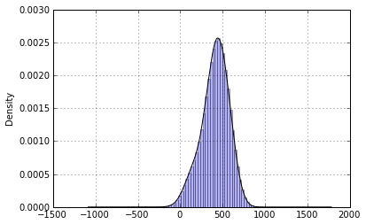
Distribution of progeny DGV
Distribution of 6,000,000 randomly sampled simulated matings.

Slide 34
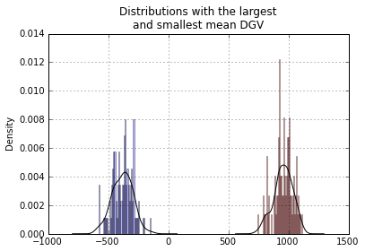
Most extreme groups for progeny DGV

Slide 35
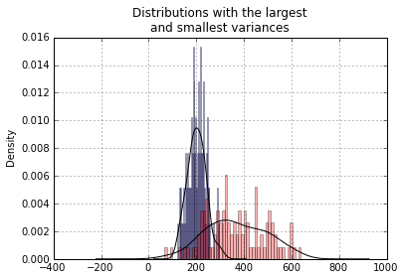
Most extreme groups for DGV variance

Slide 36

Conclusions
Genomic selection provides
tools for increasing rates of
genetic gain
Accurate genetic information
is now available early in life
Pedigree errors can be found and corrected
Accurate culling decisions save money
Better mate selection produces better heifers
Elite genetics can be marketed
http://houston.cowparade.com/cow/large/917

Slide 37
Acknowledgments
Dan Null, Paul VanRaden, Curt Van Tassell, and George Wiggans, AGIL
Tom Lawlor, Holstein Association USA
Albert de Vries, University of Florida
AFRI grant 1245-31000-101-05, “Improving Fertility of Dairy Cattle Using Translational Genomics”

Slide 38

Questions?
http://gigaom.com/2012/05/31/t-mobile-pits-its-math-against-verizons-the-loser-common-sense/shutterstock_76826245/

