Slide 1
Genetic improvement of dairy cattle health using producer-recorded data and genomic information

Slide 2
Outline
Topic 1: Genomic evaluation of
dairy cattle health
Topic 2: Genomic prediction of disease occurrence using producer-recorded health data: A comparison of methods
Topic 3: Benchmarking dairy herd health status using routinely recorded herd summary data
Notes:
2
2

Slide 3
Genomic evaluation of dairy cattle health

Slide 4
What are health and fitness traits?
Health and fitness traits do not generate revenue, but they are economically important because they impact other traits.
Examples:
  Poor fertility increases direct and indirect costs (semen, estrus synchronization, etc.).
  Susceptibility to disease results in decreased revenue and increased costs (veterinary care, withheld milk, etc.)
Notes:
4
4

Slide 5
Increased emphasis on functional traits
Trait |  | Relative emphasis on traits in index (%)
 |  | NM$ 1994 | NM$ 2000 | NM$ 2003 | NM$ 2006 | NM$ 2010 | NM$ 2014 | GM$ 2014
Milk |  | 6 | 5 | 0 | 0 | 0 | -1 | -1
Fat |  | 25 | 21 | 22 | 23 | 19 | 22 | 20
Protein |  | 43 | 36 | 33 | 23 | 16 | 20 | 18
PL |  | 20 | 14 | 11 | 17 | 22 | 19 | 10
SCS |  | –6 | –9 | –9 | –9 | –10 | –7 | -6
UDC |  | … | 7 | 7 | 6 | 7 | 8 | 8
FLC |  | … | 4 | 4 | 3 | 4 | 3 | 3
BDC |  | … | –4 | –3 | –4 | –6 | –5 | -4
DPR |  | … | … | 7 | 9 | 11 | 7 | 19
HCR |  | … | … | … | … | … | 2 | 3
CCR |  | … | … | … | … | … | 1 | 5
CA$ |  | … | … | 4 | 6 | 5 | 5 | 5
Notes:
5
5

Slide 6
Challenges with health and fitness traits
Lack of information
  Inconsistent trait definitions
  No national database of phenotypes
Low heritabilities
  Many records are needed for accurate evaluation
  Rates of change in genetic improvement programs are low
Notes:
6
6

Slide 7
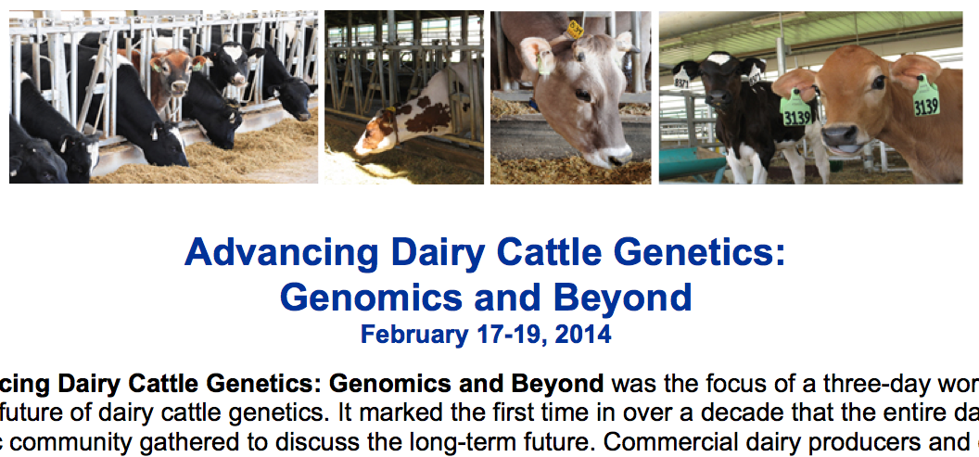
What do dairy farmers want?
National workshop in Tempe, AZ
  Producers, industry, academia, and government
Farmers want new tools
  New traits
  Better management tools
Foot health and feed efficiency were of greatest interest
Notes:
7
7

Slide 8
Path for data flow
AIPL (now AGIL) introduced Format 6 in 2008
  Permits reporting of 24 health and management traits
  Easily extended to new traits
  Simple text file
Tested by 3 DRPCs
  No data are routinely flowing
Notes:
8
8

Slide 9
Health event data for analysis
Health event | Records | Cows | Herd-years
Cystic ovaries | 222,937 | 131,194 | 3,369
Digestive disorders | 156,520 | 97,430 | 1,780
Displaced abomasum | 213,897 | 125,594 | 2,370
Ketosis | 132,066 | 82,406 | 1,358
Lameness | 233,392 | 144,382 | 3,191
Mastitis | 274,890 | 164,630 | 3,859
Metritis | 236,786 | 139,818 | 3,029
Reproductive disorders | 253,272 | 151,315 | 3,360
Retained placenta | 231,317 | 138,457 | 2,930

Slide 10
Genetic and genomic analyses
Single-trait genetic | Multiple-trait genetic | Multiple-trait genomic
MAST, METR, LAME, KETO, RETP, CYST, DSAB |  | 1) MAST, METR, LAME, KETO 2) RETP. CYST, DSAB
Fixed parity, year-season
Random sire, herd-year
Numerator relationship matrix, A |  | Blended matrix, H
ASReml | THRGIBBS1F90
Genetic analyses included only pedigree and phenotypic data.
Genomic analyses included genotypic, pedigree, and phenotypic data.

Slide 11
Methods: Single-trait genetic analysis
Estimate heritability for common health events occurring from 1996 to 2012
Similar editing applied
  US records
  Parities 1 to 5
  Minimum/maximum constraints
Lactations lasting up to 400 days
Parity considered first versus later

Slide 12
Methods: Multiple-trait genomic analyses
Multiple-trait threshold sire model using single-step methodology (Aguilar et al., 2011)
  THRGIBBS1F90 with genomic options
  Default genotype edits used
    50K SNP data available for 7,883 bulls
    Final dataset included 37,525 SNP for 2,649 sires

Slide 13
Results: Single-trait genetic analyses
Health Event | Heritability | Standard Error
Cystic ovaries | 0.03 | 0.006
Digestive disorders | 0.06 | 0.02
Displaced abomasum | 0.20 | 0.02
Ketosis | 0.07 | 0.01
Lameness | 0.03 | 0.005
Mastitis | 0.05 | 0.006
Metritis | 0.06 | 0.007
Respiratory disorders | 0.04 | 0.01
Reproductive disorders | 0.03 | 0.006
Retained placenta | 0.07 | 0.01

Slide 14
Results: Multiple-trait genomic analysis
Estimated heritabilities (95% HPD) on diagonal and estimated genetic correlations (95% HPD) below diagonal.
 | Mastitis | Metritis | Lameness | Retained placenta | Cystic ovaries | Ketosis | Displaced abomasum
Mastitis | 0.12 (0.10, 0.14)
Metritis | -0.36 (-0.53, -0.19) | 0.04 (0.027, 0.043)
Lameness |  | 0.13 (-0.1, 0.34) | 0.026 (0.015, 0.034)
Retained placenta |  |  |  | 0.04 (0.03, 0.05)
Cystic ovaries |  |  |  | -0.02 (-0.22, 0.16) | 0.03 (0.01, 0.04)
Ketosis | -0.16 (-0.31, 0.01) | 0.44 (0.26, 0.64) |  |  |  | 0.08 (0.05, 0.10)
Displaced abomasum |  |  |  | 0.01 (-0.21, 0.16) | -0.11 (-0.29, 0.13) |  | 0.12 (0.09, 0.14)

Slide 15
Reliability with and without genomics
Mean reliabilities of sire PTA computed with pedigree information and genomic information, and the gain in reliability from including genomics.
Event | EBV Reliability | GEBV Reliability | Gain
Displaced abomasum | 0.30 | 0.40 | +0.10
Ketosis | 0.28 | 0.35 | +0.07
Lameness | 0.28 | 0.37 | +0.09
Mastitis | 0.30 | 0.41 | +0.11
Metritis | 0.30 | 0.41 | +0.11
Retained placenta | 0.29 | 0.38 | +0.09

Slide 16
What do we do with these PTA?
Focus on diseases that occur frequently enough to observe in most herds
Put them into a selection index
Apply selection for a long time
  There are no shortcuts
Collect phenotypes on many daughters
  Repeated records of limited value

Slide 17
Genomic prediction of disease occurrence using producer-recorded health data: A comparison of methods

Slide 18
Objectives
Utilize health data collected from on-farm computer systems
Estimate predictive ability of two-stage and single-step genomic selection methods
Univariate and bivariate models

Slide 19
Data
Occurrences of mastitis from 1st parity cows
Editing as described in Parker Gaddis et al. (2012, JDS, 95:5422-5435)
Genomic data for 7,883 sires
High-density genotypes available for 1,371 sires

Slide 20
Analyses
Traits: mastitis, somatic cell score
BayesA analyses
  Univariate
  Bivariate
Single step analyses – 50K and HD markers
  Univariate
  Bivariate

Slide 21
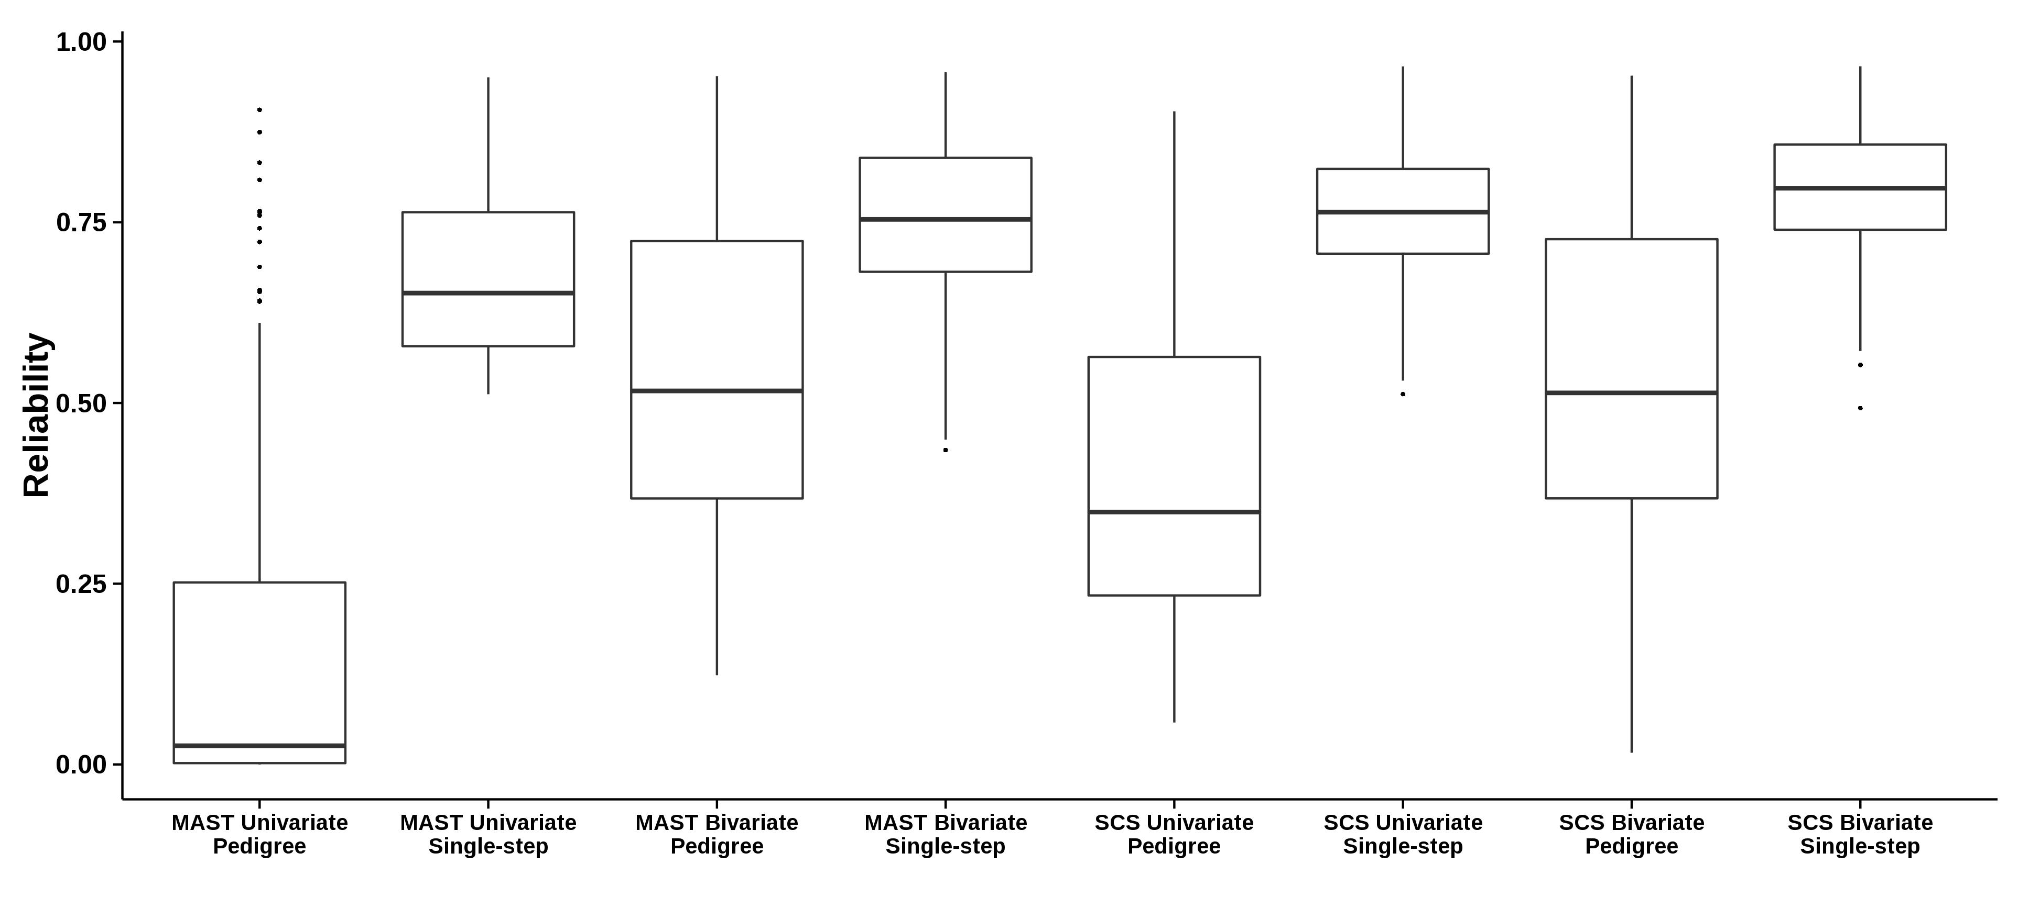
Reliability

Slide 22
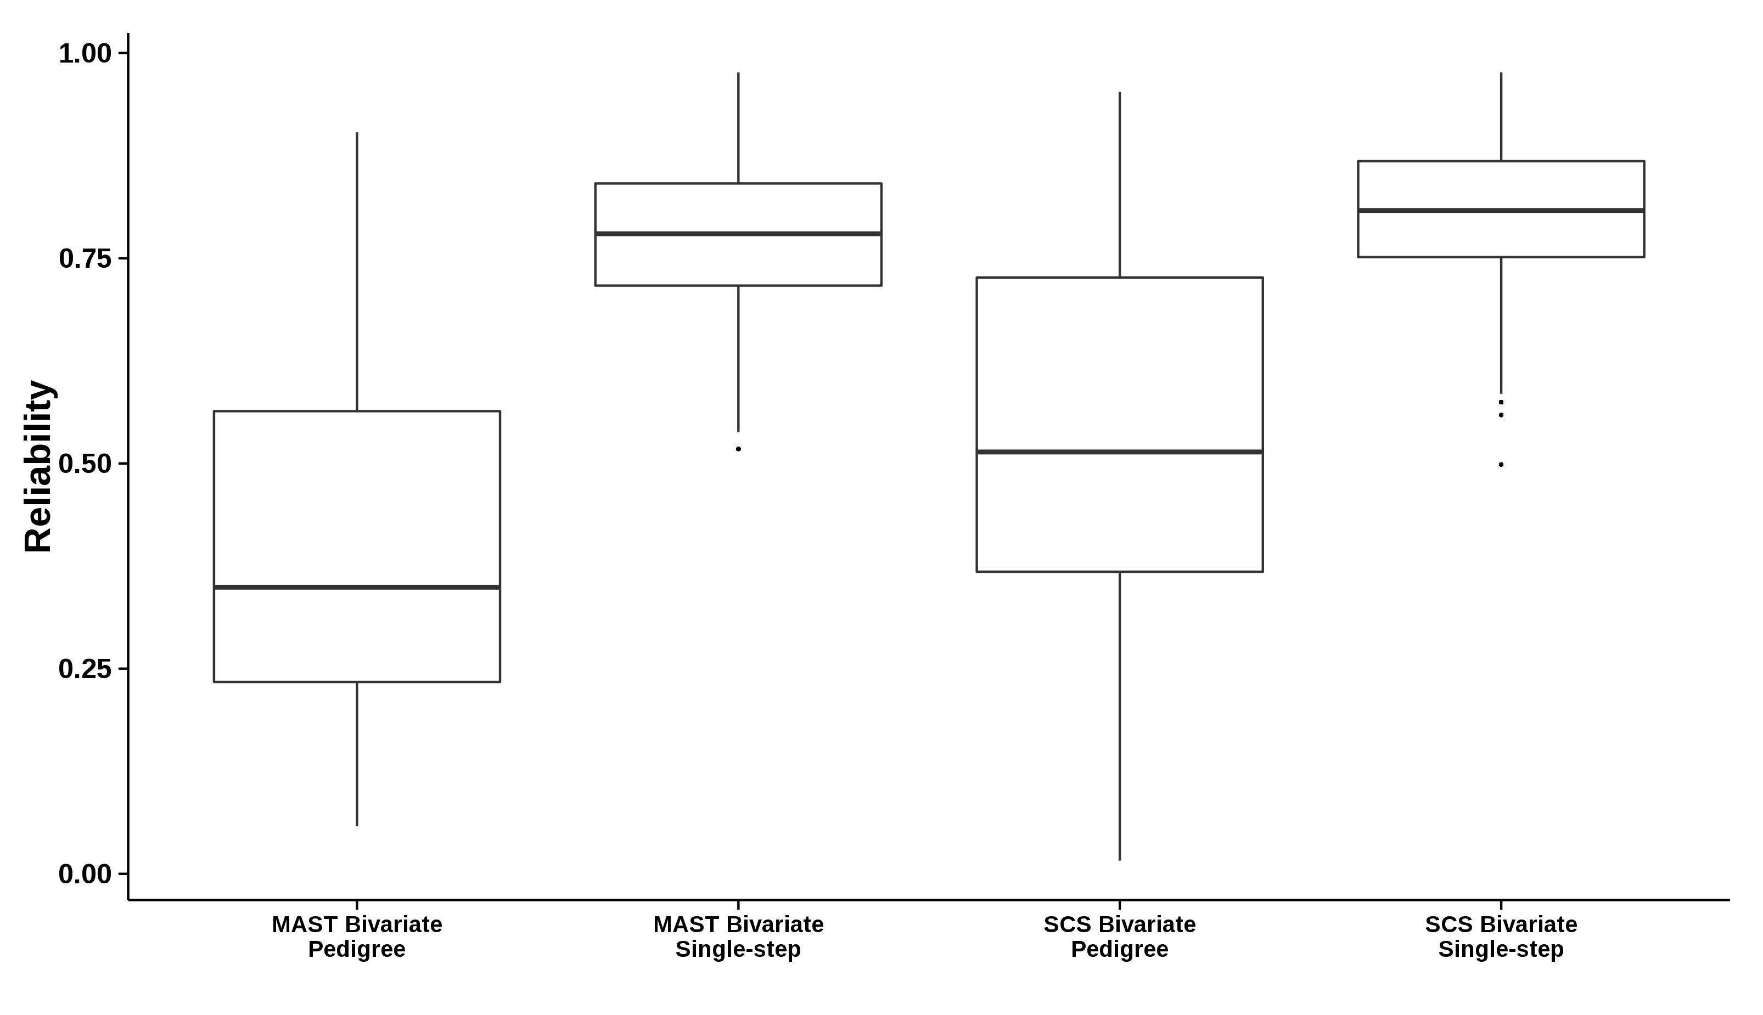
HD Reliability

Slide 23
Cross-validation summary statistics
Univariate analysis of mastitis
 | AICC | Σ χ² | Wrong predictions
Pedigree-based | -5.05 | 1846303 | 0.017
BayesA | -4.73 | 1839123 | 0.019
Single-step | -5.03 | 1787162 | 0.033

Slide 24
Conclusions
Model performance with real data will depend on many factors
Heritability and reliability will impact effectiveness of genomic evaluation methods
Currently, single-step method provided several advantages for producer-recorded health data
Parker Gaddis et al. (2015, Genetics Selection Evolution, 47:41).

Slide 25
Benchmarking dairy herd health status using routinely recorded herd summary data

Slide 26
Objectives
Utilize routinely collected herd characteristics
Parametric and non-parametric methods
Benchmarking and prediction of herd and individual health status

Slide 27
Data
Dairy Herd Improvement – 202 Herd Summary
  2000 to 2011
  March, June, September, and December
  1,100+ variables
  Number of contributing herds ranged from 647 to 1,418
Supplementary data
  National Oceanic and Atmospheric Administration
  United States Census Bureau

Slide 28
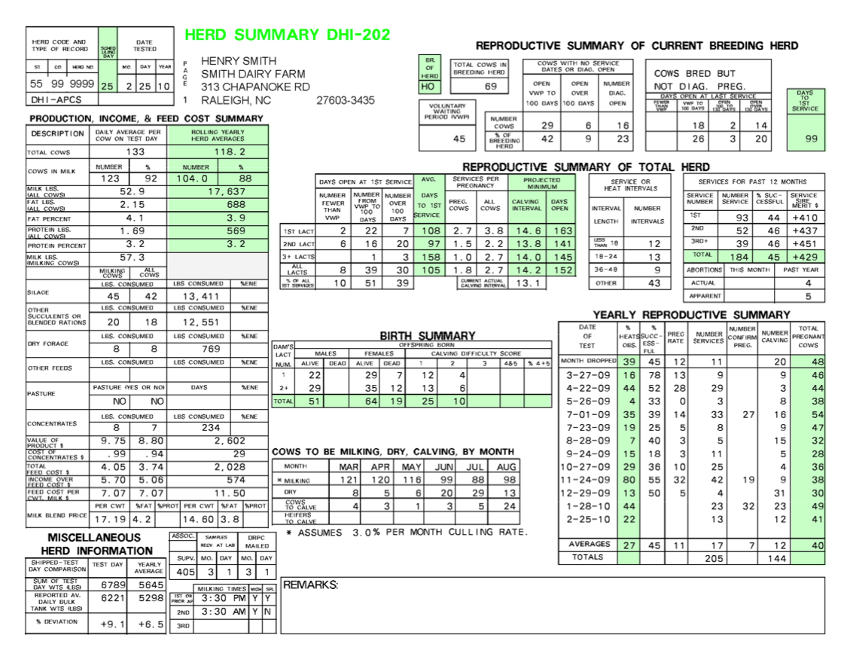

Slide 29
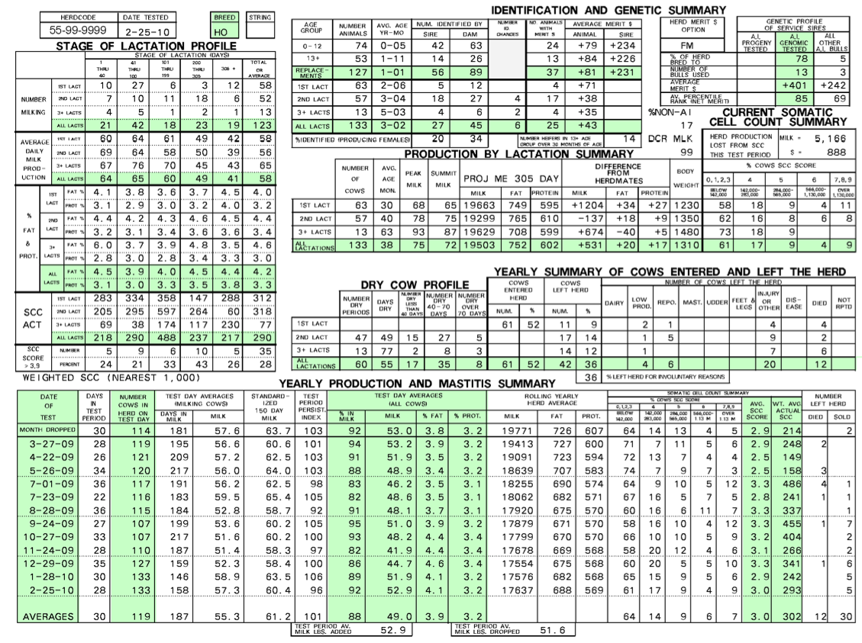

Slide 30
Editing
Correlation analysis
Remove linear combinations
Remove variables with near zero variance
Remove variables missing more than 50%
Impute remaining missing values
Group health events into 3 main categories
  Mastitis, Metabolic, Reproductive

Slide 31
Models
Stepwise logistic regression
Support vector machine
Random forest

Slide 32
Results
ROC curves for herd incidence averaged across ten-fold cross-validation

Slide 33
Results
ROC curves for individual incidence averaged across ten-fold cross-validation

Slide 34
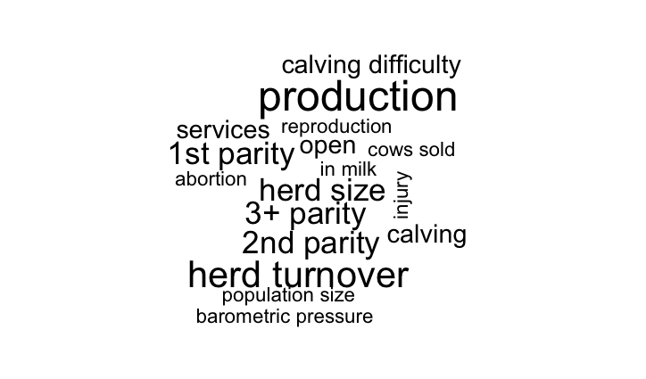
Variables selected by RF, individual level: mastitis

Slide 35
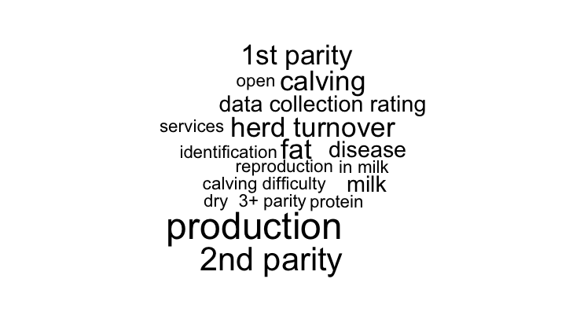
Variables selected by RF, individual level: reproduction

Slide 36
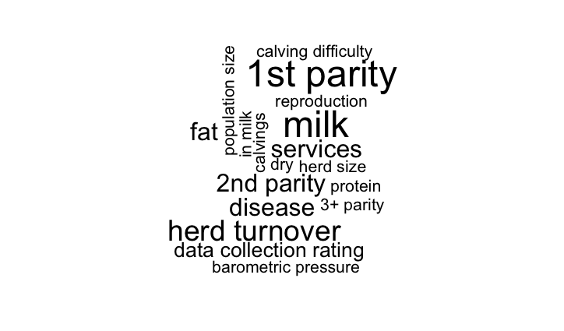
Variables selected by RF, individual level: metabolic

Slide 37
Conclusions
Machine learning algorithms (RF) can accurately identify herds and cows likely to experience a health event
Influential variables included
  Herd turnover
  Milk production
  Parity
  Weather conditions

Slide 38

ICAR functional traits working group
ICAR working group
  7 members from 6 countries
Standards and guidelines for functional traits
  Recording schemes
  Evaluation procedures
  Breeding programs
Notes:
38
38

Slide 39
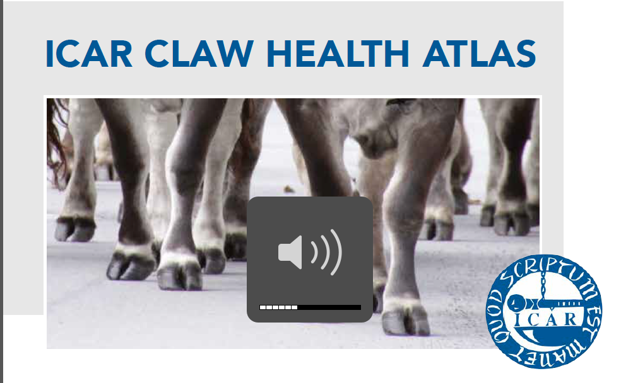
ICAR Claw Health Atlas
International group of geneticists, veterinarians, and experts in claw
  Provides uniform descriptions
  of claw health disorders to
  support data collection and
  genetic evaluation in many
  countries
Notes:
39
39

Slide 40
Acknowledgments
Christian Maltecca, Department of Animal Science, North Carolina State University, Raleigh, NC
John Clay, Dairy Records Management Systems, Raleigh, NC
Dan Null, AGIL, ARS, USDA

Slide 41

Questions?
http://gigaom.com/2012/05/31/t-mobile-pits-its-math-against-verizons-the-loser-common-sense/shutterstock_76826245/

