Slide 1
Haplotype tests for recessive disorders that affect fertility and other traits in dairy cattle
John B. Cole
USDA, Agricultural Research Service
Henry A. Wallace Beltsville Agricultural Research Center
Animal Genomics and Improvement Laboratory
Beltsville, MD 20705-2350
john.cole@ars.usda.gov

Slide 2
Overview
Introduction to genetic disorders
Identification of new genetic disorders
Validation of causal variants
Management of genetic disorders

Slide 3
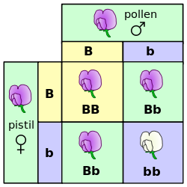
Mendelian traits
Classical model of inheritance
One locus, typically with two alleles
Often exhibit complete dominance
Mendel’s experiments with pea plants are the classical example
Source: https://commons.wikimedia.org/wiki/File:Punnett_square_mendel_flowers.svg.

Slide 4
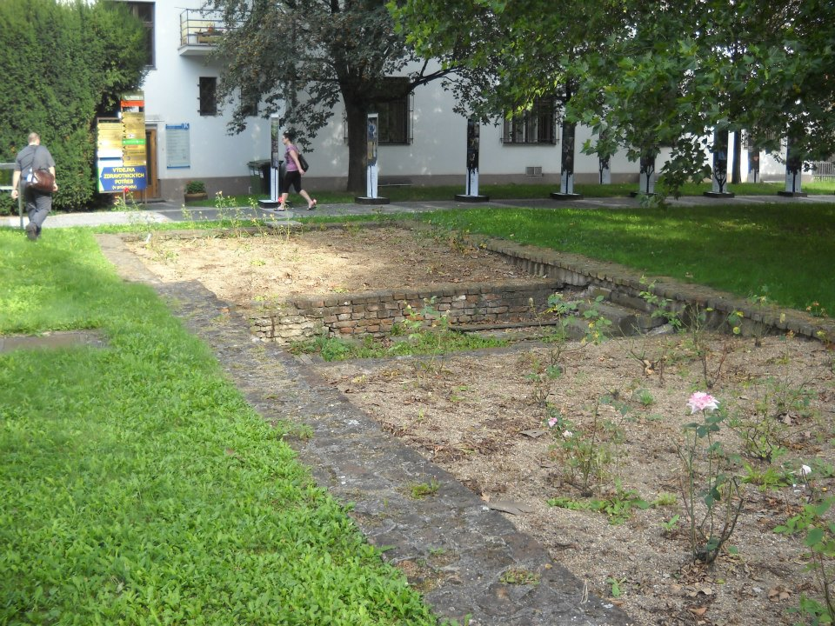
A pilgrimage, of sorts
Source: Author.

Slide 5

Genetic diseases are common
There are currently 494 genetic traits/disorders of cattle in the Online Mendelian Inheritance in Animals database
http://omia.angis.org.au/home/
229 of these are Mendelian traits/disorders

Slide 6
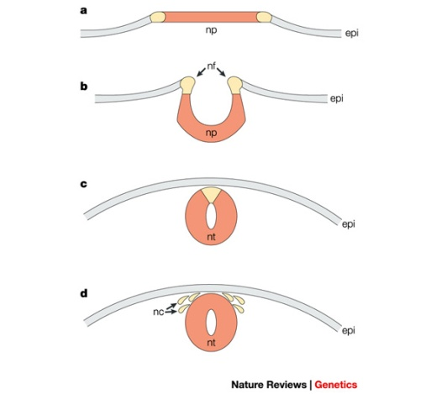
Example – HH1 (APAF1)
Bos taurus apoptotic peptidase activating factor 1 (APAF1; Adams et al., 2016)
Gene expression for APAF1 in murine development begins between 7 and 9 d (Müller et al., 2005)
Gene knockout of APAF1 results in embryonic death
Proteins required for this pathway are needed for neural tube closure in vivo

Slide 7
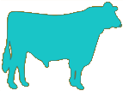

Example – Transmission of HH1 (APAF1)
100% free of recessives | 50% free, 50% carriers
50% free, 50% carriers | 25% free, 50% carriers, 25% die
Source: http://vet.tufts.edu/tas/images/002.png.

Slide 8
Haplotyping in US dairy cattle
Parental Haplotypes
Paternal and maternal chromosomes phased
Chromosomes divided into 100-SNP blocks
List of unique blocks in the population computed
What haplotypes never appear as homozygotes?
Automated part of genomic evaluation workflow
Progeny Haplotypes
!

Slide 9
Haplotypes affecting fertility
Rapid discovery of new recessive defects
Large numbers of genotyped animals
Affordable DNA sequencing
Determination of haplotype location
Significant number of homozygous animals expected, but none observed (based on pedigree, not haplotype frequency)
Narrow suspect region with fine-mapping
Use sequence data to find causative mutation

Slide 10
How are new haplotypes detected?
Lethal haplotypes found by searching for blocks that never appear as homozygotes even though a substantial number are expected
Fertility data used to determine if carrier × carrier matings have reduced fertility
Identifies recessives with effects early in gestation
Dystocia data can be used to check for effects on stillbirth rates
Identifies recessives with effects late in gestations
Methodology described in VanRaden et al. (2011)

Slide 11
Effects confirmed using fertility data
Carrier × carrier matings tested for effects on conception rate and stillbirth
Early embryonic losses show conception rate effects (e.g., HH2 and JH1)
Some variants show stillbirth effects (e.g., BH2 and HCD)
For example, matings of AH1 carrier sires to cows with AH1 carrier maternal grandsires had 6.1% lower sire conception rate

Slide 12
Timing of recessive effects
Late losses are more costly than early losses
A defect may cause deaths in more than one time period
Embryonic loss or abortion | Death at or near birth | Weeks or months following birth
BH1, HH0, HH1, HH2, HH3, HH4, HH5, CVM, JH1, JH2 | BH2, HH0, CVM, syndactyly (mulefoot) | AH1, BH2, BLAD, cholesterol deficiency, spinal dysmyelination, spinal muscular atrophy, weaver syndrome

Slide 13
Known recessives in U.S. Holsteins
Haplo- type | Functional/Gene name | BTA chromosome | Location (Mbp) | Haplotype frequency (%) | Timing¹
HBR | Black/red coat color/MC1R(MSHR) | 18 | 14.8 | 0.80 | —
HCD | Cholesterol deficiency/APOB | 11 | 78.0* | 2.50 | W
HDR | Dominant red color/MC1R(MSHR) | 3 | 9.5* | 0.04 | —
HH0 | Brachyspina/FANCI | 21 | 21.2 | 2.76 | E,B
HH1 | APAF1 | 5 | 63.2* | 1.92 | E
HH2 | — | 1 | 94.9 – 96.6 | 1.66 | E
HH3 | SMC2 | 8 | 95.4* | 2.95 | E
HH4 | GART | 1 | 1.3* | 0.37 | E
HH5 | TFB1M | 9 | 93.2 – 93.4 | 2.22 | E
HHB | BLAD/ITGB2 | 1 | 145.1* | 0.25 | W
HHC | CVM/SLC35A3 | 3 | 43.4* | 1.37 | E,B
HHD | DUMPS/UMPS | 1 | 69.8* | 0.01 | E
HHM | Mule foot/LRP4 | 15 | 77.7 | 0.07 | B
HHP | Polledness (dominant)/POLLED | 1 | 1.7 – 2.0 | 0.71 | —
HHR | Red coat color/MC1R(MSHR) | 18 | 14.8* | 5.42 | —
*Causative mutation known
¹Timing of embryonic loss/calf death for homozygous animals: B = calf death at/shortly after birth,
E = embryonic loss/abortion, W = calf death weeks/months after birth
Source: Cole et al. (2016)

Slide 14
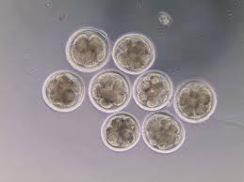
Validation of candidate variants
Candidate genes for early embryonic losses not always validated in the laboratory
Targeted knockouts can be used to validate candidates for early embryonic losses
Relatively fast and cost-effective
Source: University of Florida (2013).

Slide 15
Is the number of defects increasing?
MacArthur et al. (2012) estimated that human genomes contain ~100 loss-of-function mutations, and ~20 completely inactivated genes
The mutations are there even if we have not identified them yet
Example: HH6, mutation in SDE2 (Fritz et al., 2018)
Our detection methods are improving as our technology improves

Slide 16
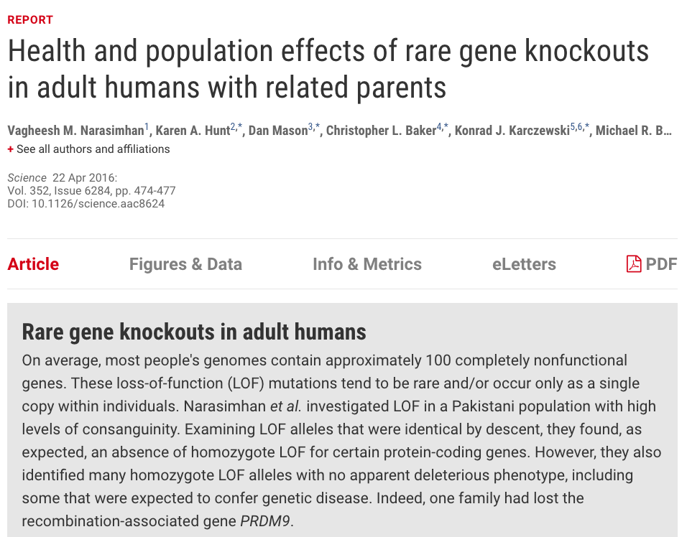
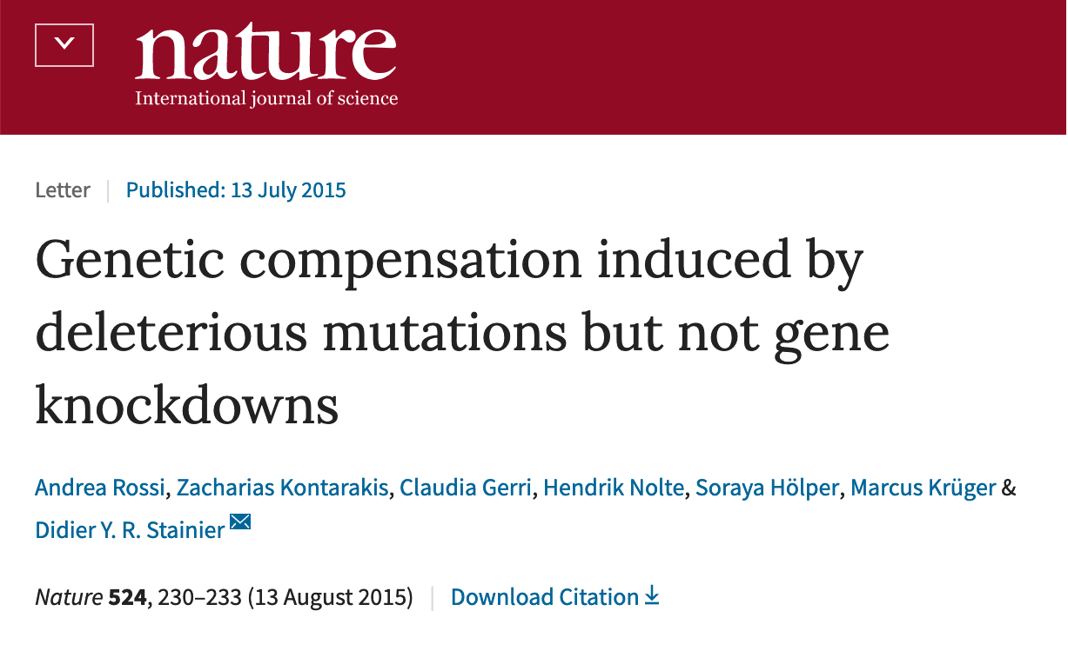
Not all mutations produce phenotypic changes
Compensatory networks can buffer against deleterious mutations (Rossi et al., 2015)
Many homozygote loss-of-function alleles produce no deleterious phenotypes, including some expected to confer genetic disease (Narasimhan et al., 2016)

Slide 17
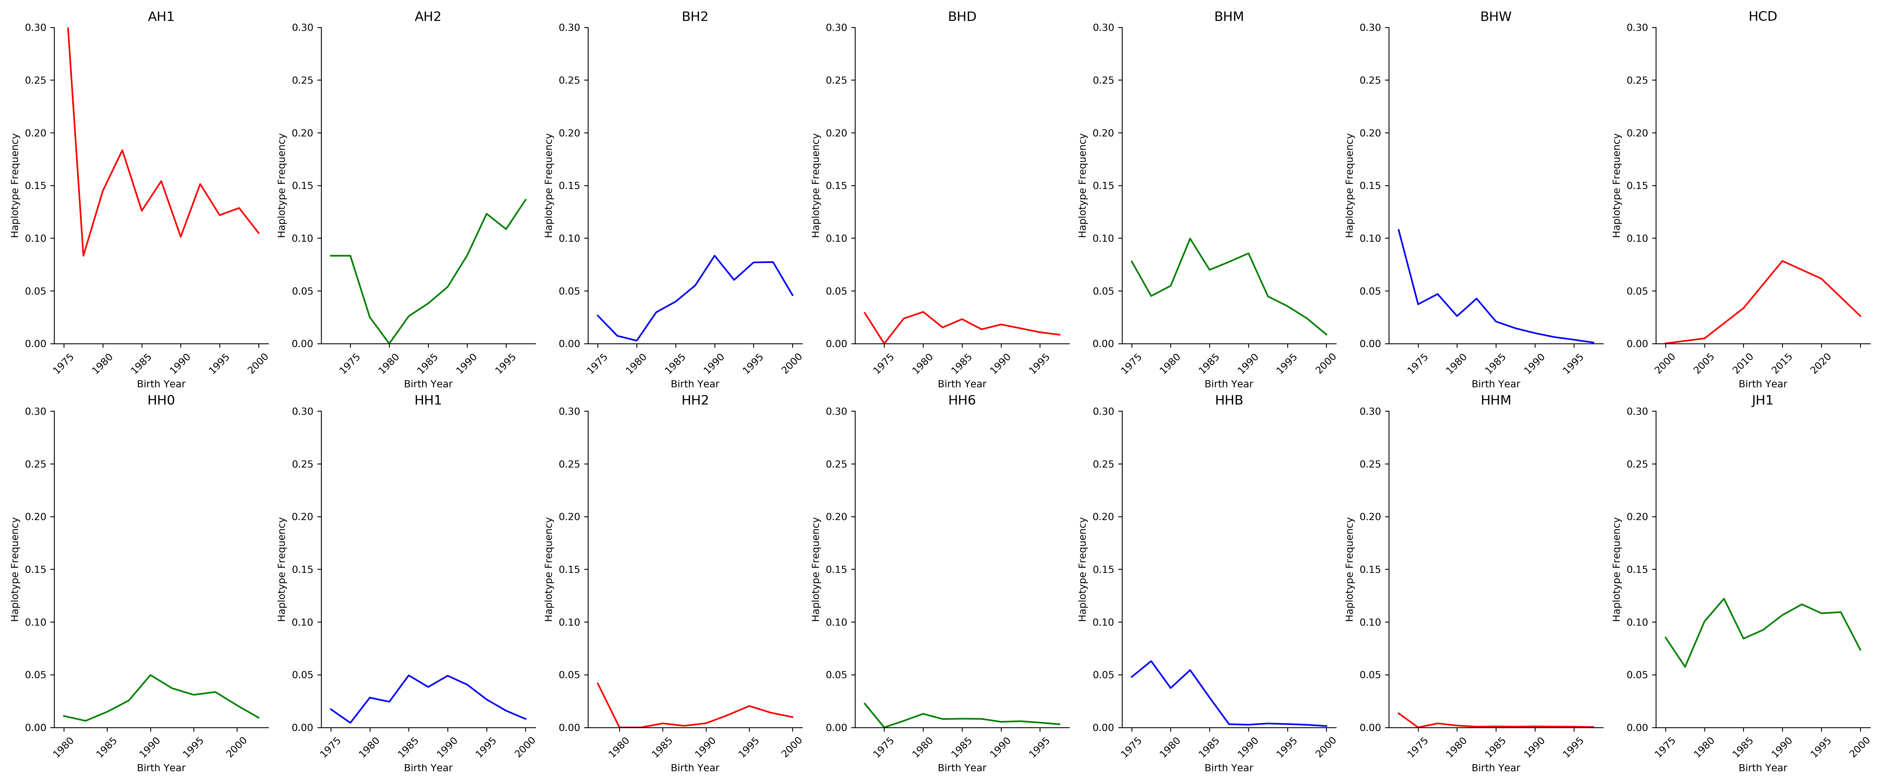
Frequencies change over time
The best way to reduce the frequency of harmful alleles is to not use carrier bulls!

Slide 18
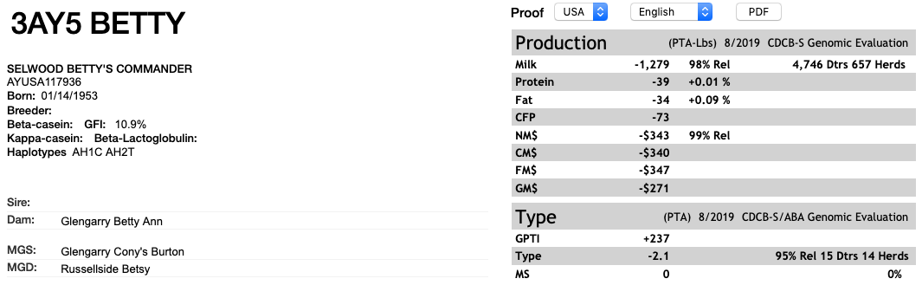
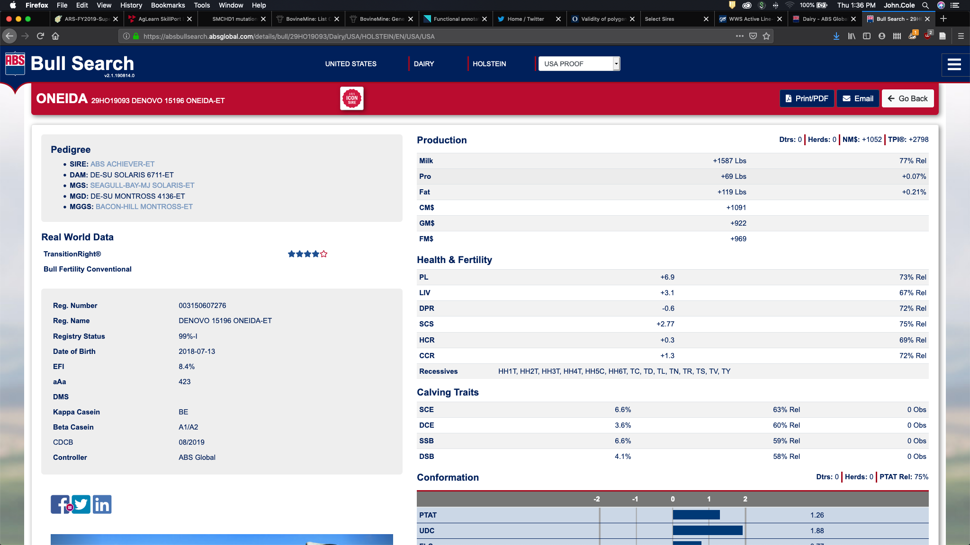
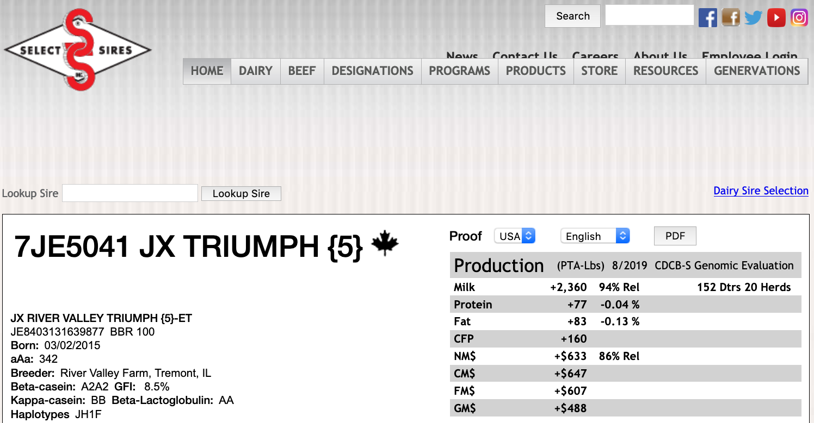
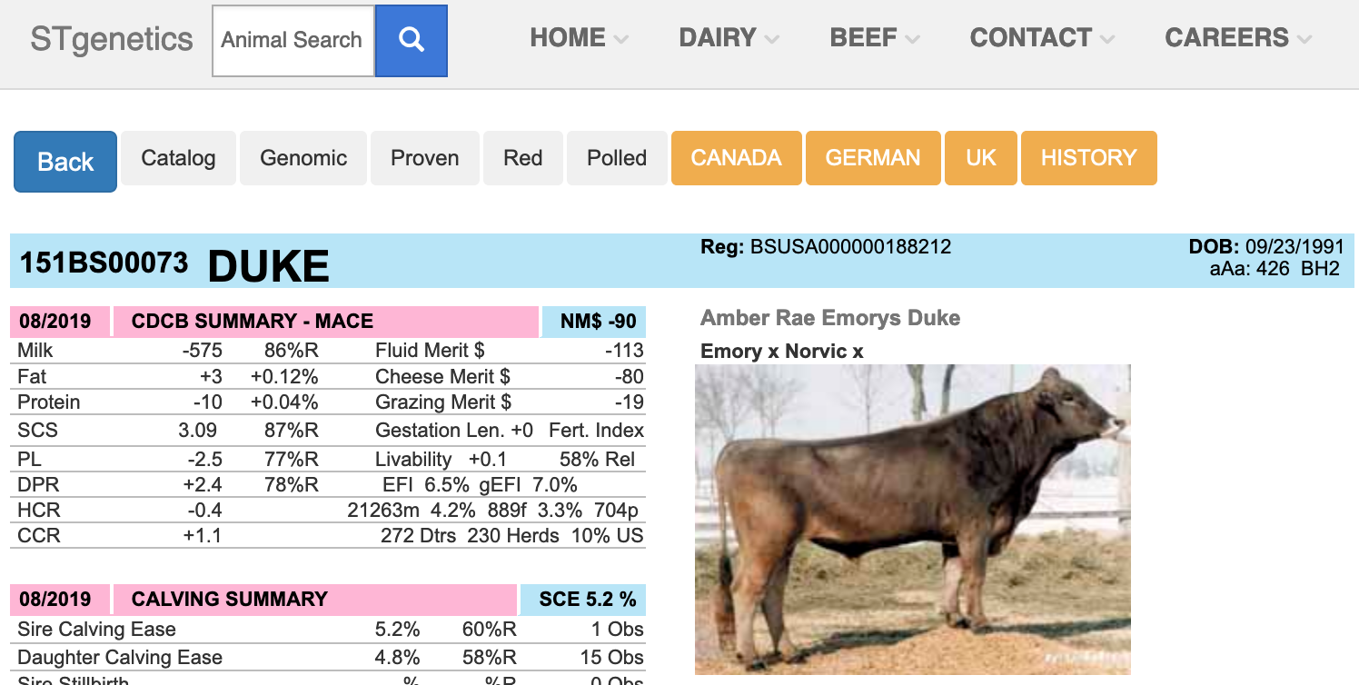
Bull carrier status is published

Slide 19
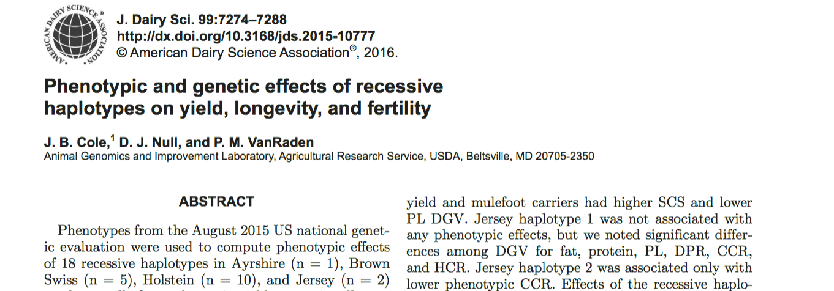
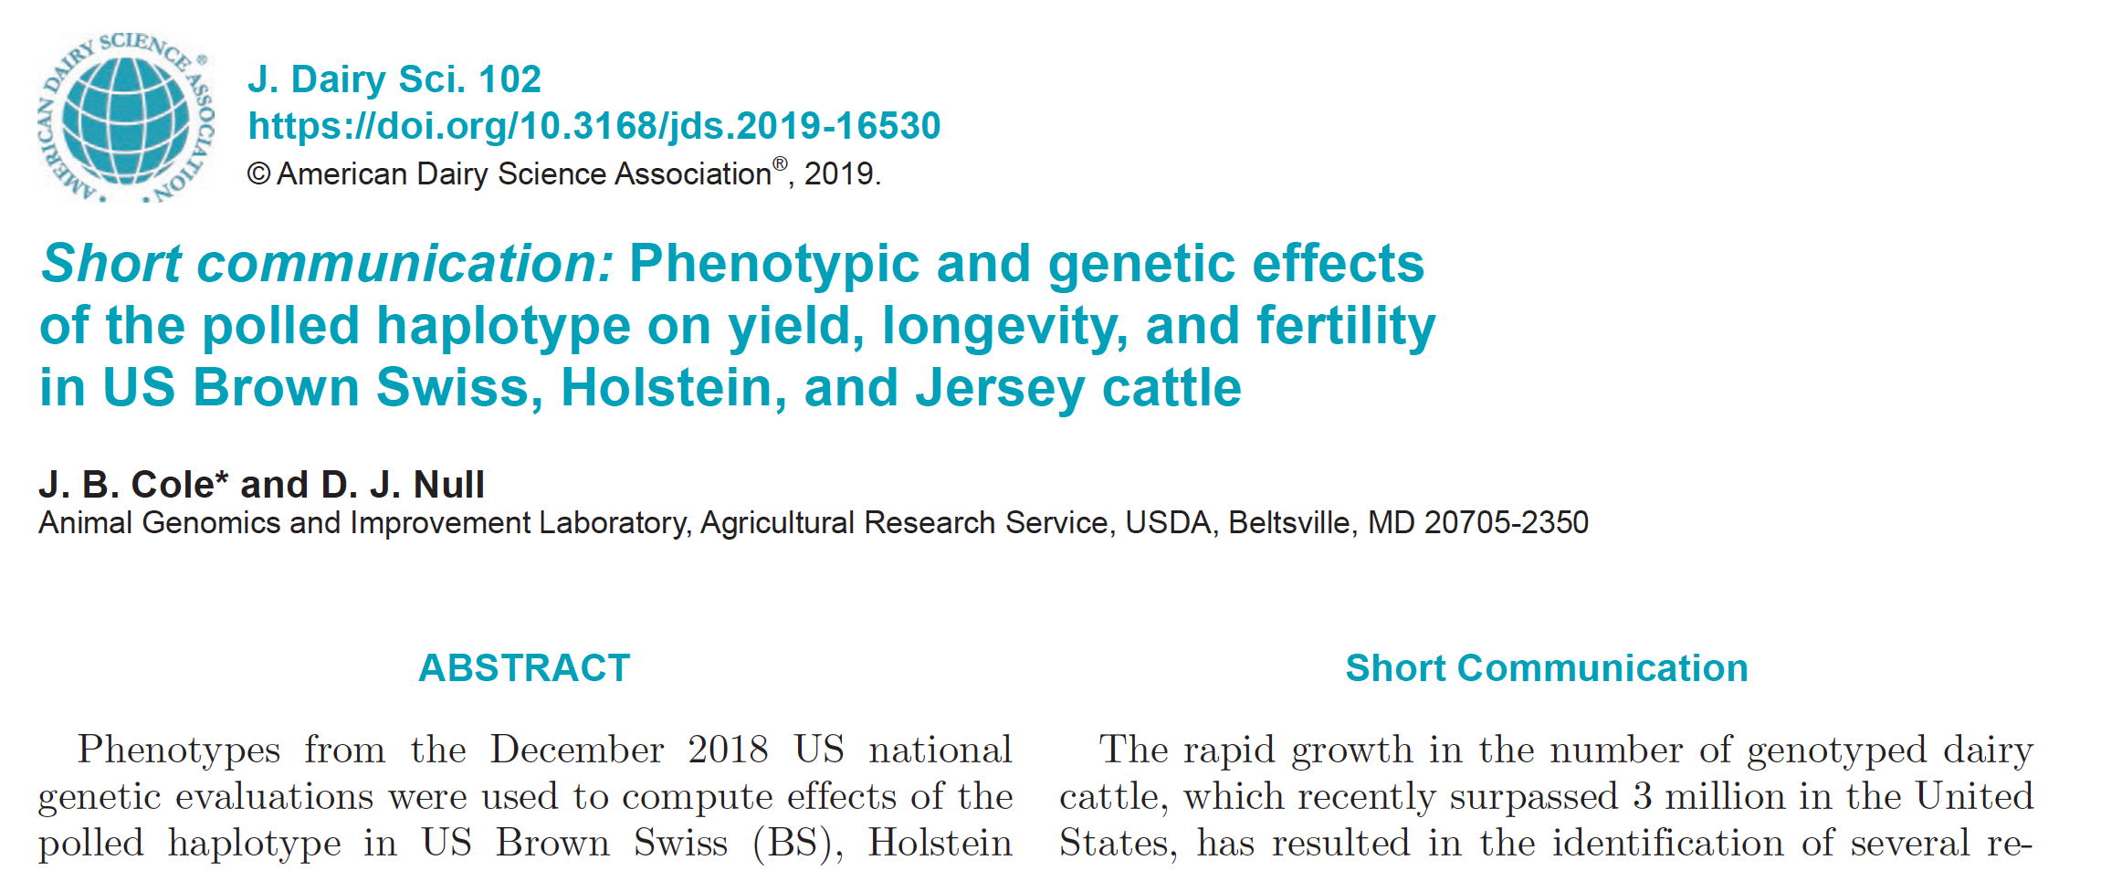
Do recessives affect other traits?
Effects of recessive haplotypes on yield, fertility, and longevity generally were small even when significant

Slide 20
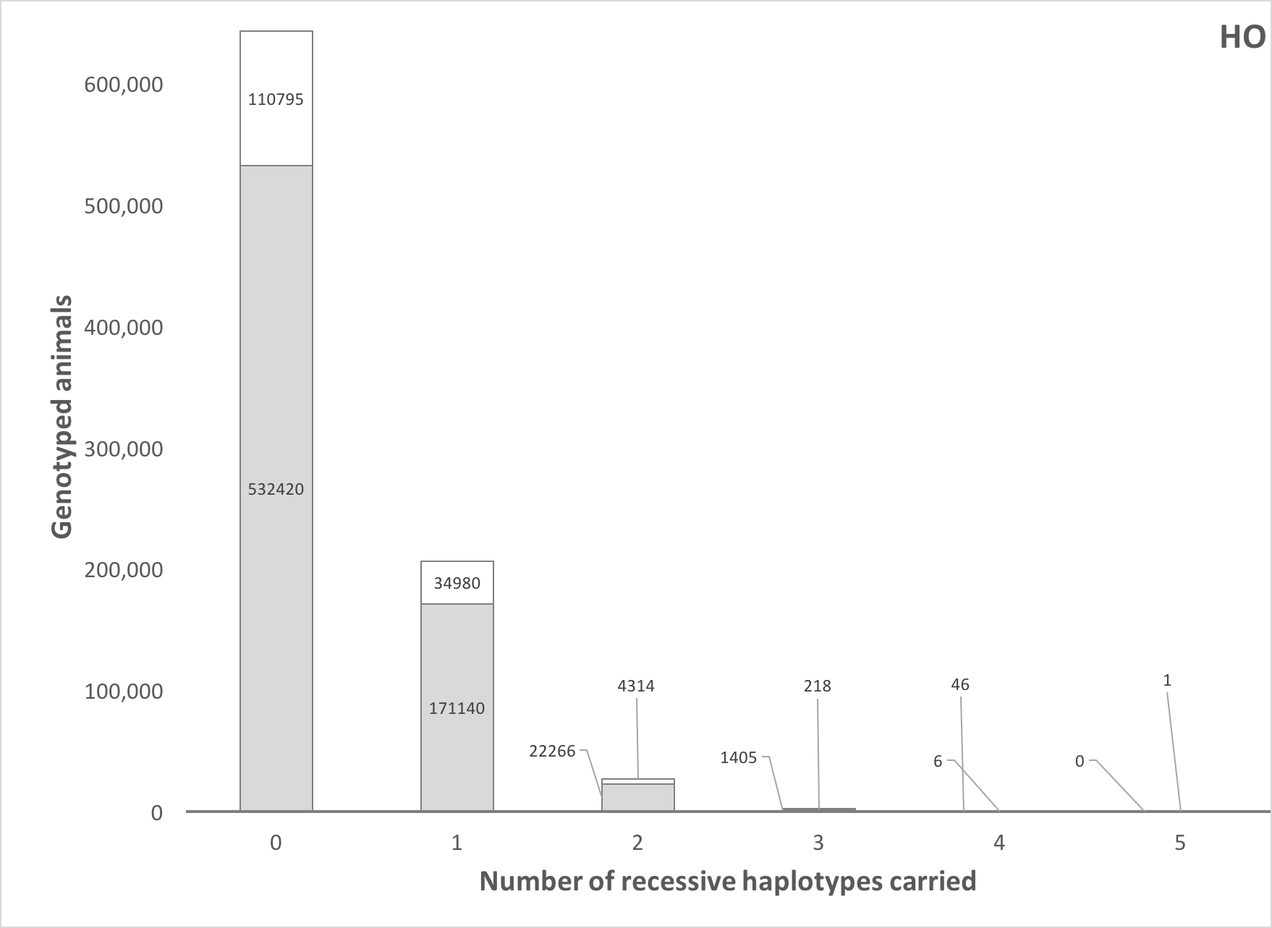
How many defects do animals carry?
Source: Cole et al. (2016).

Slide 21
Estimated cost of genetic load
Cole et al. (2016) estimated annual losses of at least $10.7 million due to known recessives.
Average losses were $5.77, $3.65, $0.94, and $2.96 in Ayrshire, Brown Swiss, Holstein, and Jersey, respectively.
This is the economic impact of genetic load as it affects fertility and perinatal mortality.
Actual losses are likely to be higher.

Slide 22
What is the best strategy for dealing with recessives?
Remove carrier bulls from the population if population is large enough and non-carrier bulls are available
Non-carrier bulls are as good as carrier bulls, on average
 | Carriers |  |  |  | Non-carriers
Breed | N | Mean | SD |  | N | Mean | SD | Difference | P value
AY | 16 | 286.43 | 194.67 |  | 53 | 272.41 | 191.69 | 13.02 | 0.407
BS | 30 | 223.10 | 218.39 |  | 59 | 284.19 | 160.36 | -61.09 | 0.087
HO | 550 | 394.08 | 216.77 |  | 1,765 | 479.49 | 213.89 | -85.41 | <0.001
JE | 99 | 340.51 | 149.00 |  | 378 | 338.82 | 153.99 | 1.69 | 0.460
Source: Cole et al. (2016).

Slide 23
Conclusions
Mendelian genetic disorders are responsible for economic losses to dairy farmers
As technology improves we are identifying more recessive defects
Gene editing should be used to eliminate harmful alleles from the population
Carrier bulls should not be used when non-carrier bulls are of comparable genetic merit and bottlenecks may be avoided

Slide 24
Acknowledgments
Mr. Daniel Null, Mr. Kenneth Shallop, and Dr. Steve Schroeder (all of AGIL) were responsible for haplotype analysis, whole-genome DNA sequencing, and analysis of the sequence data.
DNA for sequencing was provided by the Collaborative Dairy DNA Repository (Verona, WI).
Dr. Sofia Ortega (University of Missouri) carried out the embryo studies used to validate the HH2 causal variant.
Data from Run 7 of the the 1000 Bull Genomes Project were used for independent validation of HH2.

Slide 25
Disclaimer
The author was supported by USDA-ARS project 8042-31000-002-00-D, “Improving Dairy Animals by Increasing Accuracy of Genomic Prediction, Evaluating New Traits, and Redefining Selection Goals”.
USDA is an equal opportunity provider and employer.
Mention of trade names or commercial products in this presentation is solely for the purpose of providing specific information and does not imply recommendation or endorsement by the US Department of Agriculture.

Slide 26
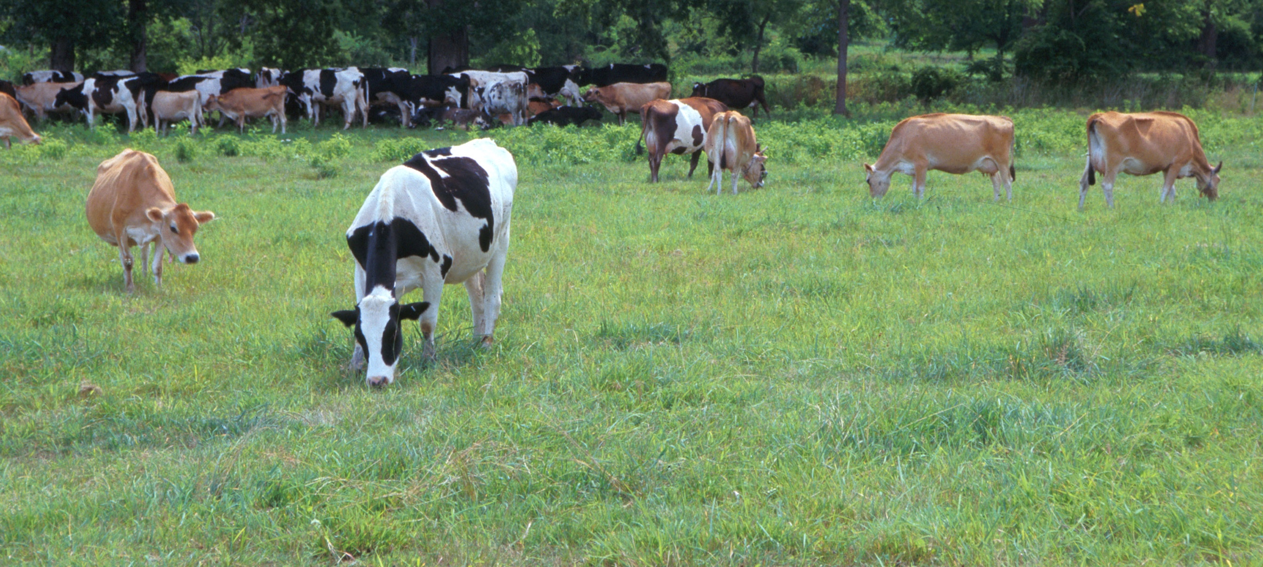
Questions?
AIP web site:
http://aipl.arsusda.gov/
Holstein and Jersey crossbreds graze on American Farm Land Trust’s
Cove Mountain Farm in south-central Pennsylvania
Source: ARS Image Gallery, image #K8587-14; photo by Bob Nichols

