Slide 1
Genomic improvement programs for US dairy cattle

Slide 2
U.S. DHI dairy statistics (2011)
9.1 million U.S. cows
~75% bred AI
47% milk recorded through Dairy Herd Information (DHI)
4.4 million cows
86% Holstein
8% crossbred
5% Jersey
<1% Ayrshire, Brown Swiss, Guernsey, Milking Shorthorn, Red & White
20,000 herds
220 cows/herd
10,300 kg/cow

Slide 3
Genomic data flow
Dairy Herd Improvement (DHI) producer
DNA samples
DNA samples
genomic
evaluations
DNA laboratory
DNA samples
AI organization,
breed association
genotypes
genotypes
nominations,
pedigree data
genotype
quality reports
genomic
evaluations
Council on Dairy Cattle Breeding (CDCB)
Notes:
3

Slide 4
Genotypes are abundant

Slide 5
Sources of DNA for genotyping
Source | Samples (no.) | Samples (%)
Blood | 10,727 | 4
Hair | 113,455 | 39
Nasal swab | 2,954 | 1
Semen | 3,432 | 1
Tissue | 149,301 | 51
Unknown | 12,301 | 4

Slide 6
SNP count for different chips
Chip | SNP (no.) |  | Chip | SNP (no.)
50K | 54,001 |  | GP2 | 19,809
50K v2 | 54,609 |  | ZLD | 11,410
3K | 2,900 |  | ZMD | 56,955
HD | 777,962 |  | ELD | 9,072
Affy | 648,875 |  | LD2 | 6,912
LD | 6,909 |  | GP3 | 26,151
GGP | 8,762 |  | ZL2 | 17,557
GHD | 77,068 |  | ZM2 | 60,914

Slide 7
2014 genotypes by chip SNP density
Chip SNP density | Female | Male | All animals
Low | 239,071 | 29,631 | 268,702
Medium | 9,098 | 14,202 | 23,300
High | 140 | 28 | 168
All | 248,309 | 43,861 | 292,170

Slide 8
2014 genotypes by breed and sex
Breed | Female | Male | All animals | Female: male
Ayrshire | 1,485 | 209 | 1,694 | 88:12
Brown Swiss | 944 | 8,641 | 9,585 | 10:90
Guernsey | 1,777 | 333 | 2,110 | 84:16
Holstein | 212,765 | 30,883 | 243,648 | 87:13
Jersey | 31,323 | 3,793 | 35,116 | 89:11
Milking Shorthorn | 2 | 1 | 3 | 67:33
Normande | 0 | 1 | 0 | 0:100
Crossbred | 13 | 0 | 13 | 100:0
All | 248,309 | 43,861 | 292,170 | 85:15

Slide 9
Genotypes by age (last 12 months)
≥

Slide 10
Growth in bull predictor population
Breed | Jan. 2015 | 12-mo gain
Ayrshire | 711 | 29
Brown Swiss | 6,112 | 336
Holstein | 26,759 | 2,174
Jersey | 4,448 | 245

Slide 11
Growth in US predictor population
 | Bulls |  | Cows^{1,2}
Breed | Jan. 2015 | 12-mo gain | Jan. 2015 | 12-mo gain
Ayrshire | 711 | 29 | 69 | 40
Brown Swiss | 6,112 | 336 | 1,138 | 350
Holstein | 26,759 | 2,174 | 109,714 | 51,950
Jersey | 4,448 | 245 | 26,012 | 10,601
¹Predictor cows must have domestic records.
²Counts include 3k genotypes, which are not included in the predictor population.

Slide 12
Holstein prediction accuracy
Trait | Bias* | Reliability (%) | Reliability gain (% points)
Milk (kg) | −80.3 | 69.2 | 30.3
Fat (kg) | −1.4 | 68.4 | 29.5
Protein (kg) | −0.9 | 60.9 | 22.6
Fat (%) | 0.0 | 93.7 | 54.8
Protein (%) | 0.0 | 86.3 | 48.0
Productive life (mo) | −0.7 | 73.7 | 41.6
Somatic cell score | 0.0 | 64.9 | 29.3
Daughter pregnancy rate (%) | 0.2 | 53.5 | 20.9
Sire calving ease | 0.6 | 45.8 | 19.6
Daughter calving ease | −1.8 | 44.2 | 22.4
Sire stillbirth rate | 0.2 | 28.2 | 5.9
Daughter stillbirth rate | 0.1 | 37.6 | 17.9
*2013 deregressed value – 2009 genomic evaluation

Slide 13
Reliability gains
Reliability (%) | Ayrshire | Brown Swiss | Jersey | Holstein
Genomic | 37 | 54 | 61 | 70
Parent average | 28 | 30 | 30 | 30
Gain | 9 | 24 | 31 | 40
Reference bulls | 680 | 5,767 | 4,207 | 24,547
Animals genotyped | 1,788 | 9,016 | 59,923 | 469,960
Exchange partners | Canada | Canada, Interbull | Canada, Denmark | Canada, Italy, UK
Source: VanRaden, Advancing Dairy Cattle Genetics: Genomics and Beyond presentation, Feb. 2014

Slide 14
Parent ages of marketed Holstein bulls

Slide 15
Active AI bulls that were genomic bulls

Slide 16
Marketed Holstein bulls
Year entered AI | Traditional progeny- tested | Genomic marketed | All bulls
2008 | 1,768 | 170 | 1,938
2009 | 1,474 | 346 | 1,820
2010 | 1,388 | 393 | 1,781
2011 | 1,254 | 648 | 1,902
2012 | 1,239 | 706 | 1,945
2013 | 907 | 747 | 1,654
2014 | 661 | 792 | 1,453

Slide 17
Genetic merit of marketed Holstein bulls
Average gain:
$85.60/year
Average gain:
$52.00/year
Average gain:
$19.77/year

Slide 18
Stability of genomic evaluations
642 Holstein bulls
Dec. 2012 NM$ compared with Dec. 2014 NM$
First traditional evaluation in Aug. 2014
≥50 daughters by Dec. 2014
Top 100 bulls in 2012
Average rank change of 9.6
Maximum drop of 119
Maximum rise of 56
All 642 bulls
Correlation of 0.94 between 2012 and 2014
Regression of 0.92
Notes:
18

Slide 19
% genotyped mates of top young bulls
Garrold
Numero Uno
Supersire
Percentage of mates genotyped
Mogul
S S I Robust Topaz
Net Merit (Aug 2013)

Slide 20
Haplotypes affecting fertility
Rapid discovery of new recessive defects
Large numbers of genotyped animals
Affordable DNA sequencing
Determination of haplotype location
Significant number of homozygous animals expected, but none observed
Narrow suspect region with fine mapping
Use sequence data to find causative mutation

Slide 21
Haplotypes affecting fertility
Name | BTA chromo- some | Location* (Mbp) | Carrier frequency (%) | Earliest known ancestor
HH1 | 5 | 63.2* | 3.8 | Pawnee Farm Arlinda Chief
HH2 | 1 | 94.9 – 96.6 | 3.3 | Willowholme Mark Anthony
HH3 | 8 | 95.4* | 5.9 | Glendell Arlinda Chief, Gray View Skyliner
HH4 | 1 | 1.3* | 0.7 | Besne Buck
HH5 | 9 | 92.4 – 93.9 | 4.4 | Thornlea Texal Supreme
JH1 | 15 | 15.7* | 24.2 | Observer Chocolate Soldier
JH2 | 26 | 8.8 – 9.4 | 2.6 | Liberators Basilius
BH1 | 7 | 42.8 – 47.0 | 13.3 | West Lawn Stretch Improver
BH2 | 19 | 10.6 – 11.7 | 15.6 | Rancho Rustic My Design
AH1 | 17 | 65.9* | 26.0 | Selwood Betty’s Commander
*Causative mutation known

Slide 22
Haplotypes tracking known recessives
Recessive | Haplo-type | BTA chromo- some | Tested animals (no.) | Concord- ance (%) | New carriers (no.)
Brachyspina | HH0 | 21 | ? | ? | ?
BLAD | HHB | 1* | 11,782 | 99.9 | 314
CVM | HHC | 3* | 13,226 | — | 2,716
DUMPS | HHD | 1* | 3,242 | 100.0 | 3
Mule foot | HHM | 15* | 87 | 97.7 | 120
Polled | HHP | 1 | 345 | — | 2,050
Red coat color | HHR | 18* | 4,137 | — | 5,927
SDM | BHD | 11* | 108 | 94.4 | 108
SMA | BHM | 24* | 568 | 98.1 | 111
Weaver | BHW | 4 | 163 | 96.3 | 32
*Causative mutation known

Slide 23
Weekly evaluations
Released to nominators, breed associations, and dairy records processing centers at 8 am each Tuesday
Calculations restricted to genotypes that first became usable during the previous week
Computing time minimized by not calculating reliability or inbreeding

Slide 24
SNP used for genomic evaluations
60,671 SNP used after culling on
MAF
Parent-progeny conflicts
Percentage heterozygous (departure from HWE)
SNP for HH1, BLAD, DUMPS, CVM, polled, red, and mulefoot included
JH1 included for Jerseys
Some SNP eliminated because incorrect location  haplotype non-inheritance

Slide 25
Some novel phenotypes studied recently
Claw health (Van der Linde et al., 2010)
Dairy cattle health (Parker Gaddis et al., 2013)
Embryonic development (Cochran et al., 2013)
Immune response (Thompson-Crispi et al., 2013)
Methane production (de Haas et al., 2011)
Milk fatty acid composition (Soyeurt et al., 2011)
Persistency of lactation (Cole et al., 2009)
Rectal temperature (Dikmen et al., 2013)
Residual feed intake (Connor et al., 2013)

Slide 26
Evaluation methods for traits
Animal model (linear)
Yield (milk, fat, protein)
Type (AY, BS, GU, JE)
Productive life
Somatic cell score
Daughter pregnancy rate
Heifer conception rate
Cow conception rate
Sire–maternal grandsire model (threshold)
Service sire calving ease
Daughter calving ease
Service sire stillbirth rate
Daughter stillbirth rate
Heritability
25 – 40%
7 – 54%
8.5%
12%
4%
1%
1.6%
8.6%
3.6%
3.0%
6.5%

Slide 27

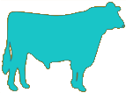
Holstein daughter pregnancy rate (%)
Cows
Sires
0.1%/yr
Phenotypic base = 22.6%

Slide 28
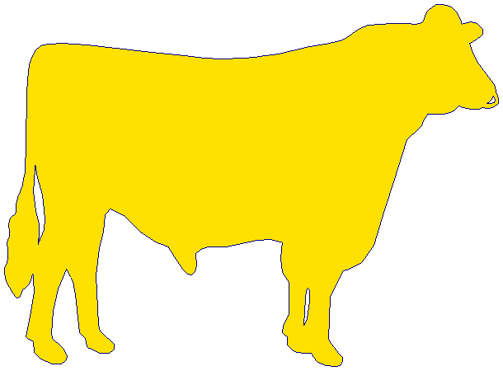
Holstein calving ease (%)
Daughter
0.18%/yr
Service-sire
phenotypic base = 7.9%
Service
sire
Daughter
phenotypic base = 7.5%
0.01%/yr

Slide 29
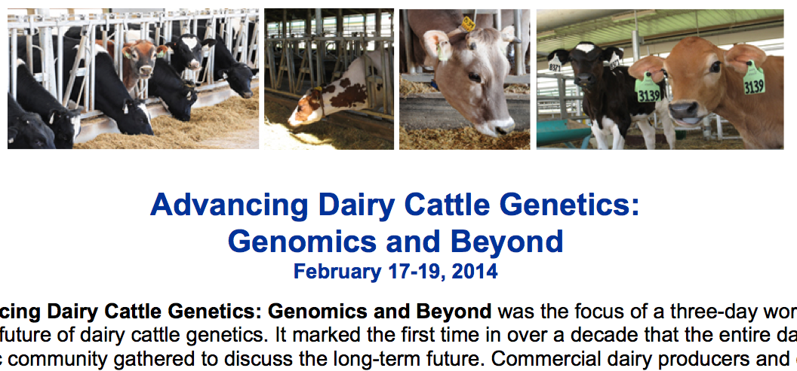
What do US dairy farmers want?
National workshop in Tempe, AZ in February
Producers, industry, academia, and government
Farmers want new tools
Additional traits (novel phenotypes)
Better management tools
Foot health and feed efficiency were of greatest interest
Notes:
29
29

Slide 30
What can farmers do with novel traits?
Put them into a selection index
Correlated traits are helpful
Apply selection for a long time
There are no shortcuts
Collect phenotypes on many daughters
Repeated records of limited value
Genomics can increase accuracy
Notes:
30
30

Slide 31
What can DRPCs do with novel traits?
Short-term – Benchmarking tools for herd management
Medium-term – Custom indices for herd management
Additional types of data will be helpful
Long-term – Genetic evaluations
Lots of data needed, which will take time
Notes:
31
31

Slide 32
International challenges
National datasets are siloed
Recording standards differ between countries
ICAR standards help here
Farmers are concerned about the security of their data
Many populations are small
Low accuracies
Small markets
Notes:
32
32

Slide 33
Conclusions
Genomic research is ongoing
Detect causative genetic variants
Find more haplotypes affecting fertility
Improve accuracy through more SNPs, more predictor animals, and more traits
Genetic trend is favorable for some important, low-heritability traits
More traits are desirable
Data availability remains a challenge for new phenotypes

Slide 34

Questions?

