Slide 1
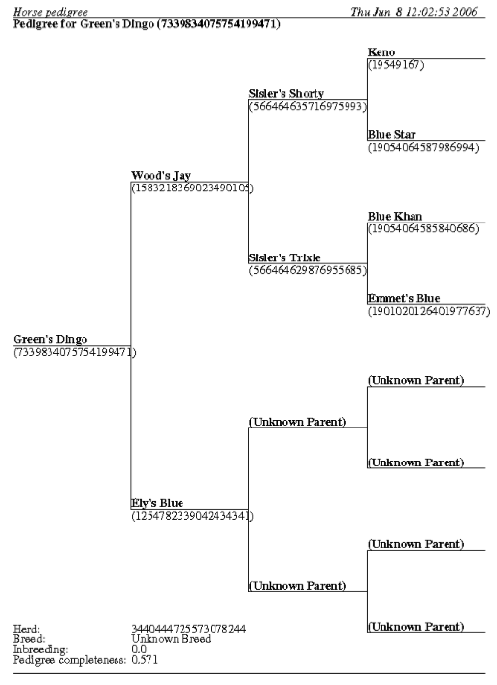
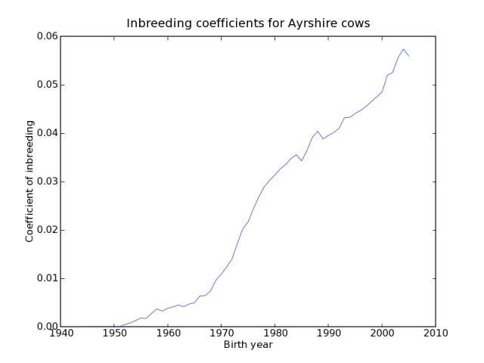
Introduction
Input and Output
Table 2. Performance of inbreeding routines.
Presentation of Results
PyPedal is an open source package written in the Python programming language that provides high-level tools for manipulating pedigrees. The goal is to provide expressive tools for exploratory data analysis.
The simplest way to get a pedigree is to read it from a text file:
>>> p = pyp_newclasses.loadPedigree(options)
>>> print p
<PyPedal.pyp_newclasses.NewPedigree instance at 0x10604a560>
Quantitative data can be visualized (Figure 2)
Printed reports can be prepared (Figure 3)
Templates are provided for user-created reports
Size (n) | Method | Time (s) | Speedup
100 | VanRaden | < 1 | -
 | Meuwissen & Luo | < 1 | 1x
 | Modified M&L | < 1 | 1x
1,000 | VanRaden | 6 | -
 | Meuwissen & Luo | 1 | 6x
 | Modified M&L | < 1 | 6x
10,000 | VanRaden | 304 | -
 | Meuwissen & Luo | 20 | 15x
 | Modified M&L | 22 | 14x
100,000 | VanRaden | 26,726 | -
 | Meuwissen & Luo | 893 | 30x
 | Modified M&L | 978 | 27x
Program Organization
Table 1. Input and output options
Figure 3. Sample page from a three-generation pedigree book.
PyPedal is built as a series of modules (Figure 1), each of which groups related functions. Third-party modules are used for matrix manipulation, pedigree visualization and graph drawing, and report generation.
Input | Output
Plain text files | Binary objects
Simulated pedigrees | Adjacency matrices
SQLite databases GEDCOM 5.5 GENES 1.20 (DBASE III)
Figure 1. Important PyPedal modules.
It’s a one-liner to compute coefficients of inbreeding:
>>> fa = pyp_nrm.inbreeding(p, \ method='meu_luo')
VanRaden’s method also provides relationships:
>>> fa, reln = pyp_nrm.inbreeding(p, \ method=’vanraden’)
Containers
Pedigree Load Process
pyp_newclasses
Data integrity checks:
Duplicate records eliminated
Parents without records added to the pedigree
Animals cannot appear as sires and dams
Numeric or character IDs
Animals added to NewPedigree object
ID cross-references established
Metadata computed and attached to pedigree
Pedigree is renumbered (optional)
Numerator relationship matrix formed and attached to pedigree (optional)
Missing information inferred (optional)
Pedigree, animal, matrix, and metadata classes used by PyPedal.
Obtain Data
Analyze data
Present results
Other Measures of Diversity
pyp_db
pyp_nrm
pyp_demog
Save PyPedal pedigrees into and load them from SQLite tables.
Create, invert, and decompose and invert NRM, recursion in pedigrees.
Demographic reports, age distributions, etc.
Other Features
Many measures of pedigree diversity are implemented in PyPedal:
Ancestral and partial inbreeding
Effective founder and ancestor numbers
Founder genome equivalents
Pedigree completeness
pyp_netwoork
pyp_metrics
pyp_reports
New methods to take unions and intersections of pedigrees
A ∪ B = unique animals in A or B or both
A ∩ B = unique animals common to A and B
Other operations, such as subtraction, can be defined using these functions
A – B = A - (A ∩ B)
>>> difference = pedigree1 – pedigree2
A + B = A ∪ B
>>> sum = pedigree1 + pedigree2
Apply network analysis and graph theory to pedigrees.
Compute inbreeding and relationships; identify related animals.
Create reports from pedigree database (loaded in pyp_db).
pyp_io
pyp_utils
pyp_graphics
Save and load NRM; read and write pedigrees used by other packages.
Load, reorder and renumber pedigrees; set operations; other tools.
Visualize pedigrees and relationship matrices (NRM).
Inbreeding and Relationships
Figure 2. Average inbreeding of US Ayrshires by birth year.
What is a pedigree?
One of the most common pedigree operations is calculation of inbreeding and relationships.
PyPedal originally used the recursive tabular method of VanRaden (1992)
Tested on a pedigree of 600,000 Ayrshires
Relatively slow (function call overhead)
PyPedal 2.0.4 has much faster inbreeding routines than previous versions
Meuwissen and Luo (1992)
Quaas’s modified Meuwissen and Luo (1996)
Tested on simulated pedigrees (Table 2)
A PyPedal pedigree is a complex object that includes information about individual animals, data about the group of animals in a pedigree, and code for manipulating those data.
Website and Documenation
NewPedigree
ANIMAL 1 RECORD
Animal ID: 1
Animal name: 7
Sire ID: 0
…
Birth Date: 01011900
Sex: m
CoI (f_a): 0.0
Founder: y
…
Website: http://pypedal.sourceforge.net/.
Cole, J.B. 2007. PyPedal: A computer program for pedigree analysis. Comp. Electron. Agric. 57:107–113.
NewAnimal object
Pedigree metadata
Relationship matrix

