Slide 1
Genetic improvement programs for US dairy cattle

Slide 2
U.S. dairy population and milk yield

Slide 3
U.S. DHI dairy statistics (2011)
9.1 million U.S. cows
~75% bred AI
47% milk recorded through Dairy Herd Information (DHI)
4.4 million cows
86% Holstein
8% crossbred
5% Jersey
<1% Ayrshire, Brown Swiss, Guernsey, Milking Shorthorn, Red & White
20,000 herds
220 cows/herd
10,300 kg/cow

Slide 4
Collaboration with industry
Council on Dairy Cattle Breeding (CDCB) responsible for receiving data and for computing and delivering US genetic evaluations for dairy cattle
AIP responsible for research and development to improve the evaluation system
CDCB and AIP employees co-located in Beltsville
Dr. João Dürr is CDCB CEO

Slide 5
Council on Dairy Cattle Breeding
CDCB
PDCA
NAAB
DRPC
DHIA
Purebred Dairy
Cattle Association
National Association of Animal Breeders
Dairy Records
Processing Centers
Dairy Herd
Information Association
3 board members from each organization
Total of 12 voting members
2 nonvoting industry members

Slide 6
Genetic evaluation advances
Year | Advance | Gain, %
1862 | USDA established
1895 | USDA begins collecting dairy records
1926 | Daughter-dam comparison | 100
1962 | Herdmate comparison | 50
1973 | Records in progress | 10
1974 | Modified contemporary comparison | 5
1977 | Protein evaluated | 4
1989 | Animal model | 4
1994 | Net merit, productive life, and somatic cell score | 50
2008 | Genomic selection | >50

Slide 7
Animal model
1989 to present
Introduced by Wiggans and VanRaden
Advantages
Information from all relatives
Adjustment for genetic merit of mates
Uniform procedures for males and females
Best prediction (BLUP)
Crossbreds included (2007)
Genomic information added (2008)

Slide 8
Traits evaluated
Year | Trait | Year | Trait
1926 | Milk & fat yields | 2000 | Calving ease¹
1978 | Conformation (type) | 2003 | Daughter pregnancy rate
1978 | Protein yield | 2006 | Stillbirth rate
1994 | Productive life | 2006 | Bull conception rate²
1994 | Somatic cell score (mastitis) | 2009 | Cow and heifer conception rates
¹Sire calving ease evaluated by Iowa State University (1978–99)
²Estimated relative conception rate evaluated by DRMS in Raleigh, NC (1986–2005)

Slide 9
Evaluation methods for traits
Animal model (linear)
Yield (milk, fat, protein)
Type (AY, BS, GU, JE)
Productive life
Somatic cell score
Daughter pregnancy rate
Heifer conception rate
Cow conception rate
Sire–maternal grandsire model (threshold)
Service sire calving ease
Daughter calving ease
Service sire stillbirth rate
Daughter stillbirth rate
Heritability
25 – 40%
7 – 54%
8.5%
12%
4%
1%
1.6%
8.6%
3.6%
3.0%
6.5%

Slide 10
Type traits
Stature
Strength
Body depth
Dairy form
Rump angle
Thurl width
Rear legs (side)
Rear legs (rear)
Foot angle
Feet and legs score
Fore udder attachment
Rear udder height
Rear udder width
Udder cleft
Udder depth
Front teat placement
Rear teat placement
Teat length

Slide 11

Holstein milk (kg)
Phenotypic base = 11,828 kg
Sires
79 kg/yr
Cows

Slide 12

Holstein productive life (mo)
Phenotypic base = 27.2 mo
0.2 mo/yr
Sires
Cows

Slide 13
Holstein somatic cell score (log₂)
Sires
Phenotypic base = 3.0
Cows
0.02/yr

Slide 14
Holstein daughter pregnancy rate (%)
Cows
Sires
0.1%/yr
Phenotypic base = 22.6%

Slide 15
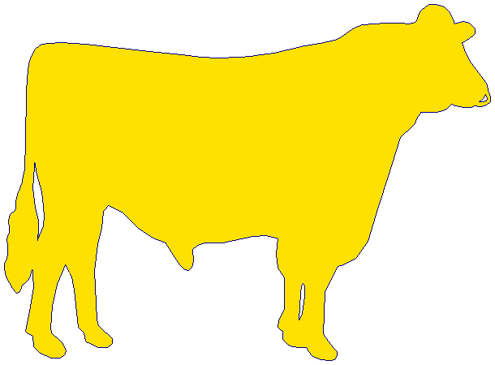
Holstein calving ease (%)
Daughter
0.18%/yr
Service-sire
phenotypic base = 7.9%
Service
sire
Daughter
phenotypic base = 7.5%
0.01%/yr

Slide 16
Genetic-economic indices (2010)
Trait | Relative value (%)
 | Net merit | Cheese merit | Fluid merit
Milk (lb) | 0 | –15 | 19
Fat (lb) | 19 | 13 | 20
Protein (lb) | 16 | 25 | 0
Productive life (PL, mo) | 22 | 15 | 22
Somatic cell score (SCS, log₂) | –10 | –9 | –5
Udder composite (UC) | 7 | 5 | 7
Feet/legs composite (FLC) | 4 | 3 | 4
Body size composite (BSC) | –6 | –4 | –6
Daughter pregnancy rate (DPR, %) | 11 | 8 | 12
Calving ability (CA$, $) | 5 | 3 | 5

Slide 17
Index changes
Trait | Relative emphasis on traits in index (%)
 | PD$ 1971 | MFP$ 1976 | CY$ 1984 | NM$ 1994 | NM$ 2000 | NM$ 2003 | NM$ 2006 | NM$ 2010
Milk | 52 | 27 | –2 | 6 | 5 | 0 | 0 | 0
Fat | 48 | 46 | 45 | 25 | 21 | 22 | 23 | 19
Protein | … | 27 | 53 | 43 | 36 | 33 | 23 | 16
PL | … | … | … | 20 | 14 | 11 | 17 | 22
SCS | … | … | … | –6 | –9 | –9 | –9 | –10
UDC | … | … | … | … | 7 | 7 | 6 | 7
FLC | … | … | … | … | 4 | 4 | 3 | 4
BDC | … | … | … | … | –4 | –3 | –4 | –6
DPR | … | … | … | … | … | 7 | 9 | 11
SCE | … | … | … | … | … | –2 | … | …
DCE | … | … | … | … | … | –2 | … | …
CA$ | … | … | … | … | … | … | 6 | 5

Slide 18
Traditional evaluation summary
Evaluation procedures have improved
Fitness traits have been added
Effective selection has produced substantial annual genetic improvement
Indices enable selection for overall economic merit
Fertility evaluations prevent continued decline

Slide 19
Genomic evaluation system
Provides timely evaluations of young bulls for purchasing decisions
Increases accuracy of evaluations of bull dams
Assists in selection of service sires, particularly for low-reliability traits
High demand for semen from genomically evaluated 2-year-old bulls

Slide 20
Genomic data flow
Dairy Herd Improvement (DHI) producer
DNA samples
DNA samples
genomic
evaluations
DNA laboratory
DNA samples
AI organization,
breed association
genotypes
genotypes
nominations,
pedigree data
genotype
quality reports
genomic
evaluations
Council on Dairy Cattle Breeding (CDCB)
Notes:
20

Slide 21
Progression of chips
BovineSNP50 BeadChip
(50K)
BovineHD BeadChip
(777K)
Bovine3K BeadChip
(3K)
Jan
Jan
Jul
2008
2009
2010
Apr
Jan
Aug
Sep
Dec
Unofficial 50K evaluations
Official 50K Holstein & Jersey evaluations
Official 50K Brown Swiss evaluations
Unofficial 3K
evaluations
Official 3K
evaluations
Affymetrix BOS 1 Plate Array
(648K)
BovineLD BeadChip
(7K)
GeneSeek Genomic Profiler (GGP) BeadChip (8K)
GGP HD BeadChip
(77K)
Zoetis LD BeadChip
(12K)
GGP v2 BeadChip
(19K)
Jan
Sep
Feb
Dec
May
Sep
2011
2012
2013
Aug
Dec
Mar
Jan
May
Oct
Official 777K evaluations
Official
7K & 648K evaluations
Official 8K evaluations
Official 77K evaluations
Official 19K evaluations
Official 12K evaluations

Slide 22
Evaluation flow
Animal nominated for genomic evaluation by breed association or AI organization
Hair or other DNA source sent to genotyping lab
DNA extracted and placed on chip for 3-day genotyping process
Genotypes sent from genotyping lab to AIPL for accuracy review

Slide 23
Laboratory quality control
Each SNP evaluated for
Call rate
Portion heterozygous
Parent-progeny conflicts
Clustering investigated if SNP exceeds limits
Number of failing SNPs indicates genotype quality
Target of <10 SNPs in each category

Slide 24
Evaluation flow (continued)
Genotype calls modified as necessary
Genotypes loaded into database
Nominators receive reports of parentage and other conflicts
Pedigree or animal assignments corrected
Genotypes extracted and imputed to 45K
SNP effects estimated

Slide 25
Imputation
Based on splitting genotype into individual chromosomes (maternal and paternal contributions)
Missing SNPs assigned by tracking inheritance from ancestors and descendants
Imputed dams increase predictor population
Genotypes from all chips merged by imputing SNPs not present

Slide 26
findhap
Developed by Dr. Paul VanRaden, ARS, USDA
Divides chromosomes into segments
Allows for successively shorter segments (usually 3 runs)
Long segments lock in identical by descent
Shorter segments fill in missing SNPs
Separates genotype into maternal and paternal contribution, haplotypes (phasing)
Builds haplotype library sequenced by frequency
Notes:
26

Slide 27
Evaluation flow (continued)
Final evaluations calculated
Evaluations released to dairy industry
Download from CDCB FTP site with separate files for each nominator
Monthly release for new animals
All genomic evaluations updated 3 times each year with traditional evaluations

Slide 28
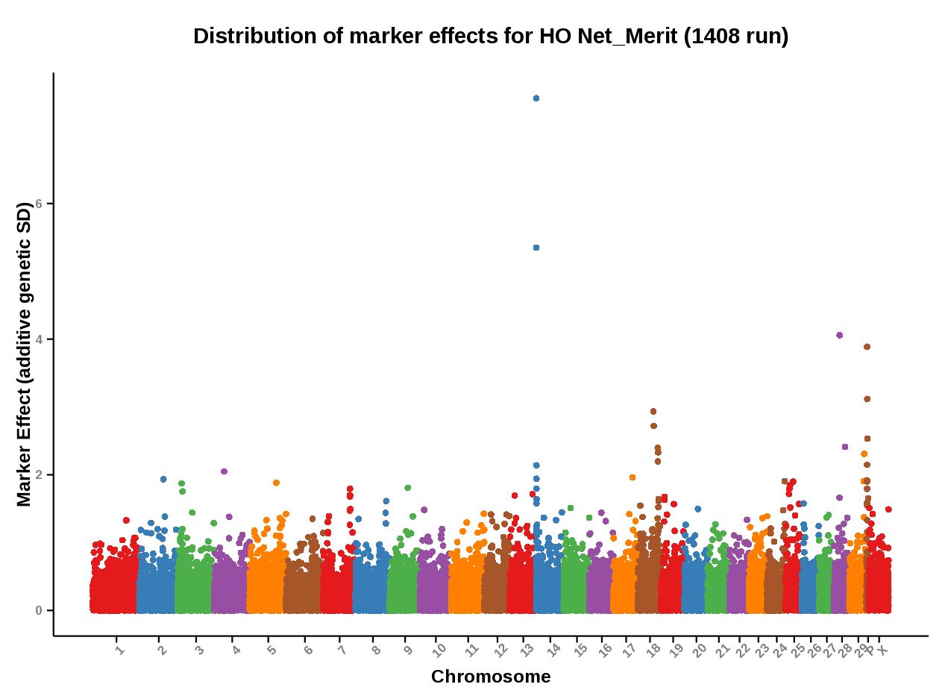
Genomic evaluation results
Source: https://www.cdcb.us/Report_Data/Marker_Effects/marker_effects.cfm?Breed=HO&Trait=Net_Merit

Slide 29
Information sources for evaluations
Traditional evaluations of genotyped bulls and cows used to estimate SNP effects
Combined final evaluation
Sum of SNP effects for an animal’s alleles
Polygenetic effect
Traditional evaluation
Pedigree data used and validated by genotypes

Slide 30
Genotypes received since July 2013
Breed | Female | Male | All animals | % female
Ayrshire | 1,359 | 229 | 1,588 | 86
Brown Swiss* | 892 | 6,253 | 7,145 | 12
Holstein | 172,956 | 31,657 | 204,613 | 85
Jersey** | 26,434 | 4,804 | 31,238 | 85
All | 201,641 | 42,943 | 244,584 | 82
*Includes >5,000 bulls added from Interbull in June 2014
**Includes 1,068 Danish bulls added in November 2013

Slide 31
Genotypes evaluated
2009
2010
2011
2012
2013

Slide 32
Growth in bull predictor population
Breed | May 2014 | 12-mo gain
Ayrshire | 678 | 30
Brown Swiss | 5,862 | 366
Holstein | 25,276 | 2,361
Jersey | 4,262 | 1,391

Slide 33
Reliabilities for young Holsteins*
9000
50K genotypes
8000
3K genotypes
7000
6000
5000
Number of animals
4000
3000
2000
1000
0
40
45
50
55
60
65
70
75
80
Reliability for PTA protein (%)
*Animals with no traditional PTA in April 2011

Slide 34
Holstein prediction accuracy
Trait | Bias* | Reliability (%) | Reliability gain (% points)
Final score | 0.1 | 58.8 | 22.7
Stature | −0.2 | 68.5 | 30.6
Dairy form | −0.2 | 71.8 | 34.5
Rump angle | 0.0 | 70.2 | 34.7
Rump width | −0.2 | 65.0 | 28.1
Feed and legs | 0.2 | 44.0 | 12.8
Fore udder attachment | −0.2 | 70.4 | 33.1
Rear udder height | −0.1 | 59.4 | 22.2
Udder depth | −0.3 | 75.3 | 37.7
Udder cleft | −0.2 | 62.1 | 25.1
Front teat placement | −0.2 | 69.9 | 32.6
Teat length | −0.1 | 66.7 | 29.4
*2013 deregressed value – 2009 genomic evaluation

Slide 35
Parent ages of marketed Holstein bulls

Slide 36
Marketed Holstein bulls
Year entered AI | Traditional progeny- tested | Young genotyped | All bulls
2008 | 1,798 | 0 | 1,798
2009 | 1,909 | 337 | 2,246
2010 | 1,827 | 376 | 2,203
2011 | 1,441 | 467 | 1,908
2012 | 1,376 | 555 | 1,931

Slide 37
Genetic merit of marketed Holstein bulls
Average gain:
$85.60/year
Average gain:
$52.00/year
Average gain:
$19.77/year

Slide 38
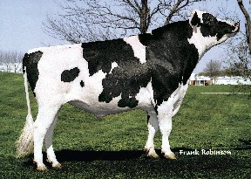
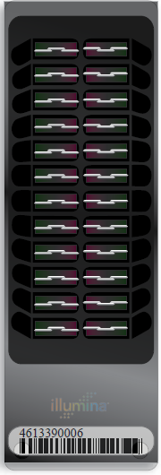
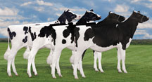
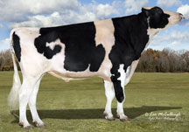
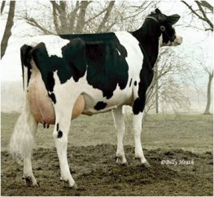
Genomic prediction of progeny test
0
1
2
3
4
5
Select parents, transfer embryos to recipients
Calves born from DNA-selected parents
Bull receives progeny test
Calves born and DNA tested
Reduce generation interval from 5 to 2 years

Slide 39
Genetic choices
Before genomics:
Proven bulls with daughter records (PTA)
Young bulls with parent average (PA)
After genomics:
Young animals with DNA test (GPTA)
Reliability of GPTA ~70% compared to PA ~35% and PTA ~85% for Holstein NM$

Slide 40
Young bulls: 2013 NM$ vs. 2010 PA

Slide 41
Proven bulls: 2013 vs. 2010 NM$

Slide 42
Young bulls: 2013 vs. 2010 NM$

Slide 43
% genotyped mates of top young bulls
Garrold
Numero Uno
Supersire
Percentage of mates genotyped
Mogul
S S I Robust Topaz
Net Merit (Aug 2013)

Slide 44
Why genomics works for dairy cattle
Extensive historical data available
Well-developed genetic evaluation program
Widespread use of AI sires
Progeny-test programs
High-value animals worth the cost of genotyping
Long generation interval that can be reduced substantially by genomics
Notes:
44

Slide 45
Key issues for the dairy industry
Inbreeding and genetic diversity
(including across breeds)
Sequencing, new genes, and mutations
Novel traits, resource populations
(feed efficiency, health, milk properties)

Slide 46
Application to more traits
Animal’s genotype good for all traits
Traditional evaluations required for accurate estimates of SNP effects
Traditional evaluations not currently available for heat tolerance or feed efficiency
Research populations could provide data for traits that are expensive to measure
Will resulting evaluations work in target population?

Slide 47
Parentage validation and discovery
Parent-progeny conflicts detected
Animal checked against all other genotypes
Reported to breeds and requesters
Correct sire usually detected
Maternal grandsire (MGS) checking
SNP at a time checking
Haplotype checking more accurate
Breeds moving to accept SNPs
in place of microsatellites
Notes:
47

Slide 48
Haplotypes affecting fertility
Rapid discovery of new recessive defects
Large numbers of genotyped animals
Affordable DNA sequencing
Determination of haplotype location
Significant number of homozygous animals expected, but none observed
Narrow suspect region with fine mapping
Use sequence data to find causative mutation

Slide 49
Haplotypes affecting fertility
Name | Chromo- some | Location (Mbp) | Carrier frequency (%) | Earliest known ancestor
HH1 | 5 | 63.2* | 4.5 | Pawnee Farm Arlinda Chief
HH2 | 1 | 94.9–96.6 | 4.6 | Willowholme Mark Anthony
HH3 | 8 | 95.4* | 4.7 | Glendell Arlinda Chief, Gray View Skyliner
HH4 | 1 | 1.3* | 0.7 | Besne Buck
HH5 | 9 | 92.4–93.9 | 4.4 | Thornlea Texal Supreme
JH1 | 15 | 15.7* | 23.4 | Observer Chocolate Soldier
BH1 | 7 | 42.8–47.0 | 14.0 | West Lawn Stretch Improver
BH2 | 19 | 10.6–11.7 | 15.4 | Rancho Rustic My Design
AH1 | 17 | 65.9–66.2 | 23.6 | Selwood Betty’s Commander
*Causative mutation known

Slide 50
Haplotypes to track known recessives
Recessive | Haplotype | Chromo-some | Tested animals (no.) | Concord- ance (%) | New carriers (no.)
BLAD | HHB | 1* | 11,782 | 99.9 | 314
CVM | HHC | 3* | 13,226 | — | 2,716
DUMPS | HHD | 1* | 3,242 | 100.0 | 3
Mule foot | HHM | 15* | 87 | 97.7 | 120
Horned | HHP | 1 | 345 | — | 2,050
Red coat color | HHR | 18* | 4,137 | — | 5,927
SDM | BHD | 11* | 108 | 94.4 | 108
SMA | BHM | 24* | 568 | 98.1 | 111
Weaver | BHW | 4 | 163 | 96.3 | 32
*Causative mutation known

Slide 51

International dairy breeding
Genotype alliances
North America (US, Canada, UK, Italy)
Ireland, New Zealand
Netherlands, Australia
Eurogenomics (Denmark/Sweden/Finland, France, Germany, Netherlands/Belgium, Spain, Poland)
Interbull genomic multitrait across-country evaluation (GMACE)

Slide 52
Impact on breeders
Haplotype and gene tests in selection and mating programs
Trend towards a small number of elite breeders that are investing heavily in genomics
About 30% of young males genotyped
directly by breeders since April 2013
Prices for top genomic heifers can be
very high (e.g., $265,000 )

Slide 53
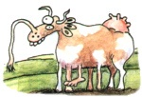
Impact on dairy producers
General
Reduced generation interval
Increased rate of genetic gain
More inbreeding/homozygosity?

Slide 54
Impact on dairy producers (continued)
Sires
Higher average genetic merit of available bulls
More rapid increase in genetic merit for all traits
Larger choice of bulls in terms of traits and semen price
Greater use of young bulls

Slide 55
Conclusions
Genomic evaluation has dramatically changed dairy cattle breeding
Rate of gain is increasing primarily because of a large reduction in generation interval
Genomic research is ongoing
Detect causative genetic variants
Find more haplotypes affecting fertility
Improve accuracy through more SNPs, more predictor animals, and more traits

Slide 56
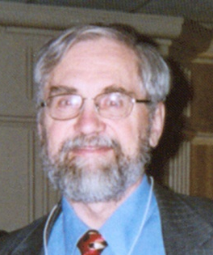
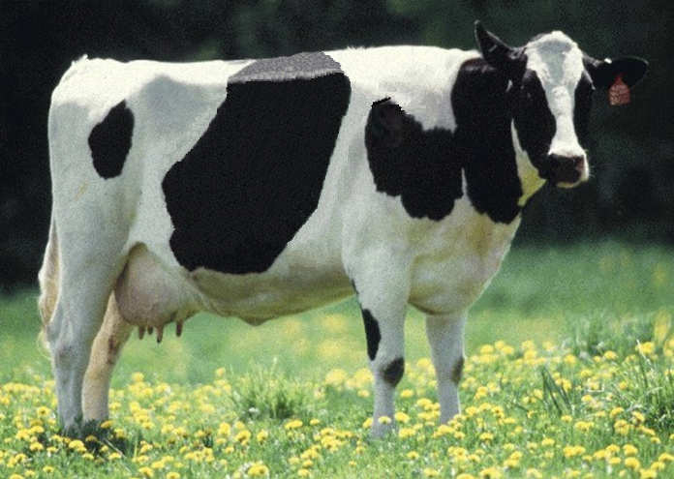
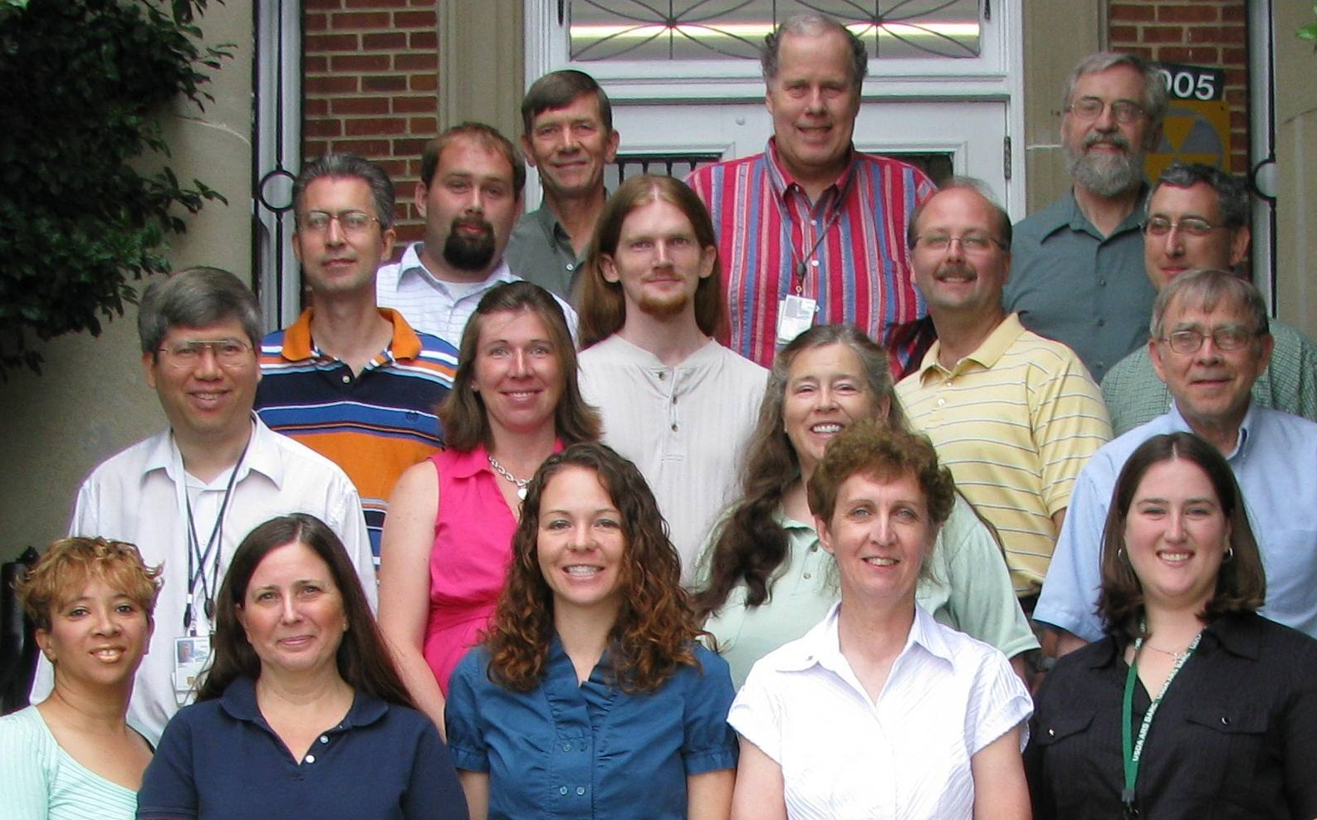
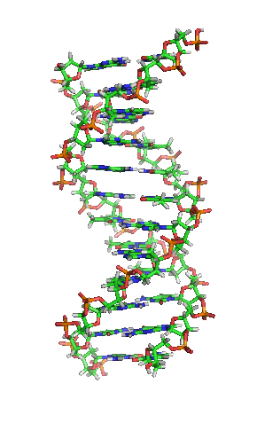
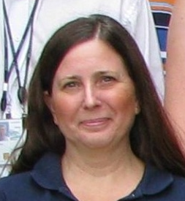
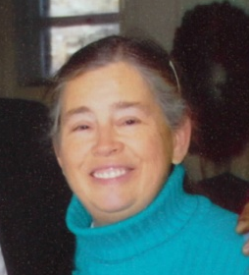




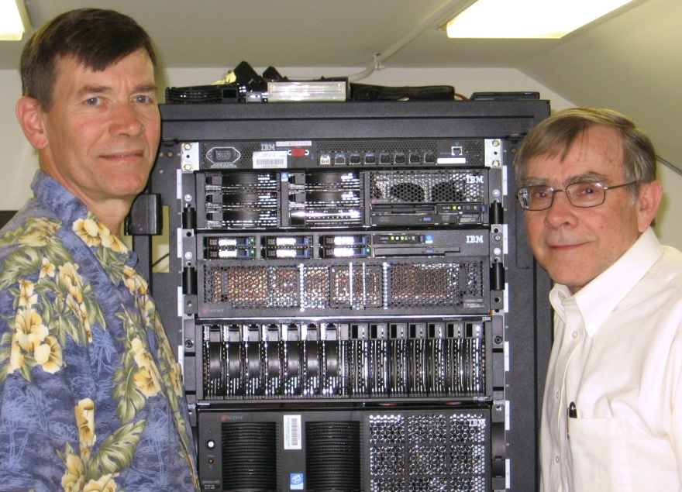
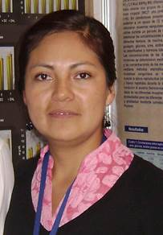

U.S. genomic evaluation team

Slide 57

Questions?

