Slide 1
Genetic improvement programs for US dairy cattle

Slide 2
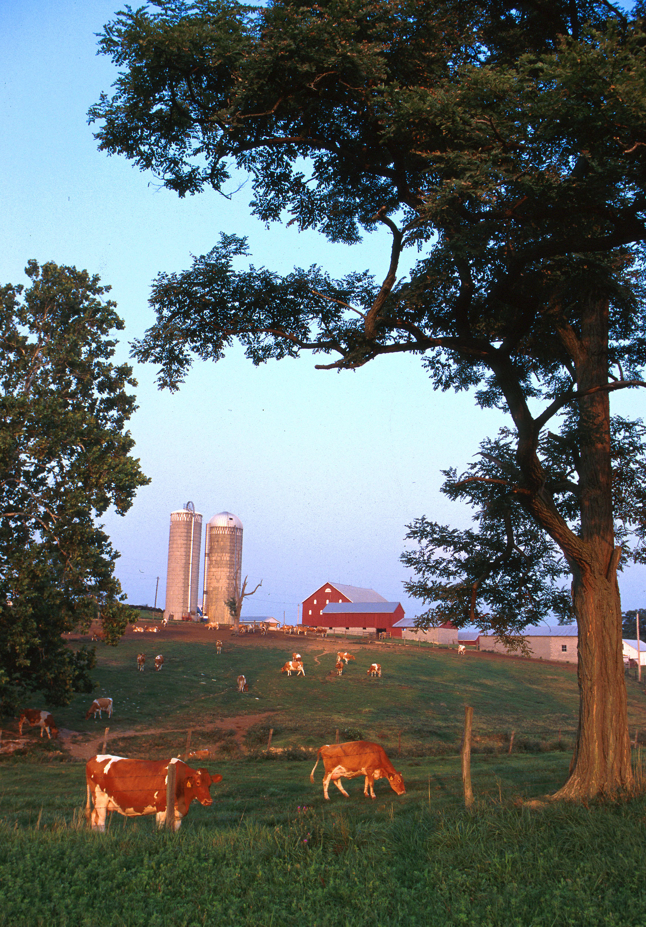
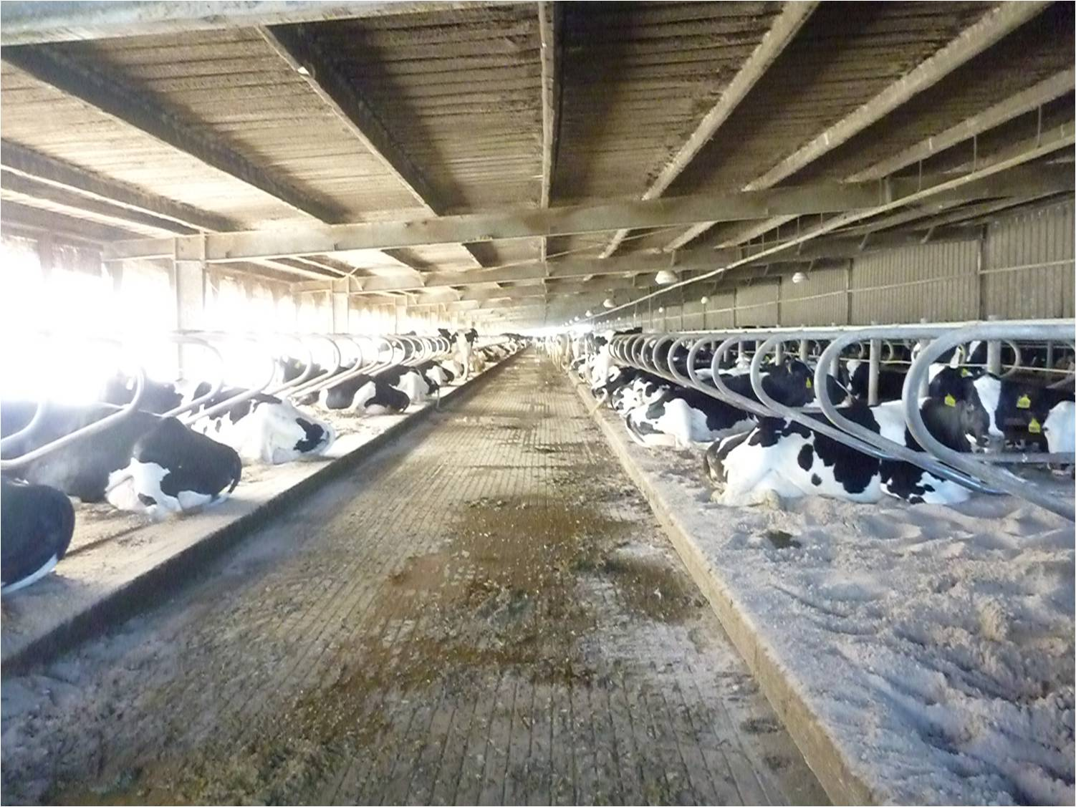
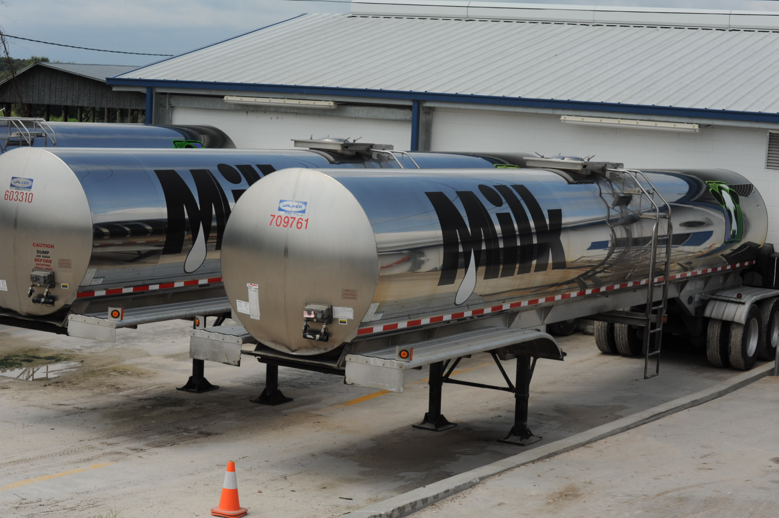
Typical US dairies
Small dairy farm in western Maryland. Photo courtesy of ARS.
Top: Large freestall barn in the state of Florida.
Bottom: 7,000 G (~26,500 l) milk tankers.
Photo courtesy of North Florida Holsteins.

Slide 3
U.S. dairy population and milk yield

Slide 4
U.S. DHI dairy statistics (2011)
9.1 million U.S. cows
~75% bred AI
47% milk recorded through Dairy Herd Information (DHI)
4.4 million cows
86% Holstein
8% crossbred
5% Jersey
<1% Ayrshire, Brown Swiss, Guernsey, Milking Shorthorn, Red & White
20,000 herds
220 cows/herd
10,300 kg/cow

Slide 5
Genetic evaluation advances
Year | Advance | Gain, %
1862 | USDA established
1895 | USDA begins collecting dairy records
1926 | Daughter-dam comparison | 100
1962 | Herdmate comparison | 50
1973 | Records in progress | 10
1974 | Modified contemporary comparison | 5
1977 | Protein evaluated | 4
1989 | Animal model | 4
1994 | Net merit, productive life, and somatic cell score | 50
2008 | Genomic selection | >50

Slide 6
Animal model
1989 to present
Introduced by Wiggans and VanRaden
Advantages
Information from all relatives
Adjustment for genetic merit of mates
Uniform procedures for males and females
Best prediction (BLUP)
Crossbreds included (2007)
Genomic information added (2008)

Slide 7
Traits evaluated
Year | Trait | Year | Trait
1926 | Milk & fat yields | 2000 | Calving ease¹
1978 | Conformation (type) | 2003 | Daughter pregnancy rate
1978 | Protein yield | 2006 | Stillbirth rate
1994 | Productive life | 2006 | Bull conception rate²
1994 | Somatic cell score (mastitis) | 2009 | Cow and heifer conception rates
¹Sire calving ease evaluated by Iowa State University (1978–99)
²Estimated relative conception rate evaluated by DRMS in Raleigh, NC (1986–2005)

Slide 8
Evaluation methods for traits
Animal model (linear)
Yield (milk, fat, protein)
Type (AY, BS, GU, JE)
Productive life
Somatic cell score
Daughter pregnancy rate
Heifer conception rate
Cow conception rate
Sire–maternal grandsire model (threshold)
Service sire calving ease
Daughter calving ease
Service sire stillbirth rate
Daughter stillbirth rate
Heritability
25 – 40%
7 – 54%
8.5%
12%
4%
1%
1.6%
8.6%
3.6%
3.0%
6.5%

Slide 9
Conformation (type) traits
Stature
Strength
Body depth
Dairy form
Rump angle
Thurl width
Rear legs (side)
Rear legs (rear)
Foot angle
Feet and legs score
Fore udder attachment
Rear udder height
Rear udder width
Udder cleft
Udder depth
Front teat placement
Rear teat placement
Teat length

Slide 10
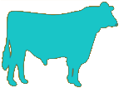
Holstein milk (kg)
Phenotypic base = 11,828 kg
Sires
79 kg/yr
Cows

Slide 11

Holstein productive life (mo)
Phenotypic base = 27.2 mo
0.2 mo/yr
Sires
Cows

Slide 12
Holstein somatic cell score (log₂)
Sires
Phenotypic base = 3.0
Cows
0.02/yr

Slide 13
Holstein daughter pregnancy rate (%)
Cows
Sires
0.1%/yr
Phenotypic base = 22.6%

Slide 14
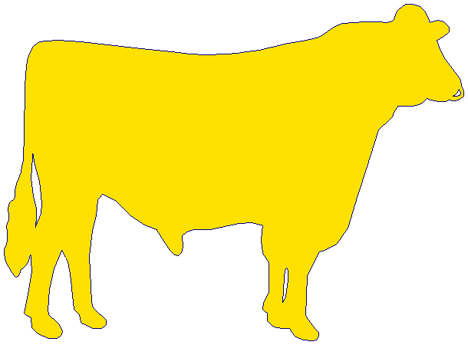
Holstein calving ease (%)
Daughter
0.18%/yr
Service-sire
phenotypic base = 7.9%
Service
sire
Daughter
phenotypic base = 7.5%
0.01%/yr

Slide 15
Index changes over time
Trait | Relative emphasis on traits in index (%)
 | PD$ 1971 | MFP$ 1976 | CY$ 1984 | NM$ 1994 | NM$ 2000 | NM$ 2003 | NM$ 2006 | NM$ 2010 | NM$ 2014
Milk | 52 | 27 | –2 | 6 | 5 | 0 | 0 | 0 | -1
Fat | 48 | 46 | 45 | 25 | 21 | 22 | 23 | 19 | 22
Protein | … | 27 | 53 | 43 | 36 | 33 | 23 | 16 | 20
PL | … | … | … | 20 | 14 | 11 | 17 | 22 | 19
SCS | … | … | … | –6 | –9 | –9 | –9 | –10 | -7
UDC | … | … | … | … | 7 | 7 | 6 | 7 | 8
FLC | … | … | … | … | 4 | 4 | 3 | 4 | 3
BDC | … | … | … | … | –4 | –3 | –4 | –6 | -5
DPR | … | … | … | … | … | 7 | 9 | 11 | 7
HCR | … | … | … | … | … | … | … | … | 2
CCR | … | … | … | … | … | … | … | … | 1
SCE | … | … | … | … | … | –2 | … | … | …
DCE | … | … | … | … | … | –2 | … | … | …
CA$ | … | … | … | … | … | … | 6 | 5 | 5
Source: AGIL, ARS, USDA (http://aipl.arsusda.gov/reference/nmcalc-2014.htm).

Slide 16
Genetic-economic indices (2014)
Trait | Relative value (%)
 | Net merit | Cheese merit | Fluid merit | Grazing merit
Milk (lb) | -1 | -9 | 23 | -1
Fat (lb) | 22 | 19 | 23 | 20
Protein (lb) | 20 | 24 | 0 | 18
Productive life (PL, mo) | 19 | 16 | 20 | 10
Somatic cell score (SCS, log₂) | -7 | -7 | -3 | -6
Udder composite (UC) | 8 | 6 | 8 | 8
Feet/legs composite (FLC) | 3 | 2 | 3 | 3
Body size composite (BSC) | -5 | -4 | -5 | -4
Daughter pregnancy rate (DPR, %) | 7 | 6 | 7 | 19
Heifer conception rate (HCR, %) | 2 | 1 | 2 | 3
Cow conception rate (CCR, %) | 1 | 1 | 2 | 5
Calving ability (CA$, $) | 5 | 4 | 5 | 5
Source: AGIL, ARS, USDA (http://aipl.arsusda.gov/reference/nmcalc-2014.htm).

Slide 17
Traditional evaluation summary
Evaluation procedures have improved
Fitness traits have been added
Effective selection has produced substantial annual genetic improvement
Indices enable selection for overall economic merit
Fertility evaluations prevent continued decline

Slide 18
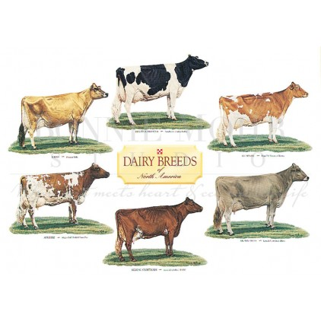
Traditional dairy breeds in the US
The six traditional US dairy breeds. Photo courtesy of Bonnie Mohr.

Slide 19
Genomic evaluation system
Provides timely evaluations of young bulls for purchasing decisions
Increases accuracy of evaluations of bull dams
Assists in selection of service sires, particularly for low-reliability traits
High demand for semen from genomically evaluated 2-year-old bulls

Slide 20
Genomic data flow
Dairy Herd Improvement (DHI) producer
DNA samples
DNA samples
genomic
evaluations
DNA laboratory
DNA samples
AI organization,
breed association
genotypes
genotypes
nominations,
pedigree data
genotype
quality reports
genomic
evaluations
Council on Dairy Cattle Breeding (CDCB)
Notes:
20

Slide 21
Collaboration with industry
Council on Dairy Cattle Breeding (CDCB) responsible for receiving data and for computing and delivering US genetic evaluations for dairy cattle
AIP responsible for research and development to improve the evaluation system
CDCB (Bowie) and AIP (Beltsville) are located near one another
Dr. João Dürr is CDCB’s CEO

Slide 22
Council on Dairy Cattle Breeding
CDCB
PDCA
NAAB
DRPC
DHIA
Purebred Dairy
Cattle Association
National Association of Animal Breeders
Dairy Records
Processing Centers
Dairy Herd
Information Association
3 board members from each organization
Total of 12 voting members
2 nonvoting industry members

Slide 23
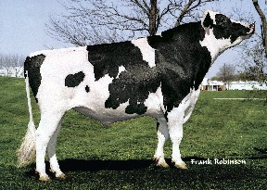
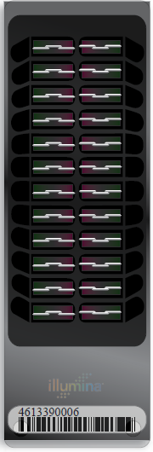
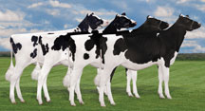
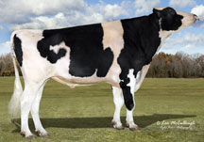
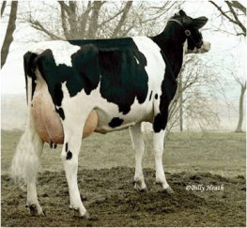
Genomic prediction of progeny test
0
1
2
3
4
5
Select parents, transfer embryos to recipients
Calves born from DNA-selected parents
Bull receives progeny test
Calves born and DNA tested
Reduce generation interval from 5 to 2 years

Slide 24
Evaluation flow
Animal nominated for genomic evaluation by breed association or AI organization
Hair or other DNA source sent to genotyping lab
DNA extracted and placed on chip for 3-day genotyping process
Genotypes sent from genotyping lab to AIPL for accuracy review

Slide 25
Laboratory quality control
Each SNP evaluated for
Call rate
Portion heterozygous
Parent-progeny conflicts
Clustering investigated if SNP exceeds limits
Number of failing SNPs indicates genotype quality
Target of <10 SNPs in each category

Slide 26
Evaluation flow (continued)
Genotype calls modified as necessary
Genotypes loaded into database
Nominators receive reports of parentage and other conflicts
Pedigree or animal assignments corrected
Genotypes extracted and imputed to 45K
SNP effects estimated

Slide 27
Imputation
Based on splitting genotype into individual chromosomes (maternal and paternal contributions)
Missing SNPs assigned by tracking inheritance from ancestors and descendants
Imputed dams increase predictor population
Genotypes from all chips merged by imputing SNPs not present

Slide 28
Evaluation flow (continued)
Final evaluations calculated
Evaluations released to dairy industry
Download from CDCB FTP site with separate files for each nominator
Monthly release for new animals
All genomic evaluations updated 3 times each year with traditional evaluations
Weekly evaluations are now available

Slide 29
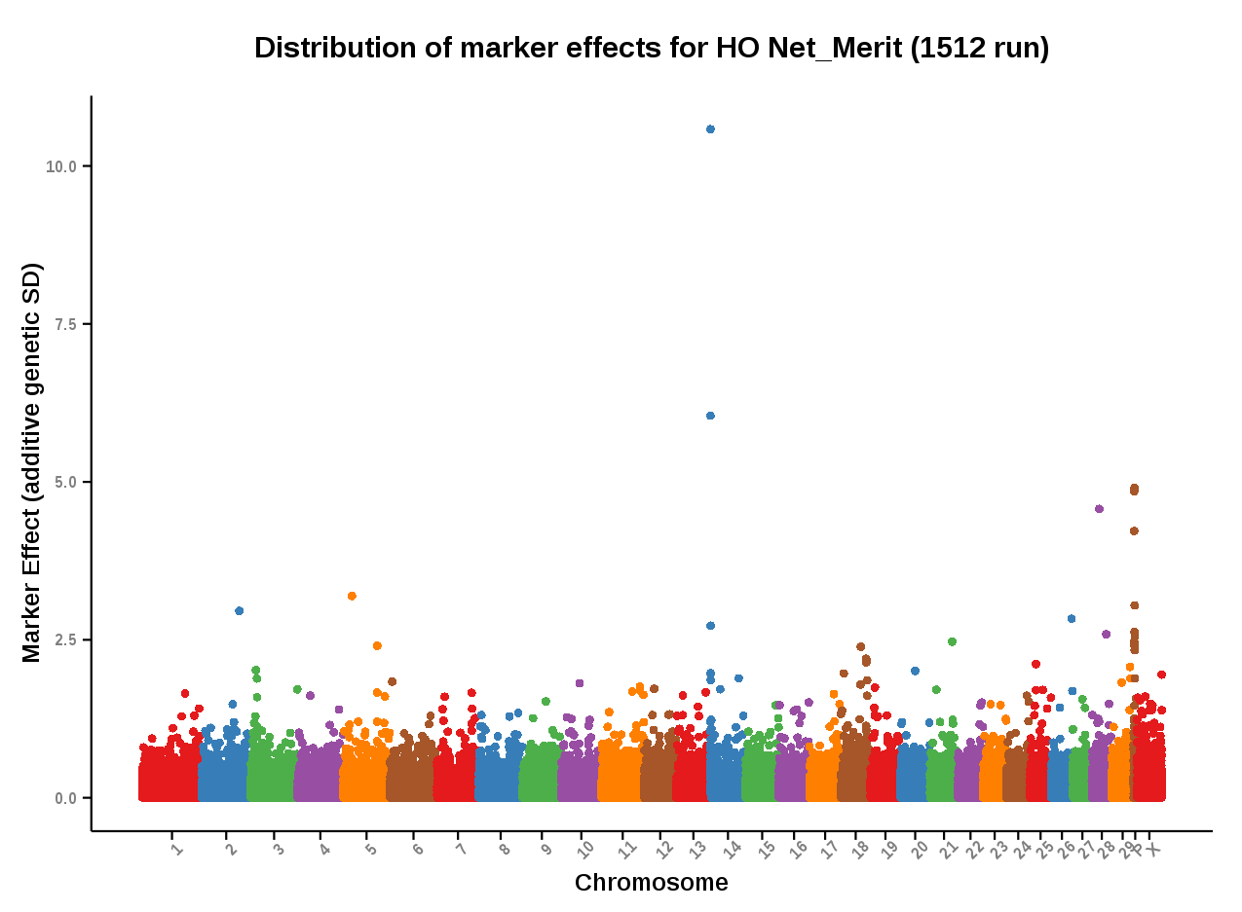
Genomic evaluation results
Source: https://www.cdcb.us/Report_Data/Marker_Effects/marker_effects.cfm?Breed=HO&Trait=Net_Merit

Slide 30
Information sources for evaluations
Traditional evaluations of genotyped bulls and cows used to estimate SNP effects
Combined final evaluation
Sum of SNP effects for an animal’s alleles
Polygenetic effect
Traditional evaluation
Pedigree data used and validated by genotypes

Slide 31
Genotypes are abundant

Slide 32
SNP used for genomic evaluations
61,013 SNP used after culling on
MAF
Parent-progeny conflicts
Percentage heterozygous (departure from HWE)
SNP for HH1, BLAD, DUMPS, CVM, polled, red, and mulefoot included
JH1 included for Jerseys
Some SNP eliminated because incorrect location  haplotype non-inheritance

Slide 33
SNP count for different chips
Chip | SNP (no.) |  | Chip | SNP (no.)
50K | 54,001 |  | ZMD | 56,955
50K v2 | 54,609 |  | ELD | 9,072
3K | 2,900 |  | LD2 | 6,912
HD | 777,962 |  | GP3 | 26,151
Affy | 648,875 |  | ZL2 | 17,557
LD | 6,909 |  | ZM2 | 60,914
GGP | 8,762 |  | GH2 | 139,480
GHD | 77,068 |  | G7K | 7,083
GP2 | 19,809 |  | GP4 | 30,112
ZLD | 11,410 |  | ZL4 | 18,815
Source: Council on Dairy Cattle Breeding.

Slide 34
2016 genotypes by breed and sex
Breed | Female | Male | All animals | Female: male
Ayrshire | 3,641 | 1,693 | 5,334 | 68:32
Brown Swiss | 4,278 | 16,757 | 21,035 | 20:80
Guernsey | 1,835 | 656 | 2,491 | 74:26
Holstein | 894,471 | 182,866 | 1,077,377 | 83:17
Jersey | 119,689 | 21,031 | 140,720 | 85:15
Milking Shorthorn | 12 | 14 | 26 | 46:54
Crossbred | 38 | 0 | 38 | 100:00
All | 1,023,964 | 223,017 | 1,246,981
Source: Council on Dairy Cattle Breeding (https://www.cdcb.us/Genotype/cur_freq.html).

Slide 35
Growth in US predictor population
 | Bulls |  | Cows^{1,2}
Breed | Jan. 2016 | 12-mo gain | Jan. 2016 | 12-mo gain
Ayrshire | 752 | 41 | 133 | 59
Brown Swiss | 6,363 | 241 | 1,580 | 429
Holstein | 28,922 | 2,163 | 190,021 | 78,917
Jersey | 4,712 | 264 | 42,717 | 16,247
¹Predictor cows must have domestic records.
²Counts include 3k genotypes, which are not included in the predictor population.
Source: Council on Dairy Cattle Breeding (https://www.cdcb.us/Genotype/cur_density.html).

Slide 36
Holstein prediction accuracy
Trait | Bias* | Reliability (%) | Reliability gain (% points)
Milk (kg) | −80.3 | 69.2 | 30.3
Fat (kg) | −1.4 | 68.4 | 29.5
Protein (kg) | −0.9 | 60.9 | 22.6
Fat (%) | 0.0 | 93.7 | 54.8
Protein (%) | 0.0 | 86.3 | 48.0
Productive life (mo) | −0.7 | 73.7 | 41.6
Somatic cell score | 0.0 | 64.9 | 29.3
Daughter pregnancy rate (%) | 0.2 | 53.5 | 20.9
Sire calving ease | 0.6 | 45.8 | 19.6
Daughter calving ease | −1.8 | 44.2 | 22.4
Sire stillbirth rate | 0.2 | 28.2 | 5.9
Daughter stillbirth rate | 0.1 | 37.6 | 17.9
*2013 deregressed value – 2009 genomic evaluation

Slide 37
Holstein prediction accuracy
Trait | Bias* | Reliability (%) | Reliability gain (% points)
Final score | 0.1 | 58.8 | 22.7
Stature | −0.2 | 68.5 | 30.6
Dairy form | −0.2 | 71.8 | 34.5
Rump angle | 0.0 | 70.2 | 34.7
Rump width | −0.2 | 65.0 | 28.1
Feed and legs | 0.2 | 44.0 | 12.8
Fore udder attachment | −0.2 | 70.4 | 33.1
Rear udder height | −0.1 | 59.4 | 22.2
Udder depth | −0.3 | 75.3 | 37.7
Udder cleft | −0.2 | 62.1 | 25.1
Front teat placement | −0.2 | 69.9 | 32.6
Teat length | −0.1 | 66.7 | 29.4
*2013 deregressed value – 2009 genomic evaluation

Slide 38
Parent ages of marketed Holstein bulls

Slide 39
Active AI bulls that were genomic bulls

Slide 40
Genetic merit of marketed Holstein bulls
Average gain:
$85.60/year
Average gain:
$52.00/year
Average gain:
$19.77/year

Slide 41
Genetic choices
Before genomics:
Proven bulls with daughter records (PTA)
Young bulls with parent average (PA)
After genomics:
Young animals with DNA test (GPTA)
Reliability of GPTA ~70% compared to PA ~35% and PTA ~85% for Holstein NM$

Slide 42
Stability of genomic evaluations
642 Holstein bulls
Dec. 2012 NM$ compared with Dec. 2014 NM$
First traditional evaluation in Aug. 2014
≥50 daughters by Dec. 2014
Top 100 bulls in 2012
Average rank change of 9.6
Maximum drop of 119
Maximum rise of 56
All 642 bulls
Correlation of 0.94 between 2012 and 2014
Regression of 0.92
Notes:
42

Slide 43
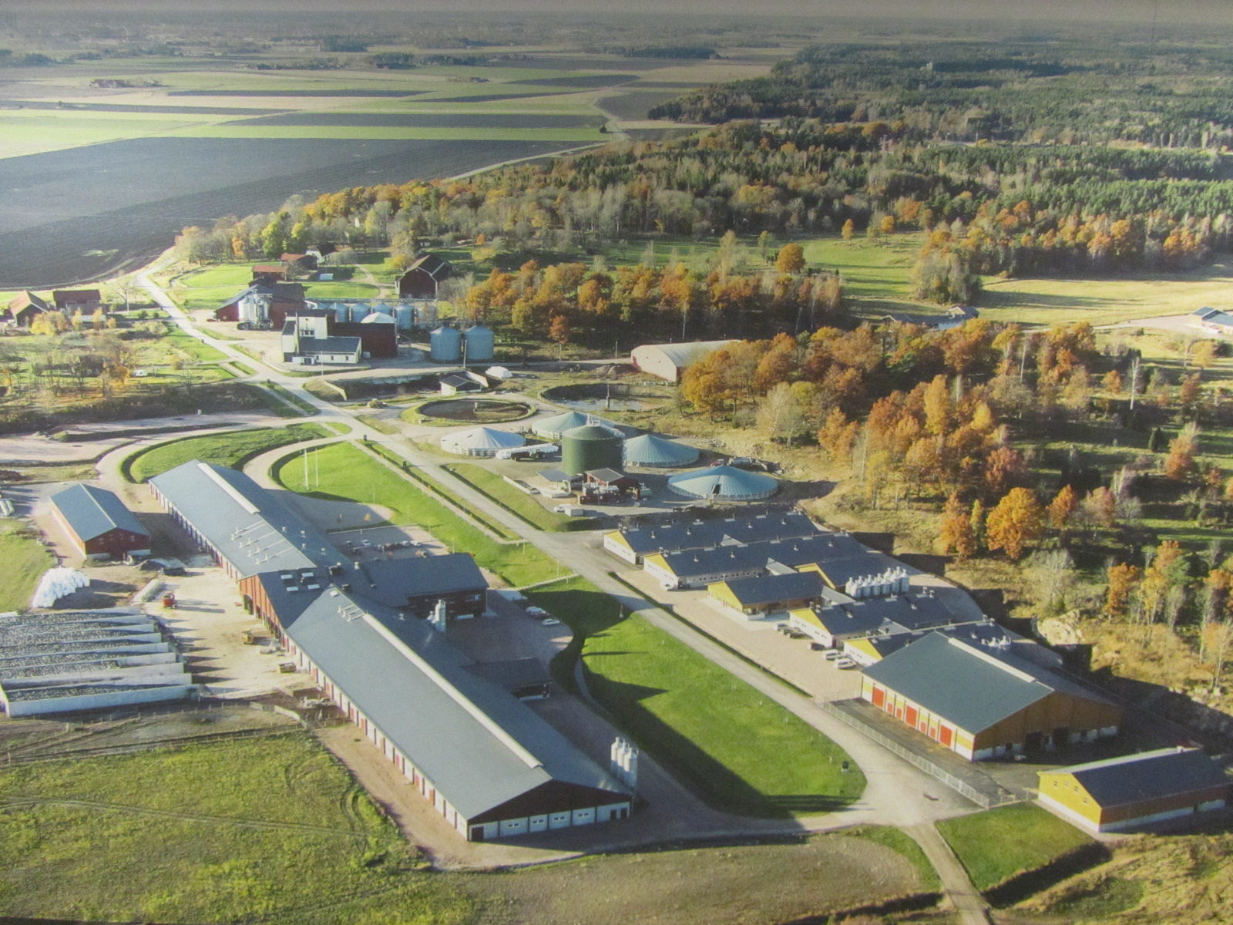
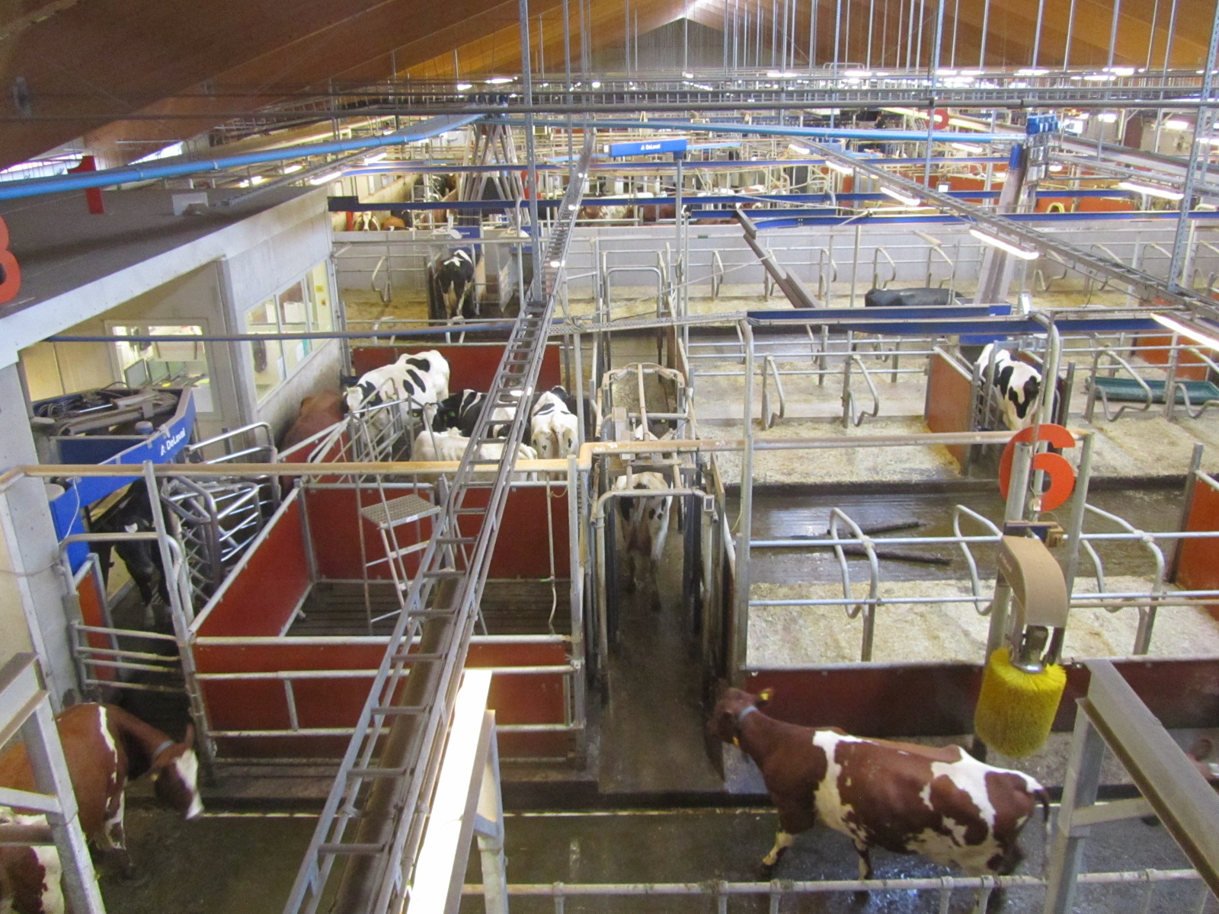
Genomics is not the only innovation
The Swedish Agricultural University dairy research center has a state-of-the-art facility equipped with the latest DeLaval technology.
Photos courtesy of Albert de Vries.

Slide 44
Application to more traits
Animal’s genotype good for all traits
Traditional evaluations required for accurate estimates of SNP effects
Traditional evaluations not currently available for heat tolerance or feed efficiency
Research populations could provide data for traits that are expensive to measure
Will resulting evaluations work in target population?

Slide 45
Some new traits studied recently
Claw health (Van der Linde et al., 2010)
Dairy cattle health (Parker Gaddis et al., 2013)
Embryonic development (Cochran et al., 2013)
Immune response (Thompson-Crispi et al., 2013)
Methane production (de Haas et al., 2011)
Milk fatty acid composition (Soyeurt et al., 2011)
Persistency of lactation (Cole et al., 2009)
Rectal temperature (Dikmen et al., 2013)
Residual feed intake (Connor et al., 2013)

Slide 46
Parentage validation and discovery
Parent-progeny conflicts detected
Animal checked against all other genotypes
Reported to breeds and requesters
Correct sire usually detected
Maternal grandsire (MGS) checking
SNP at a time checking
Haplotype checking more accurate
Breeds moving to accept SNPs
in place of microsatellites
Notes:
46

Slide 47
Haplotypes affecting fertility
Rapid discovery of new recessive defects
Large numbers of genotyped animals
Affordable DNA sequencing
Determination of haplotype location
Significant number of homozygous animals expected, but none observed
Narrow suspect region with fine mapping
Use sequence data to find causative mutation

Slide 48
Haplotypes affecting fertility
Name | BTA chromo- some | Location* (Mbp) | Carrier frequency (%) | Earliest known ancestor
HH1 | 5 | 63.2* | 3.8 | Pawnee Farm Arlinda Chief
HH2 | 1 | 94.9 – 96.6 | 3.3 | Willowholme Mark Anthony
HH3 | 8 | 95.4* | 5.9 | Glendell Arlinda Chief, Gray View Skyliner
HH4 | 1 | 1.3* | 0.7 | Besne Buck
HH5 | 9 | 92.4 – 93.9 | 4.4 | Thornlea Texal Supreme
JH1 | 15 | 15.7* | 24.2 | Observer Chocolate Soldier
JH2 | 26 | 8.8 – 9.4 | 2.6 | Liberators Basilius
BH1 | 7 | 42.8 – 47.0 | 13.3 | West Lawn Stretch Improver
BH2 | 19 | 10.6 – 11.7 | 15.6 | Rancho Rustic My Design
AH1 | 17 | 65.9* | 26.0 | Selwood Betty’s Commander
*Causative mutation known

Slide 49
Haplotypes tracking known recessives
Recessive | Haplo-type | BTA chromo- some | Tested animals (no.) | Concord- ance (%) | New carriers (no.)
Brachyspina | HH0 | 21 | ? | ? | ?
BLAD | HHB | 1* | 11,782 | 99.9 | 314
CVM | HHC | 3* | 13,226 | — | 2,716
DUMPS | HHD | 1* | 3,242 | 100.0 | 3
Mule foot | HHM | 15* | 87 | 97.7 | 120
Polled | HHP | 1 | 345 | — | 2,050
Red coat color | HHR | 18* | 4,137 | — | 5,927
SDM | BHD | 11* | 108 | 94.4 | 108
SMA | BHM | 24* | 568 | 98.1 | 111
Weaver | BHW | 4 | 163 | 96.3 | 32
*Causative mutation known

Slide 50
Impact on breeders
Haplotype and gene tests in selection and mating programs
Trend towards a small number of elite breeders that are investing heavily in genomics
About 30% of young males genotyped
directly by breeders since April 2013
Prices for top genomic heifers can be
very high (e.g., $265,000 or R$1,060,000)

Slide 51
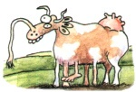
Impact on dairy producers
General
Reduced generation interval
Increased rate of genetic gain
More inbreeding/homozygosity?

Slide 52
Impact on dairy producers (continued)
Sires
Higher average genetic merit of available bulls
More rapid increase in genetic merit for all traits
Larger choice of bulls in terms of traits and semen price
Greater use of young bulls

Slide 53
Why genomics works for dairy cattle
Extensive historical data available
Well-developed genetic evaluation program
Widespread use of AI sires
Progeny-test programs
High-value animals worth the cost of genotyping
Long generation interval that can be reduced substantially by genomics
Notes:
53

Slide 54
Key issues for the dairy industry
Inbreeding and genetic diversity
(including across breeds)
Sequencing, new genes, and mutations
Novel traits, resource populations
(feed efficiency, health, milk properties)

Slide 55
Conclusions
Genomic evaluation has dramatically changed dairy cattle breeding
Rate of gain is increasing primarily because of a large reduction in generation interval
Genomic research is ongoing
Detect causative genetic variants
Find more haplotypes affecting fertility
Improve accuracy through more SNPs, more predictor animals, and more traits

Slide 56
Acknowledgments
Appropriated project 1265-31000-096-00, "Improving Genetic Predictions in Dairy Animals Using Phenotypic and Genomic Information", ARS, USDA
CNPq “Science Without Borders” project 301025/2014-2
Kristen Gaddis, Dan Null, Paul VanRaden, and George Wiggans
Council on Dairy Cattle Breeding

Slide 57
Disclaimer
Mention of trade names or commercial products in this presentation is solely for the purpose of providing specific information and does not imply recommendation or endorsement by the US Department of Agriculture.

Slide 58

Questions?

