Slide 1
Genomic Selection in Multi-Breed Dairy Cattle Populations
John B. Cole
Animal Genomics and Improvement Laboratory
Agricultural Research Service, USDA
Beltsville, MD 20705-2350

Slide 2
Introduction
Genomic selection rapidly adopted for purebred cattle (Hayes et al., 2009; Wiggans et al., 2011)
Many populations include crossbred animals that contribute to genetic progress (Olson et al., 2012; Harris and Johnson, 2010)
Breeds with small reference populations may benefit from analysis with similar breeds from other countries (e.g., Pryce et al., 2011)

Slide 3
Introduction (cont)
When reference populations are limited, genomic breeding values (GBV) are not accurately estimated
Predictions made in one breed do not perform well in other breeds (Hayes et al., 2009; Olson et al., 2012)
Lund et al. (2014) reviewed genomic selection in multiple breed populations.

Slide 4
Why select for crossbred performance?
It does not require pedigree information on crossbreds
Prediction can continue for several generations without collecting additional phenotypes (Meuwissen et al. 2001)
Rates of inbreeding should be lower under genomic selection (Daetwyler et al., 2007)
Easier to accommodate non-additive gene action in a genomic selection program (Dekkers, 2007)

Slide 5
What is the objective?
Research has focused on several problems:
  Use of information from one breed to improve predictions in one or more other breeds
  Use of data from crossbreds to improve purebred predictions
  Use of data from purebreds to improve crossbred predictions
  Use of genomic information to estimate genomic PTA for both purebred and crossbred animals

Slide 6
What are some challenges?
In many populations, few crossbred animals are genotyped
  This is not true for Girolando!
Crossbred associations may not have access to purebred phenotypes or pedigree
Validation datasets often are limited or unavailable

Slide 7
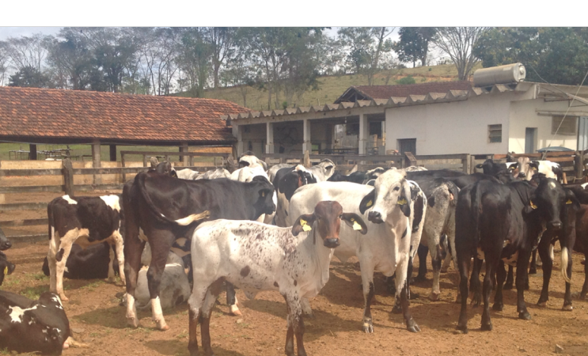
What’s the theory behind this?
Girolando cattle on a farm near Coronel Pacheco, MG, Brasil (photo taken by author).
Embrapa Pecuária Sul, Bagé, RS, Brasil 4 February 2016

Slide 8
Variants and genomic selection
Linkage disequilibrium (LD) can track causal variants using DNA markers (Nejati-Javaremi et al., 1997; Meuwissen et al., 2001; Dekkers, 2007)
Known causal variants can be used compute breeding values in other populations (de los Campos et al., 2013)
Most causal variants are unknown, and prediction accuracy is driven by the size of the reference population (Goddard, 2009)
Embrapa Pecuária Sul, Bagé, RS, Brasil 4 February 2016

Slide 9
Single- and multi-breed theory
This discussion based on the genomic BLUP model presented in Harris and Johnson (2010)
  Some intermediate steps omitted for time
The model does not include a polygenic effect
The method can be extended to an arbitrary number of breeds
Embrapa Pecuária Sul, Bagé, RS, Brasil 4 February 2016

Slide 10
Single-breed theory cont’d
y = Xb + Zu + e
phenotypes
random error
fixed effects
random SNP effects
Assume that all fixed effects are known
SNP coded −1, 0, and 1 for homozygotes, heterozygotes, and other homozygotes
If Xb is known then u may be estimated as:
Embrapa Pecuária Sul, Bagé, RS, Brasil 4 February 2016

Slide 11
Single-breed theory cont’d
ZZ’
average relationship
matrix
Diagonals: number of homozygous loci for each animal
Off-diagonals: number of alleles shared by two animals
Embrapa Pecuária Sul, Bagé, RS, Brasil 4 February 2016

Slide 12
Single-breed theory cont’d
In practice, genomic relationship matrices can be estimated by regression:
Embrapa Pecuária Sul, Bagé, RS, Brasil 4 February 2016

Slide 13
Multi-breed theory
The genomic relationship matrix from the single-breed case can be generalized to a multi-breed population
Accounting for breed-specific allele frequencies requires a multiple regression equation that accounts for different expected means and variances
Embrapa Pecuária Sul, Bagé, RS, Brasil 4 February 2016

Slide 14
Multi-breed theory cont’d
In the two-breed case, we can sum over breeds k and l to produce ZZ’:
K partitioned into breed fractions to account for different variances and allele frequencies among breeds
Embrapa Pecuária Sul, Bagé, RS, Brasil 4 February 2016

Slide 15
Multi-breed theory cont’d
Information added in the multi-breed case is about (co)variances among breeds:
When (co)variances are near 0 these expectations simplify to the single-breed case
Embrapa Pecuária Sul, Bagé, RS, Brasil 4 February 2016

Slide 16
Multi-breed theory cont’d
The multi-breed genomic relationship matrix can then be written as:
Cholesky factorization of the submatrix of A with the genotyped animals in the population
For comparison, the single-breed matrix is:
Embrapa Pecuária Sul, Bagé, RS, Brasil 4 February 2016

Slide 17
What’s already been tried?
Girolando cattle on a farm near Coronel Pacheco, MG, Brasil (photo taken by author).
Embrapa Pecuária Sul, Bagé, RS, Brasil 4 February 2016

Slide 18
Hayes et al. 2009
Used single-breed and multiple-breed reference populations to predict breeding values for purebred Holsteins and Jerseys
GBLUP and Bayesian methods used to predict SNP effects and genomic PTA
Agreement of realized with expected reliabilities lower with crossbred than purebred predictor sets under GBLUP
Embrapa Pecuária Sul, Bagé, RS, Brasil 4 February 2016

Slide 19
Hayes et al. 2009 cont’d
Predictions of opposite-breed genomic PTA had accuracies near 0
G matrix for multi-breed populations must be scaled achieve appropriate expected accuracies
Bayesian approaches produce higher accuracies for some traits, particularly when a large QTL is segregating (e.g., DGAT1)
Embrapa Pecuária Sul, Bagé, RS, Brasil 4 February 2016

Slide 20
Ibánẽz-Escriche et al. 2009
Simulated 6,000 SNP and 30 QTL in four breeds
Breeds had recent, ancient, or no common origins
Heritability of 0.30
SNP effects estimated by Bayes B
Embrapa Pecuária Sul, Bagé, RS, Brasil 4 February 2016

Slide 21
Ibánẽz-Escriche et al. 2009 cont’d
Alleles in crossbred lines originate from purebred parental lines
When purebred lines not closely related, SNP effects depend on their line of origin
Breed-specific models rarely out-performed across-breed models
Models with breed-specific allele effects may not be necessary, especially with lots of SNP
Embrapa Pecuária Sul, Bagé, RS, Brasil 4 February 2016

Slide 22
Kizilkya et al. 2009
Actual 50K SNP genotypes from purebred and crossbred animals combined with simulated phenotypes
  1,086 Angus and 924 crossbred animals
Scenarios included 50 to 500 QTL
Estimated SNP effects used to predict genomic merit for purebred and crossbred animals
Embrapa Pecuária Sul, Bagé, RS, Brasil 4 February 2016

Slide 23
Kizilkya et al. 2009 cont’d
Scenarios with QTL explained more of the within-breed variance than panels with none
Purebred training populations had greater correlations of predicted with actual genetic merit
Multi-breed training sets had greater correlations of predicted genetic merit with phenotype
Purebred training sets predicted multi-breed performance well because of greater LD
Embrapa Pecuária Sul, Bagé, RS, Brasil 4 February 2016

Slide 24
Toosi et al. 2010
Simulated purebreds and F1, F2, 3- and 4-way crosses for training datasets
1,000 purebred animals in the validation set
Admixed data effectively predicted purebred performance when target breeds were included in the training set
Performance of crossbred animals was not predicted
Embrapa Pecuária Sul, Bagé, RS, Brasil 4 February 2016

Slide 25
Harris et al. 2011
Compared results using 50K, 700K, and 330K SNP panels
Prediction data included 4,211 Holstein, Jersey, and Holstein Friesian-Jersey crossbred bulls
Increased density improved prediction accuracy of one pure breed from another
No improvement was seen for prediction of crossbred genomic PTA
Embrapa Pecuária Sul, Bagé, RS, Brasil 4 February 2016

Slide 26
Olson et al. 2012
Three methods of multi-breed evaluation were investigated:
  Method 1 estimated SNP effects within breed and applied them to other breeds
  Method 2 estimated common SNP effects using combined genotypes and phenotypes of all breeds
  Method 3 used a multiple-trait model with SNP effects in different breeds treated as correlated traits
Embrapa Pecuária Sul, Bagé, RS, Brasil 4 February 2016

Slide 27
Olson et al. 2012 cont’d
Method 1 gPTA had higher reliability than PA within breed, but worked poorly across breeds
Method 2 across-breed gPTA were less-accurate than within-breed gPTA for many traits
Method 3 produced significantly better correlations, but gains were small in magnitude
Embrapa Pecuária Sul, Bagé, RS, Brasil 4 February 2016

Slide 28
Strandén and Mäntysaari 2012
Used a random regression model to include breed composition information and genetic variances of origin breeds in multibreed analyses
Computationally tractable approximation
Correlation of 0.987 with results of García-Cortés & Toro (2006)
Intended for use in admixed populations, not prediction of crossbred performance
Embrapa Pecuária Sul, Bagé, RS, Brasil 4 February 2016

Slide 29
Christensen et al. 2014
Extended the Wei and van der Werf (1994) model to include genomic information
Partial-relationship matrices used to combine pedigree and marker information
Promising for two-breed systems, such as Girolando
Validation needed!
Embrapa Pecuária Sul, Bagé, RS, Brasil 4 February 2016

Slide 30
Makgahlela et al. 2014
Accounted for breed composition in computation of G matrix
Nordic Red population, which has a cross-breeding structure, low LD, and large effective population size
Within- and across-breed G used
Little effect on prediction accuracy
Embrapa Pecuária Sul, Bagé, RS, Brasil 4 February 2016

Slide 31
Christensen et al. 2015
Described a four-trait model that produces breeding values for both purebred and crossbred performances in three-way terminal crosses
Phenotypes are the purebred records, plus the crossbred records
Application to beef cattle may be limited
Embrapa Pecuária Sul, Bagé, RS, Brasil 4 February 2016

Slide 32
VanRaden and Cooper 2015
Pedigrees are often incomplete or inaccurate for crossbred animals
Adjusted breed composition (ABC) computed from genomic breed composition
Genomic evaluations for crossbreds computed by weighting marker effects for separate breeds by ABC
Marker effects must be computed on the all-breed base rather than within-breed bases
Embrapa Pecuária Sul, Bagé, RS, Brasil 4 February 2016

Slide 33
VanRaden and Cooper 2015 cont’d
Convert traditional evaluations of all purebred genotypes to the all-breed base
Calculate individual breed SNP effects
Apply SNP effects to crossbred animals
Combine individual breed genomic PTA weighted by breed composition
Correlations of purebred and crossbred genomic PTA ranged from 0.62 to 0.97
Embrapa Pecuária Sul, Bagé, RS, Brasil 4 February 2016

Slide 34
Wientjes et al. 2015
Discrepancy between observed and expected accuracy of multi-breed genomic evaluations may be due to incorrect assumptions
100 or 1,000 QTL with moderately low, very low, or extremely low average MAF imputed using real HD genotypes
Adding QTL to SNP used to calculate the GRM increases accuracy
Embrapa Pecuária Sul, Bagé, RS, Brasil 4 February 2016

Slide 35
Wientjes et al. 2015 cont’d
Accuracy of genomic prediction not increased by animals from a second breed
Accuracy of single- and multi-breed prediction affected by properties of QTL controlling the trait
QTL and SNP segregating in the population of selection candidates must have reasonable allele frequency in reference population
Embrapa Pecuária Sul, Bagé, RS, Brasil 4 February 2016

Slide 36
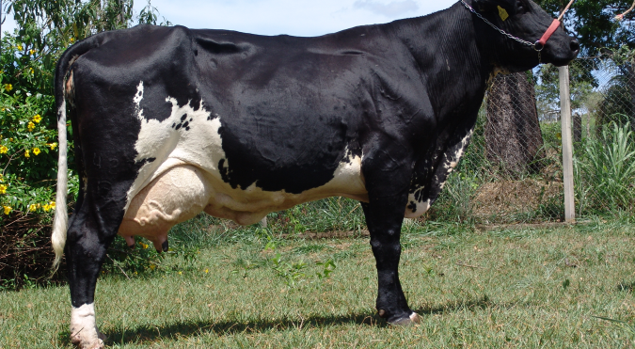
Discussion
The Girolando cow Cocaína.
Embrapa Pecuária Sul, Bagé, RS, Brasil 4 February 2016

Slide 37
What about higher density?
Multi-breed evaluations depend on similar LD among SNP and QTL in training and test data
A common suggestion is that higher-density panels are needed
High-density data have not improved predictions in multi-breed populations (Ibáñez-Escriche et al., 2009; Olson et al., 2012; Makgahlela et al., 2013)
Embrapa Pecuária Sul, Bagé, RS, Brasil 4 February 2016

Slide 38
What about sequencing?
Whole genome sequencing rapidly dropping in price
In principle, sequence data will support the discovery of many causal variants
Replacing markers with causal variants should increase the accuracy of genomic prediction
LD issues are eliminated, but variants may differ across breeds
Embrapa Pecuária Sul, Bagé, RS, Brasil 4 February 2016

Slide 39
What should we do?
Large multi-breed populations can implement genomic predictions with their own data
Smaller multi-breed populations may include information from larger purebred populations
Haplotype-based models may be more helpful than SNP-based models
  This is related to the effective number of chromosome segments
Embrapa Pecuária Sul, Bagé, RS, Brasil 4 February 2016

Slide 40
What conclusions can we draw?
Purebred evaluations can be improved by inclusion of crossbred data
Predictions of crossbred genomic merit are not as accurate in practice as in theory
It is difficult to rescale A and G so that they are comparable
No all-breed genomic evaluation?
Embrapa Pecuária Sul, Bagé, RS, Brasil 4 February 2016

Slide 41
Acknowledgments
Support for this research was provided by:
  USDA-ARS project 1265-31000-101-05, “Improving Genetic Predictions in Dairy Animals Using Phenotypic and Genomic Information”
  CNPq “Science Without Borders” project 301025/2014-2
Mention of trade names or commercial products in this article is solely for the purpose of providing specific information and does not imply recommendation or endorsement by the US Department of Agriculture. The USDA is an equal opportunity provider and employer.
Embrapa Pecuária Sul, Bagé, RS, Brasil 4 February 2016

Slide 42
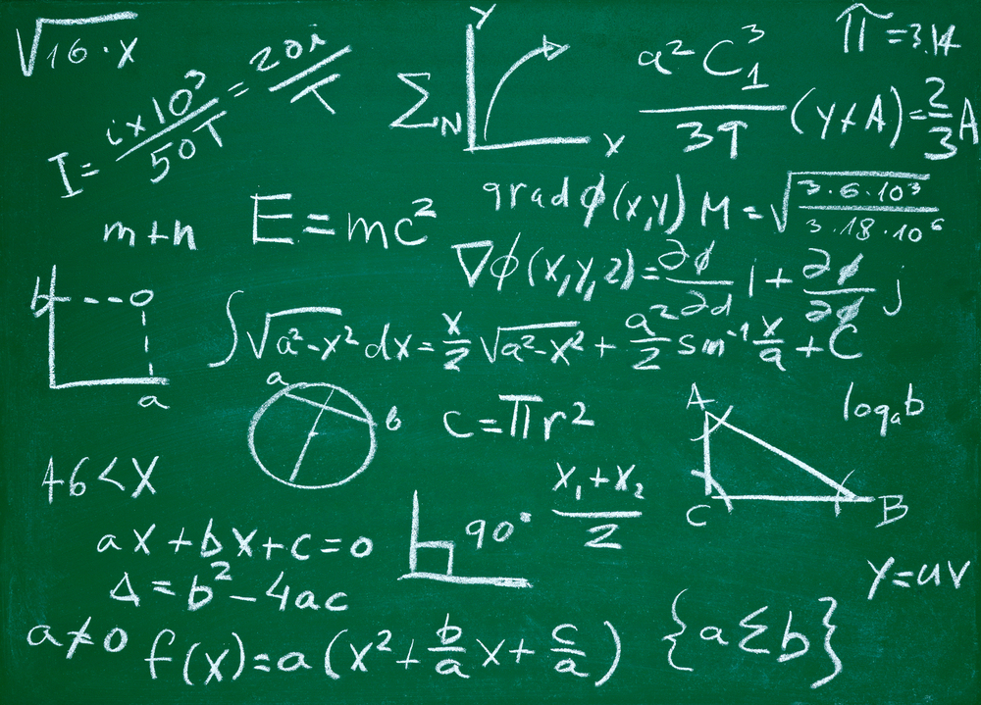
Questions?
http://gigaom.com/2012/05/31/t-mobile-pits-its-math-against-verizons-the-loser-common-sense/shutterstock_76826245/
Embrapa Pecuária Sul, Bagé, RS, Brasil 4 February 2016

Slide 43
References
de los Campos, G., et al. 2013. Prediction of complex human traits using the genomic best linear unbiased predictor. PLoS Genet. 9:e1003608.
Christensen, O.F., et al. 2015. Genetic evaluation for three-way crossbreeding. Genet. Sel. Evol. 47:1-13.
Christensen, O.F. et al. 2014. Genomic evaluation of both purebred and crossbred performances. Genet. Sel. Evol. 46:23.
Daetwyler H.D., et al. 2007. Inbreeding in genome-wide selection. J. Anim. Breed. Genet. 124:369–376.
Dekkers, J.C.M. 2007. Marker-assisted selection for commercial crossbred performance. J. Anim. Sci. 85:2104–2114.
García-Cortés, L., and M.A. Toro. 2006. Multibreed analysis by splitting the breeding values. Genet. Sel. Evol. 38:601–615.
Goddard, M. 2009. Genomic selection: prediction of accuracy and maximisation of long term response. Genetica 136:245–257.
Embrapa Pecuária Sul, Bagé, RS, Brasil 4 February 2016

Slide 44
References cont’d
Harris, B.L., et al. 2011. Experiences with the Illumina high density Bovine BeadChip. Interbull Bull. 44:3–7.
Harris, B.L., and D.L. Johnson. 2010. Genomic predictions for New Zealand dairy bulls and integration with national genetic evaluation. J. Dairy Sci. 93:1243–1252.
Hayes, B.J., et al. 2009. Accuracy of genomic breeding values in multi-breed dairy cattle populations. Genet. Sel. Evol. 41:51.
Ibánẽz-Escriche, N., et al. 2009. Genomic selection of purebreds for crossbred performance. Genet.Sel.Evol. 41.
Kizilkaya, K., et al. 2010. Genomic prediction of simulated multibreed and purebred performance using observed fifty thousand single nucleotide polymorphism genotypes. J. Anim. Sci. 88:544–551.
Lund, M.S., et al. 2014. Genomic evaluation of cattle in a multi-breed context. Livest. Sci. 166:101–110.
Embrapa Pecuária Sul, Bagé, RS, Brasil 4 February 2016

Slide 45
References cont’d
Makgahlela, M. l., et al. 2013. Across breed multi-trait random regression genomic predictions in the Nordic Red dairy cattle. J. Anim. Breed. Genet. 130:10–19.
Makgahlela, M.L., et al. 2014. Using the unified relationship matrix adjusted by breed-wise allele frequencies in genomic evaluation of a multibreed population. J. Dairy Sci. 97:1117–1127.
Meuwissen, T.H.E., et al. 2001. Prediction of total genetic value using genome-wide dense marker maps. Genetics. 157:1819–1829.
Nejati-Javaremi, A., et al. 1997. Effect of total allelic relationship on accuracy of evaluation and response to selection. J. Anim. Sci. 75:1738–1745.
Olson, K.M., et al. 2012. Multibreed genomic evaluations using purebred Holsteins, Jerseys, and Brown Swiss. J. Dairy Sci. 95:5378–5383.
Embrapa Pecuária Sul, Bagé, RS, Brasil 4 February 2016

Slide 46
References cont’d
Pryce, J.E., et al. 2011. Short communication: Genomic selection using a multi-breed, across-country reference population. J. Dairy Sci. 94:2625–2630. doi:10.3168/jds.2010-3719.
Stranden, I., and E.A. Mantysaari E.A. 2012. Use of random regression model as an alternative for multibreed relationship matrix. J. Anim. Breed. Genet.
Toosi, A., et al. 2010. Genomic selection in admixed and crossbred populations. J. Anim. Sci. 88:32–46.
VanRaden, P.M., and T.A. Cooper. 2015. Genomic evaluations and
breed composition for crossbred U.S. dairy cattle. Interbull Bull. (In press.)
Wei M., and van der Werf J.H.J. 1994. Maximizing genetic response in crossbredsusing both purebred and crossbred information. Anim. Prod. 59:401–413.
Wientjes, Y.C., et al. 2015. Impact of QTL properties on the accuracy of multi-breed genomic prediction. Genet. Sel. Evol. 47:42.
Embrapa Pecuária Sul, Bagé, RS, Brasil 4 February 2016

Slide 47
References cont’d
Wiggans, G.R., et al. 2011. The genomic evaluation system in the United States: Past, present, future. J. Dairy Sci. 94:3202–3211. doi:10.3168/jds.2010-3866.
Embrapa Pecuária Sul, Bagé, RS, Brasil 4 February 2016

