Slide 1
Managing Recessive Disorders in Breeding Programs by Gene Editing
John B. Cole
Animal Genomics and Improvement Laboratory
Agricultural Research Service, USDA
Beltsville, MD 20705-2350

Slide 2
Introduction
High-density SNP genotypes have been used to identify many new recessives that affect fertility in dairy cattle, as well as to track conditions such as polled (Cole et al., 2016).
Sequential mate allocation accounting for increases in genomic inbreeding and the economic impact of affected matings results in faster allele frequency changes than other approaches (Cole, 2015).
Effects of gene editing on selection programs should be considered because it may dramatically change rates of allele frequency change.

Slide 3
Estimated cost of genetic load
Cole et al. (2016) estimated losses of at least $10,743,308 due to known recessives.
Average losses were $5.77, $3.65, $0.94, and $2.96 in Ayrshire, Brown Swiss, Holstein, and Jersey, respectively.
This is the economic impact of genetic load as it affects fertility and perinatal mortality.
Actual losses are likely to be higher.

Slide 4
Selection using marker information
Shepherd and Kinghorn (2001) described a look-ahead mate selection scheme using markers.
Li et al. (2006, 2008) argued that QTL genotypes provide more benefit when used in mate selection rather than in index selection.
Van Eenennaam and Kinghorn (2014) proposed selection against the total number of lethal alleles and recessive lethal genotypes.
Cole (2015) suggested that parent averages can be adjusted to account for genetic load in sequential mate allocation schemes.

Slide 5
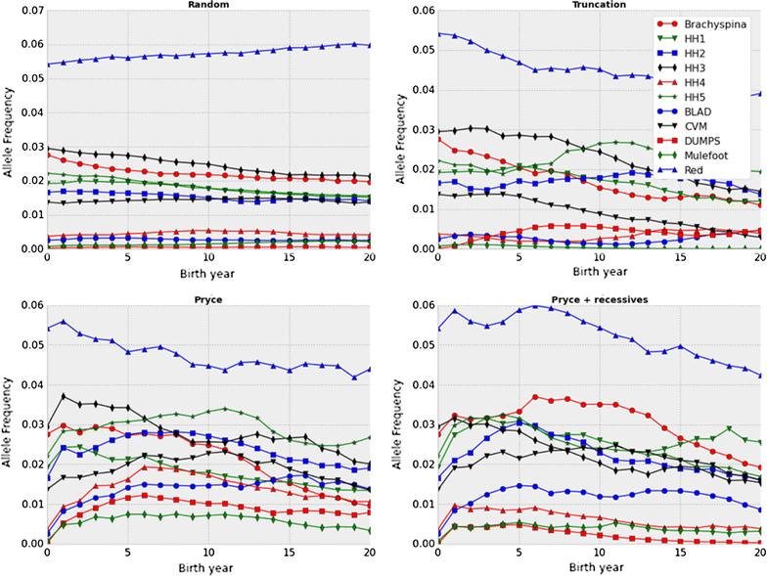
Selection may not be fast enough!
Source: Cole (2015).

Slide 6
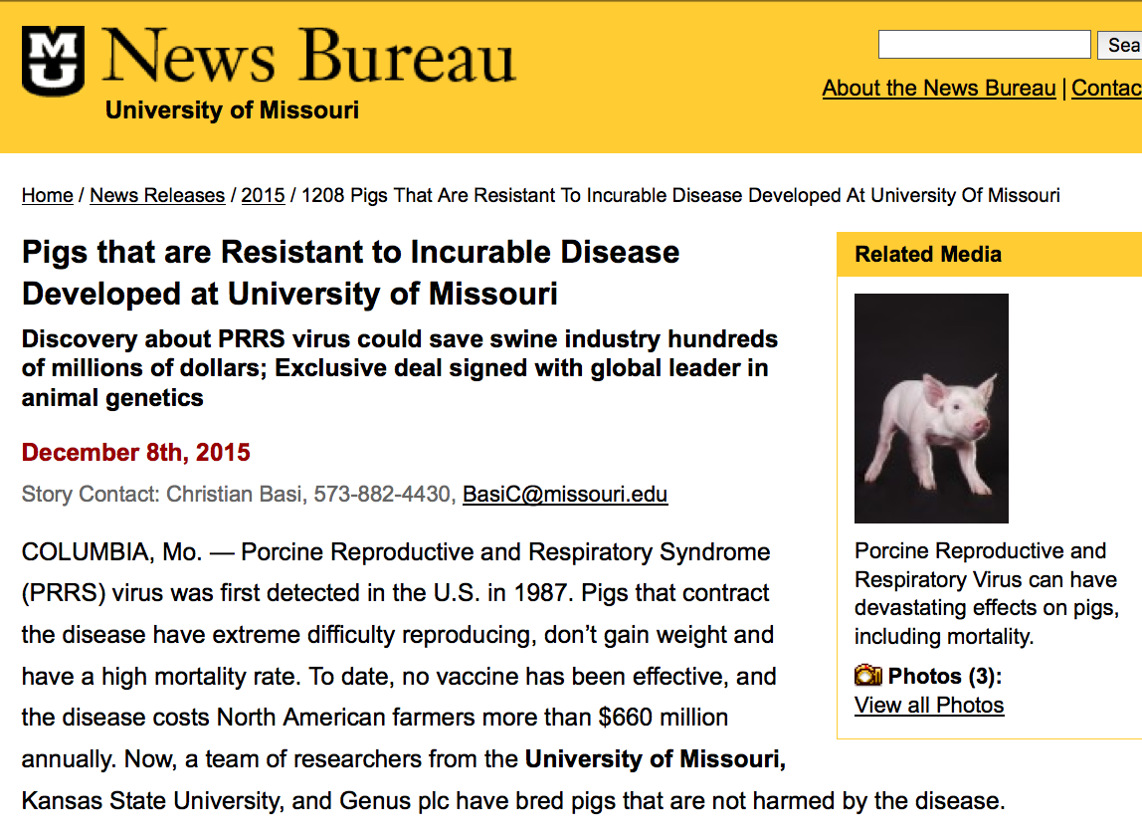
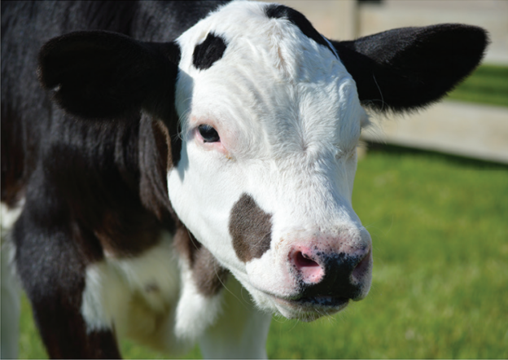
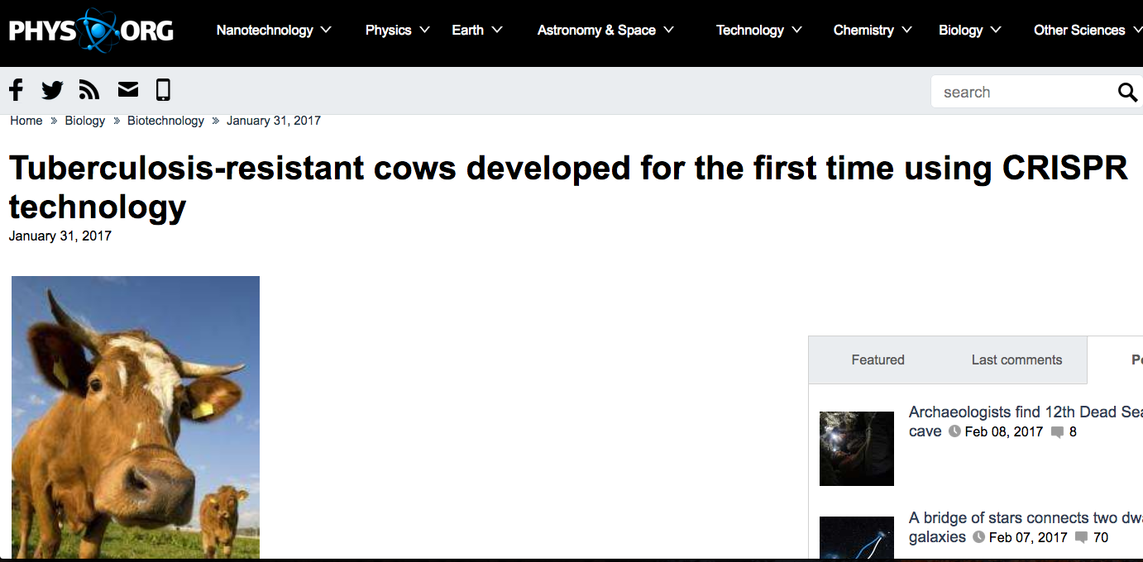
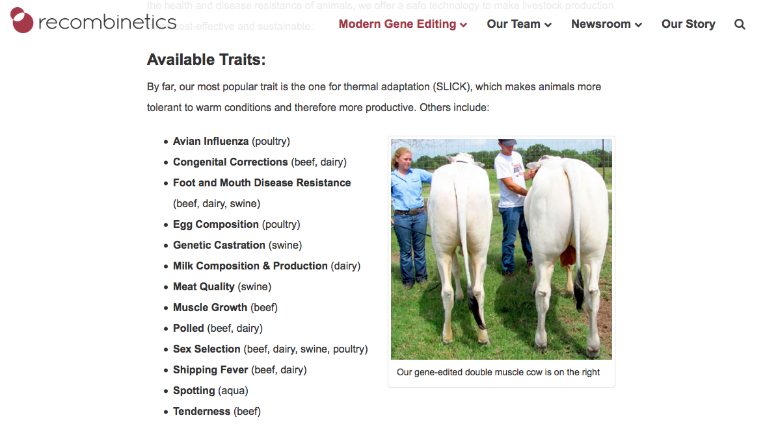
Gene editing in livestock

Slide 7
Objective
Determine rates of allele frequency change and quantify differences in cumulative genetic gain for several genome editing technologies while considering varying numbers of recessives and different proportions of bulls and cows to be edited.

Slide 8
Materials and Methods

Slide 9
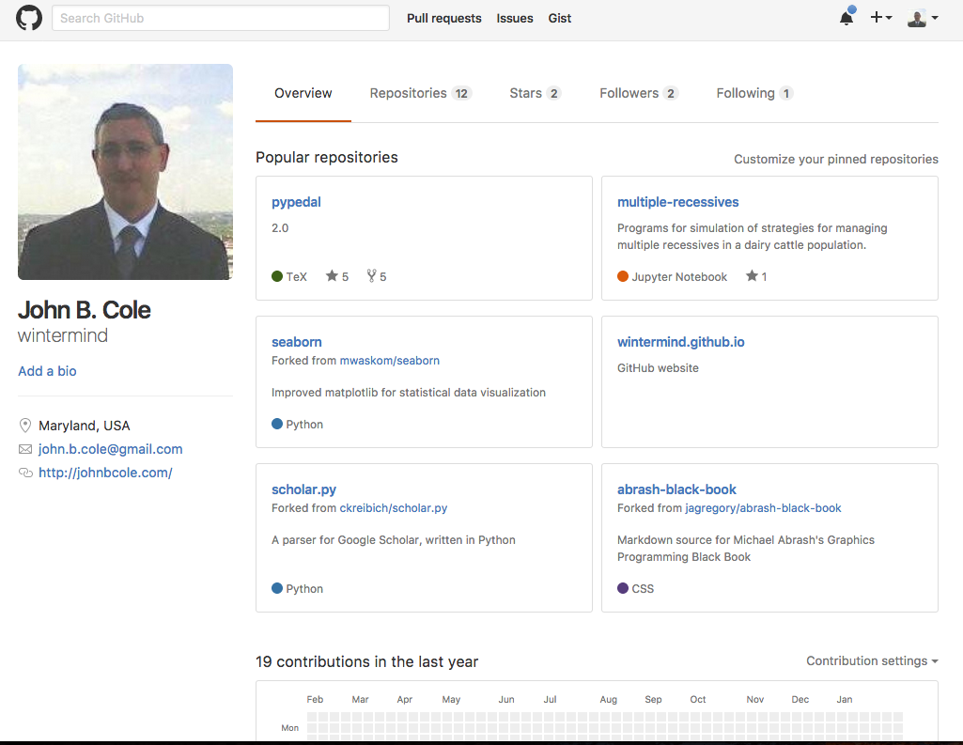
Simulation program
The multiple-recessives program of Cole (2015) was modified to accommodate gene editing
  Code will be deposited on GitHub at time of manuscript submission under a CC0 1.0 license
Any number or combination of recessives may be edited
Written in Python 2.7 with Jupyter notebooks for analysis

Slide 10
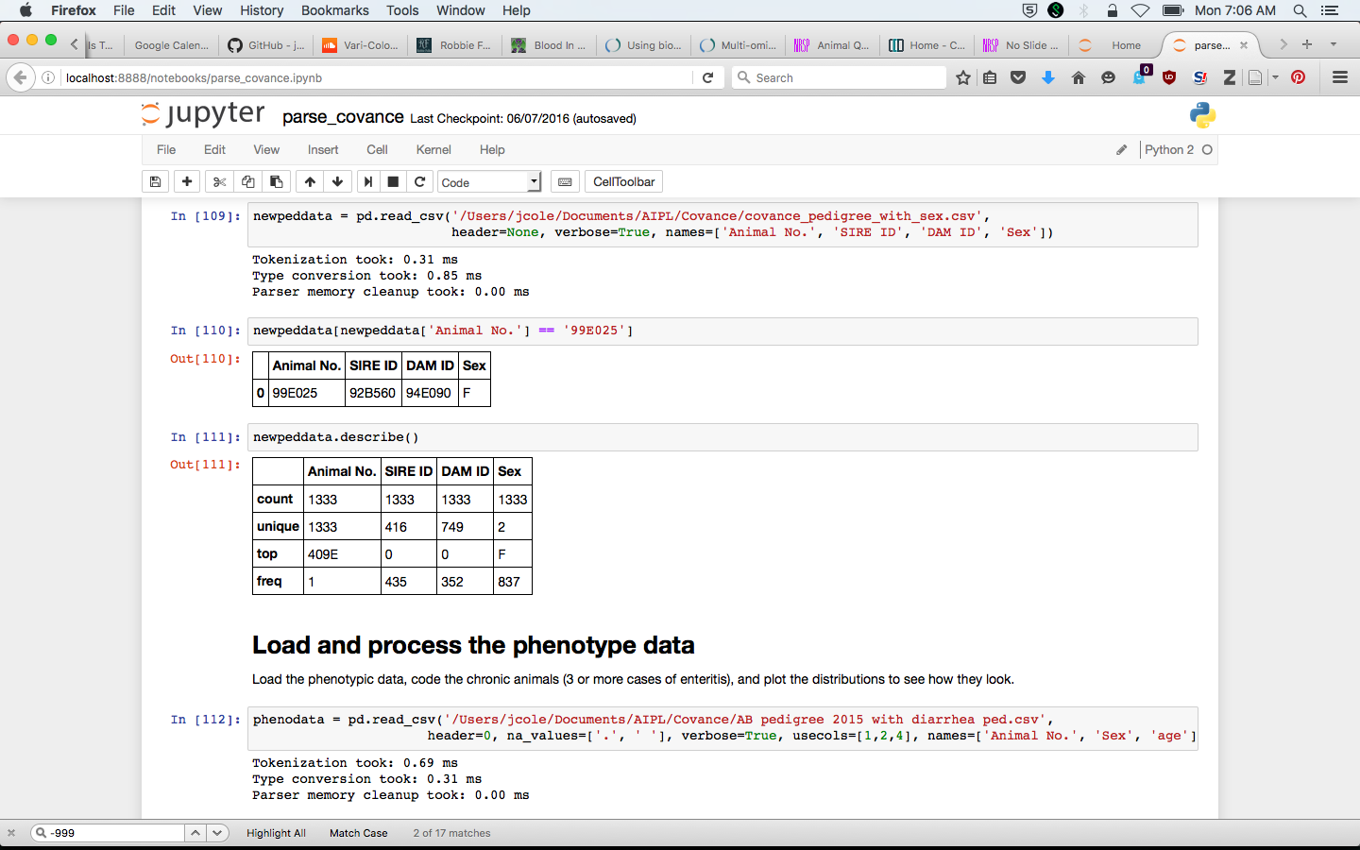
Jupyter notebook (example)

Slide 11
Parameters used
Parameter | Value |  | Parameter | Value
base_bulls | 350 |  | generations | 20
base_cows | 35,000 |  | max_matings | 5,000
service_bulls | 50 |  | debug | True
base_herds | 200 |  | history_freq | ‘end’
max_bulls | 500 |  | rng_seed | time + PID
max_cows | 100,000 |  | edit_prop | 0 %, 1 %, 10 % (bulls) 0 %, 1 % (cows)
percent | 0.10 |  | edit_type | ‘C’, ‘P’, ‘T’, 'Z'

Slide 12
Recessives in US Holsteins
Haplo | Functional/gene name | Frequency | Chrome | Location (bp) | Timing
HCD | Cholesterol deficiency/APOB | 2.5 | 11 | 77,953,380 – 78,040,118 | W
HH0 | Brachyspina/FANCI | 2.76 | 21 | 21,184,869 – 21,188,198 | E, B
HH1 | APAF1 | 1.92 | 5 | 63,150,400 | E
HH2 | — | 1.66 | 1 | 94,860,836 – 96,553,339 | E
HH3 | SMC2 | 2.95 | 8 | 95,410,507 | E
HH4 | GART | 0.37 | 1 | 1,277,227 | E
HH5 | TFB1M | 2.22 | 9 | 92,350,052 – 93,910,957 | E
HHB | BLAD/ITGB2 | 0.25 | 1 | 145,119,004 | W
HHC | CVM/SLC35A3 | 1.37 | 3 | 43,412,427 | E, B
HHM | Mulefoot/LRP4 | 0.07 | 15 | 77,663,790 – 77,701,209 | B
Source: Cole et al. (2016).

Slide 13

Sequential mate allocation
Mating PA are adjusted for inbreeding (Pryce et al., 2012) and expected embryonic losses (Cole, 2015):
$$B_{ij}=0.5\left({TBV}_{i}+{TBV}_{j}\right)−λF_{ij}−\sum_{r=1}^{n_{r}}{{P(aa)}_{r}×v_{r}}$$
B_{ij} is a matrix of PA, TBV are true breeding values, λ is the value of a 1% increase in inbreeding, F_{ij} is the inbreeding of the mating, P(aa) is the probability of an affected embryo, and v_{r} is the economic loss associated with an affected embryo.

Slide 14
Mate allocation (cont’d)
A matrix, M, is used to allocate bulls to cows
M_{ij} is set to 1 if B_{ij} is the greatest value in column j (largest PA available for mating to that cow)
If the sum of row i < the number of permitted matings for that bull the mating is allocated
Else, the bull with the next-highest value of B_{ij} is selected, until each column has only one element equal to 1

Slide 15
Scenarios simulated
Recessives (all recessive loci, horned) | Proportion of bulls edited (0%, 1%, 5%, 10%) | Proportion of dams edited (0%, 1%) | Editing technology (CRISPR, TALEN, Perfect, ZFN)

Slide 16
Recessives by scenario
Scenario¹ | N² | Frequency | Value ($)³ | Name | Lethal
All recessive loci | 12 | 0.0276 | 150 | Brachyspina | Yes
 |  | 0.0192 | 40 | HH1 | Yes
 |  | 0.0166 | 40 | HH2 | Yes
 |  | 0.0295 | 40 | HH3 | Yes
 |  | 0.0037 | 40 | HH4 | Yes
 |  | 0.0222 | 40 | HH5 | Yes
 |  | 0.0025 | 150 | BLAD | Yes
 |  | 0.0137 | 70 | CVM | Yes
 |  | 0.0001 | 40 | DUMPS | Yes
 |  | 0.0007 | 150 | Mulefoot | Yes
 |  | 0.9929 | 40 | Horned | No
 |  | 0.0542 | -20 | Red coat color | No
Horned locus | 1 | 0.9929 | 40 | Horned | No
¹Specific scenario simulated for each trait or group of traits.
²Number of recessive loci in the scenario.
³Positive values are undesirable and negative values are desirable.

Slide 17
Gene editing algorithm
Gene editing occurs when an embryo is created:
  For each recessive edited:
    A uniform random variate is drawn and checked for success
    Failure means that the genotype was not changed
  A uniform variate is drawn to determine if a live birth occurs
Production of many embryos to guarantee some survive is simulated by setting the embryonic death rate to 0.
Transfer of only edited embryos to recipients is simulated by setting the editing failure rate to 0.

Slide 18
Properties of gene editing strategies
Technology¹ | Editing failure rate | Embryonic death rate | Probability of success²
CRISPR | 0.37 | 0.79 | 0.71
TALEN | 0.79 | 0.88 | 0.30
Perfect | 0.00 | 0.00 | 1.00
ZFN | 0.89 | 0.92 | 0.18
¹CRISPR = clustered regularly interspaced short palindromic repeats, TALEN = transcription activator-like effector nuclease, Perfect = hypothetical technology with a perfect success rate, ZFN = zinc finger nuclease.
²Calculated as 1 – (editing failure rate * embryonic death rate).

Slide 19
Embryos to be edited
In simulation, only one embryo is edited
In practice, many embryos would be produced to ensure a live birth
Reliable estimates of costs are currently unavailable
More efficient editing and ET procedures require fewer embryos

Slide 20
Low efficiency means higher costs
 | Edit¹ | ET | Total | No sexing
CRISPR | 5 | 20 | 100 | 200
TALEN | 20 | 37 | 740 | 1,480
ZFN | 40 | 56 | 2,240 | 4,480
¹Number of embryos to edit to have a 99% chance of obtaining desired result, modeled using a geometric distribution.

Slide 21
Multiple Recessives

Slide 22
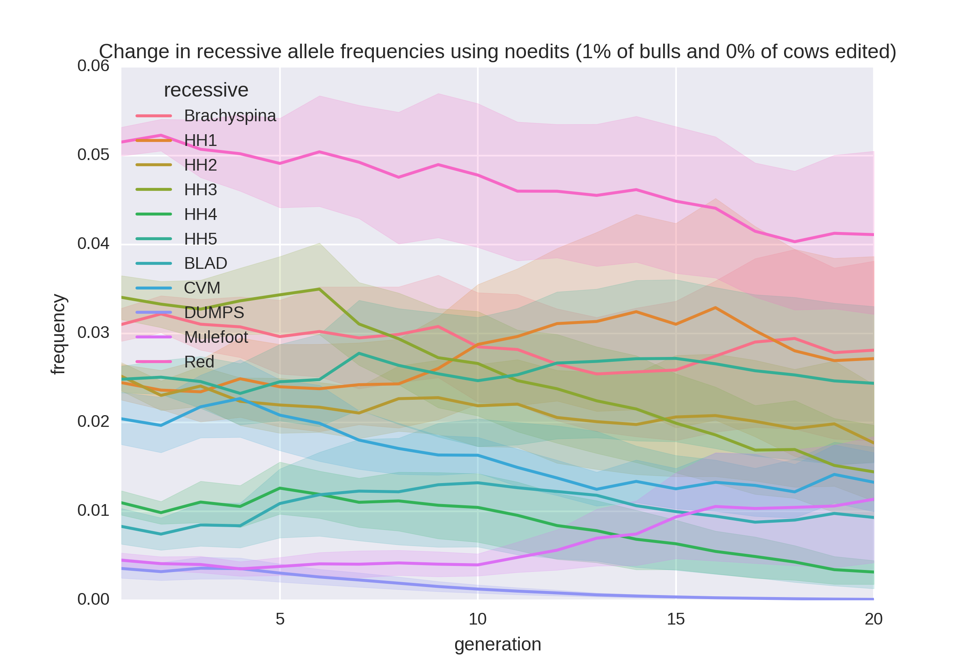
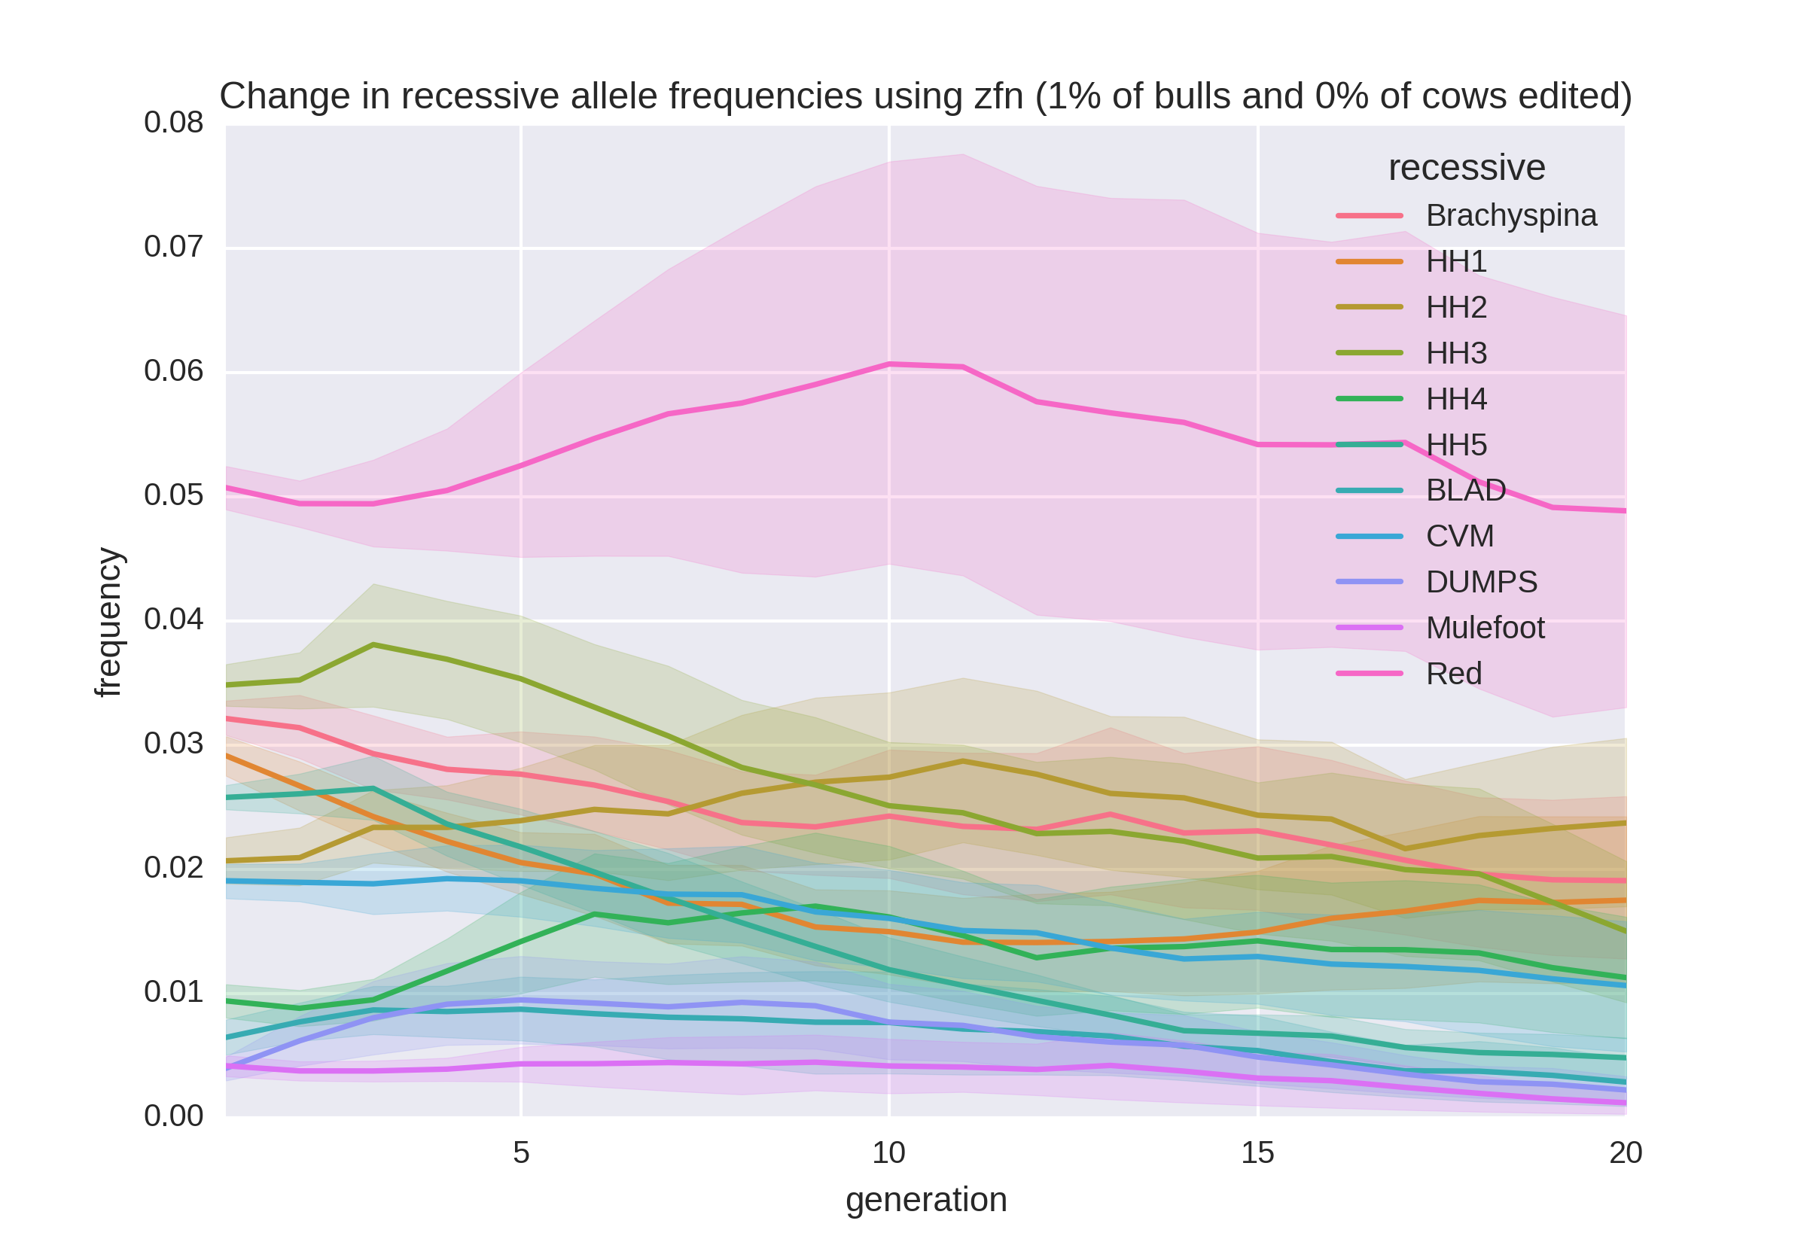
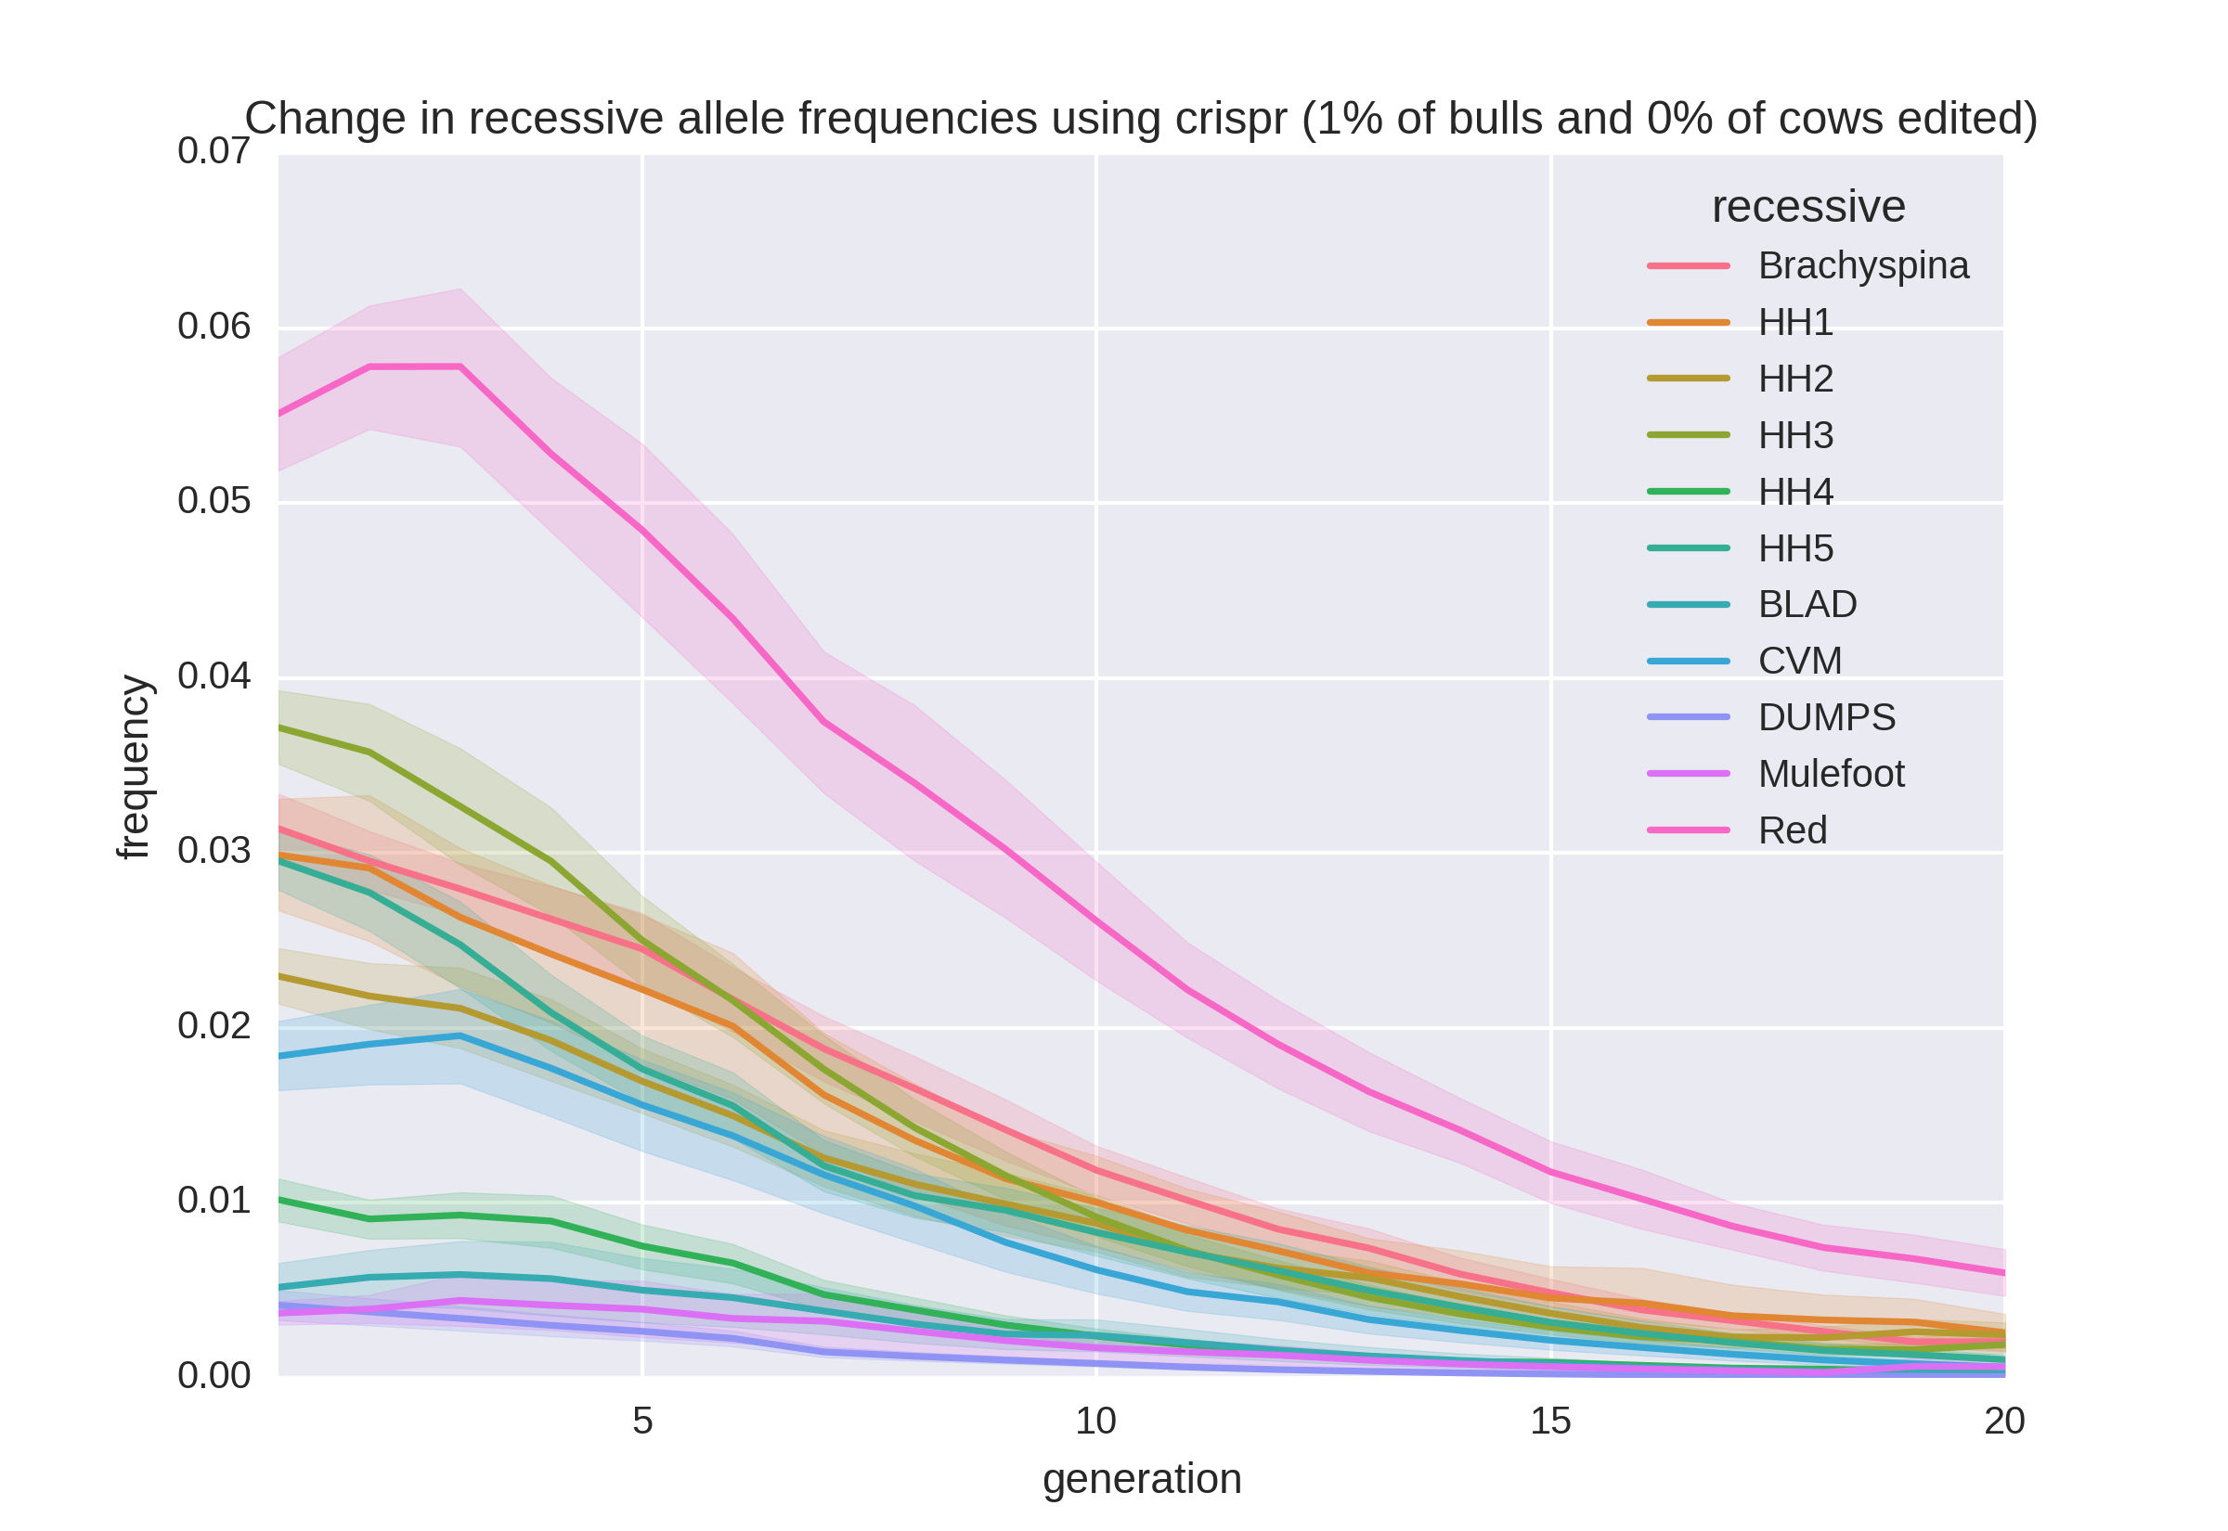
Allele frequency change

Slide 23
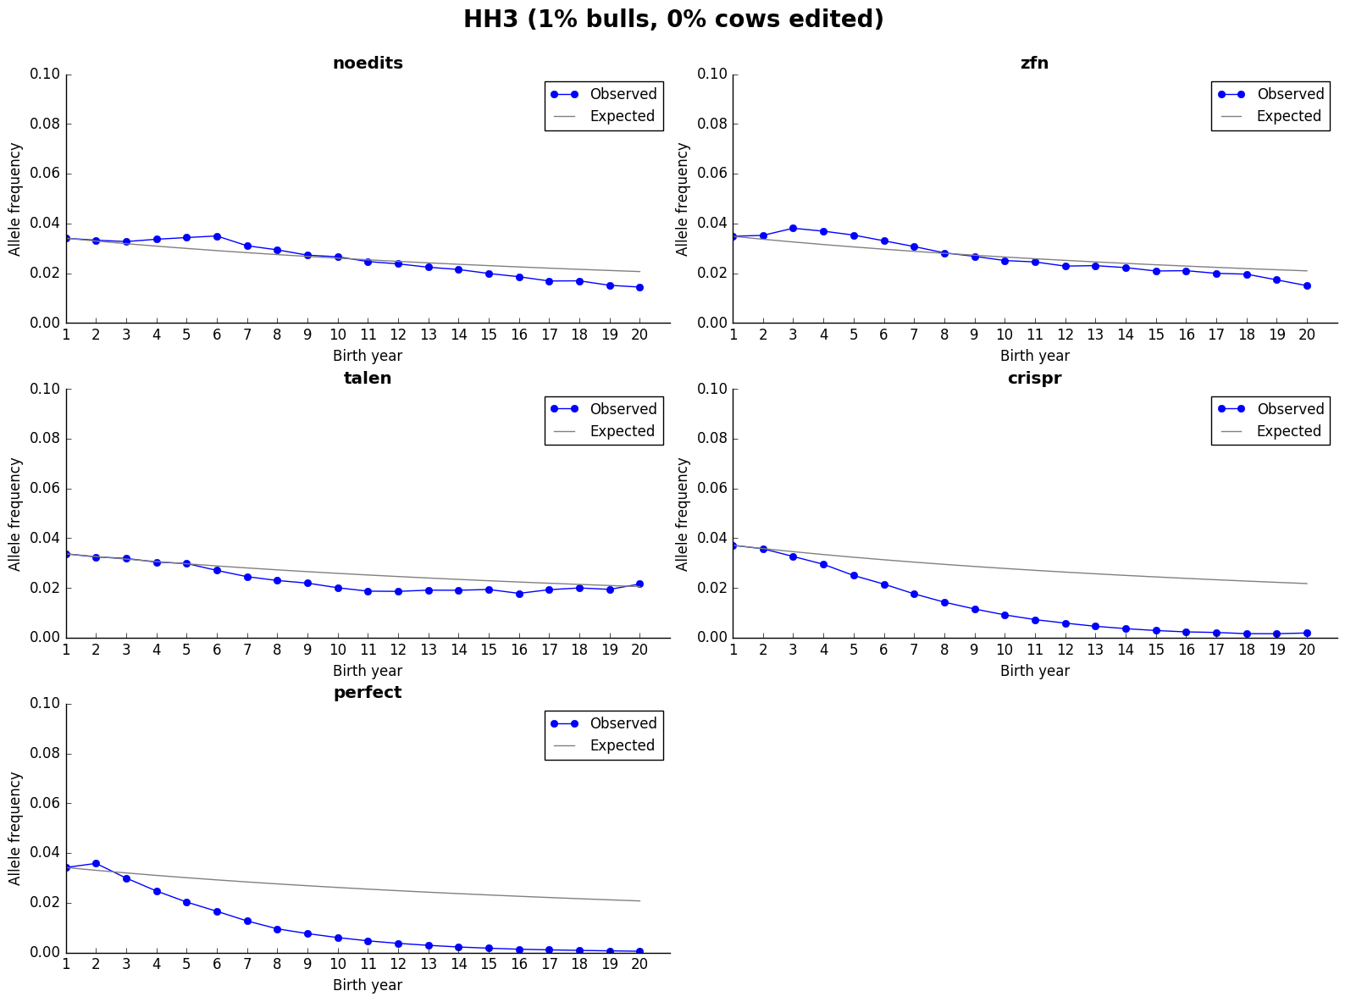
Actual versus observed frequency

Slide 24
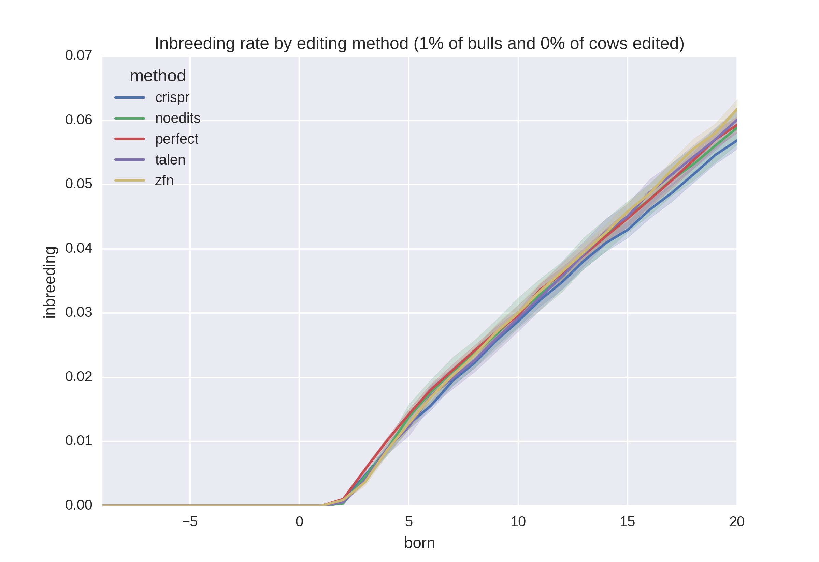
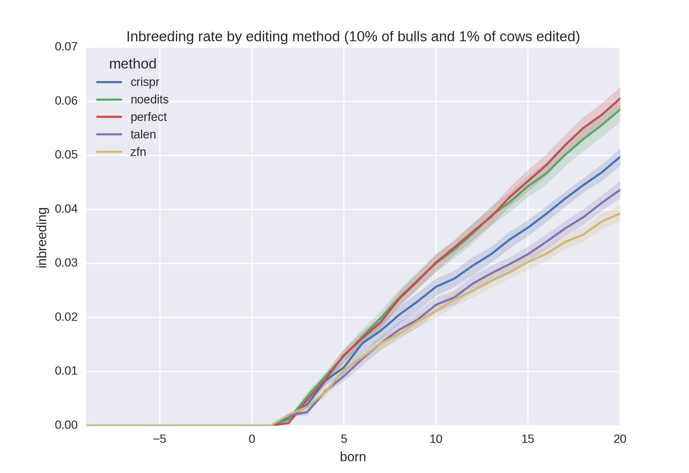
Inbreeding

Slide 25
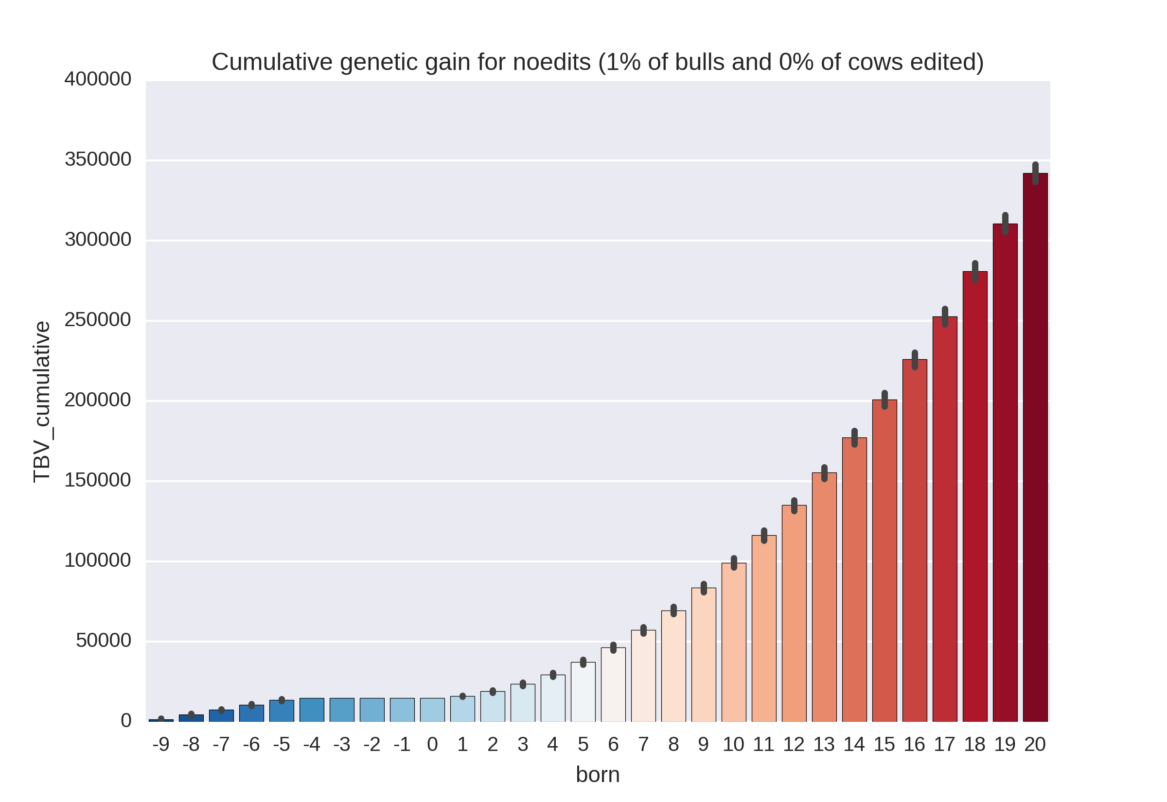
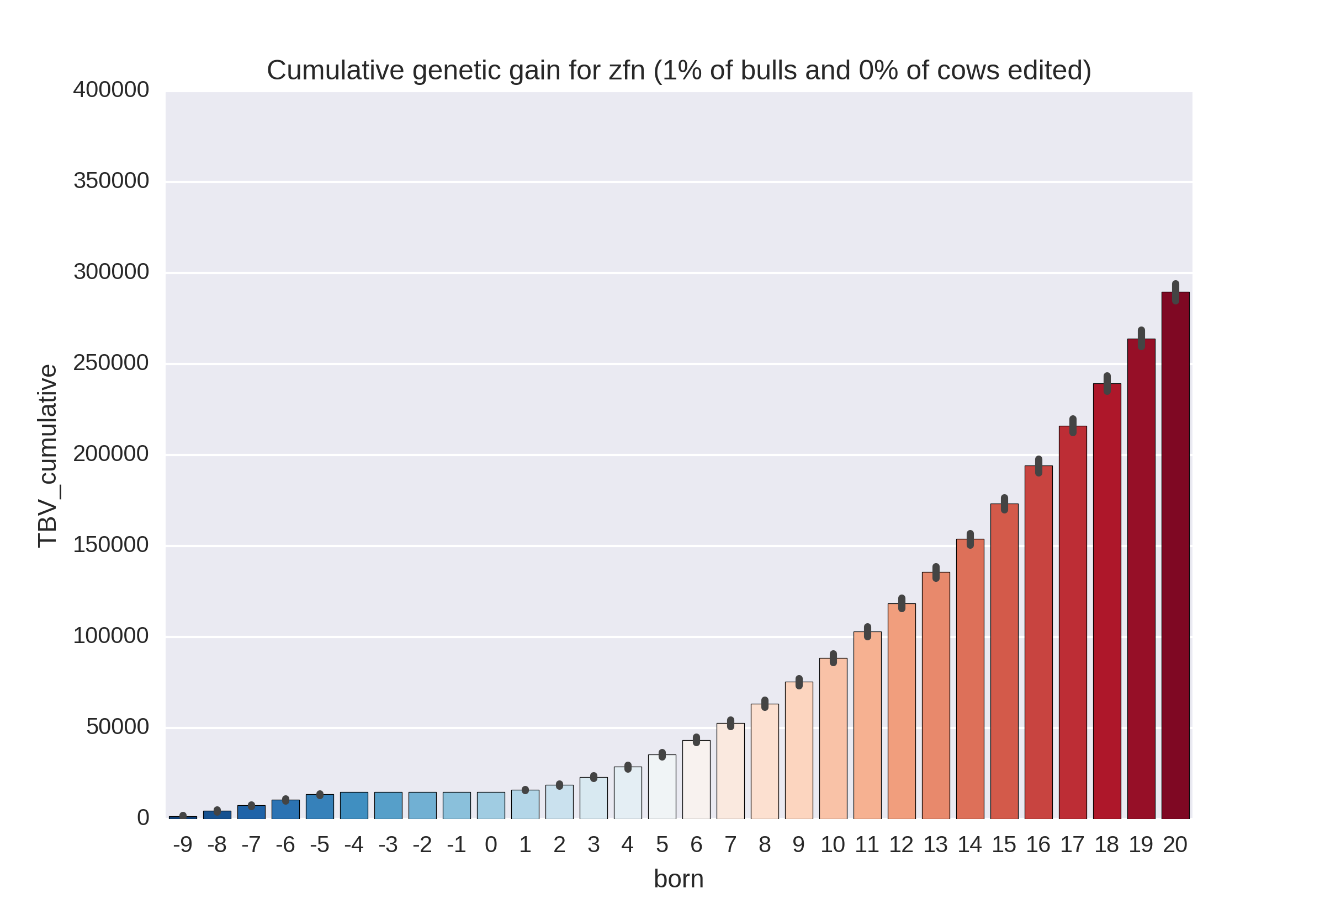

Cumulative genetic gain

Slide 26
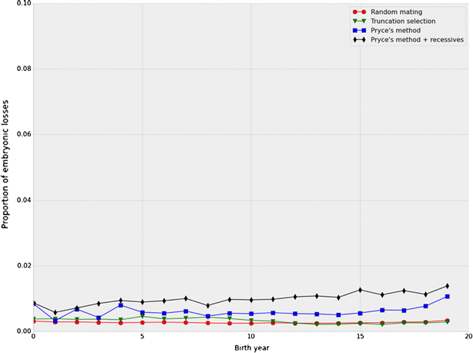
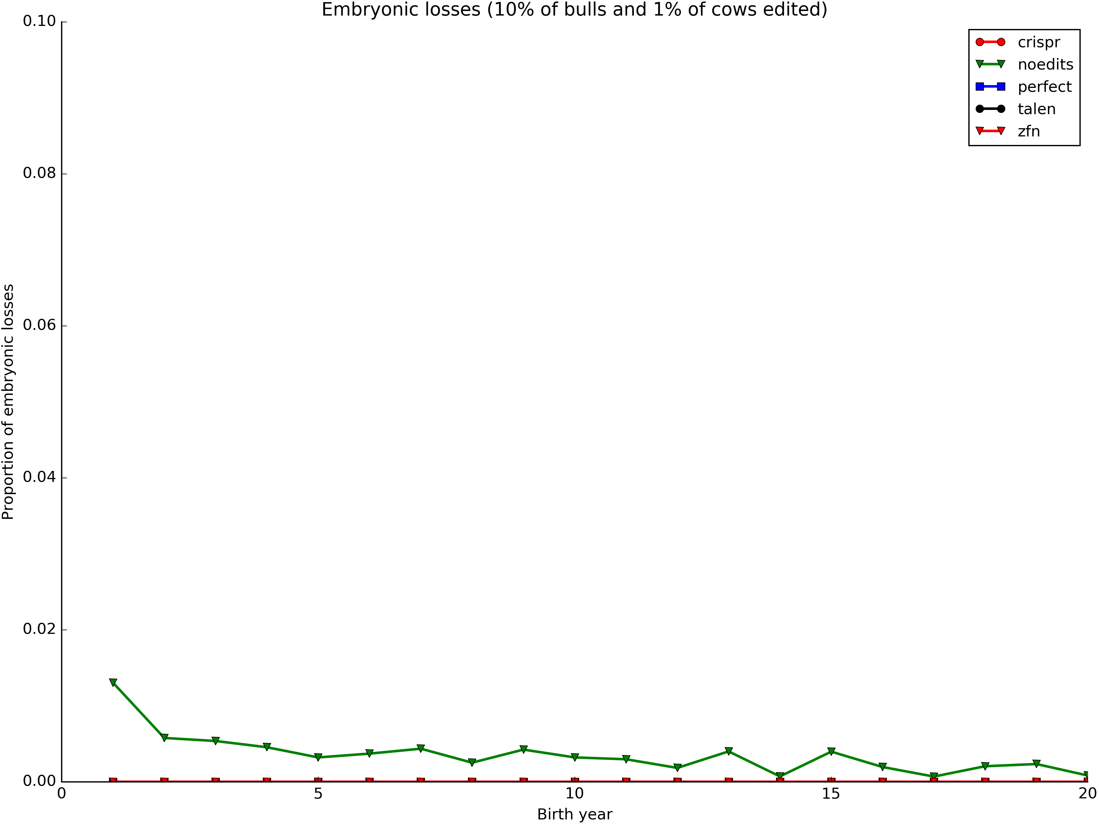
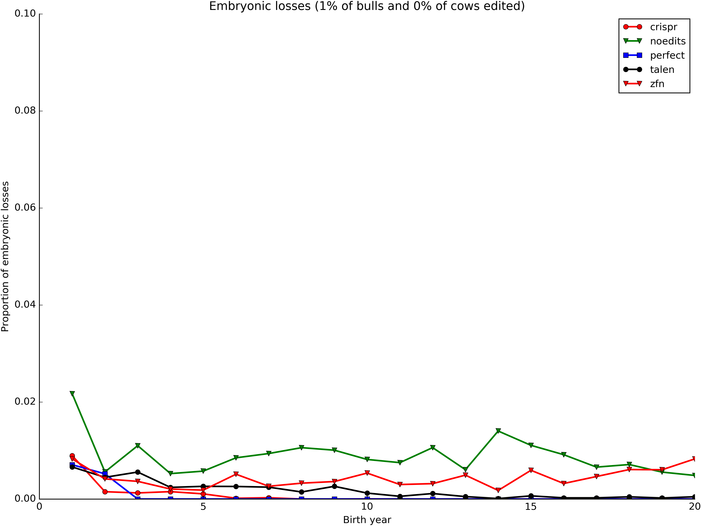
Embryonic deaths by generation

Slide 27
Horned

Slide 28
Why edit for polled?
Increasing polled frequency is slow without a sudden, substantial increase in value
Adding polled to selection indices a long-term (slow) solution
Gene editing to produce high-genetic merit polled bulls may be a short-term (fast) solution

Slide 29
Adding polled to Net Merit
$22.52 = $11.79 + $10.73 for costs of dehorning and polled genetics, respectively (Widmar et al., 2013; Thompson et al., 2017)
Haplotype count multiplied by $11.26 for genotyped animals
Gene content multiplied by $11.26 for non-genotyped animals
Rank correlations with 2014 NM$ very high for bulls and cows

Slide 30
Economic value of polled animals
 | Polled |  |  | Horned
Genotype | PP | Pp |  | pp
Copies of polled haplotype | 2 | 1 |  | 0
% polled offspring | 100 | 50 |  | 0
Average value of offspring | 2 x $11.26 | 1 x $11.26 |  | 0 x $11.26
Total gain from polled | $22.52 | $11.26 |  | $0.00

Slide 31
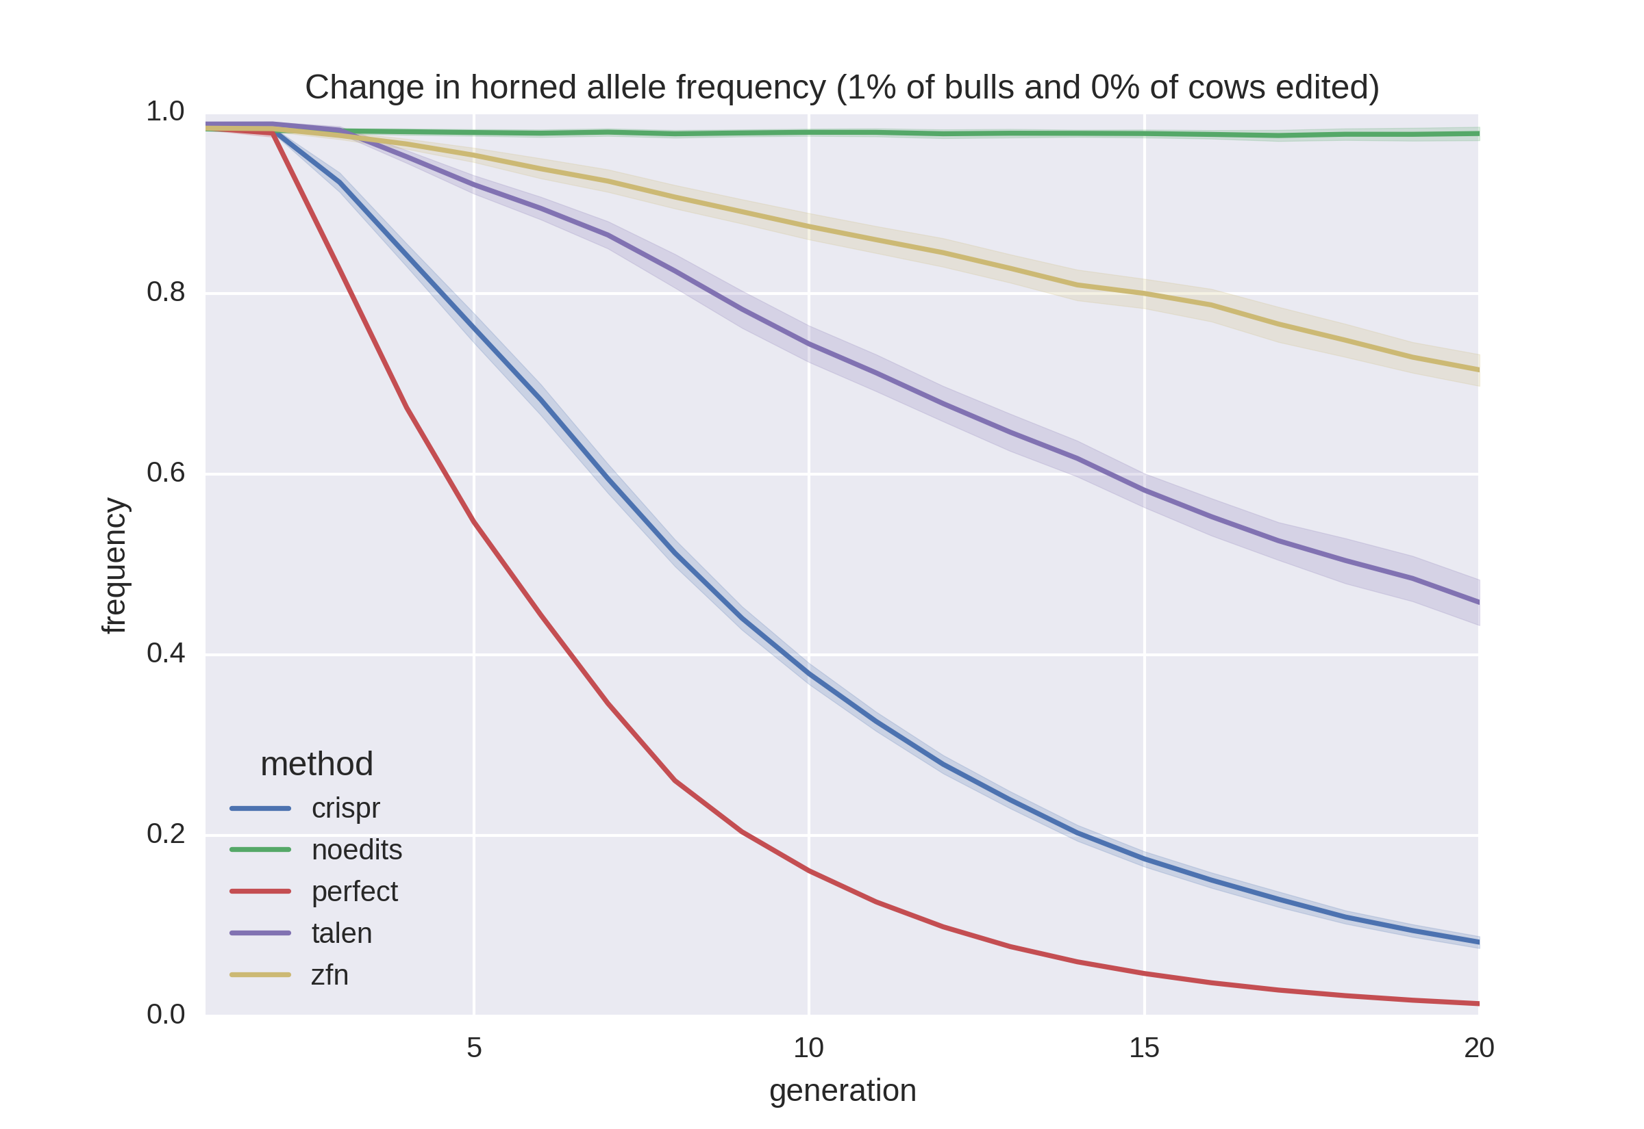
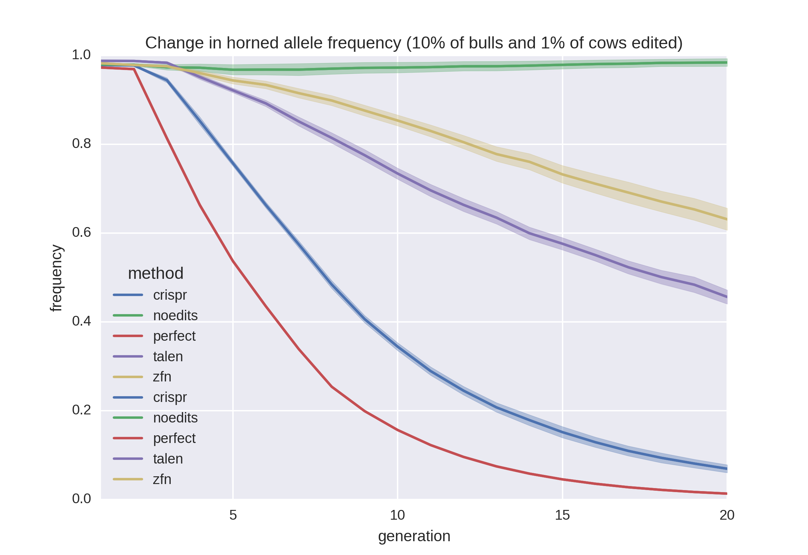
Allele frequency change

Slide 32
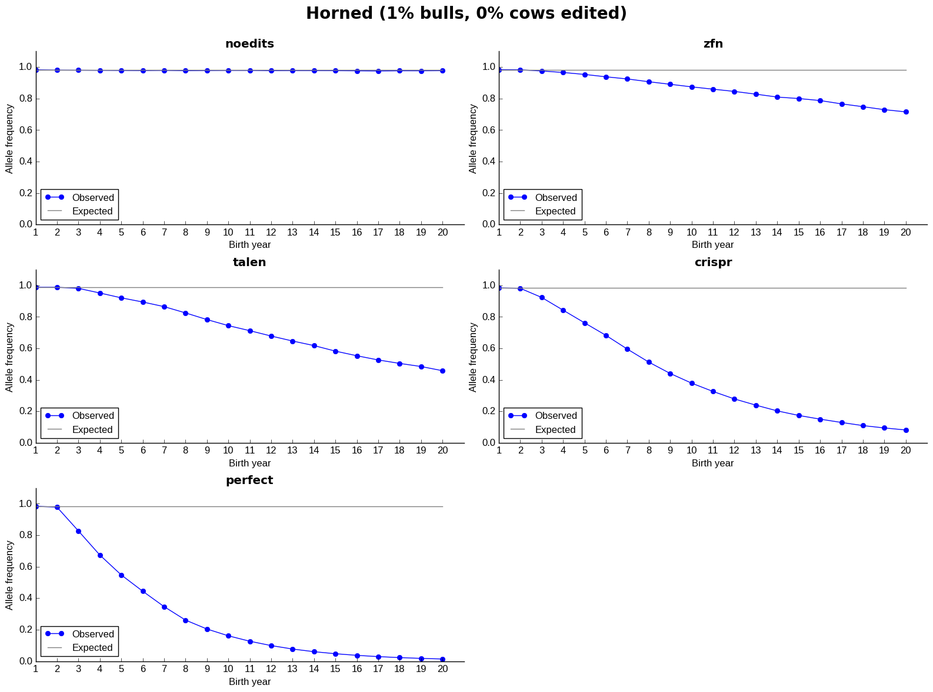
Actual versus observed frequency

Slide 33
Discussion

Slide 34
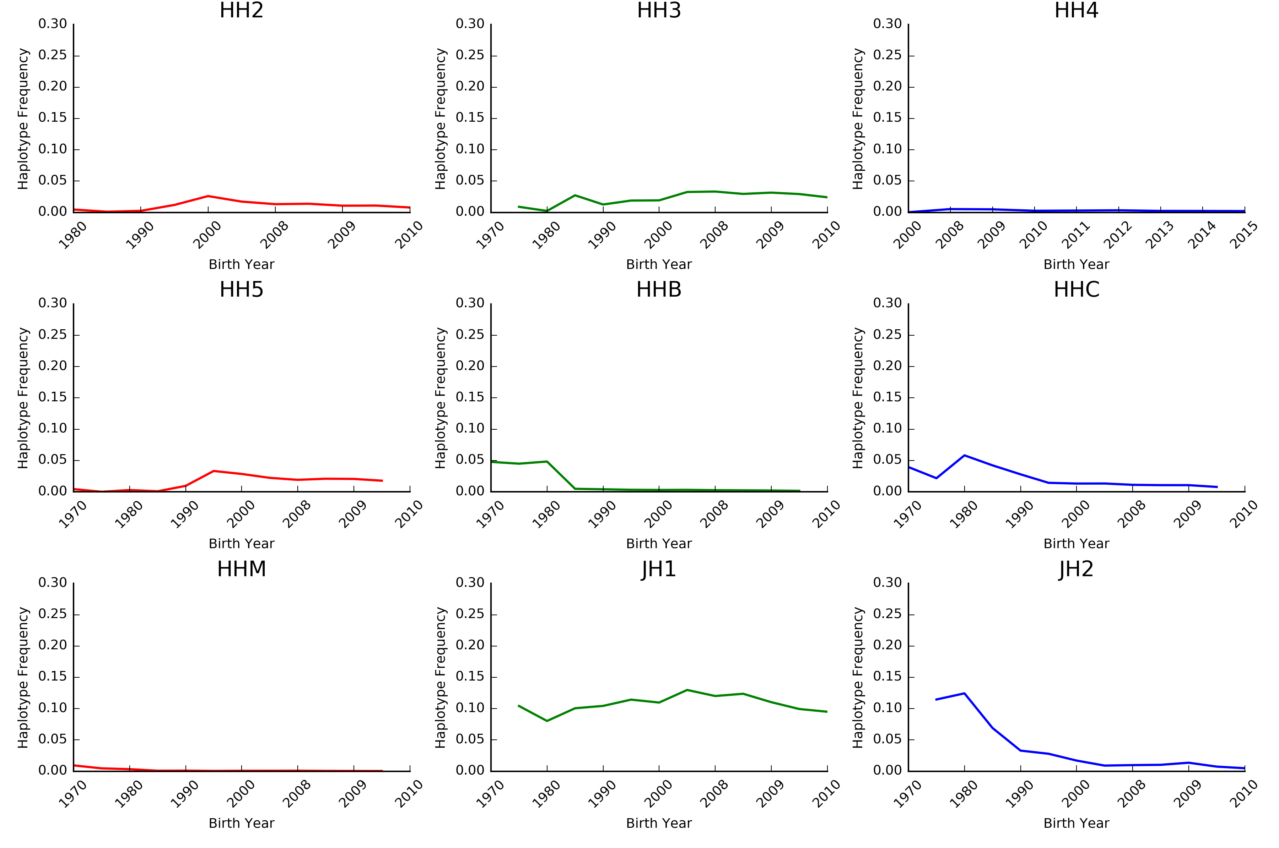
Frequencies change over time
The best way to reduce the frequency of harmful alleles is to not use carrier bulls!
Source: Cole et al. (2016).

Slide 35
What is the best strategy?
Remove carrier bulls from the population
Non-carrier bulls are as good as carrier bulls
 | Carriers |  |  |  | Non-carriers
Breed | N | Mean | SD |  | N | Mean | SD | Difference | P value
AY | 16 | 286.43 | 194.67 |  | 53 | 272.41 | 191.69 | 13.02 | 0.407
BS | 30 | 223.10 | 218.39 |  | 59 | 284.19 | 160.36 | -61.09 | 0.087
HO | 550 | 394.08 | 216.77 |  | 1,765 | 479.49 | 213.89 | -85.41 | <0.001
JE | 99 | 340.51 | 149.00 |  | 378 | 338.82 | 153.99 | 1.69 | 0.460
Source: Cole et al. (2016).

Slide 36
Regulatory considerations
Some gene-edited products have reached the U.S. marketplace (Ledford, 2015; Waltz, 2016)
Regulatory uncertainty remains a concern (Maxmen, 2017)
Oversight is encouraged based on the product, rather than the tool product (Carroll et al., 2016)
It is unknown if meat and milk from gene-edited animals will be offered for sale in the US

Slide 37
Key findings
Proportion of bulls edited had only a small effect on allele frequencies
Editing elite cows had little effect on allele frequencies
The efficiency of the editing technology is more important than the proportion edited
The more efficient the editing technology used the lower the rate of inbreeding

Slide 38
Conclusions
When animals are edited, fewer embryos die because of lethal recessives
Gene editing is a useful tool for increasing the frequency of the polled locus
It may be more effective to remove carriers from the population than to correct them with gene editing

Slide 39
Acknowledgments
USDA-ARS project 8042-31000-101-00, “Improving Genetic Predictions in Dairy Animals Using Phenotypic and Genomic Information”
CNPq “Science Without Borders” project 301025/2014-2
Mention of trade names or commercial products in this article is solely for the purpose of providing specific information and does not imply recommendation or endorsement by the US Department of Agriculture. The USDA is an equal opportunity provider and employer.

Slide 40

Questions?

Slide 41
References
Carroll, D., A.L. Van Eenennaam, J.F. Taylor, J. Seger, and D.F. Voytas. 2016. Regulate genome-edited products, not genome editing itself. Nat. Biotechnol. 34:477–479.
Cole, J.B. 2015. A simple strategy for managing many recessive disorders in a dairy cattle breeding program. Genet. Sel. Evol. 47:94.
Cole, J.B., D.J. Null, and P.M. VanRaden. 2016. Phenotypic and genetic effects of recessive haplotypes on yield, longevity, and fertility. J. Dairy Sci. doi: http://dx.doi.org/10.3168/jds.2015-10777.
Gaj, T., C.A. Gersbach, and C.F. Barbas III. 2013. ZFN, TALEN, and CRISPR/Cas-based methods for genome engineering. Trends Biotechnol. 31:398–405.
Ledford, H. 2015. Salmon approval heralds rethink of transgenic animals. Nat. News 527:417. doi:10.1038/527417a.

Slide 42
References (cont’d)
Li, Y., J.H.J. van der Werf, and B.P. Kinghorn. 2006. Optimisation of crossing system using mate selection. Genet. Sel. Evol. 38:147–65.
Li, Y., J.H.J. van der Werf, and B.P. Kinghorn. 2008. Optimal utilization of non-additive quantitative trait locus in animal breeding programs. J. Anim. Breed. Genet. 125:342–50.
Maxmen, A. 2017. Gene-edited animals face US regulatory crackdown. Nat. News. doi:10.1038/nature.2017.21331.
Pryce, J.E., B.J. Hayes, and M.E. Goddard. 2012. Novel strategies to minimize progeny inbreeding while maximizing genetic gain using genomic information. J. Dairy Sci. 95:377–388.
Shepherd, R.K., and B.P. Kinghorn. 2001. Designing algorithms for mate selection when major genes or QTL are important. Proc. Assoc. Advmt. Anim. Breed. Genet. 14:377–80.

Slide 43
References (cont’d)
Thompson, N.M., N.O. Widmar, M.M. Schutz, J.B. Cole, and C.A. Wolf. 2017. Economic and social considerations of breeding for polled dairy cows versus dehorning. J. Dairy Sci. (Accepted.)
Van Eenennaam A.L., and B.P. Kinghorn. 2014. Use of mate selection software to manage lethal recessive conditions in livestock populations. In: Proceedings of the 10th WCGALP: 17–22 August 2014; Vancouver.
Waltz, E. 2016. Gene-edited CRISPR mushroom escapes US regulation. Nat. News 532:293. doi:10.1038/nature.2016.19754.
Widmar, N.J.O., M.M. Schutz, and J.B. Cole. 2013. Breeding for polled dairy cows versus dehorning: Preliminary cost assessments & discussion. J. Dairy Sci. 96(Suppl. 2):602 (abstr. TH373).

