Slide 1
Hay Burners versus Hay Converters (a.k.a. Feed Efficiency)
Kent Weigel John B. Cole
Department of Dairy Science AGIL, ARS, USDA
University of Wisconsin – Madison Beltsville, MD

Slide 2
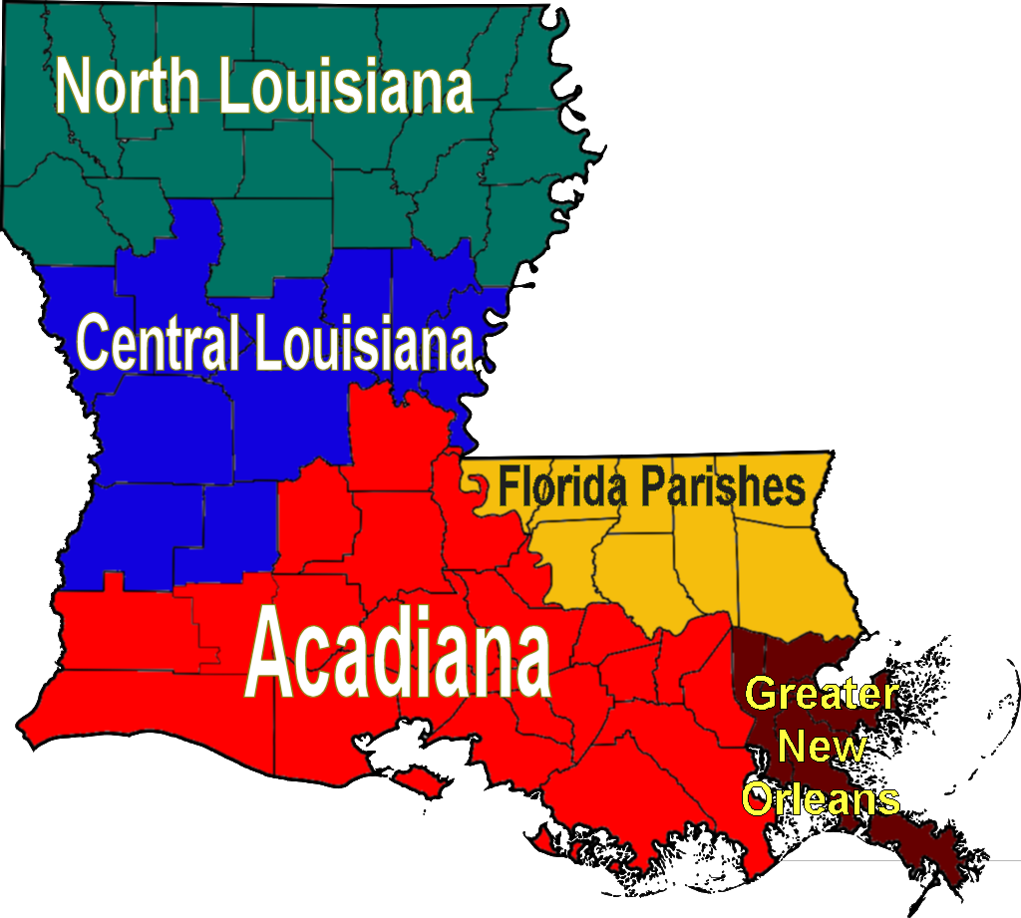

I’ve even been Even north of i-10!
Rice and gravy!
Rice with NO gravy!!!

Slide 3
Topics for discussion
What is feed efficiency?
What do we need to develop genomic evaluations?
How do we include it in selection indices?

Slide 4
Feed efficiency in dairy cattle
Units of product output per unit of product input
Outputs: milk + meat products consumed by humans
Inputs: lifetime feed consumed + energy, fertilizer, . . .
Biological efficiency vs. economic efficiency
Individual cow level vs. whole farm level
Energy efficiency vs. protein efficiency
Both important, but protein usually isn’t limiting
Our focus is biological efficiency of energy utilization in mid lactation, relative to herdmates fed the same diet
VandeHaar et al., 2016

Slide 5
Selection for feed efficiency – why now?
Before Genomics
• Measurement for 1 cow = $500
• Young bulls per year = 1,500
• Daughters per bull = 100
Cows per year = 150,000
Annual cost = $75 million
After Genomics
• Measurement for 1 cow = $500
• Cost per genomic test = $40
No. reference cows = 25,000
Young bulls per year = 5,000
One-time cost = $13.5 million
Annual update cost = $200,000
$50,000 per bull
$310 per bull

Slide 6
Why is it so expensive to measure?
Source: Isa Beefmasters.

Slide 7
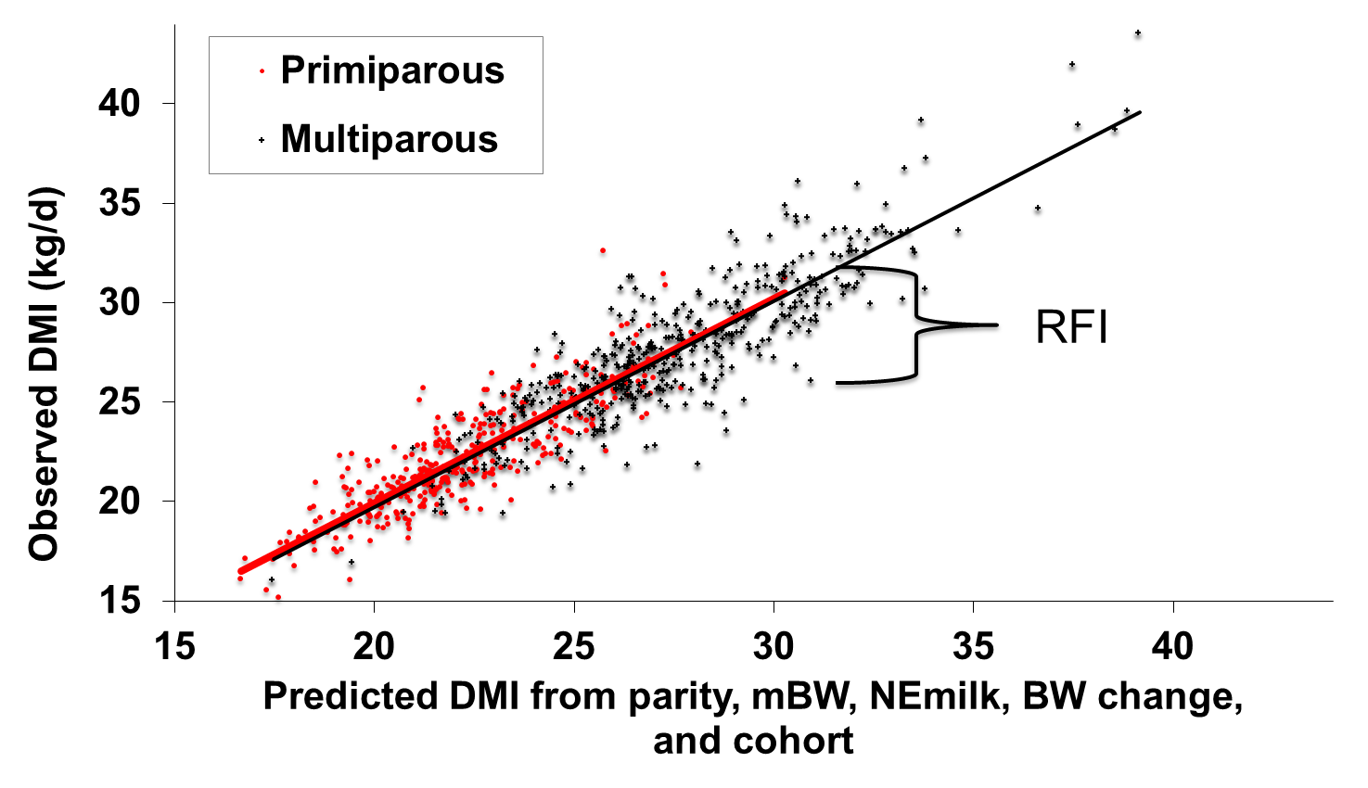
Residual feed intake (RFI)
RFI = Observed DMI - Expected DMI
Milk
Maintenance
Weight Gain/Loss
Energy Sinks
VandeHaar, 2013

Slide 8
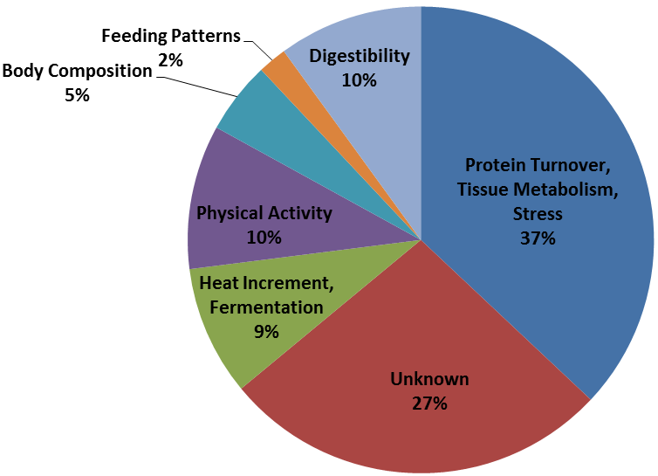
Biology of residual feed intake (RFI)
Gross Energy
RFI
feces, urine,
gas, heat
Net Energy
maintenance
Energy Captured in
Milk and Tissue
Herd & Arthur, 2014

Slide 9
When is the best time to measure RFI?
Connor et al., 2019

Slide 10
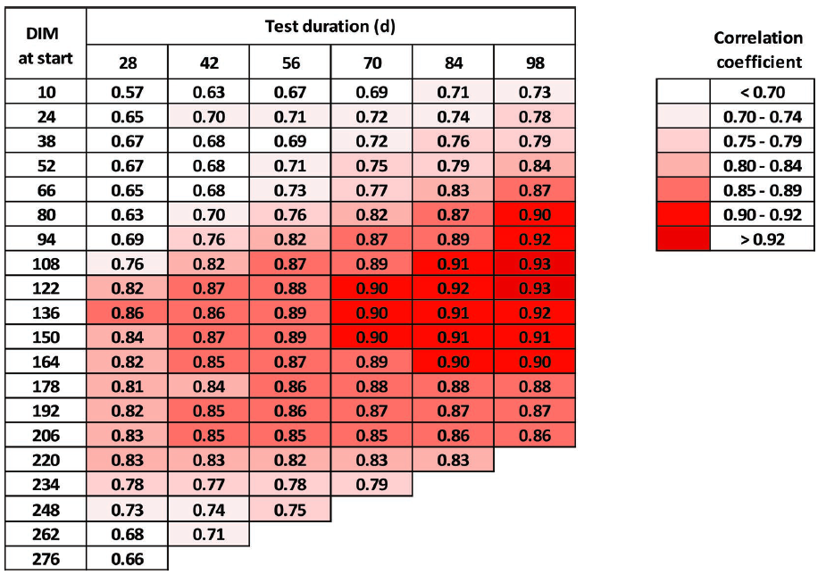
When is the best time to measure RFI?
Connor et al., 2019

Slide 11
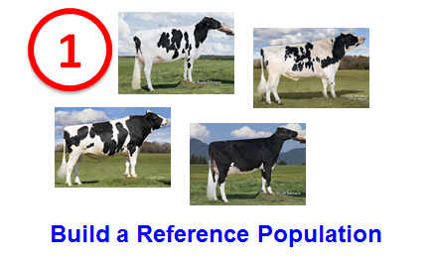
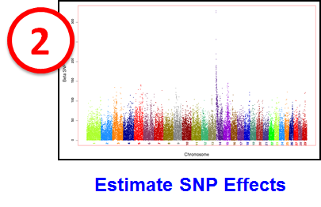
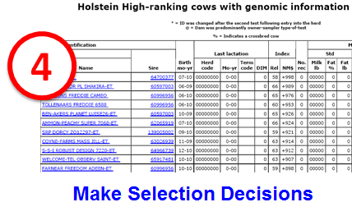
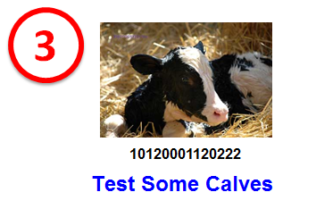
Key steps in genomic selection

Slide 12
AFRI feed efficiency project partners
records* cows *
Michigan State University (East Lansing, MI) 315 273
Iowa State University (Ames, IA) 1,006 953
University of Florida (Gainesville, FL) 582 491
University of Wisconsin-Madison (Madison, WI) 1,056 916
U.S. Dairy Forage Research Center (Madison, WI) 622 474
USDA-AGIL (Beltsville, MD) 834 534
Virginia Tech University (Blacksburg, VA) 93 93
Purina Animal Nutrition Center (Grays Summit, MO) 184 151
Miner Agricultural Research Center (Chazy, NY) 58 58
Agriculture and Food Research Initiative Competitive Grant no. 2011-68004-30340 from the USDA National Institute of Food and Agriculture *used in VanRaden et al., 2018 and Li et al., 2019

Slide 13
Genomic predictions for RFI
Animals:
3,947 cows from 9 research herds
4,823 lactation records
Phenotypes:
Residual feed intake (RFI), in kg/d, computed from:
Dry matter intake (DMI), in kg/d
Metabolic body weight (MBW), in kg^{0.75}, and body weight change
Net energy in milk (Milk NE), in Mcal/d
Measured on 42 consecutive days between 50 to 200 DIM
Genotypes:
Low/medium/high density imputed to 278,524K
Li et al., 2019

Slide 14
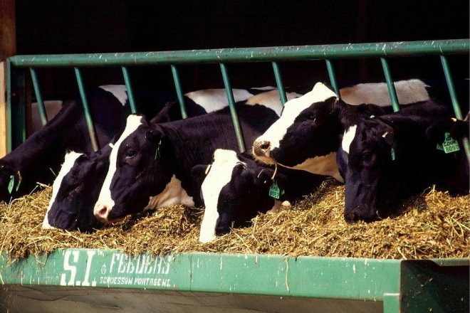
National genomic evaluation for RFI
Feed intakes from research cows already adjusted for phenotypic correlations with milk net energy, metabolic body weight (BW), and weight change to get RFI
Genetic evaluation model:
RFI = breeding value + permanent environment + herd × sire + management group + age-parity + b₁(inbreeding) + b₂(GPTA_{milk net energy} ) + b₃(GPTA_{BW composite})
Remove remaining genetic correlations and include 60 million nongenotyped Holsteins
Genomic model:
Predict 1.4 million genotyped Holsteins

Slide 15
Genomic predictions for RFI
Cows with RFI Data (N=3,947)
Standard deviation of RFI breeding values: 0.33 lb/day
Average theoretical (observed) reliability: 0.31 (0.26)
Young Heifers (N=4,029)
Standard deviation of RFI breeding values: 0.21 lb/day
Average theoretical (observed) reliability: 0.15 (0.10)
Young Bulls (N=5,252)
Standard deviation of RFI breeding values: 0.22 lb/day
Average theoretical (observed) reliability: 0.18 (0.11)
Li et al., 2019

Slide 16
Variance estimates for RFI (and SCS)
Parameter | RFI | SCS
Heritability (%) | 14 | 16
Repeatability (%) | 24 | 35
Phenotypic correlation with yield | 0.00 | –0.10
Genetic correlation with yield | 0.00 | –0.03
SCS provided a 2nd trait with similar properties, which allowed genomic predictions from research cows to be compared with national SCS predictions

Slide 17
Feed data vs. other trait data
Top 100 progeny-tested Holstein bulls for NM$
Average 739 milk daughters, <0.1 RFI daughters
GREL averages 94% milk, 89% NM$, 16% RFI
Top 100 young Holstein bulls for NM$
GREL averages 75% milk, 71% NM$, 12% RFI
REL_{PA} averages 35% milk, 33% NM$, 3% RFI

Slide 18
Computed vs. actual GREL for SCS
Expected genomic reliability (GREL) was 19% for both RFI and SCS
SCS GPTA was correlated by only 0.39 for national vs. research-cow reference data
Observed GREL of SCS was (0.39)² × 72% = 11%
RFI GREL was discounted to agree with Var(PTA) for RFI and observed GREL of SCS

Slide 19
Economic progress
Higher reliability for other traits than for RFI because of more records
RELNM$ averages 75% for young and 91% for proven bulls
RELRFI averages ~12% for young and 16% for proven bulls
Progress for lifetime profit may be only 1.01 times or 1% faster than current NM$ progress, but the extra gain is worth $4.5 million per year to the U.S. dairy industry

Slide 20
Economic value of RFI
Statistic | Milk production (3.5% F, 3.0% P) | Dry matter intake | Residual feed intake
Lactation mean (lb/lactation) | 25,000 | 16,600 | 0
Lactation SD (lb/lactation) | 2,900 | 2,750 | 1,130
Price/lb | $0.17 | $0.12 | $0.12
Mean income or cost/lactation | $4,250 | –$1,992 | 0
Lifetime value/lb (2.8 lactations) | $0.253 | –$0.336 | –$0.336
Relative value (% of NM$) | 36% |  | –16%
Economic values for milk and BW continue to subtract correlated feed consumption
Subtraction of expected feed intake from milk yield is the “net” in NM$

Slide 21
Lifetime net merit including RFI
20% Fat Yield –6% Somatic Cell Score
–16% Residual Feed Intake –5% Body Weight Composite
15% Protein Yield 4% Calving Ability
11% Productive Life 2% Feet & Legs Composite
6% Cow Livability 1% Cow Conception Rate
6% Udder Composite 1% Heifer Conception Rate
6% Daughter Pregnancy Rate – 1% Milk Yield
VanRaden et al., 2018

Slide 22
How is this different from feed efficiency in TPI®?
An indirect indirect predictor of feed efficiency is included in TPI®
(Dollar Value of milk produced) – (Feed costs of extra milk) – (Extra maintenance costs)
Milk and components yields are used along with body weight composite
FE = (– 0.0187 x Milk) + (1.28 x Fat) + (1.95 x Protein) – (12.4 x BWC)
Feed efficiency receives 8% of the weight in TPI®
Holstein Association, 2017

Slide 23
Alternatives to publishing RFI
Feed Saved
Index of RFI and excess maintenance costs
Feed Saved per Lactation (pounds of dry matter)
- (305 days x RFI per day) - (1.67 x 40 x Body Weight Comp.)
Lifetime Feed Saved (dollars)
- $0.12 x 2.8 lactations x Feed Saved per Lactation
Example bull with RFI = -0.6 and BWC = -2.5
- (305 x -0.6) - (1.67 x 40 x -2.5)) = 350 pounds per lactation
-$0.12 x 2.8 x 350 = $118 lifetime value of feed saved
Pryce et al., 2015; VanRaden et al., 2018

Slide 24
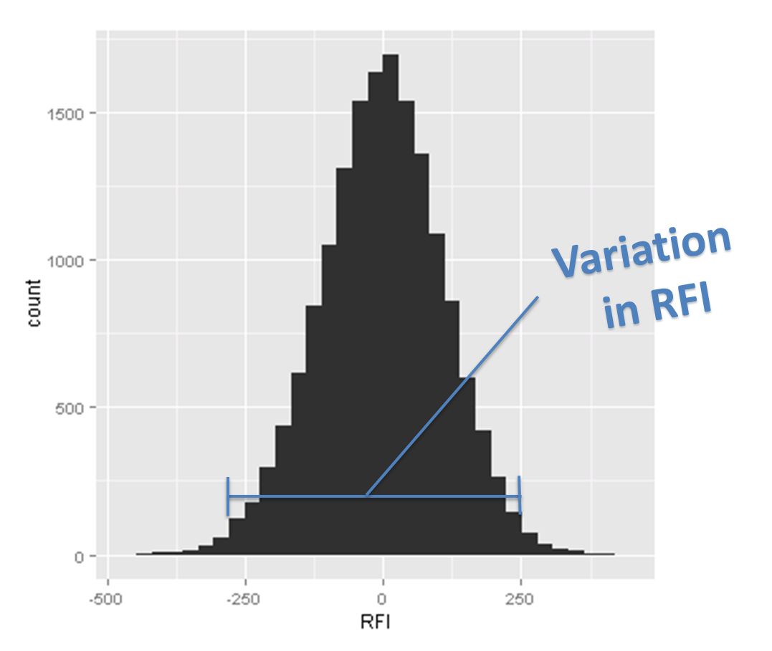
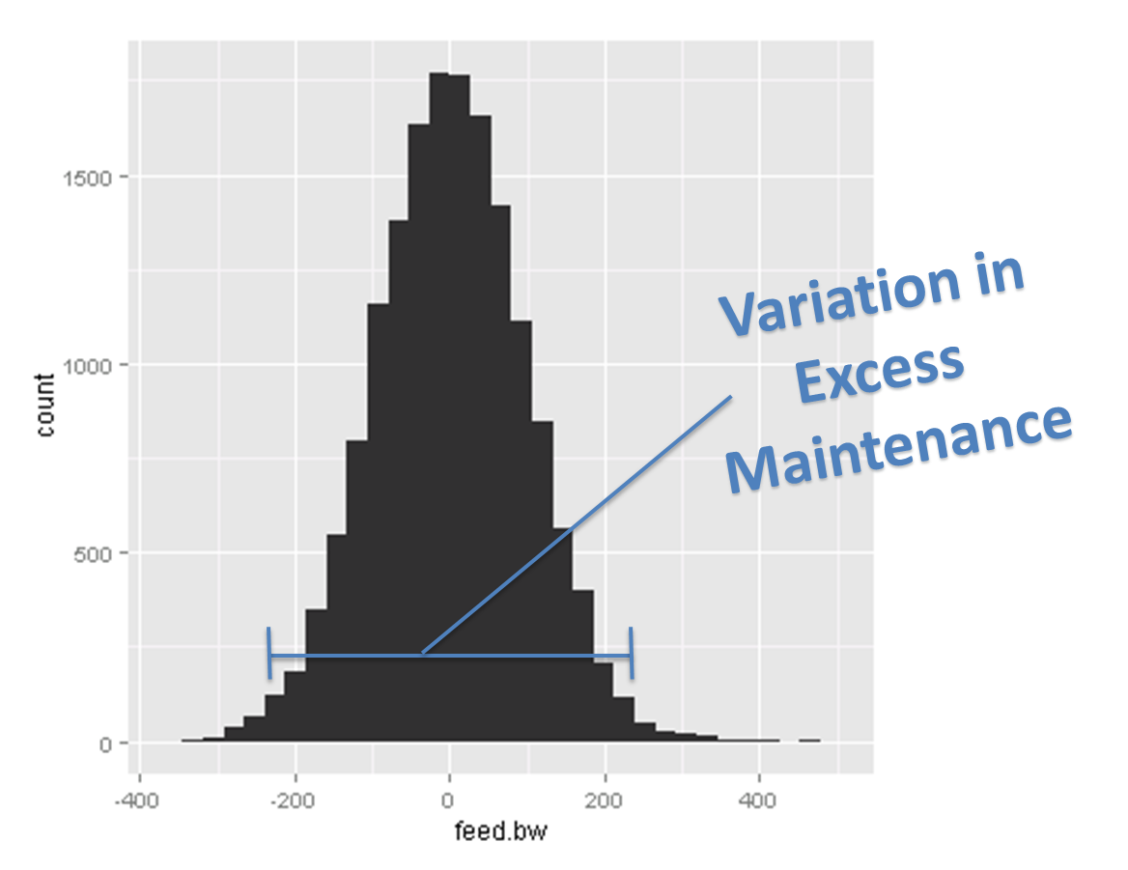
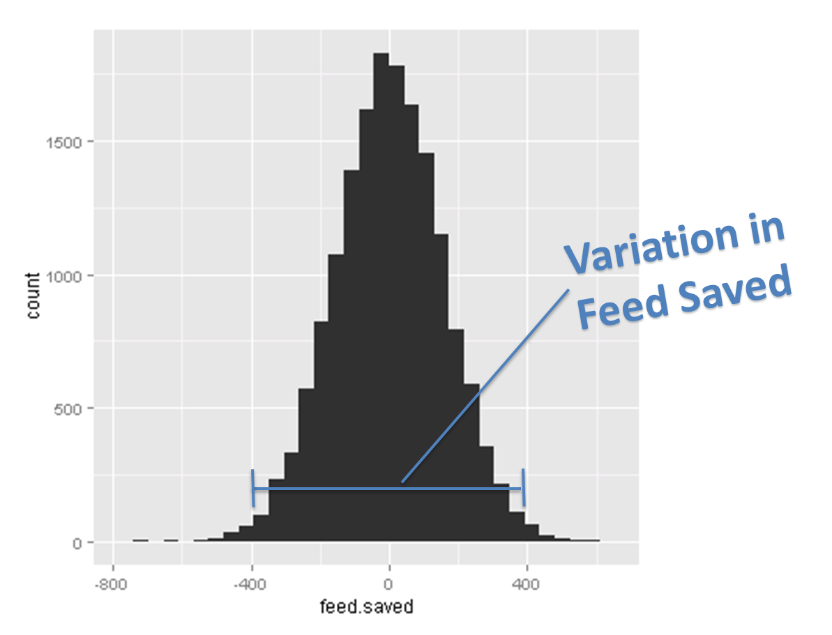
RFI, excess maintenance, and feed saved
Yao et al., 2016

Slide 25
CDCB-FFAR feed efficiency partners
new phenotypes/year
Michigan State University (East Lansing, MI) 80
Iowa State University (Ames, IA) 216
University of Florida (Gainesville, FL) 150
University of Wisconsin-Madison (Madison, WI) 320
USDA-AGIL (Beltsville, MD) 50
Project Aims: 1) increase reliability of genomic predictions for RFI
2) implement plan for updating RFI reference population
3) develop sensor-based index to predict dry matter intake
4) study associations between RFI and methane emissions

Slide 26
Several genomic regions are associated with RFI

Slide 27
Future research
How is feed efficiency related to methane production?
Can the rumen microbiome be manipulated to improve cow efficiency and enhance sustainability?
What correlated traits can we use to improve genomic predictions of feed efficiency?

Slide 28
Take-home messages
Our USDA-AFRI grant ended in 2017
We have dry matter intake, secreted milk energy, and body weight data for >5,000 Holstein cows
RFI is the contemporary deviation in dry matter intake after accounting for known energy sinks
RFI is independent of milk yield and body size
Significant genetic variation exists in RFI

Slide 29
Take-home messages
Genomic predictions for RFI can be computed from our Holstein reference population
RFI will comprise about 16% of Lifetime Net Merit
Reliabilities will be low, typically only 15 to 20%
Feed Saved (RFI + body size penalty) is an option
Collecting more feed intake phenotypes is critical!
The CDCB-FFAR project will provide > 800 cows per year plus info about sensors and biomarkers

Slide 30
Acknowledgments
The author was supported by USDA-ARS project 8042-31000-002-00-D, “Improving Dairy Animals by Increasing Accuracy of Genomic Prediction, Evaluating New Traits, and Redefining Selection Goals”.
The conference organizers funded the author’s travel.
USDA is an equal opportunity provider and employer.
Mention of trade names or commercial products in this presentation is solely for the purpose of providing specific information and does not imply recommendation or endorsement by the US Department of Agriculture.

Slide 31
Questions?

