Slide 1
AGIL Research Report, March 2018
John B. Cole
USDA, Agricultural Research Service
Henry A. Wallace Beltsville Agricultural Research Center
Animal Genomics and Improvement Laboratory
Beltsville, MD 20705-2350
john.cole@ars.usda.gov

Slide 2
Outline
Current projects in AGIL
Recent and anticipated staffing changes
Animal Improvement Program research

Slide 3
AGIL structure
Animal Genomics and Improvement Laboratory
(28.6 FTE, ~$8 million appropriated budget)
Enhancing Genetic Merit of Ruminants Through Improved Genome Assembly, Annotation, and Selection (G. Liu)
Improving Dairy Animals by Increasing Accuracy of Genomic Prediction, Evaluating New Traits, and Redefining Selection Goals (P. VanRaden)
Improving Feed Efficiency and Environmental Sustainability of Dairy Cattle Through Genomics and Novel Technologies (E. Connor)
Development of Genomic Tools to Study Ruminant Resistance to Gastrointestinal Nematodes (R. Li) (Project moved to another Laboratory)

Slide 4
Animal Improvement Program staffing
Dr. John Cole is Acting Research Leader
Dr. Paul VanRaden is full-time (100% FTE)
Dr. Curt Van Tassell is contributing 25% FTE
Dr. Jeff O’Connell (University or Maryland School of Medicine) paid for 20% FTE
We are entering Year 2 of a Department-level hiring freeze
  Permanent RL position (vacant)
  Dr. Derek Bickhart’s position (vacant)

Slide 5
Staffing (cont’d)
I’ve hired two postdoctoral scientists
Collaboration with university and industry colleagues remains important
  Dr. Yang Da, University of Minnesota
  Dr. Li Ma, University of Maryland
  Dr. Christian Maltecca, NCSU
  Dr. Yutaka Masuda, University of Georgia
Frank Ross, IT Specialist, left AGIL for CDCB on March 2.
Mel Tooker, Animal Scientist, will retire this spring.

Slide 6
Dr. Heather Bradford
PhD, 2017, University of Georgia
Thesis work on improved methods
for ssGBLUP, including selection of
core animal and effects of pedigree
structure
Hired to work on issues related to
pedigree structure and unknown
parent groups to improve the accuracy
of genomic evaluations

Slide 7
Dr. Bingjie Li
PhD, 2017, Department of Animal Breeding
and Genetics, Swedish University of
Agricultural Sciences, Sweden
Thesis focused on feed utilization in Nordic
cattle
Hired to work with whole-genome DNA sequence data from University of Minnesota selection and control line cows, as well as other projects of mutual interest
  Data not available, working on feed intake/animal efficiency at the moment

Slide 8
Current projects in AGIL
All projects are on new 5-year plans that began in 2017
“Enhancing Genetic Merit of Ruminants Through Improved Genome Assembly, Annotation, and Selection” – George Liu (genomics tools)
“Improving Dairy Animals by Increasing Accuracy of Genomic Prediction, Evaluating New Traits, and Redefining Selection Goals” – Paul VanRaden (AIP)
“Improving Feed Efficiency and Environmental Sustainability of Dairy Cattle through Genomics and Novel Technologies ” – Erin Connor (feed efficiency, nutrient metabolism, GHG)

Slide 9
AIP project plan objectives
Expand genomic data used in prediction by selecting new variants that more precisely track the true gene mutations that cause phenotypic differences.
Evaluate new traits that can all be predicted at birth from the same inexpensive DNA sample.
Improve efficiency of genomic prediction and computation by developing faster algorithms, testing new adjustments and models, and accounting for genomic pre-selection in evaluation.

Slide 10
Objective 1 – Causal variants
Using true causal DNA variants preferable to SNP that are in linkage
Results
  Null et al. (2017): New Ayrshire fertility haplotype
  Ortega et al. (ongoing): Confirming biological mechanisms of fertility haplotypes
  VanRaden et al. (2017): Comparison of whole-genome DNA sequencing versus SNP chips for genotyping new variants
  Weller et al. (2018): Concordance of causal DNA variants with QTL is low

Slide 11
Objective 2 – New traits
Hutchison et al. (2017): Age at first calving evaluations
Hutchison et al. (2017): Bull fertility evaluations for Angus service sires
Parker Gaddis et al. (2018): Cow health evaluations
Tiezzi et al. (2017): Using gene networks to improve calving ease evaluations
Tooker et al. (2017): Genomic predictions for crossbred cows
VanRaden et al. (2017): Feed saved evaluations
Wright et al. (2017): Gestation length evaluations

Slide 12
Objective 3 – Improved methodology
Better models, evaluations, computing procedures
Results
  Ongoing research with University of Georgia on single-step methodology
  Dr. Bradford working on pedigree structure and unknown parent groups
  AIP staff have delivered new backend programs to CDCB to simplify addition of new traits to the genetic evaluation system

Slide 13
Other AIP research
A new genome assembly developed in collaboration with AGIL staff, UC Davis, and University of Missouri has been submitted to NCBI for annotation
  Almost all of the markers on the UMD 3.1.1 assembly have been successfully mapped
  Annotation tells us where genes are, which is not needed for genomic prediction but is important for research
Zoetis has a new Holstein assembly, but it is not available to the public
The Australians have a new Brangus reference assembly

Slide 14
Dairy Calf DNA BioBank
Collect DNA and phenotype information from calves affected with genetic disorders, and their relatives
Beta version of website
  https://aipl.arsusda.gov/BioBank/
If patterns are observed (e.g., many problems in one family), DNA is available for sequencing to identify causal change in genome and develop a diagnostic test
To make a report, contact john.cole@ars.usda.gov
Hoping to work with breed associations and National DHIA to raise awareness of project

Slide 15
Disclaimers
USDA is an equal opportunity provider and employer
Mention of trade names or commercial products in this presentation is solely for the purpose of providing specific information and does not imply recommendation or endorsement by USDA

Slide 16
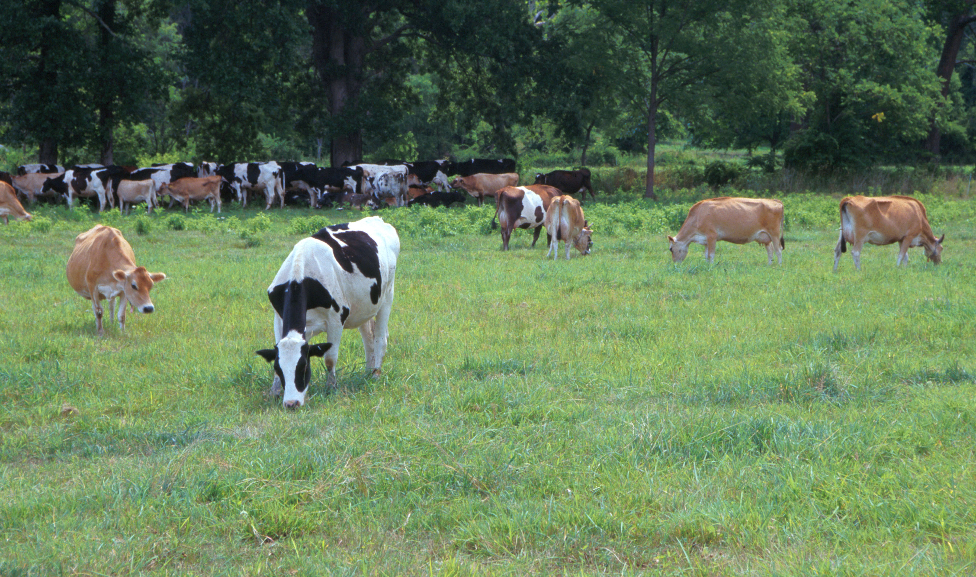
Questions?
AIP web site:
http://aipl.arsusda.gov
Holstein and Jersey crossbreds graze on American Farm Land Trust’s
Cove Mountain Farm in south-central Pennsylvania
Source: ARS Image Gallery, image #K8587-14; photo by Bob Nichols

