Slide 1
  Everything you need to know about gene editing…in 25 minutes or less!
John B. Cole
USDA, Agricultural Research Service
Henry A. Wallace Beltsville Agricultural Research Center
Animal Genomics and Improvement Laboratory
Beltsville, MD 20705-2350

Slide 2
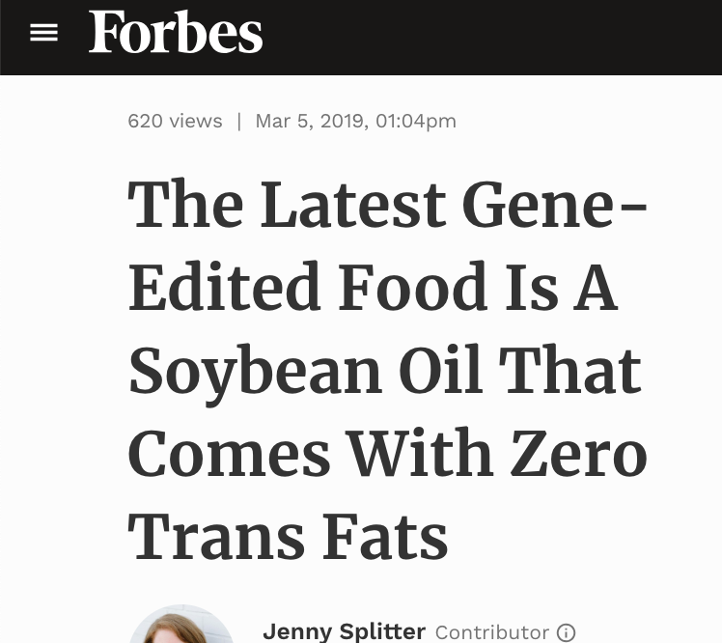
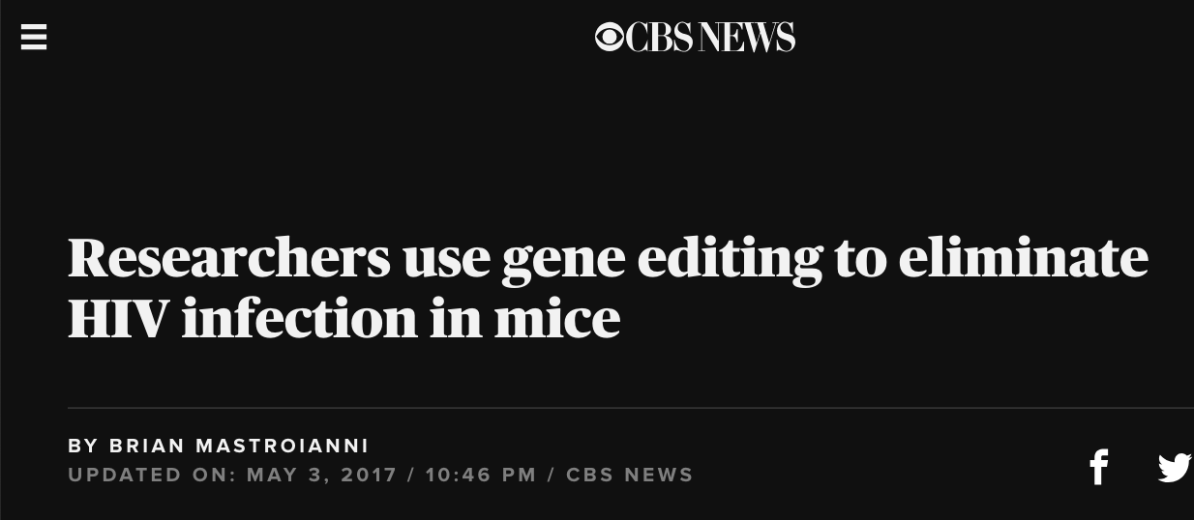
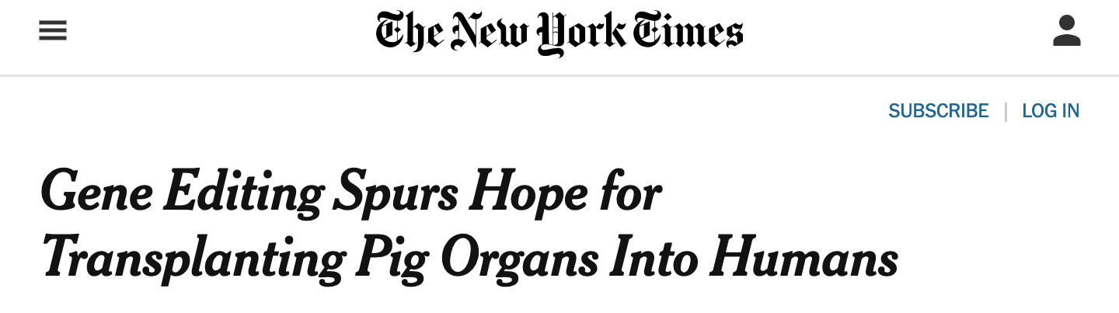


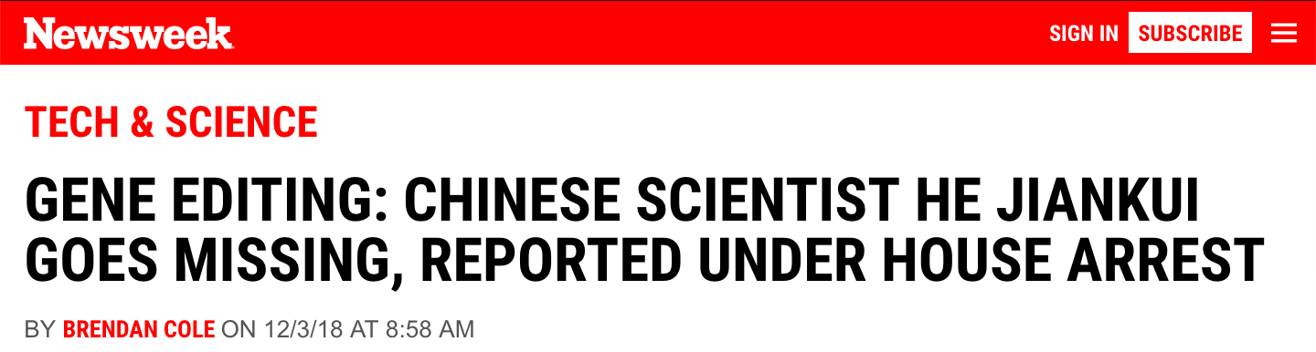
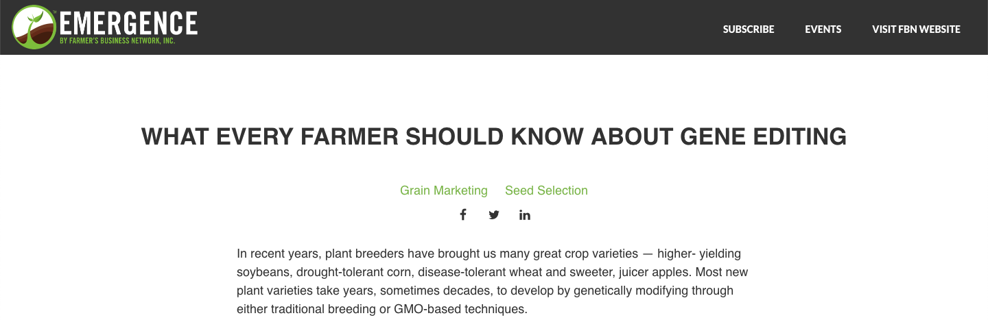
Gene editing is a hot topic!

Slide 3
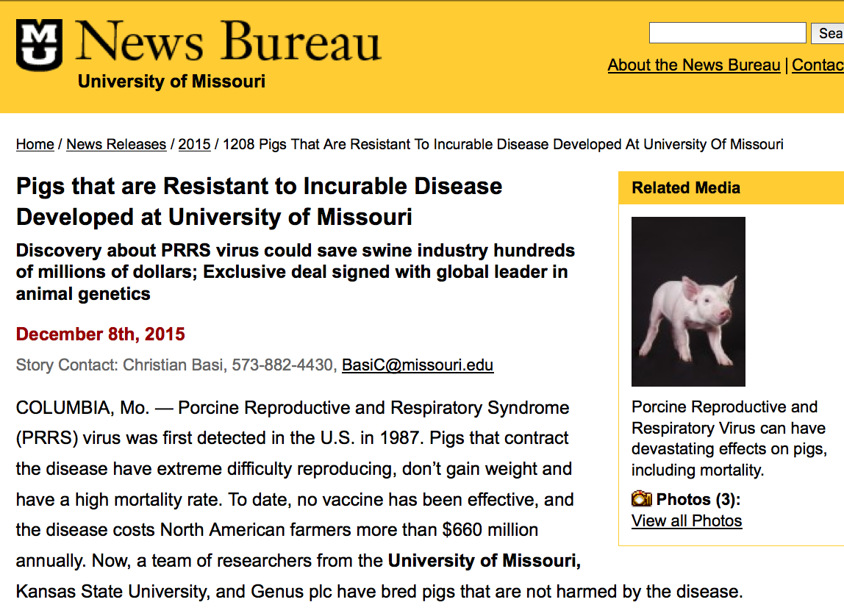
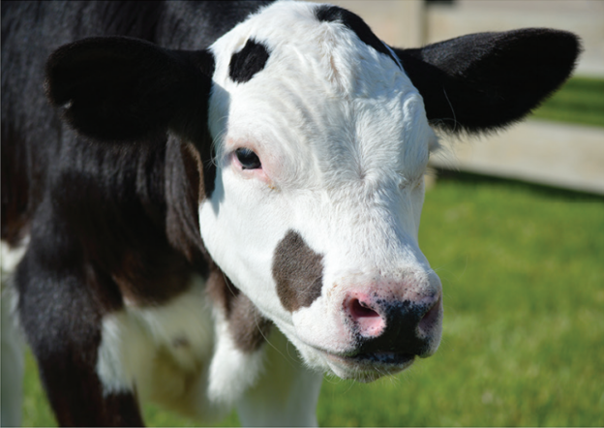
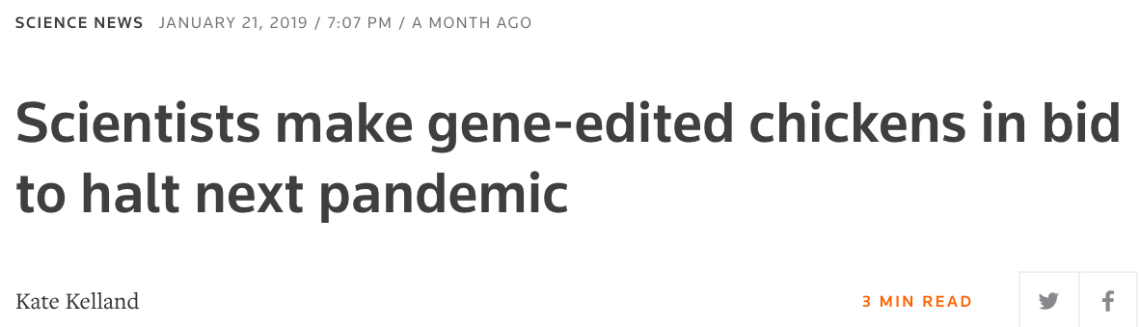
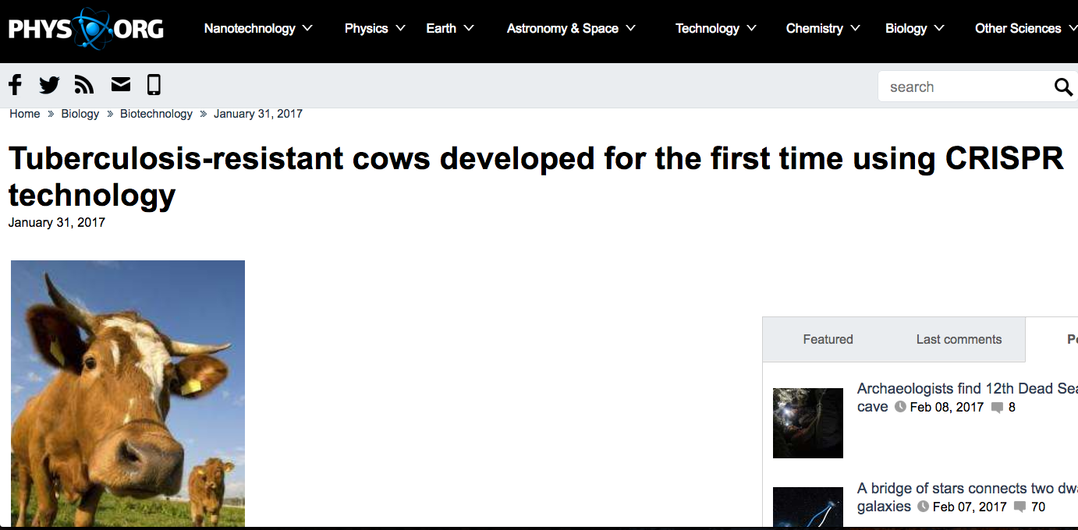
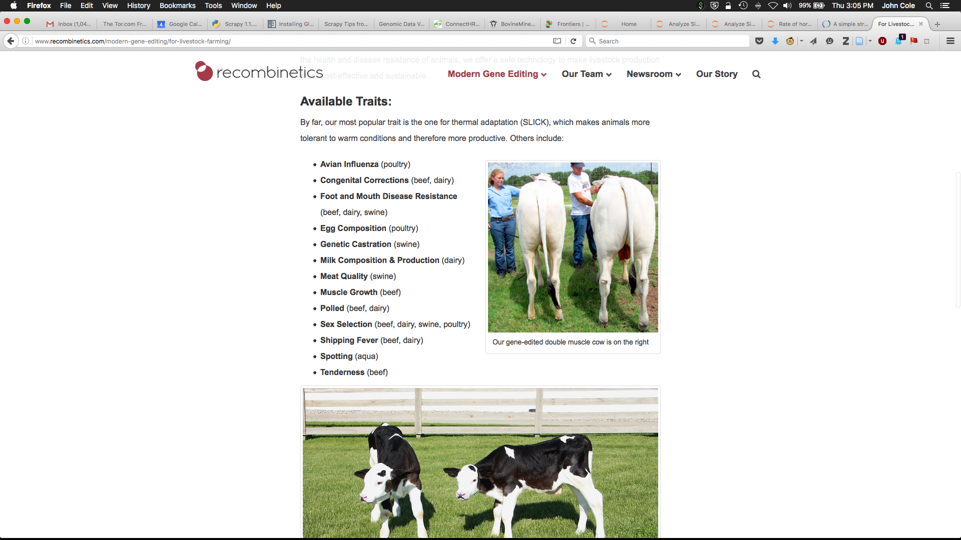
Some examples of gene editing in livestock

Slide 4
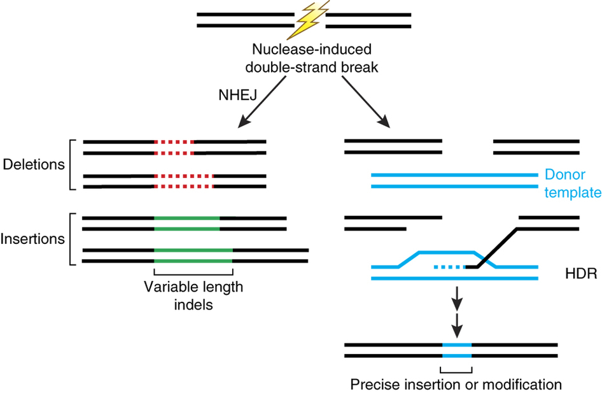
What is gene editing?
Notes:
Heat maps of global export and import of maize and soybean (FAOSTAT)
Red high levels of export or import, green low
U.S. world’s largest producer and exporter of corn, 2nd largest exporter of soybeans after Brazil
China, Japan, and some developing countries are leading importers.
Implications for asynchronous approvals

Slide 5
Types of edits
Deletions (knock-outs)
  Used to “turn off” or deactivate genes
  Relatively easy to do
  Example: Myostatin knockouts for increased muscle growth
Insertions (knock-ins)
  Used to insert new products into an animal’s genome
  Relatively difficult to do
  Example: Introgression of the polled allele

Slide 6
Van Eenennaam, A. L. 2017. Genetic Modification of Food Animals. Current Opinion in Biotechnology. 44:27-34.
Notes:
Heat maps of global export and import of maize and soybean (FAOSTAT)
Red high levels of export or import, green low
U.S. world’s largest producer and exporter of corn, 2nd largest exporter of soybeans after Brazil
China, Japan, and some developing countries are leading importers.
Implications for asynchronous approvals

Slide 7
What genes might be edited in cattle?
Target | Targeted Trait/Goal | Reference
Intraspecies POLLED allele substitution | No horns/welfare trait | Carlson et al., 2016
Intraspecies SLICK allele substitution | Heat tolerance | Sonstegard et al., 2017
Myostatin (MSTN) gene knockout | Increased lean muscle yield | Proudfoot et al., 2014
Beta-lactoglobulin gene knockout | Elimination of milk allergen | Yu et al., 2011
Prion protein (PRNP) knockout | Elimination of prion protein | Bevacqua et al., 2016
Intraspecies CALPAIN & CAPASTATIN allele substitution | Improved meat tenderness | Casas et al., 2006 (not reduced to practice)
Insertion of lysostaphin/lysozyme transgene | Resistance to mastitis | Liu et al., 2013 &2014
CD18 gene edit | Resistance to bovine respiratory disease | Shanthalingam et al., 2016
Insertion of SP110, NRAMP1 | Resistance to tuberculosis | Wu et al., 2015; Gao et al., 2017
Intraspecies SRY translocation onto X chromosome | All male offspring | Owen et al., 2018
NANOS gene knockout | Infertile males (for gonial cell transfer) | Ideta et al., 2016
Notes:
Heat maps of global export and import of maize and soybean (FAOSTAT)
Red high levels of export or import, green low
U.S. world’s largest producer and exporter of corn, 2nd largest exporter of soybeans after Brazil
China, Japan, and some developing countries are leading importers.
Implications for asynchronous approvals

Slide 8
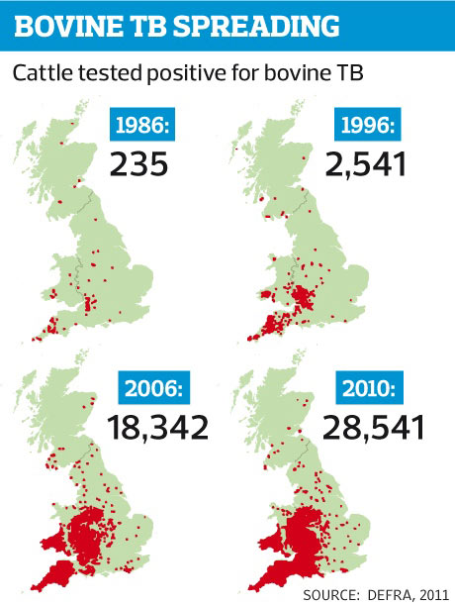
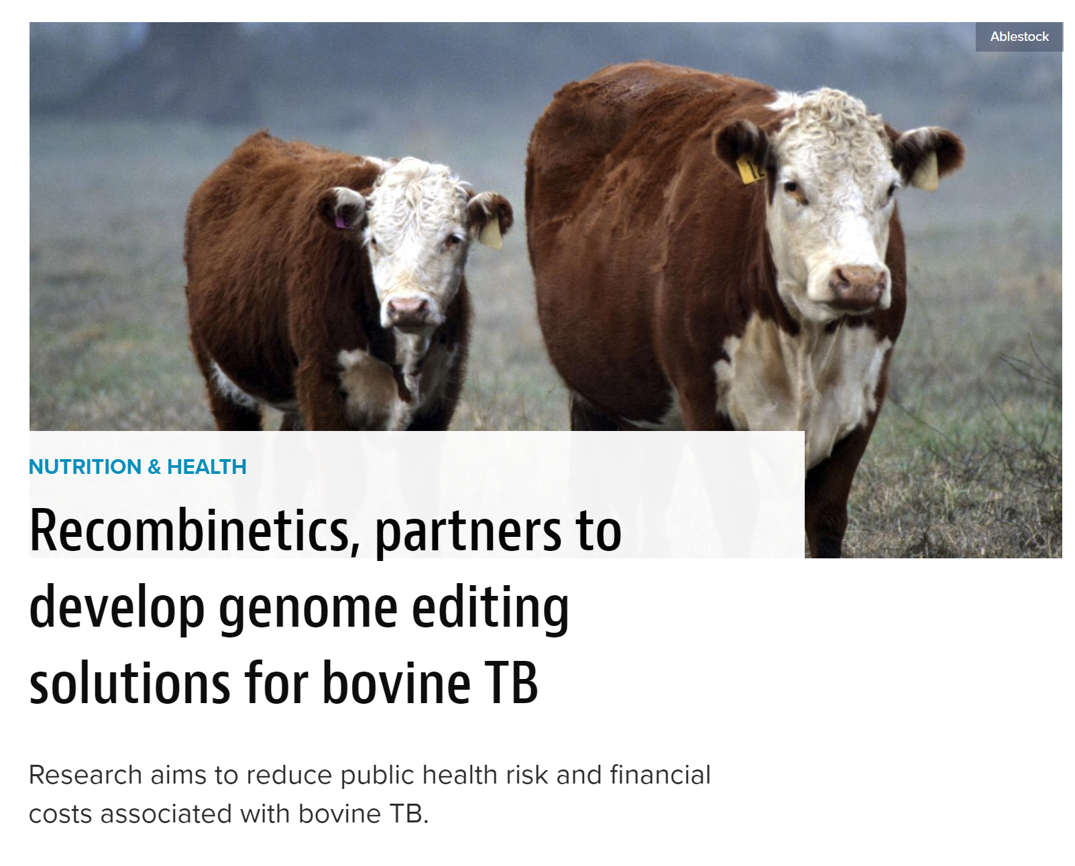
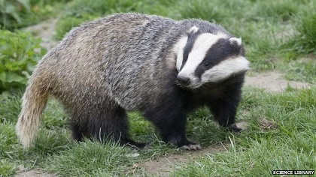
Improving resistance to bovine tuberculosis
TARGET-TB: University College Dublin in the Republic of Ireland, Queen’s University Belfast in Northern Ireland & Recombinetics collaborate to combat Mycobacterium bovis, pathogen that causes bovine tuberculosis
https://www.feedstuffs.com/nutrition-health/recombinetics-partners-develop-genome-editing-solutions-bovine-tb
Notes:
Heat maps of global export and import of maize and soybean (FAOSTAT)
Red high levels of export or import, green low
U.S. world’s largest producer and exporter of corn, 2nd largest exporter of soybeans after Brazil
China, Japan, and some developing countries are leading importers.
Implications for asynchronous approvals

Slide 9
How might editing be used in other species?
Species | Target | TargetedTrait/Goal
Cattle | Intraspecies POLLED allele substitution | No horns (welfare trait)
 | Myostatin gene silence | Increased muscle yield
 | Beta-lactoglobulin gene silence | Elimination of milk allergen
 | Intraspecies insertion of SP110 gene | Resistance to tuberculosis
Chicken | Ovalbumin gene silence | Elimination of ovalbumin in egg
 | Insertion of Immunoglobulin heavy chain locus | Germline gene editing
Goat | Myostatin gene silence | Increased muscle growth
 | Prion protein gene silence | Elimination of prion protein
 | Beta-lactoglobulin gene silence | Elimination of milk allergen
Pig | CD163 gene silence | PRRS Virus Resistance
 | Interspecies (warthog) RELA allele substitution | African Swine Fever Resistance
 | Myostatin gene silence | Increased muscle yield
 | Knockout of sexual maturity pathway | No need for castration
Sheep | Myostatin gene silence | Increased muscle yield
 | FGF5 gene silence | Increased wool length & yield
Notes:
Heat maps of global export and import of maize and soybean (FAOSTAT)
Red high levels of export or import, green low
U.S. world’s largest producer and exporter of corn, 2nd largest exporter of soybeans after Brazil
China, Japan, and some developing countries are leading importers.
Implications for asynchronous approvals

Slide 10
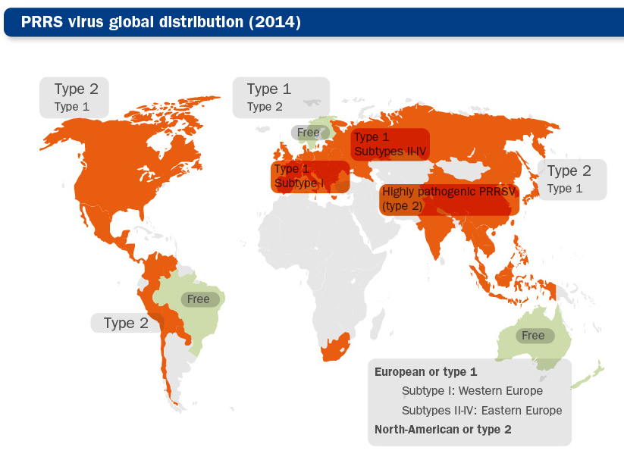


Porcine Reproductive and Respiratory Syndrome
Annual cost to industry:
US
$600,000,000
Europe
>$1,000,000,000
Notes:
Heat maps of global export and import of maize and soybean (FAOSTAT)
Red high levels of export or import, green low
U.S. world’s largest producer and exporter of corn, 2nd largest exporter of soybeans after Brazil
China, Japan, and some developing countries are leading importers.
Implications for asynchronous approvals

Slide 11
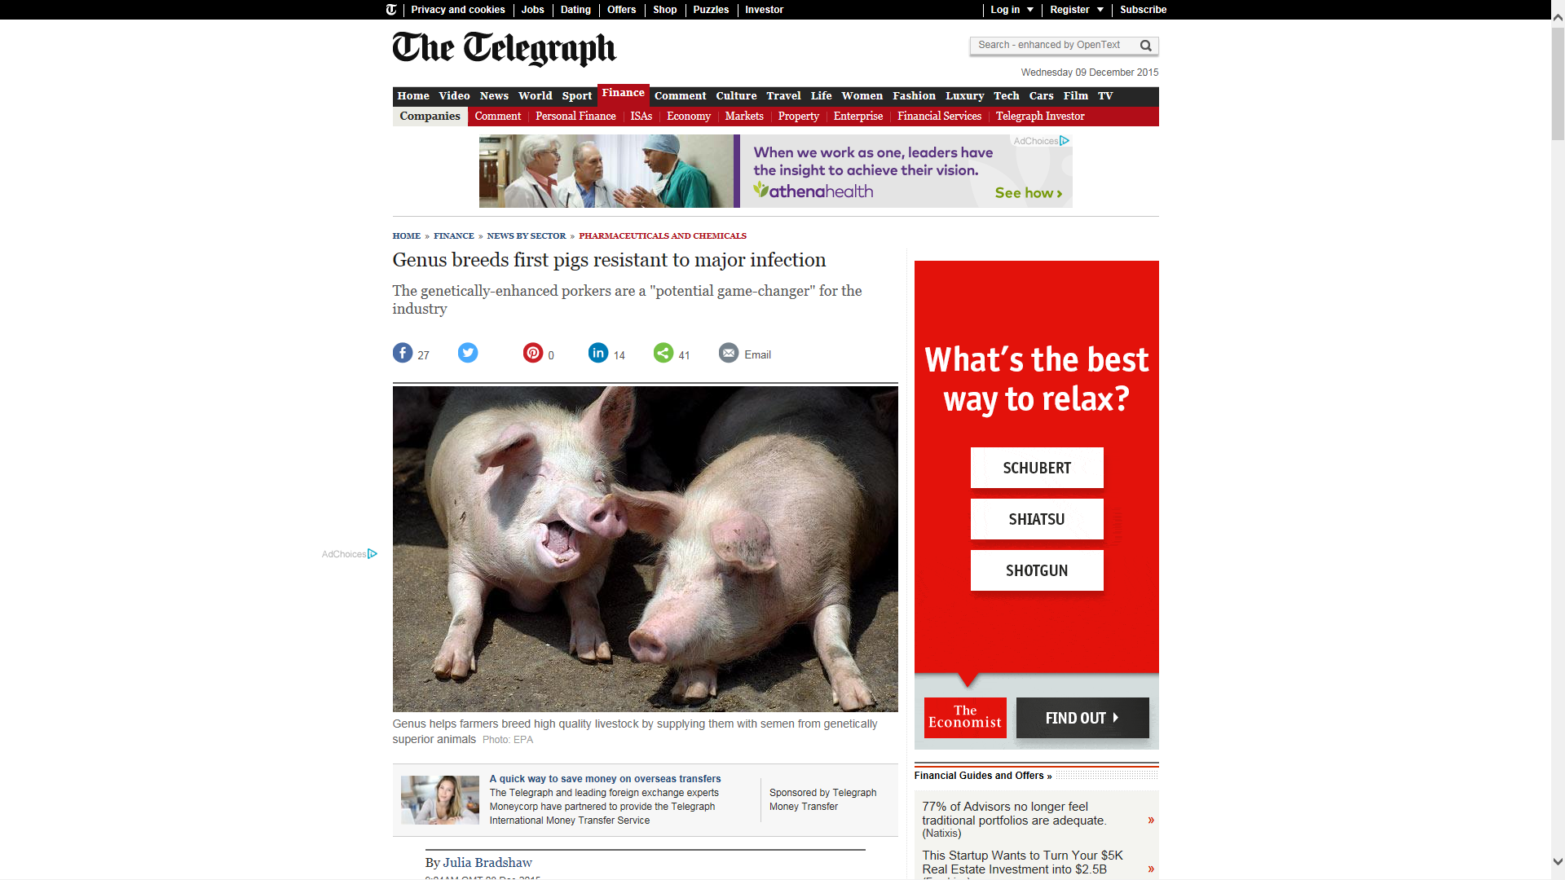
Editing produces pigs that are not susceptible to PRRS
Kristin Whitworth et al. 2016. Gene-edited pigs are protected from porcine reproductive and respiratory syndrome virus (PRRSV). Nature Biotech. 34:20-22.
University of Missouri, USA
Christine Burkard et al. 2018. Pigs Lacking the Scavenger Receptor Cysteine-Rich Domain 5 of CD163 Are Resistant to Porcine Reproductive and Respiratory Syndrome Virus 1 Infection. Virol. 92:16
Roslin Institute, Scotland
Notes:
Heat maps of global export and import of maize and soybean (FAOSTAT)
Red high levels of export or import, green low
U.S. world’s largest producer and exporter of corn, 2nd largest exporter of soybeans after Brazil
China, Japan, and some developing countries are leading importers.
Implications for asynchronous approvals

Slide 12
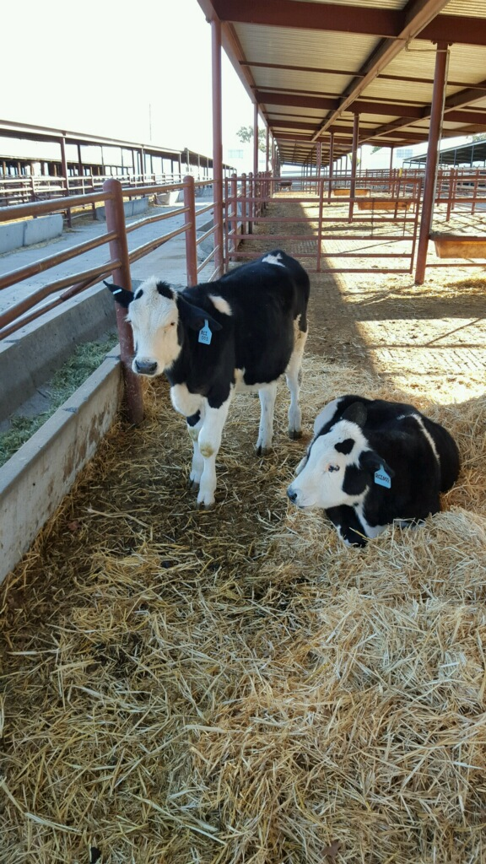
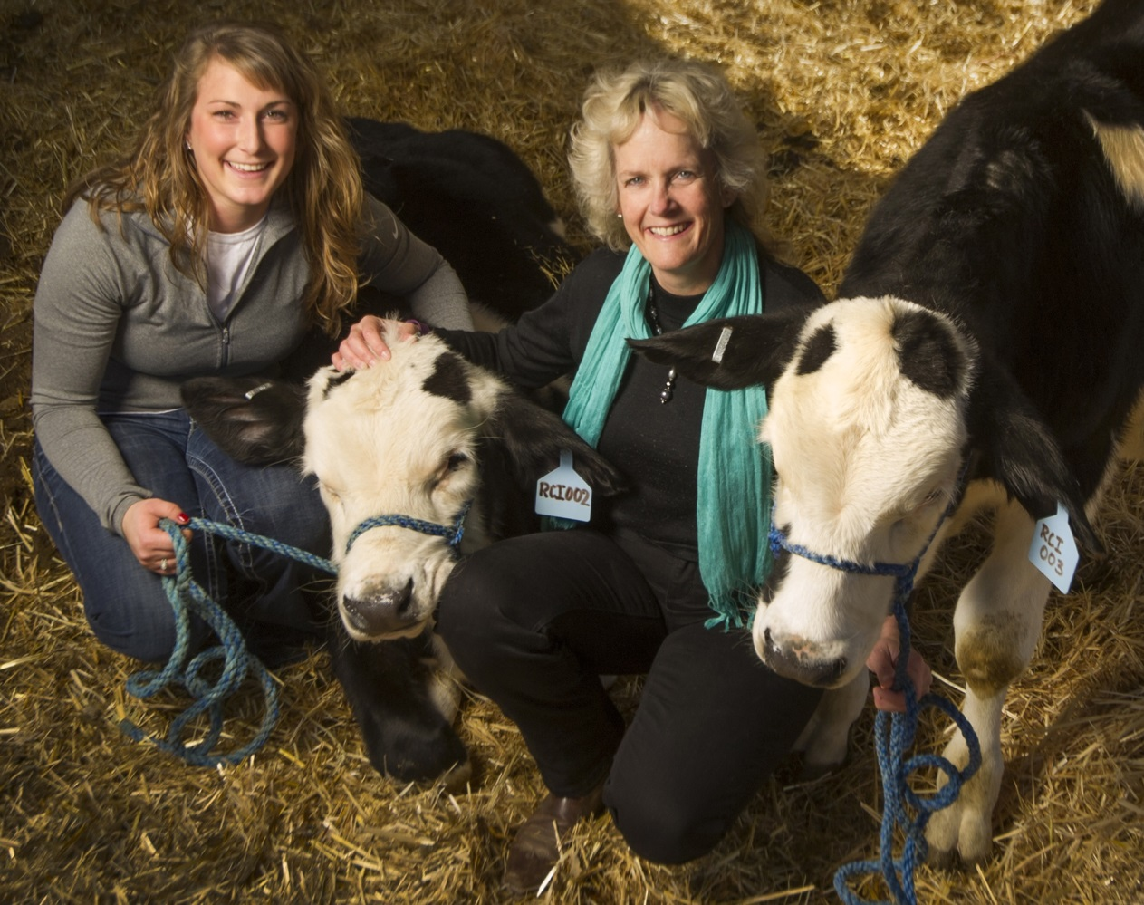
Gene edited polled calves: Naturally occurring allele
Carlson DF, Lancto CA, Zang B, Kim E-S, Walton M, et al. 2016. Production of hornless dairy cattle from genome-edited cell lines. Nat Biotech 34: 479-81
Notes:
Heat maps of global export and import of maize and soybean (FAOSTAT)
Red high levels of export or import, green low
U.S. world’s largest producer and exporter of corn, 2nd largest exporter of soybeans after Brazil
China, Japan, and some developing countries are leading importers.
Implications for asynchronous approvals

Slide 13

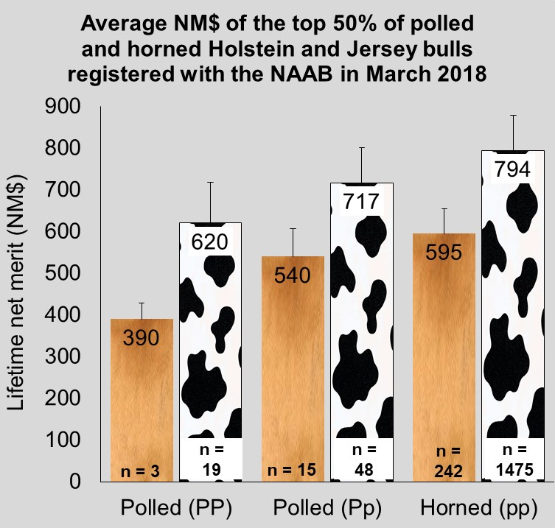
Many polled bulls lag behind horned contemporaries
Daughters of polled Holstein sires will earn less over their lifetimes
Polled allele frequency is 0.0071
Adding polled to selection indices is not effective
If used exclusively polled sires would increase inbreeding & decrease genetic gain
Mueller, Maci et al. 2018. Simulation of introgression of the POLLED allele into the Holstein breed via conventional breeding versus gene editing. Proc. 11th World Congr. Genet. Appl. Livest. Prod., Auckland, New Zealand 11:755
Notes:
Heat maps of global export and import of maize and soybean (FAOSTAT)
Red high levels of export or import, green low
U.S. world’s largest producer and exporter of corn, 2nd largest exporter of soybeans after Brazil
China, Japan, and some developing countries are leading importers.
Implications for asynchronous approvals

Slide 14
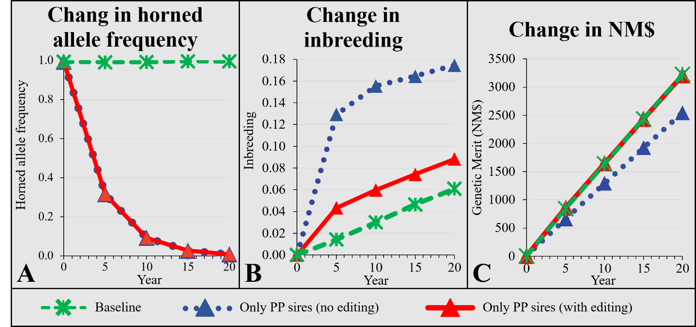
Simulation of introgression of the polled allele
Notes:
Heat maps of global export and import of maize and soybean (FAOSTAT)
Red high levels of export or import, green low
U.S. world’s largest producer and exporter of corn, 2nd largest exporter of soybeans after Brazil
China, Japan, and some developing countries are leading importers.
Implications for asynchronous approvals

Slide 15
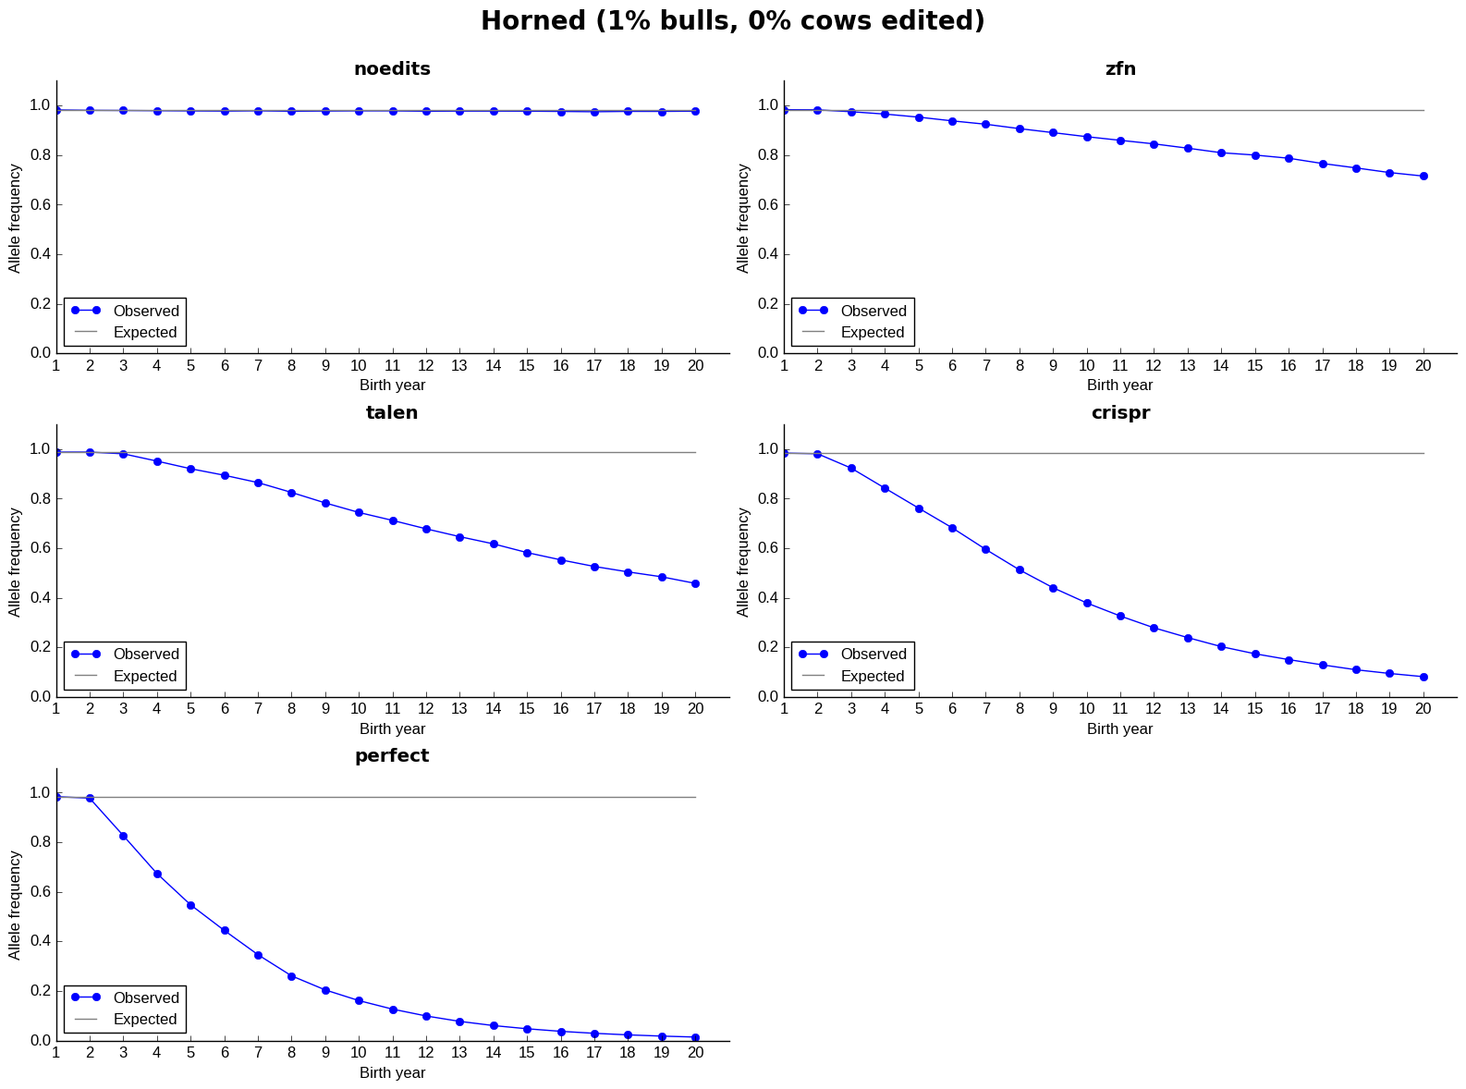
Actual versus observed frequencies vary by method

Slide 16
Is gene editing the solution to the recessives problem?
Estimated losses are at least $11 million/year in the US alone
Much speculation about application of gene editing in livestock populations
  Rapid introgression of desirable Mendelian traits, such as the Slick (Loi et al., 2016) and Polled (Mueller et al., 2019) loci
  Improvement of quantitative traits (Jenko et al., 2015)
  Development of animal models of complex human disease (e.g., Tu et al., 2015)
What about editing carriers to rapidly eliminate harmful alleles from the population?

Slide 17
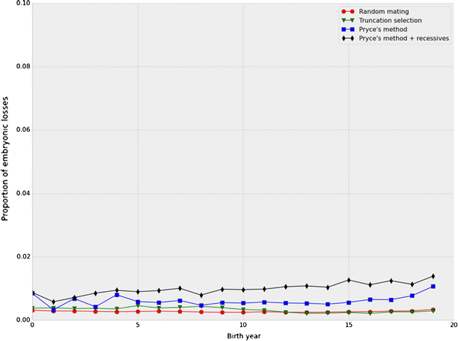
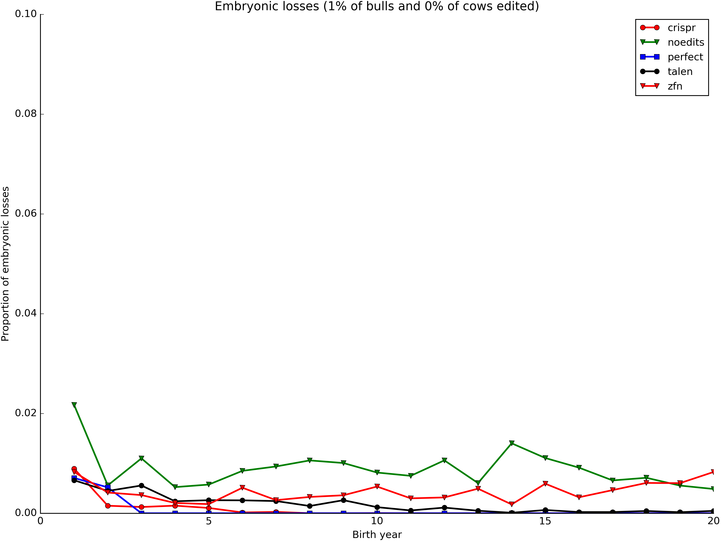
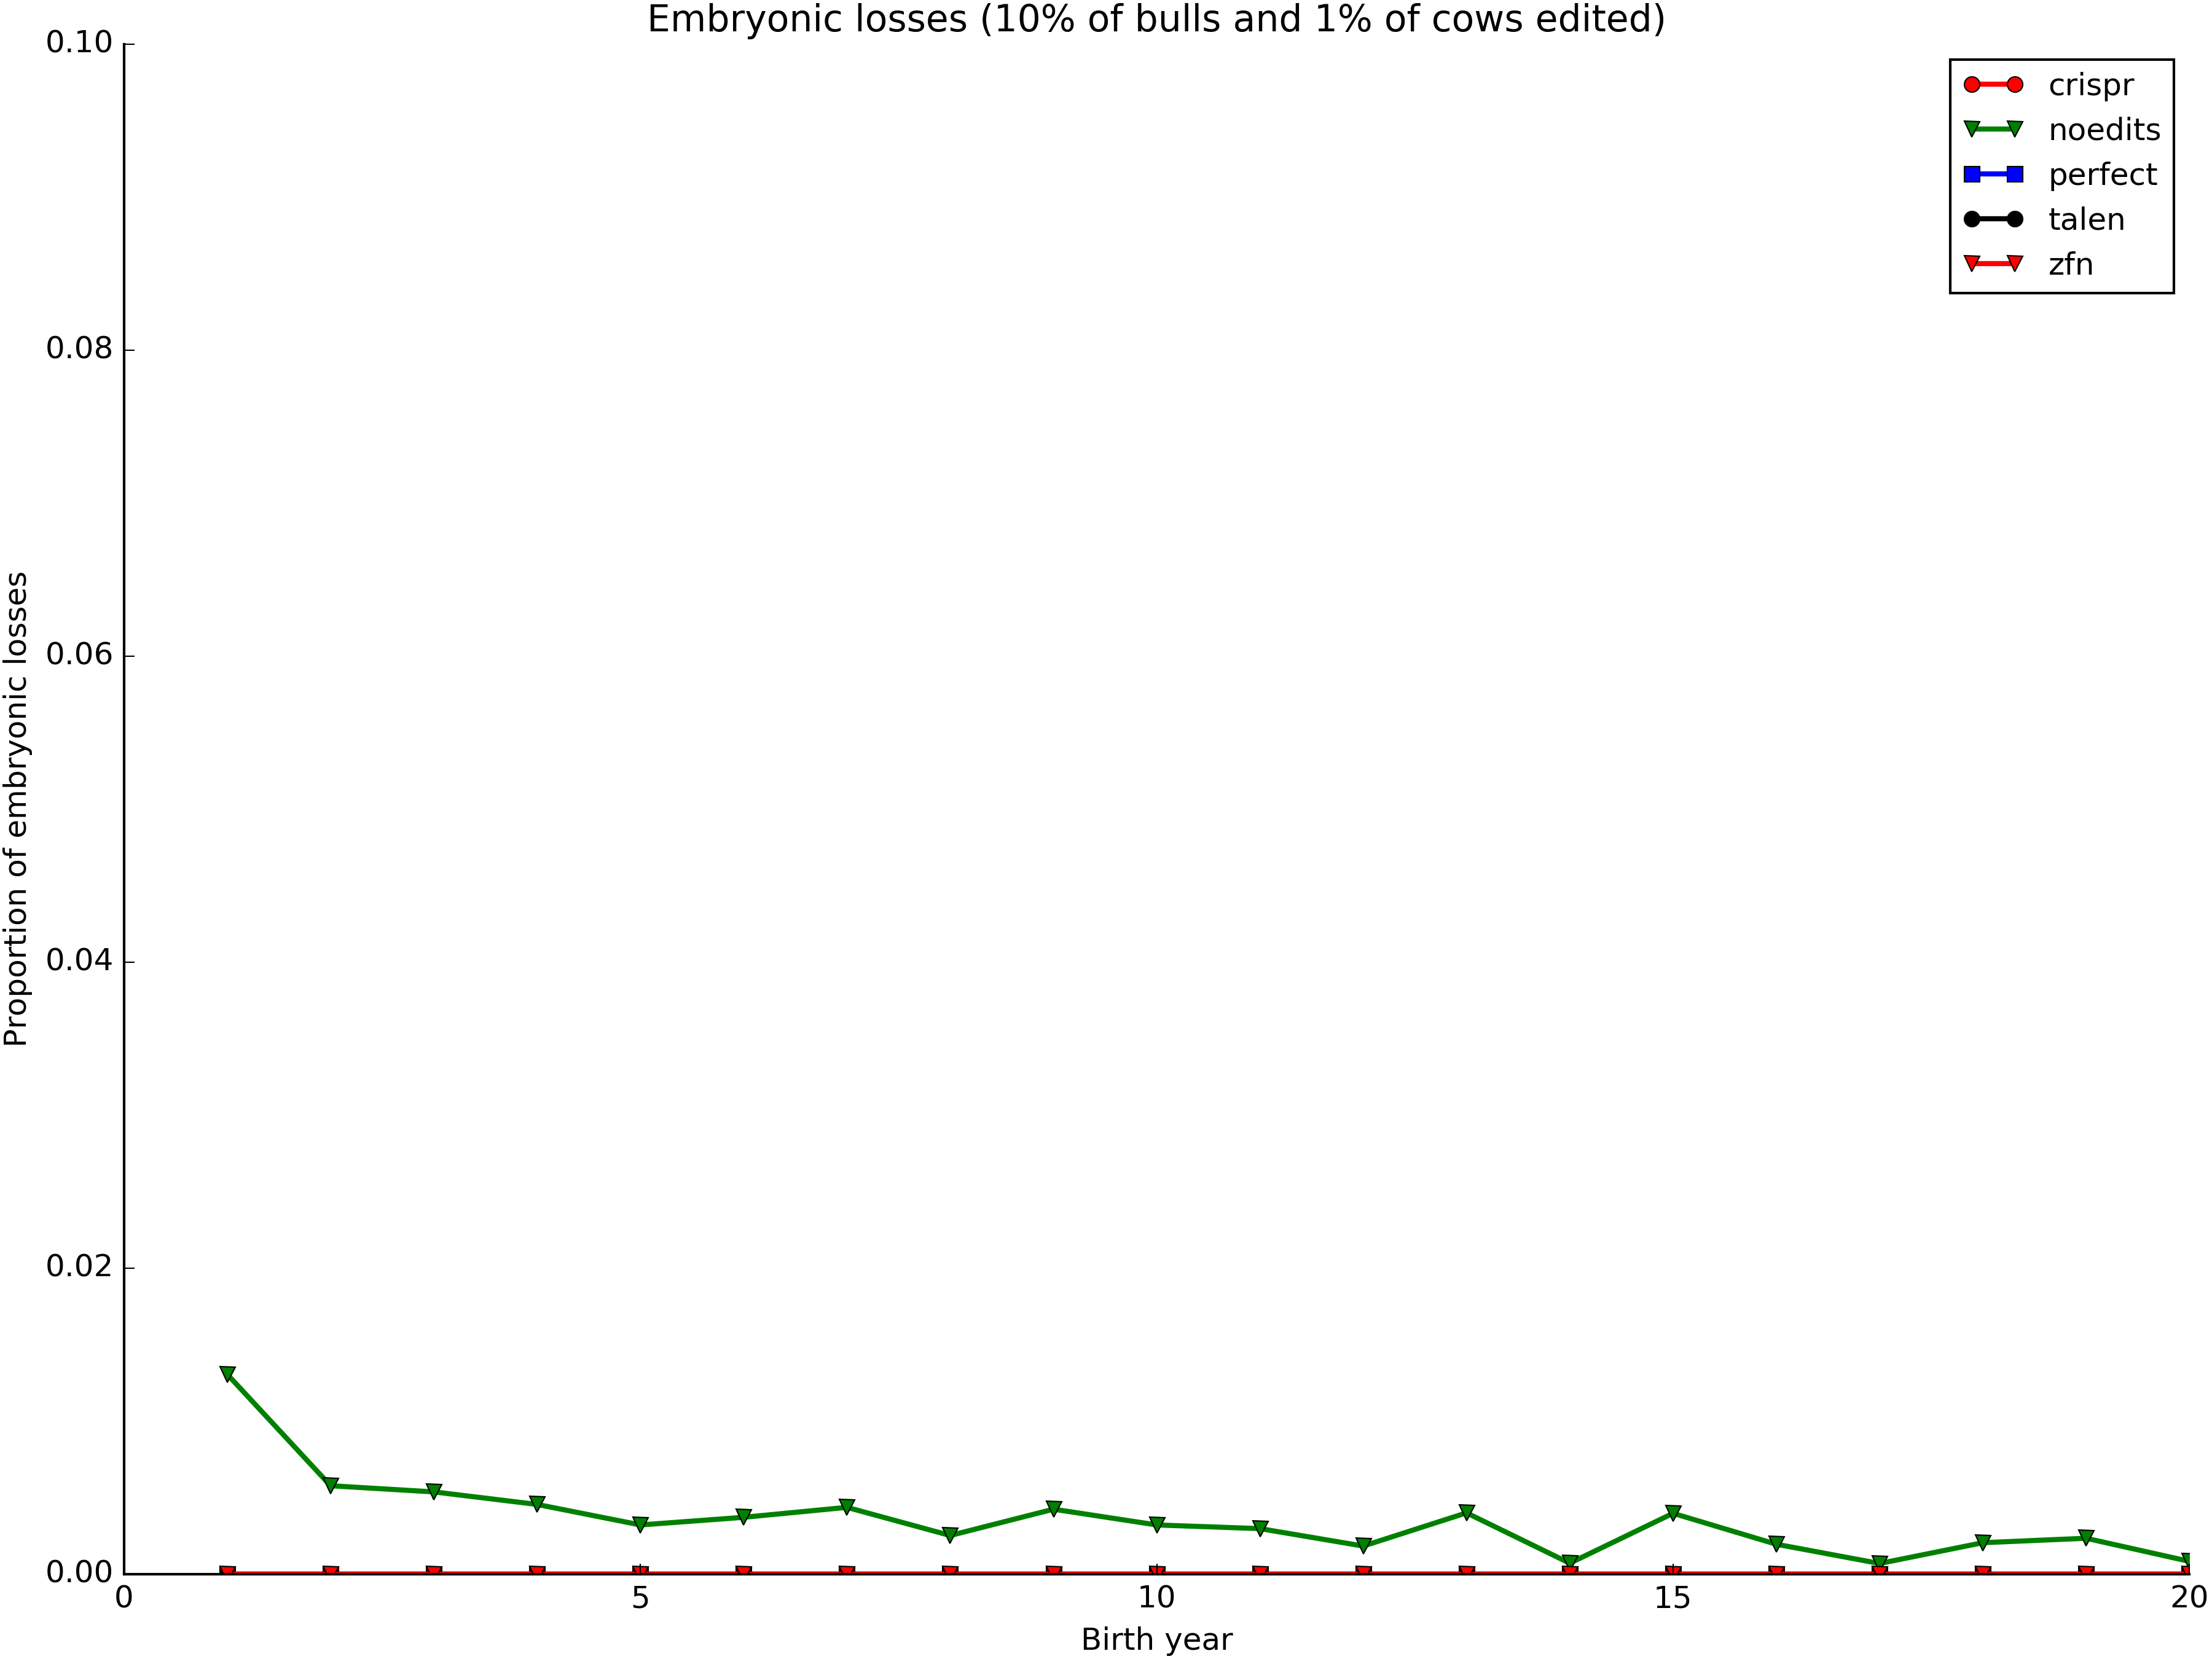
Embryonic deaths by generation

Slide 18

How does genome editing fit with other technologies?
Genome Editing
Somatic cell nuclear transfer cloning
Genomic selection
Embryo transfer
Artificial insemination
Progeny testing
Performance recording
Development of breeding goals
Association of like-minded breeders
Notes:
Heat maps of global export and import of maize and soybean (FAOSTAT)
Red high levels of export or import, green low
U.S. world’s largest producer and exporter of corn, 2nd largest exporter of soybeans after Brazil
China, Japan, and some developing countries are leading importers.
Implications for asynchronous approvals

Slide 19
Challenges to routine use of gene editing
We don’t know what loci should be edited
  Studies designed to find “true” causal variants have identified few causal loci (e.g., Weller and Wiggans, 2018)
  Most variants will have very small effects, so many must be edited to produce desired effects
Consumer acceptance of technology
  Should probably focus on animal health and welfare
Regulatory uncertainty
  Rules are likely to vary dramatically across countries, and conceptual frameworks may be incompatible

Slide 20
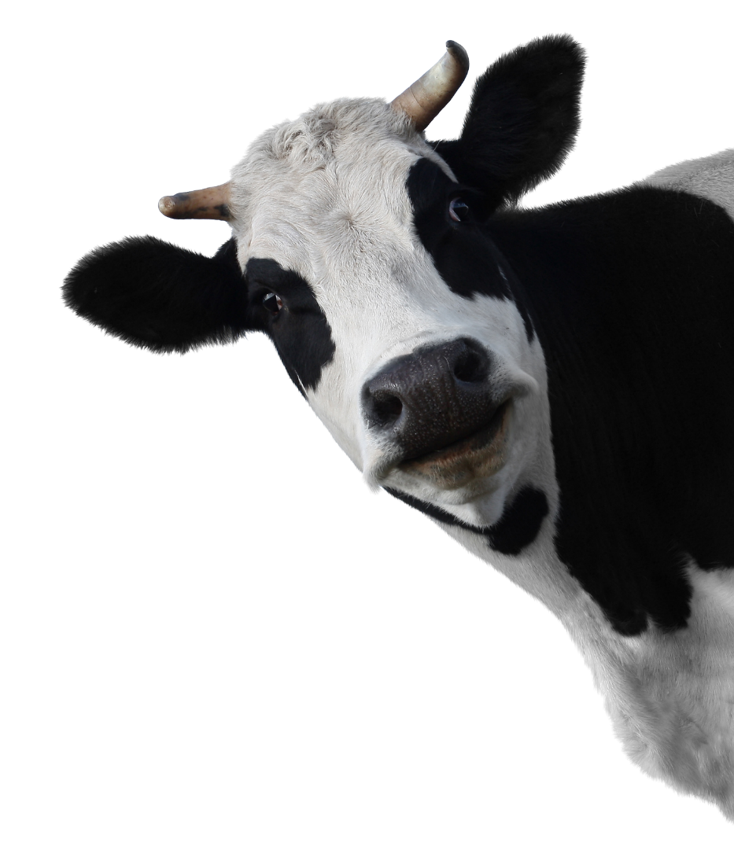
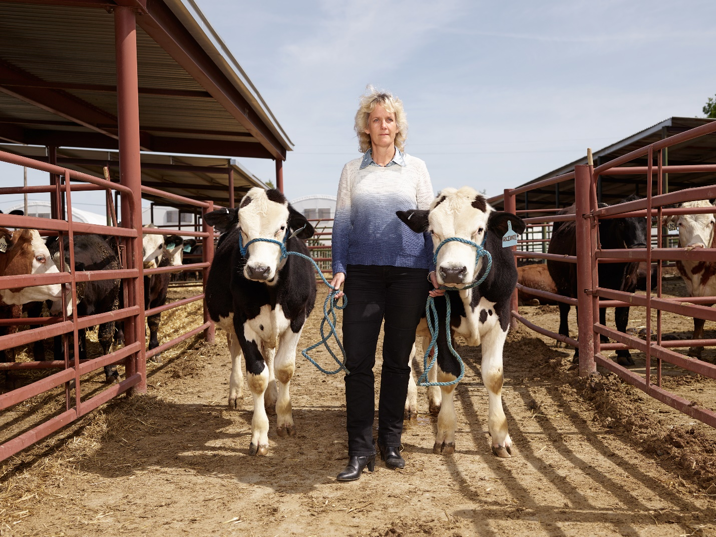
FDA draft guidance 187
FDA now considers all gene edited animals whose genomes have been “altered intentionally” to be drugs!
That does not sound very risk-based, more process-based
Notes:
Heat maps of global export and import of maize and soybean (FAOSTAT)
Red high levels of export or import, green low
U.S. world’s largest producer and exporter of corn, 2nd largest exporter of soybeans after Brazil
China, Japan, and some developing countries are leading importers.
Implications for asynchronous approvals

Slide 21
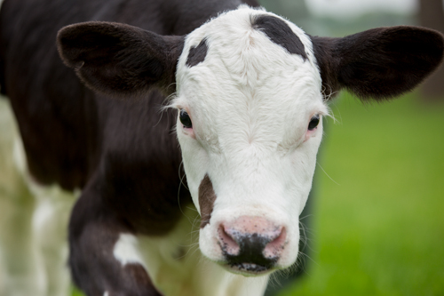
July 25, 2018
European High Court rules all edits are GMO
“Organisms obtained by mutagenesis are GMOs within the meaning of the GMO Directive, in so far as the techniques and methods of mutagenesis alter the genetic material of an organism in a way that does not occur naturally. It follows that those organisms come, in principle, within the scope of the GMO Directive and are subject to the obligations laid down by that directive.
The Court states, however, that it is apparent from the GMO Directive that it does not apply to organisms obtained by means of certain mutagenesis techniques, namely those which have conventionally been used in a number of applications and have a long safety record.” (defined as before 2001)
But the polled allele does occur naturally
Notes:
Heat maps of global export and import of maize and soybean (FAOSTAT)
Red high levels of export or import, green low
U.S. world’s largest producer and exporter of corn, 2nd largest exporter of soybeans after Brazil
China, Japan, and some developing countries are leading importers.
Implications for asynchronous approvals

Slide 22








Edited, polled Holsteins could be regulated by country
Country | Additional Regulations? | Basis of trigger/regulation?
Argentina | No | Novel DNA sequence
Australia | Yes | Use of “long” template
Brazil | No | Novel DNA sequence
Canada | No | Trait novelty (i.e. novel product risk)
European Union | Yes | Is a GMO if used a mutagenesis technique not in existence before 2001
Japan | No | No exogenous genes
New Zealand | Yes | Using of in vitro technique that modifies the genes/genetic material
United States | Yes | New Animal Drug
Notes:
Heat maps of global export and import of maize and soybean (FAOSTAT)
Red high levels of export or import, green low
U.S. world’s largest producer and exporter of corn, 2nd largest exporter of soybeans after Brazil
China, Japan, and some developing countries are leading importers.
Implications for asynchronous approvals

Slide 23
What do consumers want?
“They sell the snot out of that glowfish!” -- Alison Van Eenenaam

Slide 24
Summary
Gene editing allows us to make precisely targeted changes to an animal’s DNA
This is a powerful tool for improving animal health and increasing production efficiency
Current regulatory proposals may block market access for gene-edited animals
Innovators will seek out a supportive regulatory climate
Consumers are motivated more by positive impacts on human health than improved production efficiency

Slide 25
Acknowledgments
Dr. Alison Van Eenennaam, University of California Davis, provided many slides
USDA-ARS project 1265-31000-101-00, “Improving Genetic Predictions in Dairy Animals Using Phenotypic and Genomic Information” (AGIL funding)
Additional resources
  Cole, J.B. 2019. Promotion of alleles by genome engineering. CAB Reviews: Perspectives in Agriculture, Veterinary Science, Nutrition and Natural Resources. (In press.)
  Mueller, M., J. Cole, T. Sonstegard, and A. Van Eenennaam. 2019. Comparison of gene editing vs. conventional breeding to introgress the POLLED allele into the U.S. dairy cattle population. J. Dairy Sci. (In press.)

Slide 26
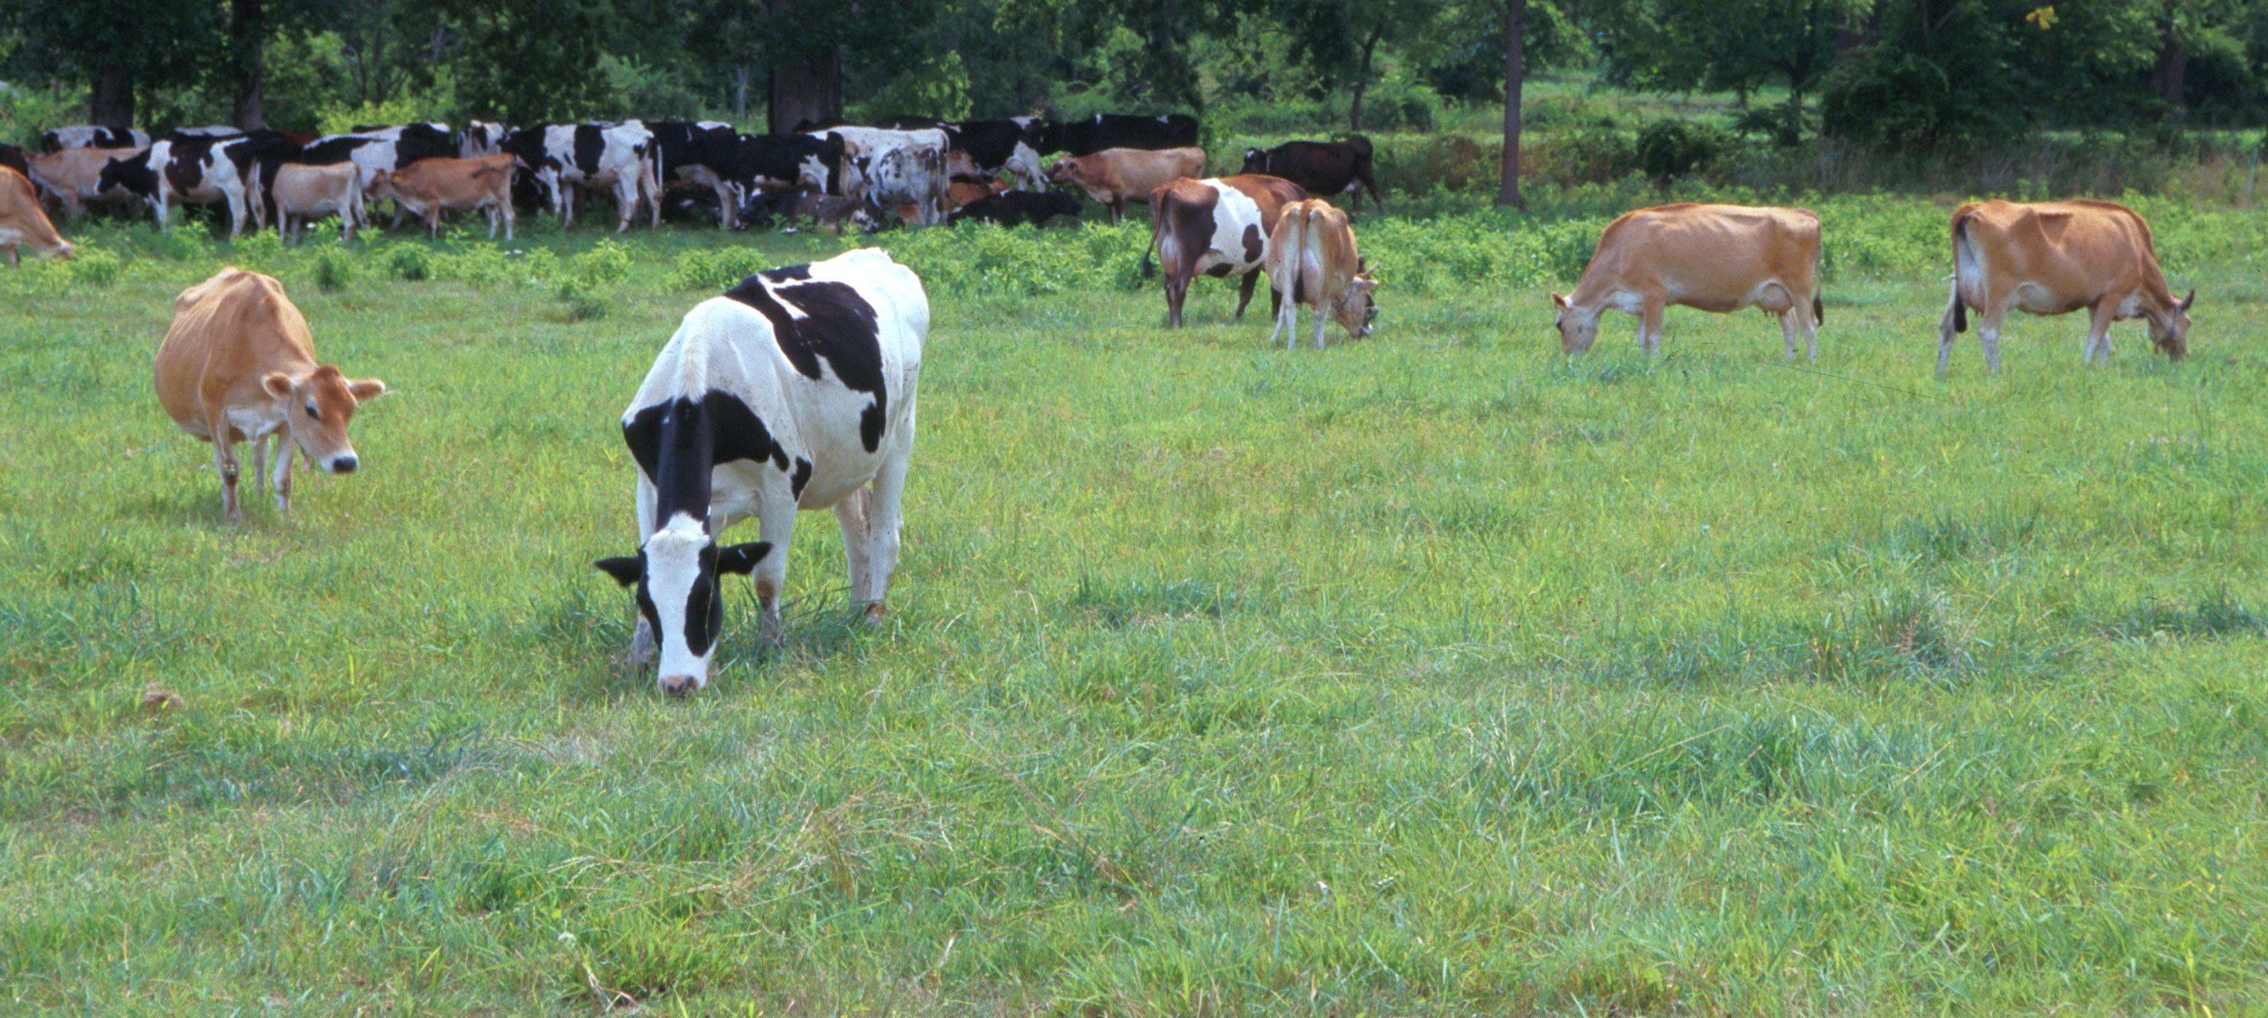
Questions?
AIP web site:
http://aipl.arsusda.gov/
Holstein and Jersey crossbreds graze on American Farm Land Trust’s
Cove Mountain Farm in south-central Pennsylvania
Source: ARS Image Gallery, image #K8587-14; photo by Bob Nichols

