Slide 1
2017 AGIL-AIP Update
John B. Cole
Animal Genomics and Improvement Laboratory
Agricultural Research Service, USDA
Beltsville, MD 20705-2350

Slide 2

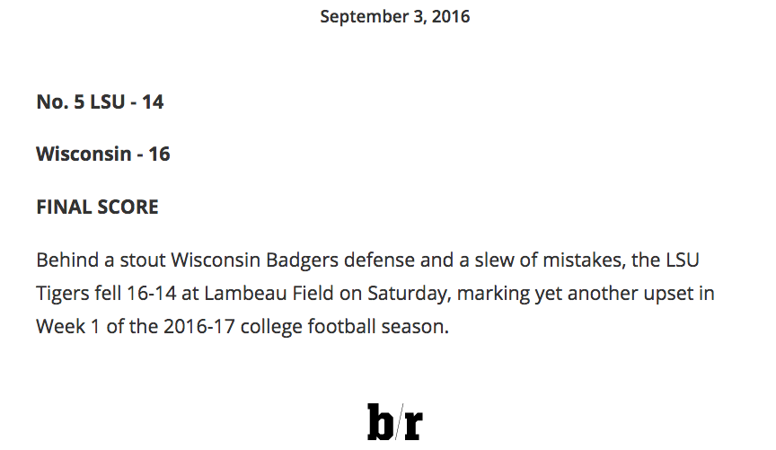
First things first…

Slide 3
AGIL structure
Animal Genomics and Improvement Laboratory
(35.7 FTE, ~$8.2 million appropriated budget)
Enhancing Genetic Merit of Ruminants Through Genome Selection and Analysis (G. Liu)
Improving Genetic Predictions in Dairy Animals Using Phenotypic and Genomic Information (P. VanRaden)
Understanding Genetic and Physiological Factors Affecting Nutrient Use Efficiency of Dairy Cattle (E. Connor)
Development of Genomic Tools to Study Ruminant Resistance to Gastrointestinal Nematodes (R. Li)

Slide 4
Staffing
Dr. John Cole is Acting Research Leader
Dr. George Wiggans retired in 07/16
Dr. Derek Bickhart transferred to the US Dairy Forage Research Center in Madison 10/16
Dr. Curt Van Tassell will contribute 25% FTE when new project plan begins
Dr. Jeff O’Connell (University or Maryland School of Medicine) paid for 20% FTE

Slide 5
Staffing (cont’d)
Exploring options for hiring postdocs, dependent on qualified candidates
Collaboration with university and industry colleagues remains important
When the hiring freeze is lifted…
  National search for permanent RL
  Advertise Dr. Bickhart’s position

Slide 6
New 5-Year Plan
Our current five-year project plan is ending
  All milestones accomplished in whole or part
A new plan has been drafted and is under peer-review
Objectives are similar between the old and new plans
Our mission hasn’t changed

Slide 7
Objective 1
“Expand genomic data used in prediction by selecting new variants that more precisely track the true gene mutations that cause phenotypic differences”
Focus on new SNP chips, use of DNA sequence, and strategies for gene editing
New reference genome assembly (where everything goes)

Slide 8
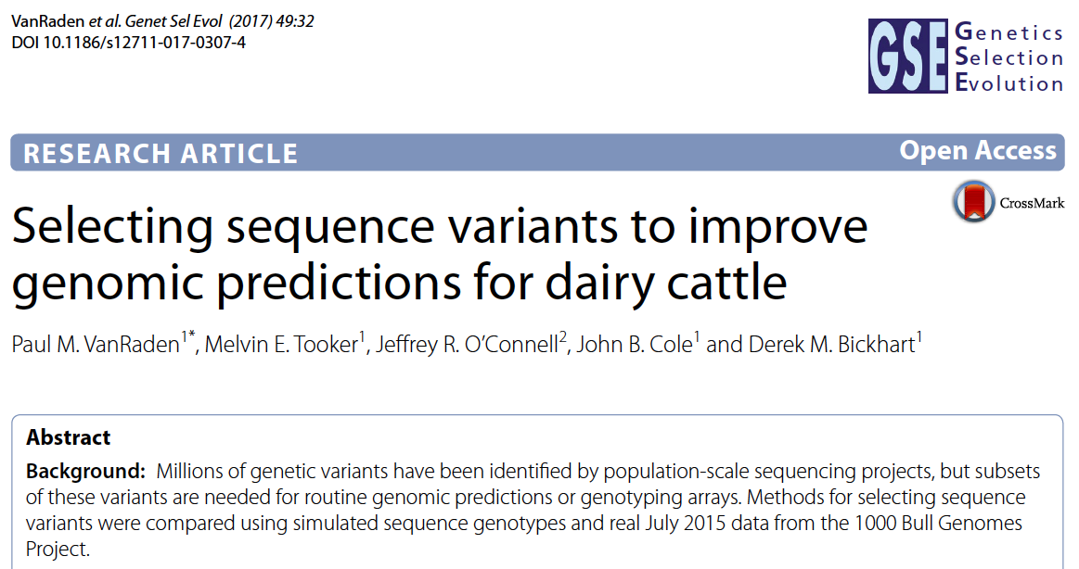
Chips and DNA sequence data
Currently, 27 different SNP chips in database
DNA sequence data for many animals

Slide 9
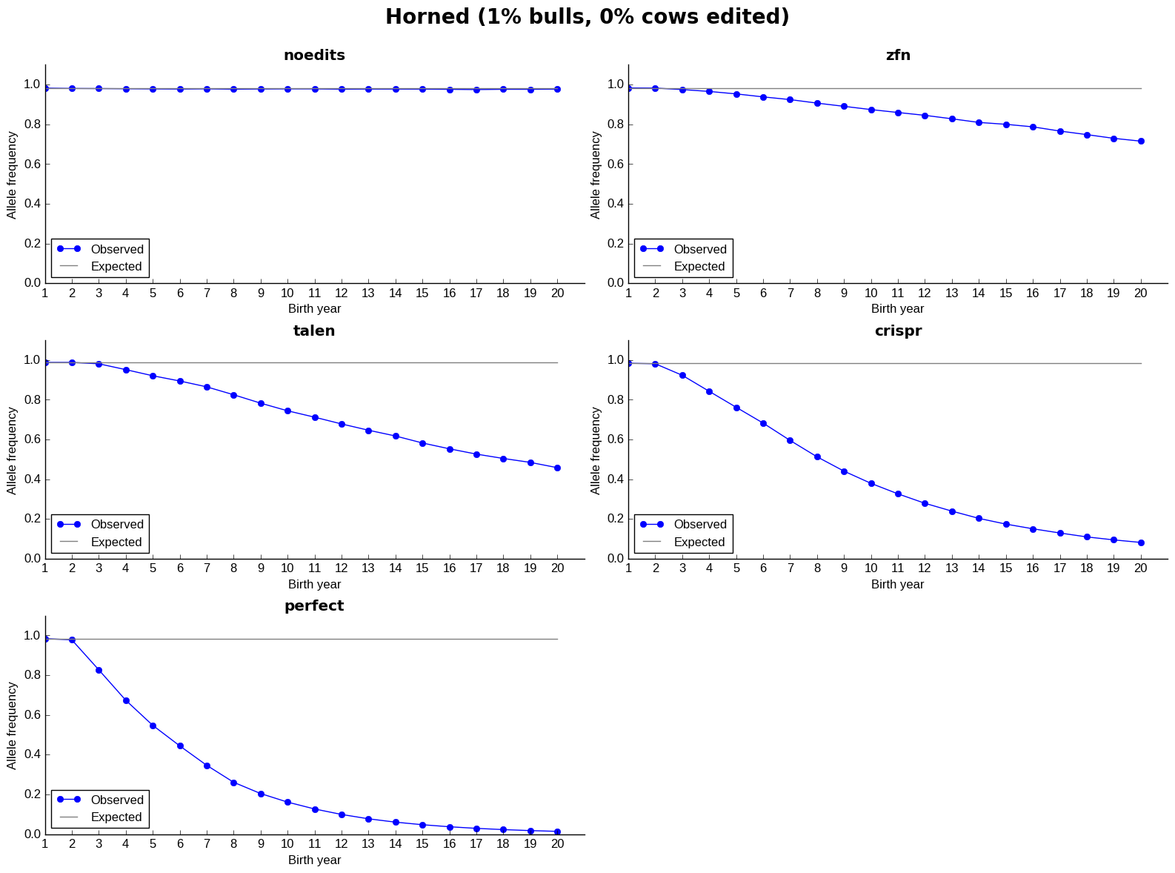
Gene editing

Slide 10
Objective 2
“Evaluate new traits that can all be predicted at birth from the same inexpensive DNA sample”
Focus on evaluation of new traits using phenotypes already in the system, as well as efforts to obtain new phenotypes

Slide 11
New traits
Feed saved
Gestation length
Health traits (Dr. Kristen Gaddis)
SCR for Angus bulls bred to Holsteins
Age at first calving
Persistency of lactation
Genomic evaluations for crossbred animals

Slide 12
What do we do with new traits?
Put them into a selection index
  Correlated traits are helpful
Apply selection for a long time
  There are no shortcuts (not even genomics!)
Collect many phenotypes
  Repeated records of limited value
  Genomics can increase accuracy

Slide 13
2017 Net Merit
Traits included | USDA genetic-economic index (and year introduced)
 | PD$ (1971) | MFP$ (1976) | CY$ (1984) | NM$ (1994) | NM$ (2000) | NM$ (2003) | NM$ (2006) | NM$ (2010) | NM$ (2014) | NM$ (2017)
Milk | 52 | 27 | −2 | 6 | 5 | 0 | 0 | 0 | −1 | −1
Fat | 48 | 46 | 45 | 25 | 21 | 22 | 23 | 19 | 22 | 24
Protein | … | 27 | 53 | 43 | 36 | 33 | 23 | 16 | 20 | 18
PL | … | … | … | 20 | 14 | 11 | 17 | 22 | 19 | 13
SCS | … | … | … | −6 | −9 | −9 | −9 | −10 | −7 | −7
Udder composite | … | … | … | … | 7 | 7 | 6 | 7 | 8 | 7
Feet/legs composite | … | … | … | … | 4 | 4 | 3 | 4 | 3 | 3
BSC/BWC | … | … | … | … | −4 | −3 | −4 | −6 | −5 | −6
DPR | … | … | … | … | … | 7 | 9 | 11 | 7 | 7
CA$ | … | … | … | … | … | … | 6 | 5 | 5 | 5
HCR | … | … | … | … | … | … | … | … | 1 | 1
CCR | … | … | … | … | … | … | … | … | 2 | 2
LIV | … | … | … | … | … | … | … | … | … | 7
Source: https://aipl.arsusda.gov/reference/nmcalc-2017.htm.

Slide 14
Objective 3
“Developing, testing, and implementing new computational methods can improve accuracy with little extra cost or provide the same or similar accuracy with reduced cost”
Improved genomic evaluation methodology, evaluations for crossbred animals, models for new traits
How do we deal with pre-selection bias?

Slide 15
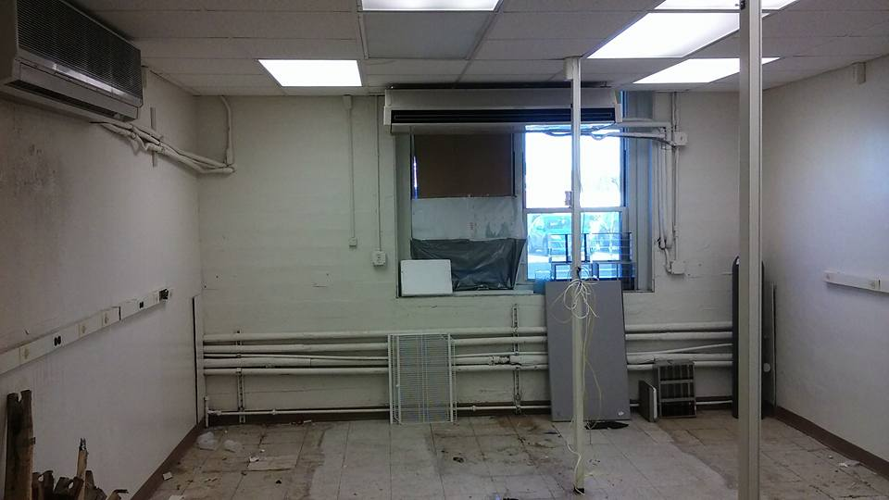
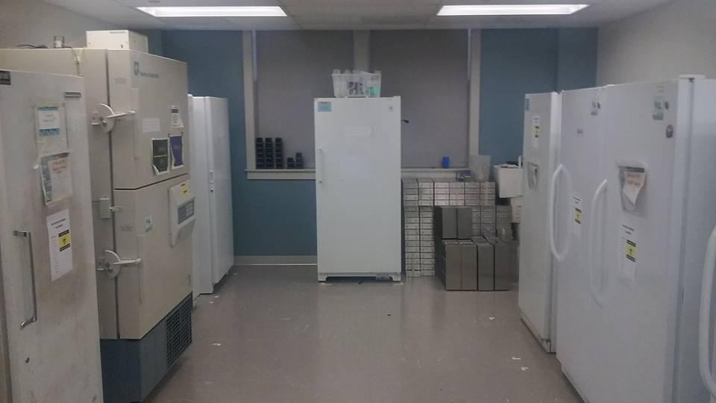
CDDR Moved
Left: Old freezer room in basement
of Bldg 200, which AGIL staff moved
out of 2 years ago.
Right: New freezer room in Bldg
306, which AGIL staff currently
occupy.

Slide 16
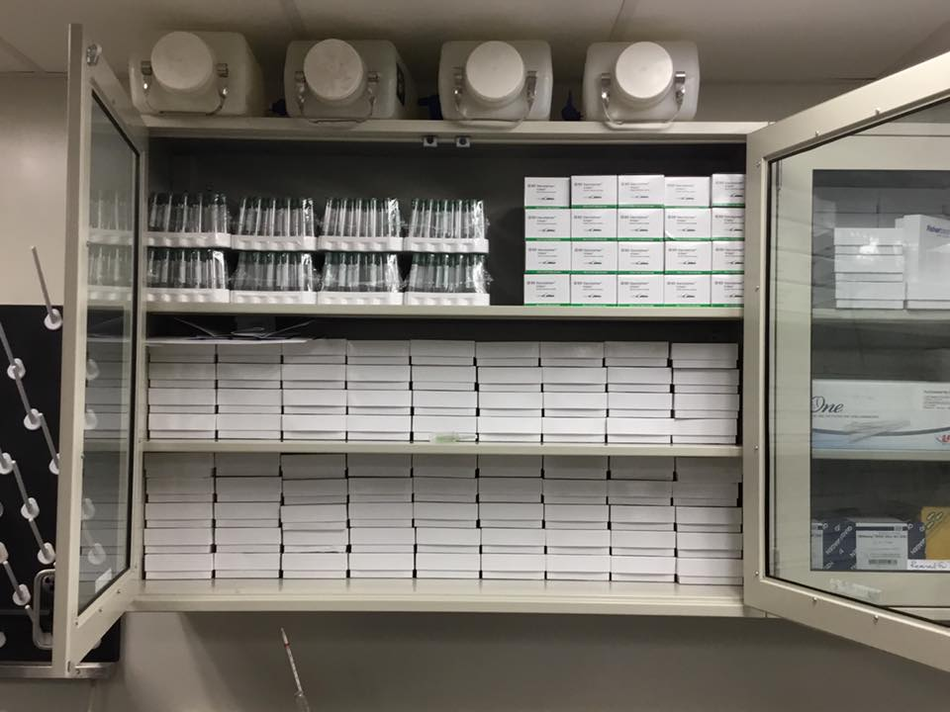
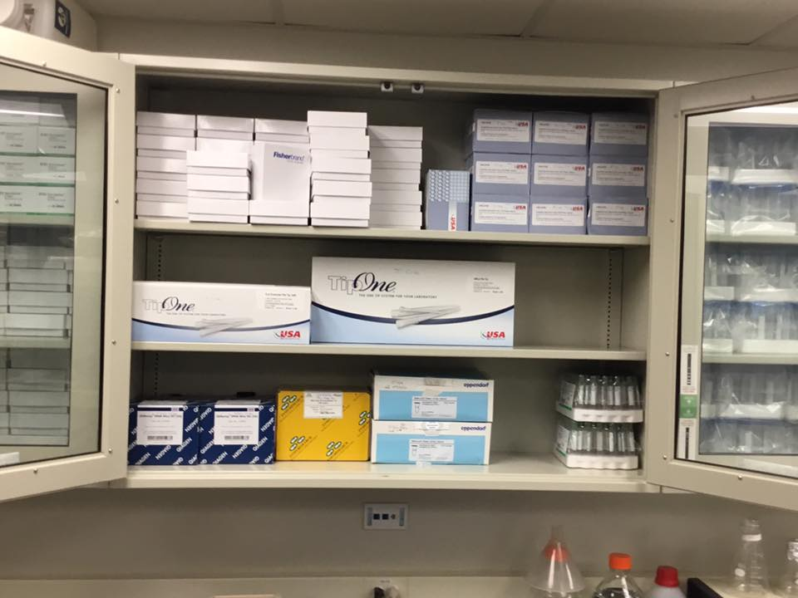
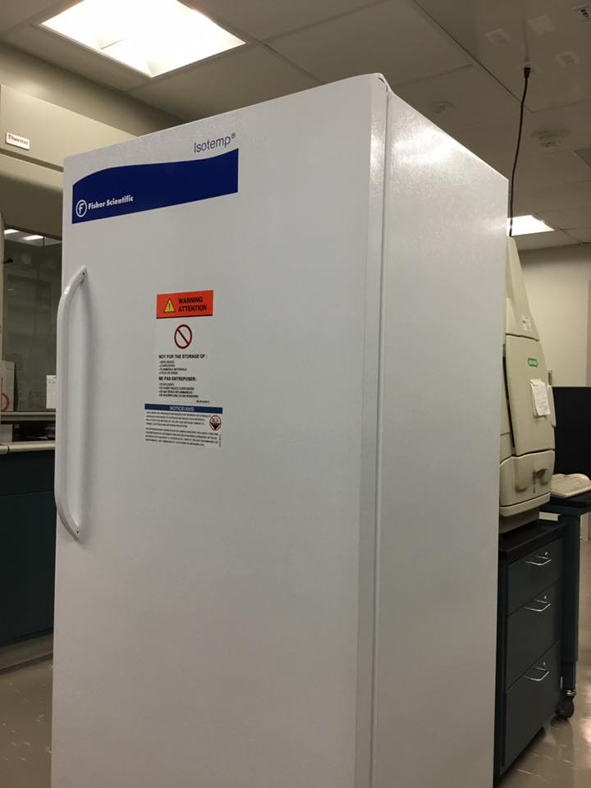
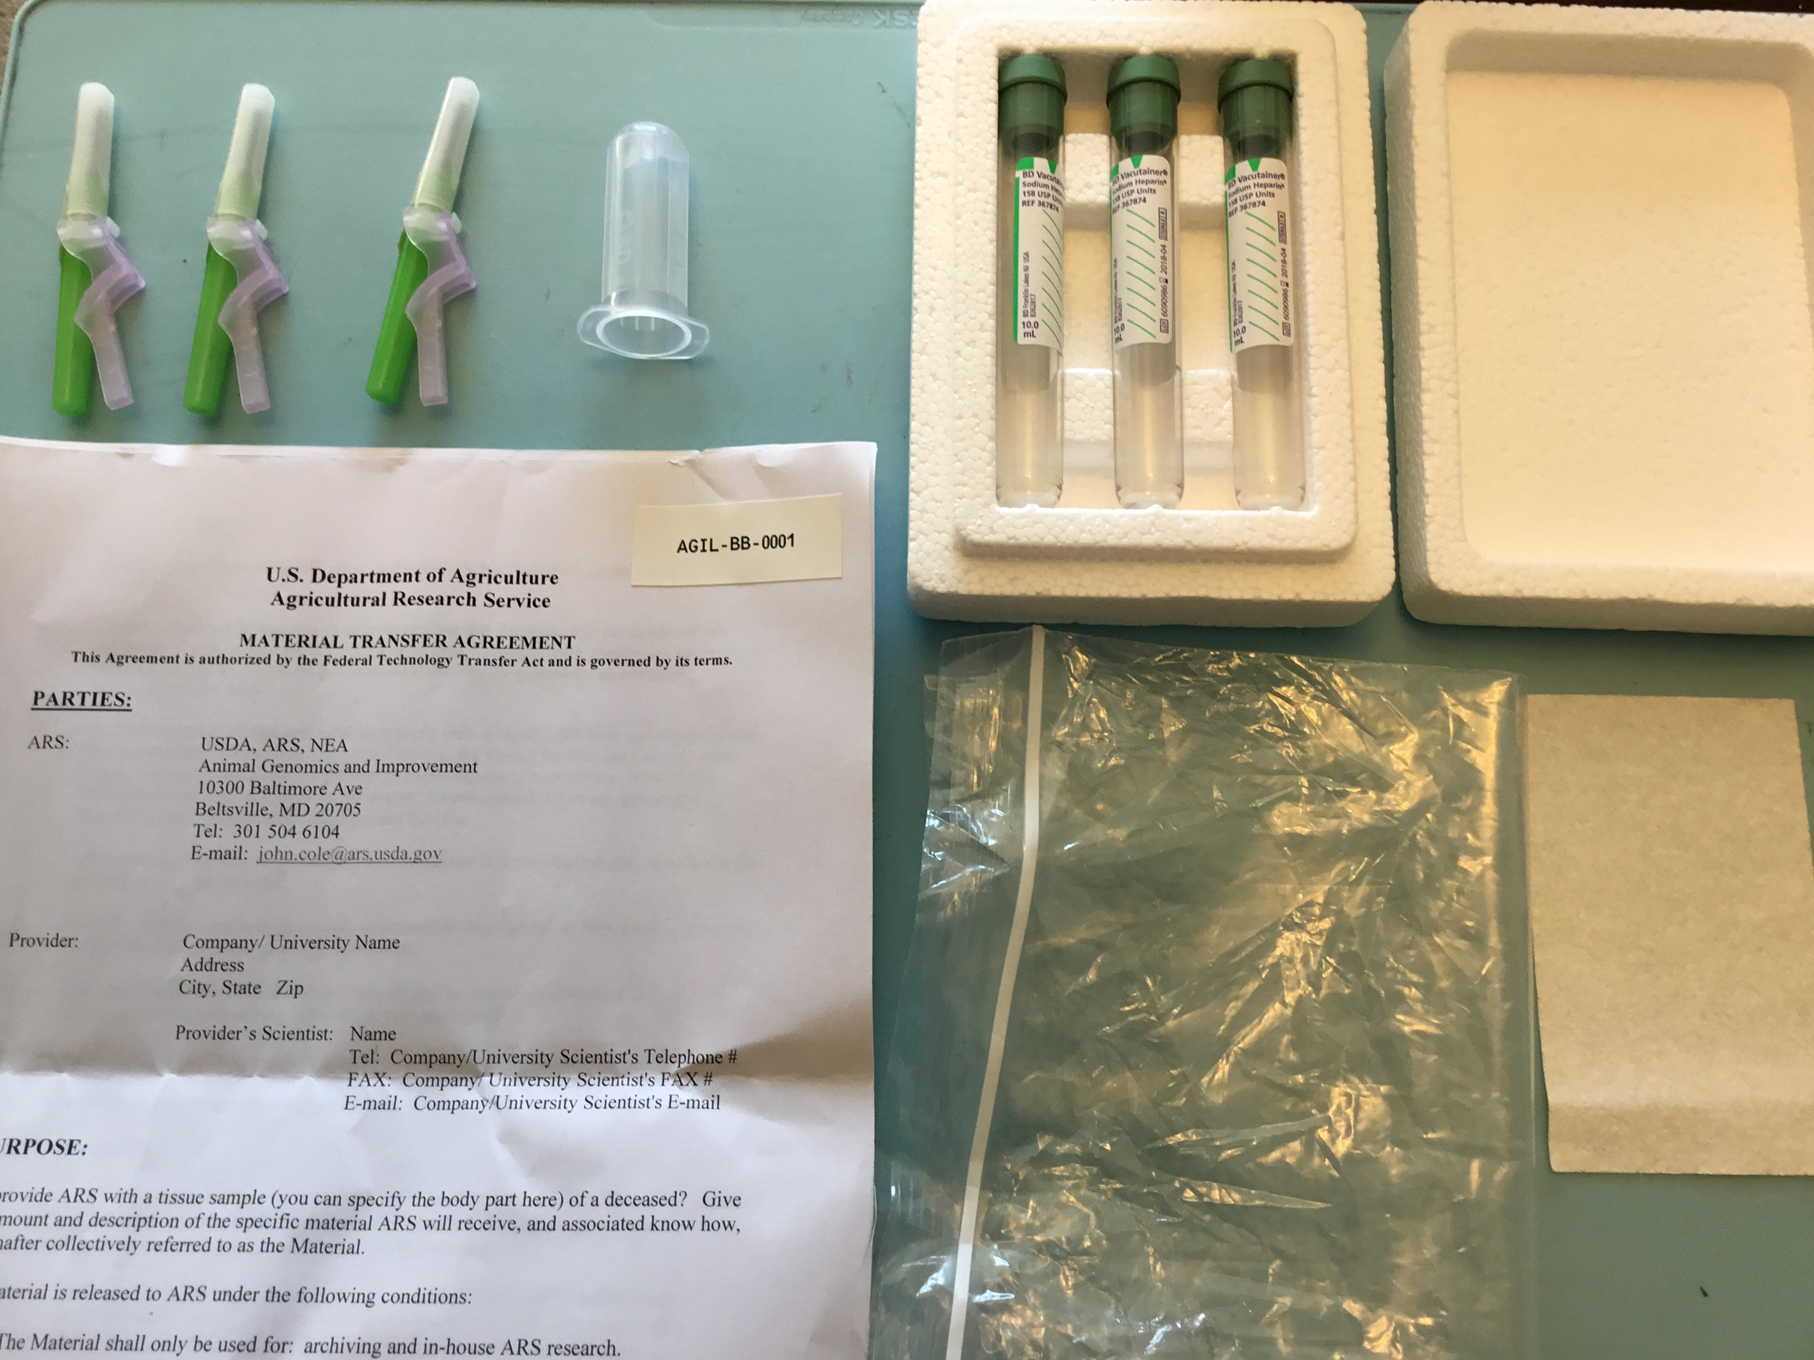
New Dairy Calf DNA BioBank

Slide 17
Acknowledgments
USDA-ARS project 8042-31000-101-00, “Improving Genetic Predictions in Dairy Animals Using Phenotypic and Genomic Information”
Mention of trade names or commercial products in this article is solely for the purpose of providing specific information and does not imply recommendation or endorsement by the US Department of Agriculture. The USDA is an equal opportunity provider and employer.

Slide 18
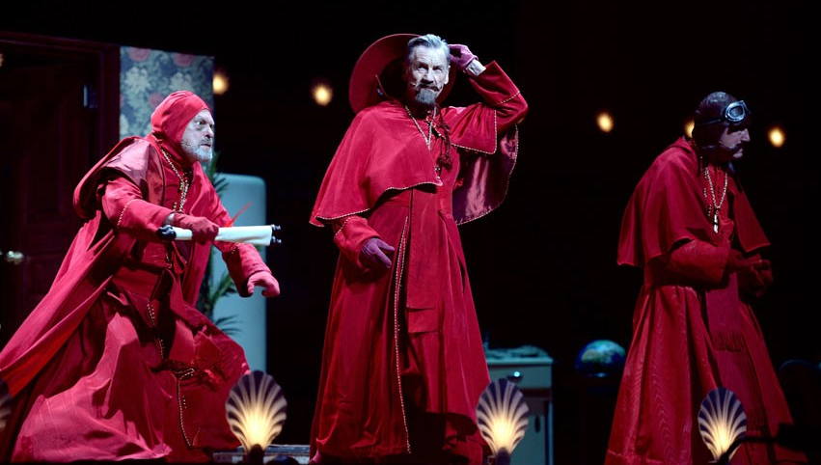
Questions?

