Slide 1
Health and fitness data – what might be possible for dairy cattle?

Slide 2
Health and fitness traits
Growing emphasis on functional traits
  Economically important because they impact other traits
Challenges with functional traits
  Inconsistent trait definitions
  Not collected in national database
  Most have low heritabilities
Notes:
2
2

Slide 3
What does “low heritability” mean?
P = G + E
The percentage of total variation attributable to genetics is small.
CA$: 0.07
DPR: 0.04
PL: 0.08
SCS: 0.12
The percentage of total variation attributable to environmental factors is large:
Feeding/nutrition
Housing
Reproductive management
Notes:
3
3

Slide 4
Where are we now?
Trait | Relative emphasis on traits in index (%)
 | PD$ 1971 | MFP$ 1976 | CY$ 1984 | NM$ 1994 | NM$ 2000 | NM$ 2003 | NM$ 2006 | NM$ 2010
Milk | 52 | 27 | –2 | 6 | 5 | 0 | 0 | 0
Fat | 48 | 46 | 45 | 25 | 21 | 22 | 23 | 19
Protein | … | 27 | 53 | 43 | 36 | 33 | 23 | 16
PL | … | … | … | 20 | 14 | 11 | 17 | 22
SCS | … | … | … | –6 | –9 | –9 | –9 | –10
UDC | … | … | … | … | 7 | 7 | 6 | 7
FLC | … | … | … | … | 4 | 4 | 3 | 4
BDC | … | … | … | … | –4 | –3 | –4 | –6
DPR | … | … | … | … | … | 7 | 9 | 11
SCE | … | … | … | … | … | –2 | … | …
DCE | … | … | … | … | … | –2 | … | …
CA$ | … | … | … | … | … | … | 6 | 5
Notes:
4
4

Slide 5
Where are we going?
Trait |  | Relative emphasis on traits in index (%)
 |  | NM$ 1994 | NM$ 2000 | NM$ 2003 | NM$ 2006 | NM$ 2010 | NM$ 2014
Milk |  | 6 | 5 | 0 | 0 | 0 | 5
Fat |  | 25 | 21 | 22 | 23 | 19 | 24
Protein |  | 43 | 36 | 33 | 23 | 16 | 15
PL |  | 20 | 14 | 11 | 17 | 22 | 17
SCS |  | –6 | –9 | –9 | –9 | –10 | –8
UDC |  | … | 7 | 7 | 6 | 7 | 8
FLC |  | … | 4 | 4 | 3 | 4 | 4
BDC |  | … | –4 | –3 | –4 | –6 | –4
DPR |  | … | … | 7 | 9 | 11 | 5
HCR |  | … | … | … | … | … | 2
CCR |  | … | … | … | … | … | 2
CA$ |  | … | … | 4 | 6 | 5 | 6
More yield
(44%)
Less PL
(17%)
Less fertility,
more traits
(9%)
Notes:
5
5

Slide 6
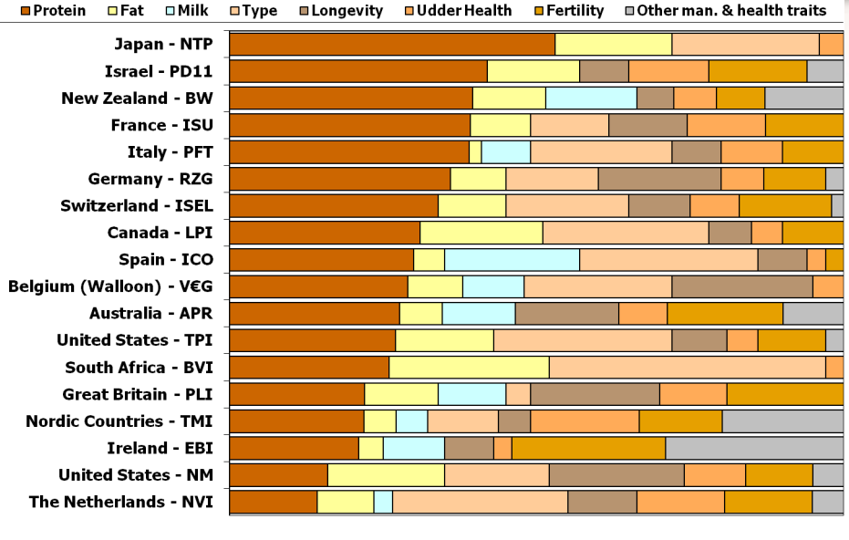
Selection indices worldwide
Source: Miglior et al., 2012

Slide 7
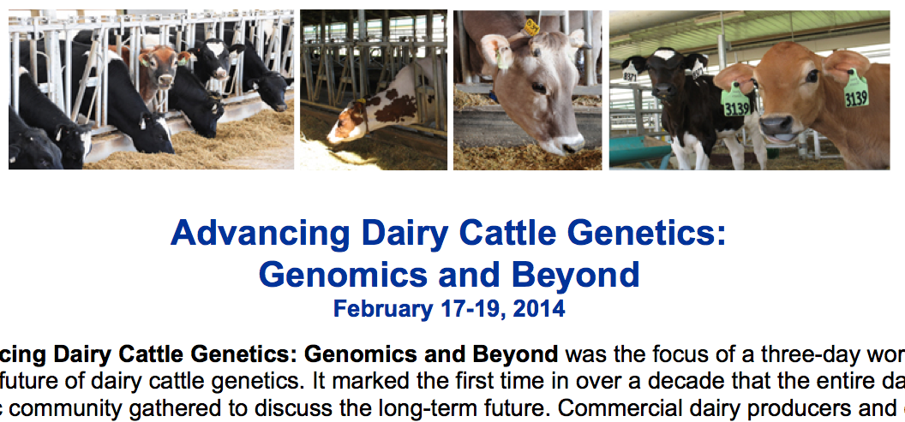
What do dairy farmers want?
National workshop in Tempe, AZ
  Producers, industry, academia, and government
Farmers want new tools
  New traits
  Better management tools
Foot health and feed efficiency were of greatest interest
Notes:
7
7

Slide 8
Path for data flow
AIPL introduced Format 6 in 2008
  Permits reporting of 24 health and management traits
  Easily extended to new traits
  Simple text file
Tested by 3 DRPCs
  No data are routinely flowing
Notes:
8
8

Slide 9
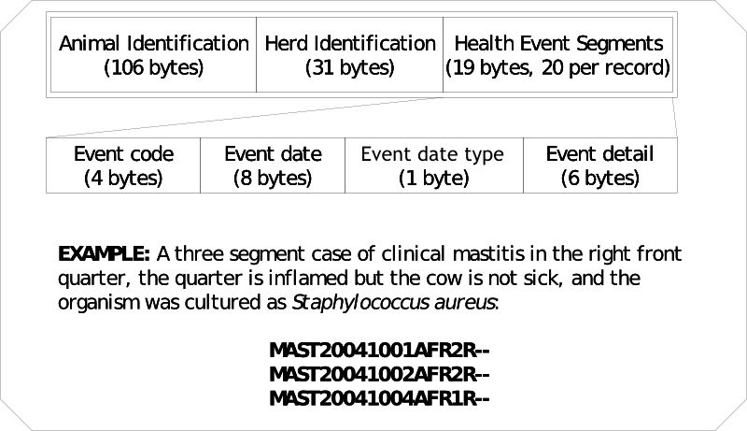
Format 6 records
Animal Identification
(106 bytes)
Herd Identification
(31 bytes)
Health Event
Segment
(19 bytes, 20/record)
Event code
(4 bytes)
Event date
(8 bytes)
Event date type
(1 byte)
Event detail
(6 bytes)
(optional, format varies)
A three-segment case of clinical mastitis in the right front quarter; the quarter is inflamed
but the cow is not sick, and the organism was cultured as Staphylococcus aureus:
MAST20041001AFR2R--
MAST20041002AFR2R--
MAST20041004AFR1R--
Treatment data cannot be collected!

Slide 10
Domestic challenges
What incentives are there for producers to provide data?
  Recording, storage, transmission = $
Will reporting expose producers to liability?
  FOIA/activism CDCB not subject to FOIA!
Reasonable expectations
Council on Dairy
Cattle Breeding
Notes:
10
10

Slide 11
Domestic opportunities
Improving health increases profit
Consumers link health and welfare
No movement on a national solution
  Nov. 2012 Hoard’s editorial, “Let’s Standardize Our Herd Health Data”
  Jul. 2013 Hoard’s article, “We are making inroads on health and fitness traits”
Notes:
11
11

Slide 12
Possible products
Short-term – Benchmarking tools for herd managment
Medium-term – Custom indices for herd management
  Additional types of data will be helpful
Long-term – Genetic evaluations
  Lots of data needed, which will take time
Notes:
12
12

Slide 13
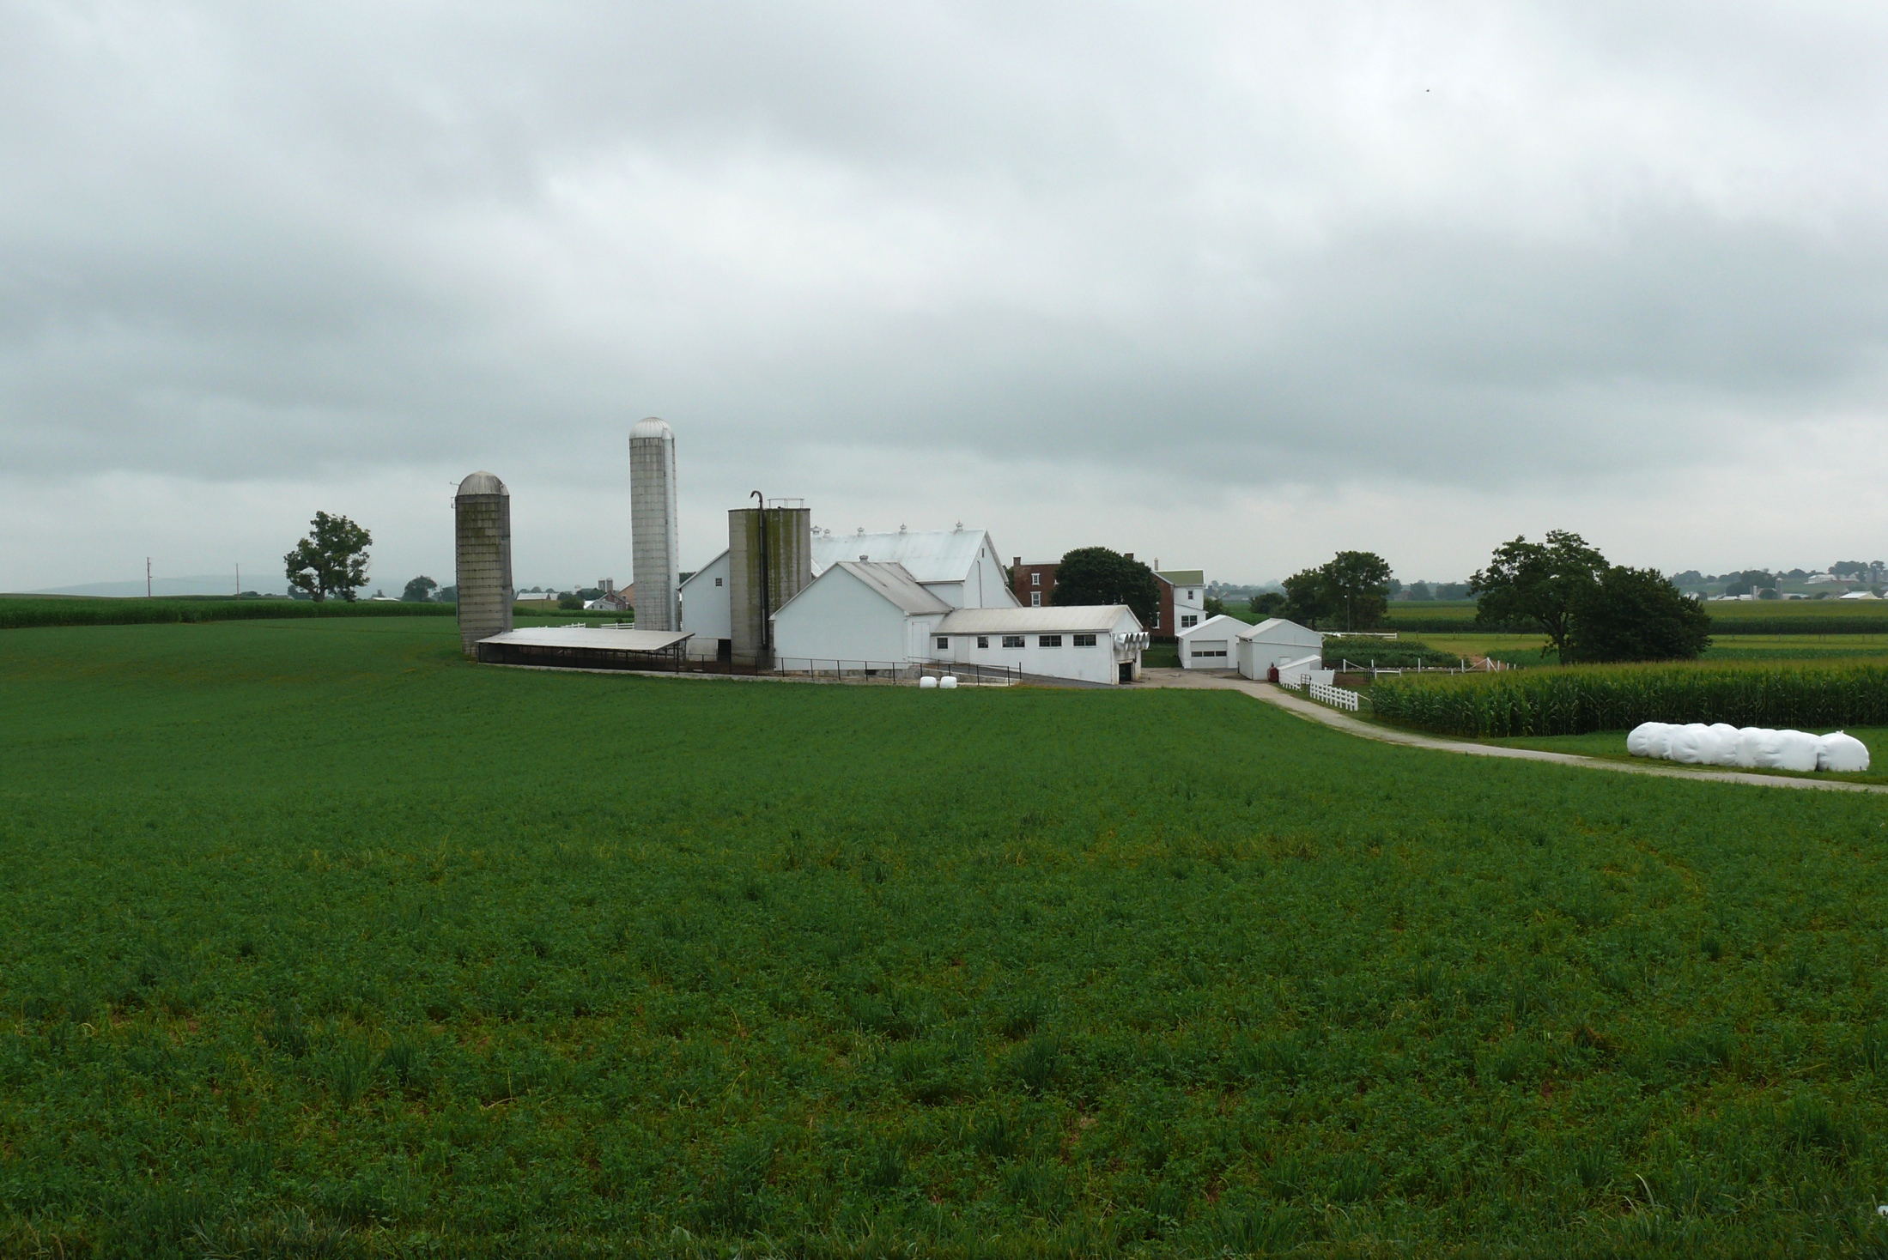
Sources of on-farm data
Barn: flooring type, bedding materials, density, weather data
Cow: body temperature, activity, rumination time, intake
Herdsmen/consultants: health events, foot/claw health, veterinary treatments
Parlor: yield, composition, milking speed, conductivity, progesterone, temperature
Silo/bunker: ration composition, nutrient profiles
Pasture: soil type/composition, nutrient composition
http://commons.wikimedia.org/wiki/File:Amish_dairy_farm_3.jpg

Slide 14
What are other countries doing?
Scandinavia – Evaluations for health traits (1970s)
Austria & Germany - Evaluations for health traits (2010)
France – Evaluations for health traits (2012)
Canada – Evaluations for health traits, immune response (2013)
Notes:
14
14

Slide 15
International challenges
National datasets are siloed
Recording standards differ between countries
Many populations are small
  Low accuracies
  Small markets
Notes:
15
15

Slide 16
International opportunities
International recording standards published in 2012
  First-mover advantage
Interbull only evaluates a few health traits (e.g., clinical mastitis)
European consumers may be more conscious of animal welfare issues
Notes:
16
16

Slide 17
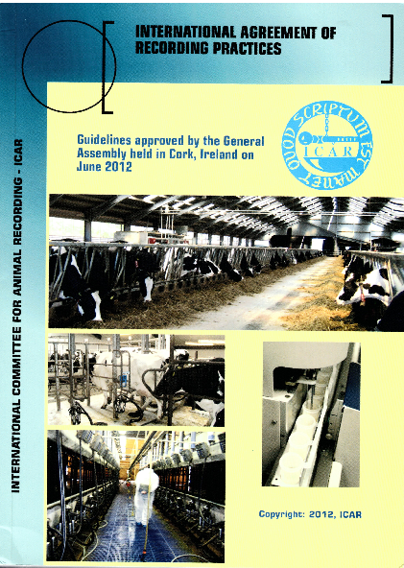
Functional traits working group
ICAR working group
  7 members from 6 countries
Standards and guidelines for functional traits
  Recording schemes
  Evaluation procedures
  Breeding programs
Notes:
17
17

Slide 18
New and revised ICAR guidelines
Section 16: Recording, Evaluation and Genetic Improvement of Health Traits
  Included in the 2012 ICAR Guidelines
New: Recording, Evaluation and Genetic Improvement of Female Fertility
  Accepted by steering committee in 2013
Section 7: Recording, Evaluation and Genetic Improvement of Udder Health
  Currently under revision
Notes:
18
18

Slide 19
New and revised ICAR guidelines (cont’d)
New: Recording, Evaluation and Genetic Improvement of Foot & Leg Health
  Currently being researched and drafted
  Making contacts with other groups in Europe for collaboration/exchange of information
Notes:
19
19

Slide 20
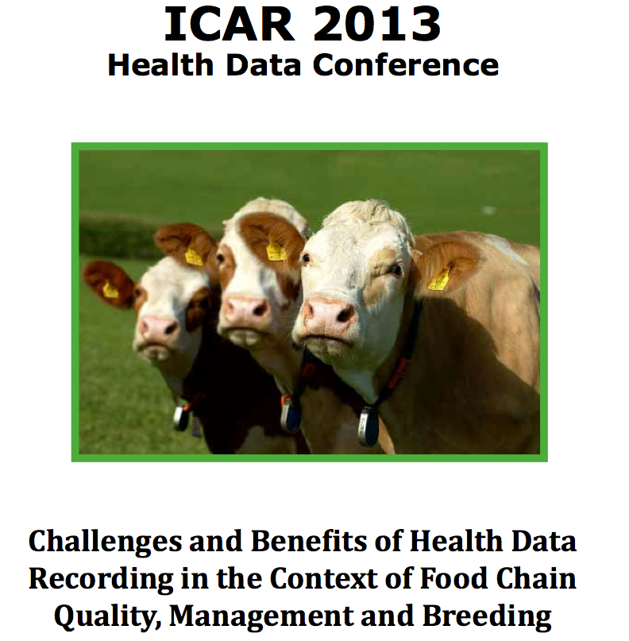
2013 ICAR Health Conference
Challenges and benefits of health data recording in the context of food chain quality, management and breeding.
May 2013 in Aarhus, Denmark
20 speakers from around
the world.
Roundtable discussion with
industry leaders.
Notes:
20
20

Slide 21
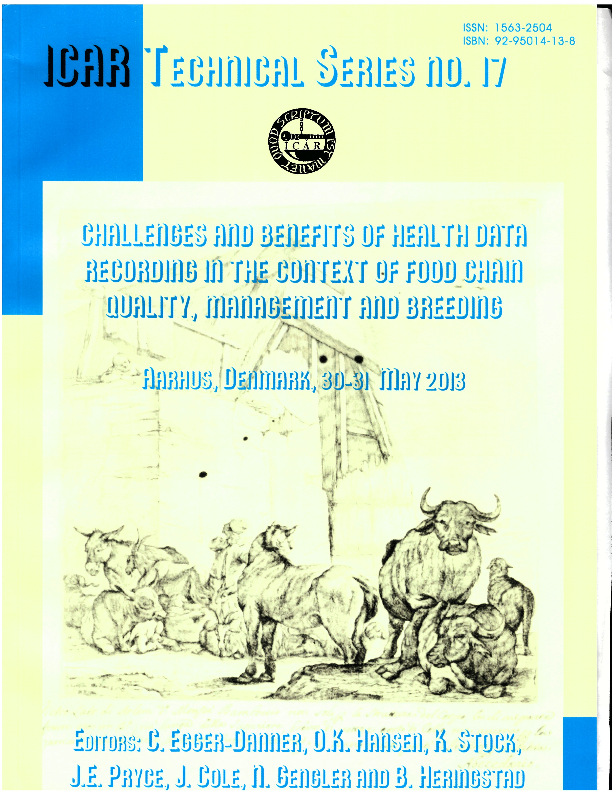
Results of 2013 ICAR health conference
Proceedings
available for free
download at: http://www.icar.org/Documents/technical_series/tec_series_17_Aarhus.pdf
Notes:
21
21

Slide 22
What is AIPL doing?
Use of producer-recorded health data
  JDS doi:10.3168/jds.2013-7543
Stillbirth in Brown Swiss and Jersey
  JDS doi:10.3168/jds.2013-7320
Gene networks associated with dystocia
  Currently underway with NCSU
Notes:
22
22

Slide 23
Conclusions (2013)
…

Slide 24
Conclusions (2014)
For low-heritability traits, big gains can be realized from managing the environment.
The best short-term use of health and fitness data is benchmarking for herd management.
Immediate feedback is important for motivating and sustaining data collection.

Slide 25
Acknowledgments
Dairy Records Processing Centers
ICAR Functional Traits Working Group
Christian Maltecca and Kristen Parker Gaddis, NCSU
Dan Null and Lillian Bacheller, AIPL

Slide 26

Questions?
http://gigaom.com/2012/05/31/t-mobile-pits-its-math-against-verizons-the-loser-common-sense/shutterstock_76826245/

