Slide 1
2015 AGIL Report

Slide 2
Meet the new lab, same as the old lab
The Animal Improvement Programs Laboratory and the Bovine Functional Genomics Laboratory were merged into the Animal Genomics and Improvement Laboratory in April, 2014.
The Animal Improvement Program continues with the same personnel and slightly increased funding.
Notes:
2
2

Slide 3


Comings and goings
Dr. Kristen Parker Gaddis arrived from NCSU in August.
Dr. Chuanyu Sun accepted a position with Sexing Technologies in November.
Notes:
3
3

Slide 4
Base change
Genetic bases for all traits were updated by 5 years.
For most traits of most breeds, average PTA decreased.
Changes for each breed are reported in “Genetic Base Changes for December 2014.”
The next base change is scheduled for 2020.
Notes:
4
4

Slide 5
Net merit revised
Economic values in net merit (NM$) were updated and 2 more fertility traits (HCR, CCR) were included.
Grazing merit (Gay et al., 2014) is recommended for herd owners desiring to improve fertility to maintain seasonal calving cycles.
See “Net Merit as a Measure of Lifetime Profit: 2014 Revision” for more details.
Notes:
5
5

Slide 6
New index weights
Trait |  | Relative emphasis on traits in index (%)
 |  | NM$ 1994 | NM$ 2000 | NM$ 2003 | NM$ 2006 | NM$ 2010 | NM$ 2014 | GM$ 2014
Milk |  | 6 | 5 | 0 | 0 | 0 | -1 | -1
Fat |  | 25 | 21 | 22 | 23 | 19 | 22 | 20
Protein |  | 43 | 36 | 33 | 23 | 16 | 20 | 18
PL |  | 20 | 14 | 11 | 17 | 22 | 19 | 10
SCS |  | –6 | –9 | –9 | –9 | –10 | –7 | -6
UDC |  | … | 7 | 7 | 6 | 7 | 8 | 8
FLC |  | … | 4 | 4 | 3 | 4 | 3 | 3
BDC |  | … | –4 | –3 | –4 | –6 | –5 | -4
DPR |  | … | … | 7 | 9 | 11 | 7 | 19
HCR |  | … | … | … | … | … | 2 | 3
CCR |  | … | … | … | … | … | 1 | 5
CA$ |  | … | … | 4 | 6 | 5 | 5 | 5
Notes:
6
6

Slide 7
Redefine Pregnancy Rate
Derived from days open using
  Non-linear: 21 / (DO – VWP + 11)
  Linear approx: (233 – DO) / 4
Weight by number of opportunities
  Now more similar to conception rate
  Previously equal weights for DPR
  Weights = n / [1 + (n – 1) repeat]
  Heritability = 1.4% / 21 days
    (was 4.0% / lactation)

Slide 8
Properties of DPR change
Genetic SD 35% larger (2.3 vs. 1.7)
Cows open at 250 DIM no longer assumed pregnant
DPR requires weighted average of PR rather than simple average
Faster testing using new software

Slide 9
Weekly evaluations
Approximate genomic evaluations for new animals will be computed weekly for recently received genotypes.
Will include new animals and animals with genotypes that became usable since the previous weekly evaluation.
Supports the earlier sale or culling of animals (or embryos) not needed for breeding purposes to minimize the expense of raising newborn calves.
Notes:
9
9

Slide 10
Genomic inbreeding for mating programs
Genomic relationships of genotyped females with marketed males are now provided for genomic mating programs.
The use of genomic instead of pedigree inbreeding can improve economic merit by $30 per heifer calf.
Switching from random mating to a genomic mating program will reduce genomic inbreeding by >3 percentage points and increase calf merit by $72 for Holsteins, $103 for Jerseys, and $67 for Brown Swiss.
Notes:
10
10

Slide 11
Brown Swiss haplotype for polled
A Brown Swiss haplotype for polled (BHP) was developed using nearly the same methods as for HHP and JHP.
Most polled BS have the same haplotype and pedigrees tracing to BSUSA000000183024 MEADOW VIEW RENDITION NP, born 1985.
As of February, 18,558 BS were genotyped, 152 were heterozygous BHP, and 4 were homozygous polled.
Notes:
11
11

Slide 12
Determination of polled status
Laboratory tests for polled are used as data, and US and Canadian bulls with ≥500 daughters and not designated as polled are assumed homozygous normal.
Brown Swiss, Holstein, and Jersey polled haplotypes have frequencies of 0.41%, 0.93%, and 2.22%, respectively.
An animal is heterozygous if it has either mutation, and is homozygous if both haplotypes contain polled.
Notes:
12
12

Slide 13
Gene content for polled
Gene content (GC) is the number of polled haplotypes in an animal's genotype, and ranges between 0 and 2.
Computed using records from genotyped relatives.
Predictions checked by comparing known polled status to GC for 1,615 non-genotyped Jerseys with known status.
Notes:
13
13

Slide 14
Gene content for polled (cont’d)
97% of horned animals were correctly assigned GC near 0.
Heterozygous polled animals had GC near 0 (52%) and near 1 (47%).
Expected GC near 1 for heterozygotes, but can be lower if many polled ancestors have unknown status or pedigree is unknown.
Polled status for non-genotyped animals can be accurately determined, and this method can be used for other haplotypes.
Notes:
14
14

Slide 15
Genotype-by-environment interaction
GxE was estimated with random regressions for heat stress (HS) and herd production level (HL).
The goal was to improve predictions of future records and rankings in other climate and production situations.
Coefficients for HS were the state’s July average THI; coefficients for HL were mgmt level weighted means for ECM divided by breed-year mean ECM.
Notes:
15
15

Slide 16
GxE interaction (cont’d)
Coefficients were standardized to mean 0 and variance 1.
Estimated regression coefficients for sire and dam EBV were always near their expected values of 0.5 and did not change when HS or HL interactions were added to the model.
Squared correlations increased by <.0003 for both HS and HL; increases for non-yield traits were even smaller.
Notes:
16
16

Slide 17
GxE interaction (cont’d)
Another test used MACE to predict rankings of the same bulls in the US and 14 other countries.
HS was significant (P<0.05) in 9 of the 14 countries for milk and protein, and 10 for fat; HL was significant in 8 countries for milk, 5 for protein, and just 1 for fat.
Current genetic predictions perform very well in a variety of environments.
Notes:
17
17

Slide 18

Genotypes as far as the eye can see
Chip Name | Count |  | Chip Name | Count
50K V1 | 66,832 |  | ZLD | 118,692
50K V2 | 79,896 |  | ZMD | 3,506
3K | 63,271 |  | ELD | 801
HD | 3,596 |  | LD2 | 9,480
LD | 167,978 |  | GP3 | 74,208
GGP | 68,600 |  | ZL2 | 100,687
GHD | 32,172 |  | ZM2 | 0
GGP2 | 105,193 |  | Total | 894,912

Slide 19
A new low-cost chip was announced
~4,100 SNP
Built-in validation
Single-gene tests
Lower imputation accuracy if neither parent genotyped
Imputation accuracy within 1% of LD chip if at least 1 parent genotyped
Notes:
19
19

Slide 20
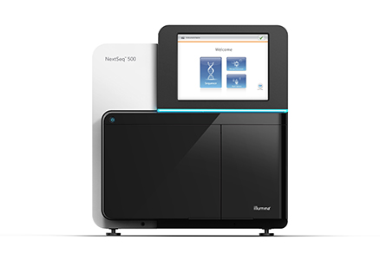

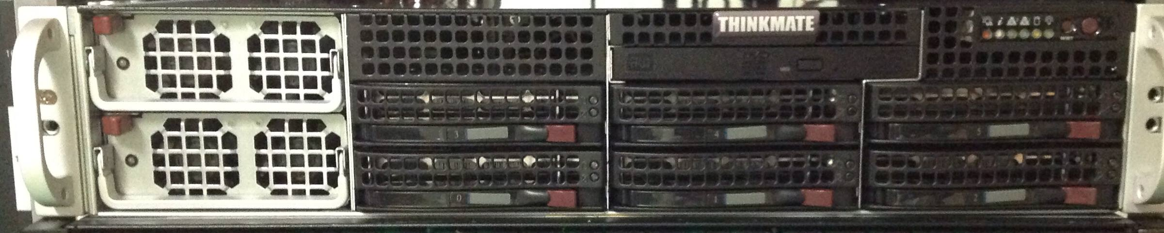
New NextSeq 500 DNA sequencer
Much faster – Results in 29
hours instead of 2 weeks.
Fewer samples – Four
lanes per flow cell.
More data – Additional
computing resources were
added.

Slide 21

Questions?

