Slide 1
2016 AGIL Report

Slide 2
AIP objectives
Expand national and international collection of phenotypic and genotypic data
Develop a more accurate genomic evaluation system with advanced, efficient methods to combine pedigrees, genotypes, and phenotypes
Use economic analysis to maximize genetic progress and financial benefits from collected data

Slide 3
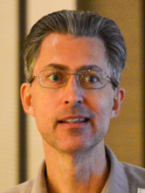




AIP scientists
Paul VanRaden (project leader)
  Genomic evaluation methods, haplotypes
George Wiggans (CDCB liaison)
  SNP selection, genotype exchange, goats
John Cole (acting research leader)
  Fertility, health, heat stress resistance, indices
Derek Bickhart
  Sequence data analysis, genome assembly
  correction and gene annotation
Kristen Parker Gaddis (UFL postdoctoral associate)
  Fertility, health, use of sequence data

Slide 4
Recent research and changes
Genomic evaluations for Guernseys
Breed composition and GPTAs for crossbreds
Increase to 77,531 SNPs used for evaluations
  (includes 30 gene tests provided by GeneSeek)
New GeneSeek 7K chip
New Affymetrix 44K chip

Slide 5
Recent research and changes cont’d
Imputed dams now used for parent-progeny checks
Goats (separate management groups for miniature and standard)
Developed an efficient procedure for syncing the AIP and CDCB databases
Additional traits (cow livability, age at first calving, persistency)
Changes to calving traits models

Slide 6
Cow livability - Background
Reasons for disposal have been reported and stored in DHI records since 1970
About 20% of cows die instead of being sold across all lactations
Death loss per lactation averages 7%, higher in later, lower in earlier lactation

Slide 7
Productive life (PL) vs. Livability (LIV)
PL measures cow’s ability to avoid dying or being culled
LIV measures cow’s ability to stay alive
LIV is a subset of PL

Slide 8
LIV model
Definition
Reverse of mortality:
  0 = died this lactation
  100 = lived this lactation
Multiply by average lactations/cow (2.8) to put on a lifetime scale

Slide 9
LIV model cont’d
Data
  92 million records on 32 million cows
Methodology
  Multi-trait 1-step model with PL (by lactation) using similar edits as other traits
Heritability of 1.3 (Miller et al., 2008), genetic correlation with lactation PL of 0.50

Slide 10
Correlation of PTA LIV with other trait PTA
Trait | HO | JE
Milk | 0.09 | -0.08
Fat | 0.21 | 0.01
Protein | 0.16 | -0.01
Productive Life | 0.70 | 0.54
SCS | -0.28 | -0.07
Daughter Pregnancy Rate | 0.40 | 0.54
Cow Conception Rate | 0.40 | 0.33
Heifer Conception Rate | 0.28 | 0.32
Number of bulls | 45,840 | 3,893
Bulls born 1990 or later, minimum 50 daughters, 0.50 rel for PTALIV.

Slide 11
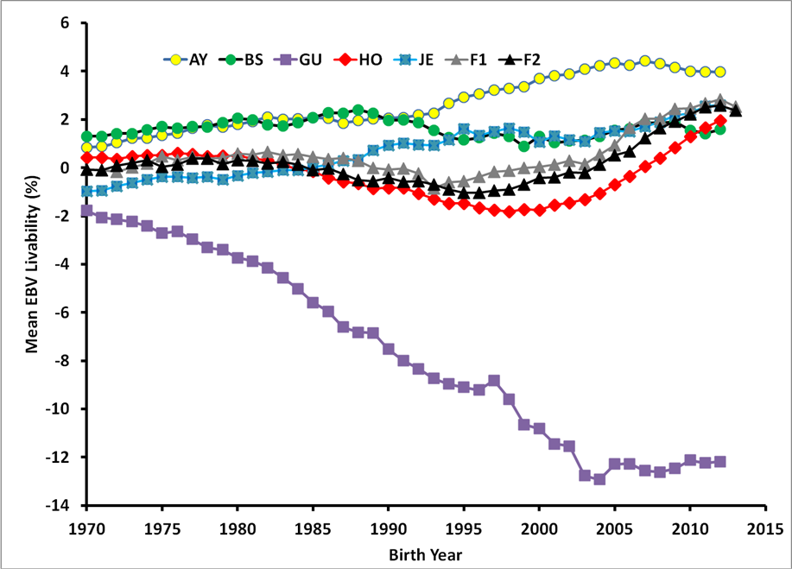
LIV genetic trends 1970-2013

Slide 12
Genetic improvement of cow health
Compute breeding values for 6 common health events
Reflects economic importance, heritability, and reporting consistency based on analyses of field data
Trait | Incidence rate (%) | Heritability
Displaced abomasum | 2.20 ± 0.42 | 0.32 ± 0.04
Ketosis | 5.15 ± 0.78 | 0.14 ± 0.03
Mastitis | 12.32 ± 1.06 | 0.10 ± 0.01
Metritis | 6.86 ± 0.47 | 0.07 ± 0.01
Milk fever | 2.40 ± 1.06 | 0.10 ± 0.01
Retained placenta | 4.60 ± 0.63 | 0.36 ± 0.08
Sources: Parker Gaddis et al. 2015. J. Dairy Sci. 97:3190-3199;
Uribet el al. 1995. J. Dairy Sci. 78:421-430.

Slide 13
Health Merit $ and NM$
HM$ will provide a single value that farmers can use to make selection decisions
  Change in lifetime income due to reductions in health care costs (e.g., $50)
  Preferred to selection on individual traits
Can be added into NM$ similarly to CA$
Similar concept to Zoetis’s new Wellness Trait Index (WT$)

Slide 14
VERY Rough Draft of HM$
Correlations assembled from several sources – need to re-estimate!
Economic values from Liang (2013)
HM$ = (0.35 x DSAB) + (0.17 x KETO) + (0.14 x MAST) + (0.08 x METR) + (0.08 x CALC) + (0.18 x RETP)
  Rough numbers, more work needed!
  Does not yet account for any other traits!

Slide 15
Genetic correlations
Health traits are correlated with other traits already included in NM$
Easy to over-state gain from new traits if correlations not well-estimated
Trait | DPR | PL | Milk yield | SCS | NM$
Displaced abomasum | -0.47 | -0.47 | 0.02 | 0.19 | -0.35
Ketosis | -0.48 | -0.48 | 0.02 | 0.25 | -0.40
Mastitis | -0.19 | -0.27 | 0.09 | 0.56 | -0.21
Metritis | -0.35 | -0.18 | -0.21 | 0.01 | -0.37
Retained placenta | -0.44 | -0.34 | -0.05 | 0.24 | -0.30
Source: Parker Gaddis et al. 2015. J. Dairy Sci. 97:3190-3199.

Slide 16
Correlations of SCS with mastitis
Correlation | CAN | DFS | FRA
USA SCS, foreign MAST | 0.87 | 0.87 | 0.86
USA SCS, foreign SCS | 0.94 | 0.88 | 0.90
Genetic correlations estimated by Interbull, Dec 2015
Genetic correlation estimated by Zoetis = 0.45

Slide 17
Added value from more traits
Year | Traits | Added | Data | Corr | Gain
1977 | 3 | Protein | DHIA
1994 | 5 | Productive life, SCS | DHIA | 0.84 | 19%
2000 | 18 | Size, udder, feet / legs | Breeds | 0.94 | 6%
2003 | 21 | Pregnancy rate, calving ease (sire, dtr) | DHIA / NAAB | 0.98 | 2%
2006 | 23 | Stillbirth (sire, dtr) | NAAB | 0.98 | 2%
2014 | 25 | Heifer, cow conception | DHIA | 0.97 | 3%
2016 |  | Cow death | DHIA | > 0.99 | < 1%
2016 | 31 | 6 more health traits | Zoetis | 0.92 ?? | 21% ??

Slide 18
Use in Selection Programs
Avoid using bulls with undesirable PTA
  Not all bulls with high rates of daughter illness have low NM$
Select on an index
  This ensures that you don’t overemphasize one trait or another
  Results in optimal rates of genetic gain

Slide 19
Acknowledgments
Council on Dairy Cattle Breeding
National DHIA
Binational Agricultural Research and Development (BARD)
National Institute of Food and Agriculture (NIFA), USDA
Washington State University & University of Missouri (NIFA grant)
CNPq “Science Without Borders” Program

Slide 20
Disclaimer
Mention of trade names or commercial products in this presentation is solely for the purpose of providing specific information and does not imply recommendation or endorsement by the US Department of Agriculture.

Slide 21

Questions?

