Slide 1
AIPL Report

Slide 2
Implementation of new software
Paul VanRaden has developed new programs to calculate genetic evaluations.
System for the post-processing of these evaluations to simplify the storage and creation of the distribution files is under development.
Goal is to have results by September to submit to the Interbull test run.
Notes:
2
2

Slide 3
More SNP for use in genomic evaluation
Small increase in accuracy of genomic evaluations achieved by increasing SNP used from 45,195 to 61,013.
All 45,195 SNP used previously were retained, and >15,000 SNP were added from the GeneSeek high-density genotyping chip.
For Holsteins, the gain in reliability across all traits from the additional SNP averaged 0.7 percentage points.
Notes:
3
3

Slide 4
Acquisition of full-sequence data
Arrangements to share full sequence data are being developed.
  Canada has sequenced 48 bulls
  Dr. G. Liu of BFGL will contribute 23 Holstein & Jersey bulls.
  AIPL has sequenced 21 animals and may add 24-48 over the next 6 mos.
Participation in the 1000 Bull Genomes project has been approved by USDA.
Notes:
4
4

Slide 5
Use of full-sequence data
Projects using sequence data include detecting causal variants for AH1 and a birth weight QTL on chromosome 18.
Paul VanRaden has developed a method of imputing all SNP in the genome from a subset.
The combination of SNP genotypes and sequence data may permit imputation of important genetic variants that are not on existing SNP chips.
Notes:
5
5

Slide 6
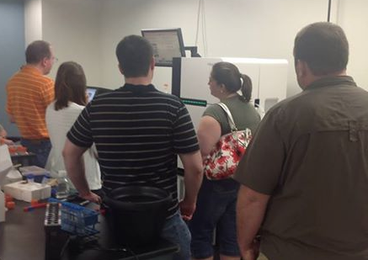
How many scientists does it take…

Slide 7
Sequencing successes at AIPL/BFGL
APAF1 – Spontaneous abortions in Holstein cattle (Adams et al., 2012)
CWC15 – Early embryonic death in Jersey cattle (Sonstegard et al., 2013)
Weaver syndrome – Neurological degeneration and death in Brown Swiss cattle (McClure et al., 2013)
HH2, HH3, and BH1 – Holstein and Brown Swiss fertility haplotypes (McClure et al., 2014)

Slide 8
Imputation of recessive conditions
Research data on JH1 was incorporated to improve the accuracy of imputation.
GeneSeek has begun to send SNP data on single-gene tests. These SNP will provide direct tests for BLAD, DUMPS, citrullinemia, etc. for many animals.
Notes:
8
8

Slide 9
Assisting the CDCB with computing
AIPL is collecting usage information to assist the CDCB in determining its computational requirements.
Cloud computing may be a good option for providing needed resources.
PostgreSQL is being evaluated as a possible replacement for DB2.
Notes:
9
9

Slide 10
Adjusted weights in genomic evaluations
The weighting for cow evaluations used to estimate SNP effects has been reduced.
The change prevents evaluations for bulls with many genotyped daughters from being distorted by shrinkage of cow evaluations toward birth year means.
Resulted in improved regressions of genomic evaluations on future performance and reduced bias.
Notes:
10
10

Slide 11
Mate selection strategies
Our NAAB-funded postdoc, Chuanyu Sun, has developed some software tools for mate selection using genomic relationships.
He also is working on strategies for use of dominance effects.
Notes:
11
11

Slide 12

Questions?
http://gigaom.com/2012/05/31/t-mobile-pits-its-math-against-verizons-the-loser-common-sense/shutterstock_76826245/

