Slide 1
The New USDA Blueprint for Animal Genome Research 2018–2027: A Quantitative Geneticist’s Perspective
John B. Cole
USDA, Agricultural Research Service
Henry A. Wallace Beltsville Agricultural Research Center
Animal Genomics and Improvement Laboratory
Beltsville, MD 20705-2350
john.cole@usda.gov

Slide 2
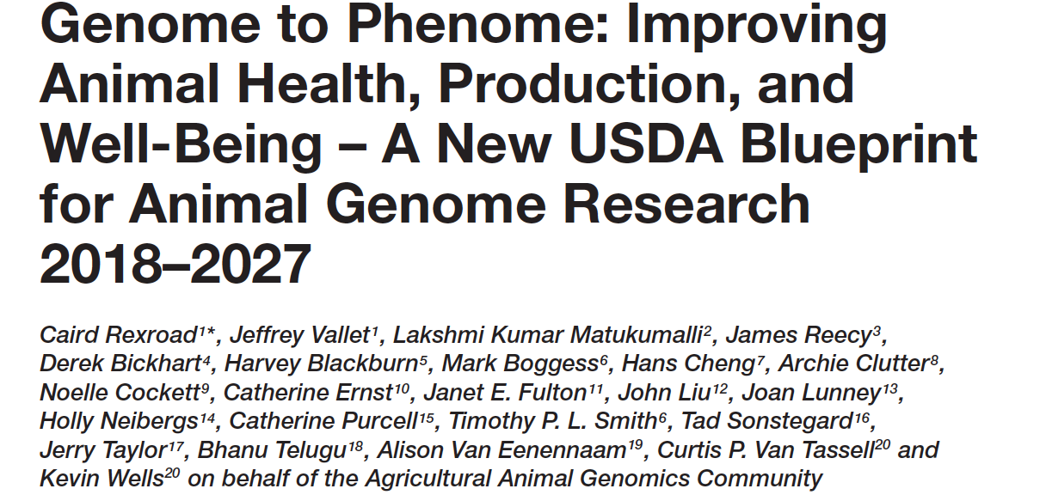
Genome to Phenome
This is a prediction problem, and
prediction is what geneticists do!
  1950s: Pedigree + Performance
  2010s: DNA + Pedigree + Performance
  2020s: “Omics” + Sensors + Pedigree + Performance?
Producers increasingly need tools to predict performance, not only genetic merit!
  Precision management of animals and other resources

Slide 3
What are we actually trying to improve?
Feed Intake
CO₂ emission
Calves produced
Lifetime profit
“Efficiency”
Body size
Functional longevity
Live weight
Methane production
Income over feed cost
Mid-infrared milk spectrum
Body condition score
Microbiome

Slide 4
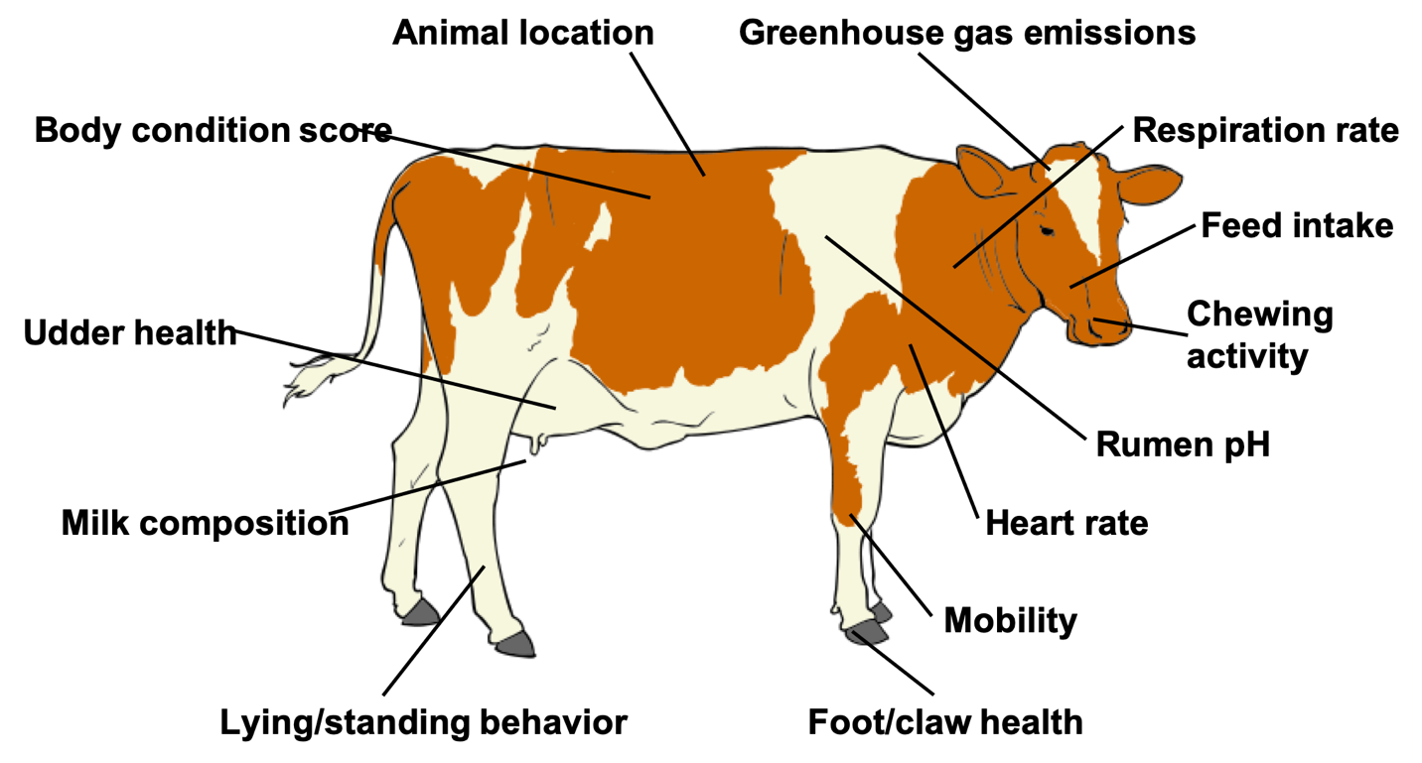
Phenotype is king!
Source: Villarreal (2010; https://en.wikipedia.org/wiki/File:Cow_clipart_01.svg).

Slide 5
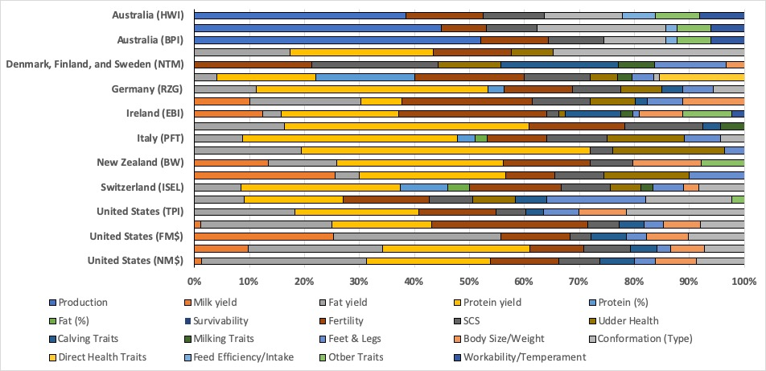
More traits, more problems?
Combining many measurements into a decision tool is a familiar problem to quantitative geneticists
Source: After Cole & VanRaden (2017; PMID: 29103719).

Slide 6
Do more data make prediction more difficult?
Genetic prediction
  Volume of data not a problem per se
  New data may need more complex models
  Causal inference remains challenging, but is needed to bridge gaps
  Advancements will be incremental
Phenotypic prediction
  Real-time or near-real-time calculation needed
  Data transfer speeds may be limiting
  Information may be siloed on the farm
  Collaboration with industry is critical!

Slide 7
How does this relate to the Blueprint?
Understanding Genome Biology to
Accelerate Genetic Improvement of
Economically Important Traits
Harnessing the Microbiome
Where is the
human capital?
Applying Precision Technology
Developing Advanced Genomic Tools,
Technologies, and Resources for
Agricultural Animals
Creating Big Data Tools

Slide 8
Disclaimer
The author was supported by USDA-ARS project 8042-31000-002-00-D, “Improving Dairy Animals by Increasing Accuracy of Genomic Prediction, Evaluating New Traits, and Redefining Selection Goals”.
USDA is an equal opportunity provider and employer.
Mention of trade names or commercial products in this presentation is solely for the purpose of providing specific information and does not imply recommendation or endorsement by the US Department of Agriculture.

Slide 9
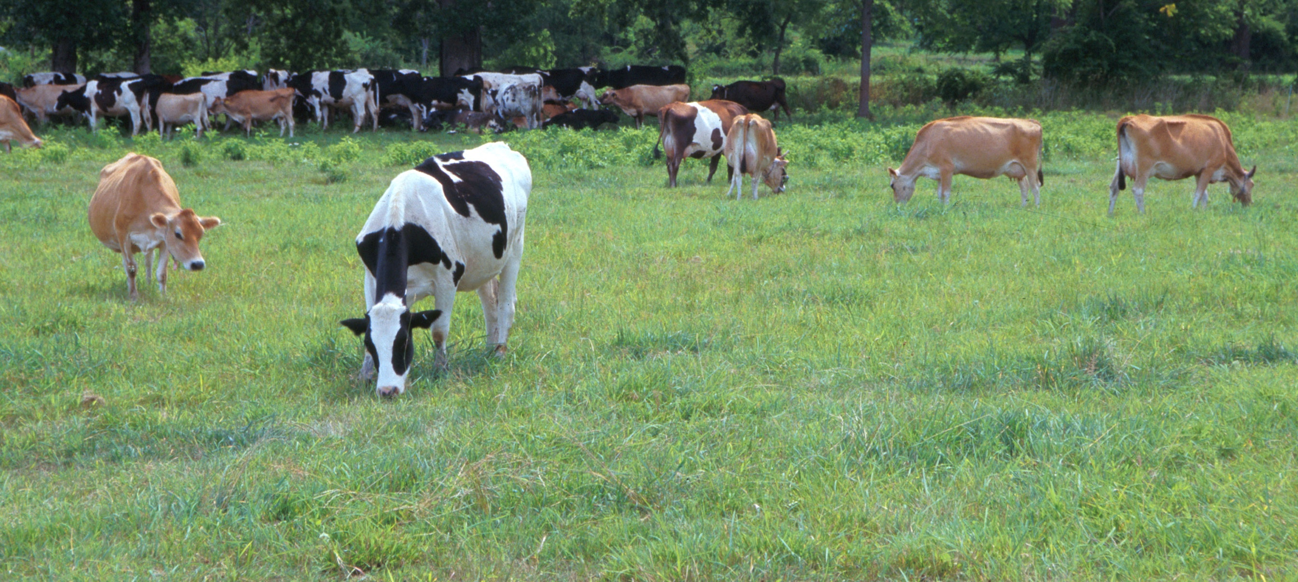
Questions?
AIP web site:
http://aipl.arsusda.gov/
Holstein and Jersey crossbreds graze on American Farm Land Trust’s
Cove Mountain Farm in south-central Pennsylvania
Source: ARS Image Gallery, image #K8587-14; photo by Bob Nichols

