Slide 1
New tools for genomic selection in dairy cattle

Slide 2
Why genomic selection works in dairy
Extensive historical data available
Well-developed genetic evaluation program
Widespread use of AI sires
Progeny test programs
High-valued animals, worth the cost of genotyping
Long generation interval which can be reduced substantially by genomics
Notes:
2
2

Slide 3
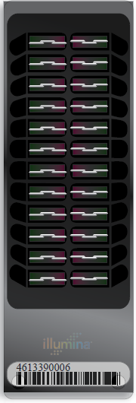
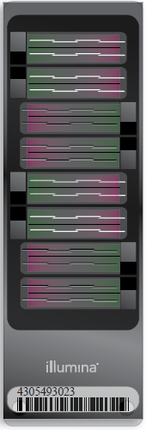
Illumina genotyping arrays
BovineSNP50
  54,001 SNPs (version 1)
  54,609 SNPs (version 2)
  45,187 SNPs used in evaluation
BovineHD
  777,962 SNPs
  Only BovineSNP50 SNPs used
  >1,700 SNPs in database
BovineLD
  6,909 SNPs
  Allows for additional SNPs
BovineSNP50 v2
BovineHD
BovineLD
Notes:
3

Slide 4
Genotyped animals (April 2013)
Chip | Traditional evaluation? | Animal sex | Holstein | Jersey | Brown Swiss | Ayrshire
≥50K | Yes | Bulls | 21,904 | 2,855 | 5,381 | 639
 |  | Cows | 16,062 | 1,054 | 110 | 3
 | No | Bulls | 45,537 | 3,884 | 1,031 | 325
 |  | Cows | 32,892 | 660 | 102 | 110
<50K | Yes | Bulls | 19 | 11 | 28 | 9
 |  | Cows | 21,980 | 9,132 | 465 | 0
 | No | Bulls | 14,026 | 1,355 | 90 | 2
 |  | Cows | 158,622 | 18,722 | 658 | 105
Imputed | Yes | Cows | 2,713 | 237 | 103 | 12
 | No | Cows | 1,183 | 32 | 112 | 8
All |  |  | 314,938 | 37,942 | 8,080 | 1,213
362,173

Slide 5
Marketed Holstein bulls

Slide 6
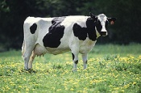
What’s a SNP genotype worth?
Pedigree is equivalent to information on about 7 daughters
For the protein yield (h²=0.30), the SNP genotype provides information equivalent to an additional 34 daughters
Notes:
6

Slide 7

What’s a SNP genotype worth?
And for daughter pregnancy rate (h²=0.04), SNP = 131 daughters
Notes:
7

Slide 8
Genotypes and haplotypes
Genotypes indicate how many copies of each allele were inherited
Haplotypes indicate which alleles are on which chromosome
Observed genotypes partitioned into the two unknown haplotypes
  Pedigree haplotyping uses relatives
  Population haplotyping finds matching allele patterns

Slide 9
Haplotyping program – findhap.f90
Begin with population haplotyping
  Divide chromosomes into segments, ~250 to 75 SNP / segment
  List haplotypes by genotype match
  Similar to fastPhase, IMPUTE
End with pedigree haplotyping
  Detect crossover, fix noninheritance
  Impute nongenotyped ancestors

Slide 10
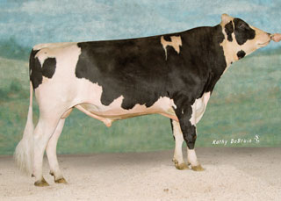
Example Bull: O-Style (USA137611441)
Read genotypes and pedigrees
Write haplotype segments found
  List paternal / maternal inheritance
  List crossover locations

Slide 11
O-Style Haplotypes Chromosome 15

Slide 12
Loss-of-function mutations
At least 100 LoF per human genome surveyed (MacArthur et al., 2010)
  Of those genes ~20 are completely inactivated
  Uncharacterized LoF variants likely to have phenotypic effects
How should mating programs deal with this?
Can we find them?

Slide 13
Recessive defect discovery
Check for homozygous haplotypes
  7 to 90 expected but none observed
  5 of top 11 are potentially lethal
  936 to 52,449 carrier sire by carrier MGS fertility records
  3.1% to 3.7% lower conception rates
  Some slightly higher stillbirth rates
Confirmed Brachyspina same way

Slide 14
Haplotypes affecting fertility & stillbirth
Name | Chromosome | Location | Haplotype Freq | Earliest Known Ancestor
HH1 | 5 | 63150400 | 1.9 | Pawnee Farm Arlinda Chief
HH2 | 1 | 94.8-96.5 | 1.6 | Willowholme Mark Anthony
HH3 | 8 | 95410507 | 2.9 | Glendell Arlinda Chief, Gray View Skyliner
HH4 | 1 | 1,277,227 | 0.37 | Besne Buck
HH5 | 9 | 92-94 | 2.22 | Thornlea Texal Supreme
JH1 | 15 | 11-16 | 12.1 | Observer Chocolate Soldier
BH1 | 7 | 42-47 | 6.67 | West Lawn Stretch Improver
BH2 | 19 | 10-12 | 7.78 | Rancho Rustic My Design
AH1 | 17 | 65.9-66.2 | 11.8 | Selwood Betty’s Commander

Slide 15
Precision mating
Eliminate undesirable haplotypes
  Detection at low allele frequencies
Avoid carrier-to-carrier matings
  Easy with few recessives, difficult with many recessives
Include in selection indices
  Requires many inputs
Use a selection strategy for favorable minor alleles (Sun & VanRaden, 2013)
Notes:
15
15

Slide 16
Sequencing successes at AIPL/BFGL
Simple loss-of-function mutations
  APAF1 (HH1) – Spontaneous abortions in Holstein cattle (Adams et al., 2012)
  CWC15 (JH1) – Early embryonic death in Jersey cattle (Sonstegard et al., 2013)
  Weaver syndrome – Neurological degeneration and death in Brown Swiss cattle (McClure et al., 2013)

Slide 17
Modified pedigree & haplotype design
These bulls carry
the haplotype with
the largest, negative
effect on SCE:
Bull A (1968)
AA, SCE: 8
Bull B (1962)
AA, SCE: 7
MGS
Bull J (2002)
Aa, SCE: 6
Bull C (1975)
AA, SCE: 8
δ = 10
Bull E (1974)
Aa, SCE: 10
Bull K (2002)
Aa, SCE: 15
Bull K (2002)
aa, SCE: 15
MGS
Bull E (1982)
Aa, SCE: 8
Bull F (1987)
Aa, SCE: 15
Couldn’t obtain DNA:
Bull D (1968)
??, SCE: 7
Bull H (1989)
Aa, SCE: 14
Bull I (1994)
Aa, SCE: 18

Slide 18
Things can move quickly!
Brown Swiss family with possible BH2 homozygotes (dead)
Dead calves will be
genotyped for BH2
status
If homozygous, we
will sequence in a
family-based design
Austrian group also
working on BH2
(Schwarzenbacher
et al., 2012)
Strong industry
support!
AI firm
sending
10 units
of semen
Semen
in CDDR
Owner will collect
blood samples
Tissue samples (ears)
being processed for DNA
Owner will collect blood
samples when born

Slide 19
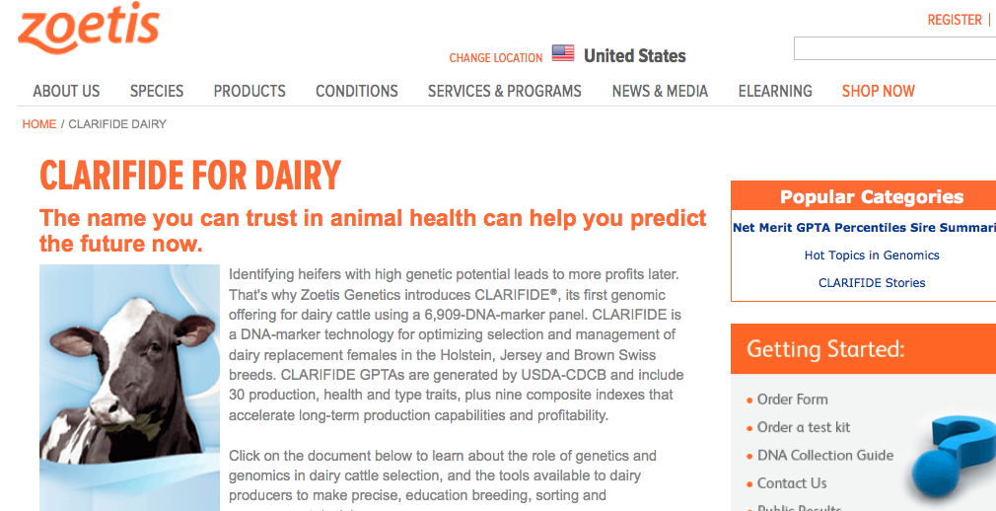
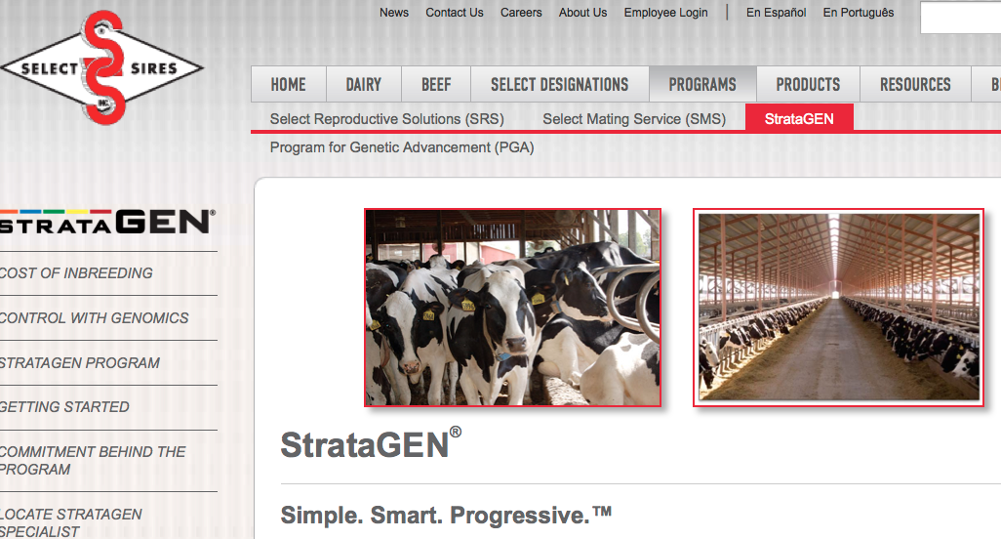
Our industry wants new genomic tools

Slide 20
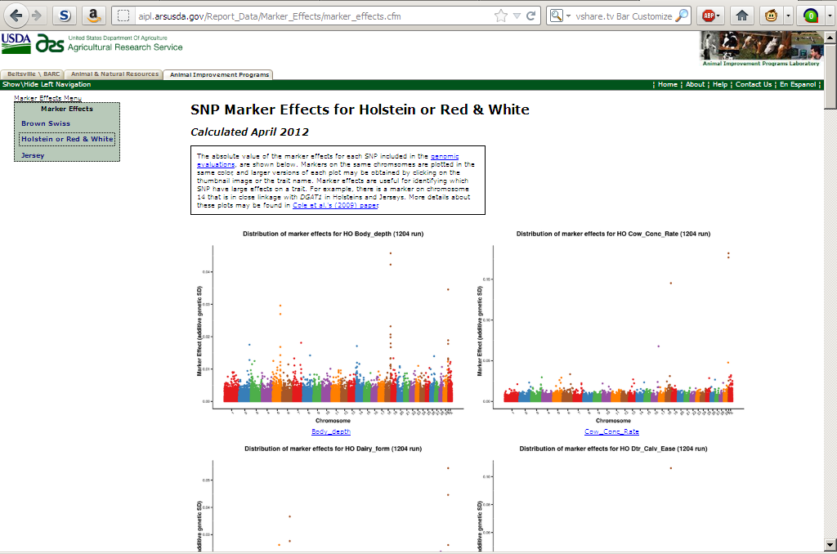
We already have some tools
https://www.cdcb.us/Report_Data/Marker_Effects/marker_effects.cfm`

Slide 21
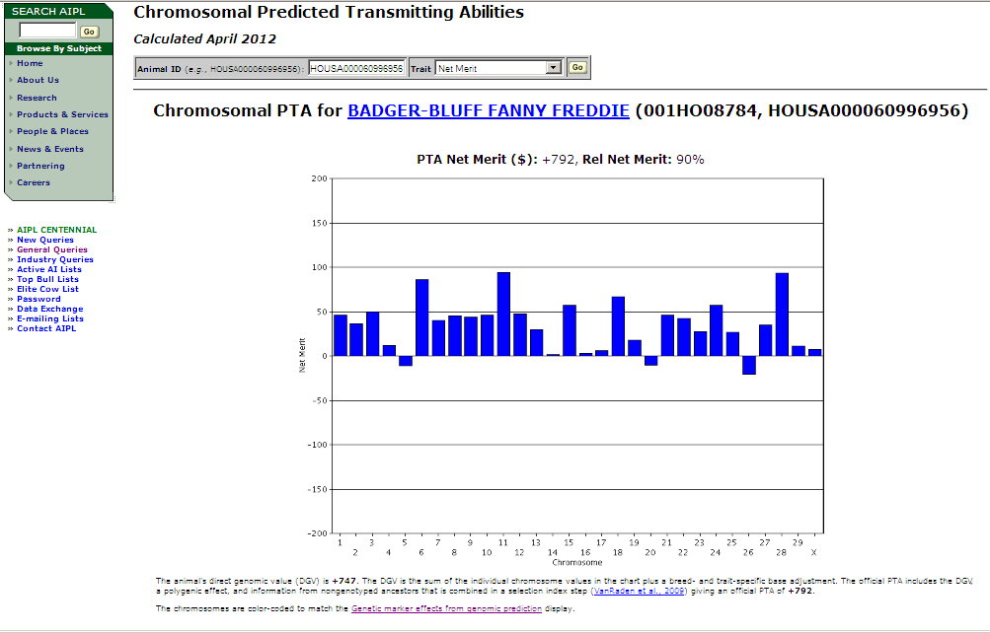
Chromosomal DGV query
https://www.cdcb.us/CF-queries/Bull_Chromosomal_EBV/bull_chromosomal_ebv.cfm

Slide 22
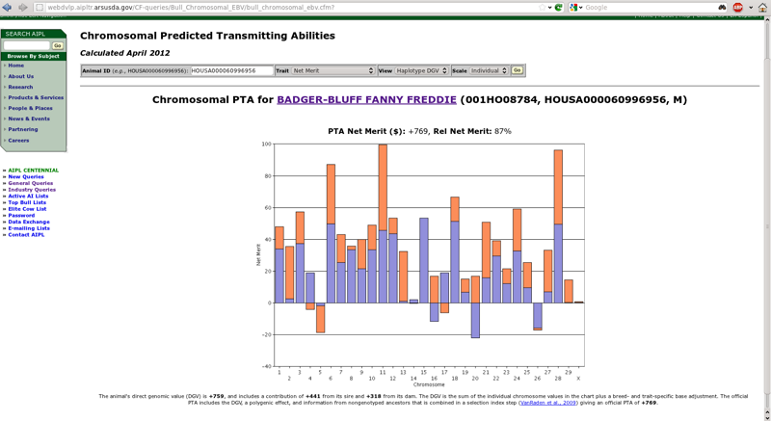
Now we have a new haplotype query
https://www.cdcb.us/CF-queries/Bull_Chromosomal_EBV/bull_chromosomal_ebv.cfm

Slide 23
Paternal and maternal DGV
Shows the DGV for the paternal and maternal haplotyles
  Imputed from 50K using findhap.f90 v.2
Can we use them to make mating decisions?
  People are going to do it – we need to help them!
  Who is actually making planned matings?

Slide 24
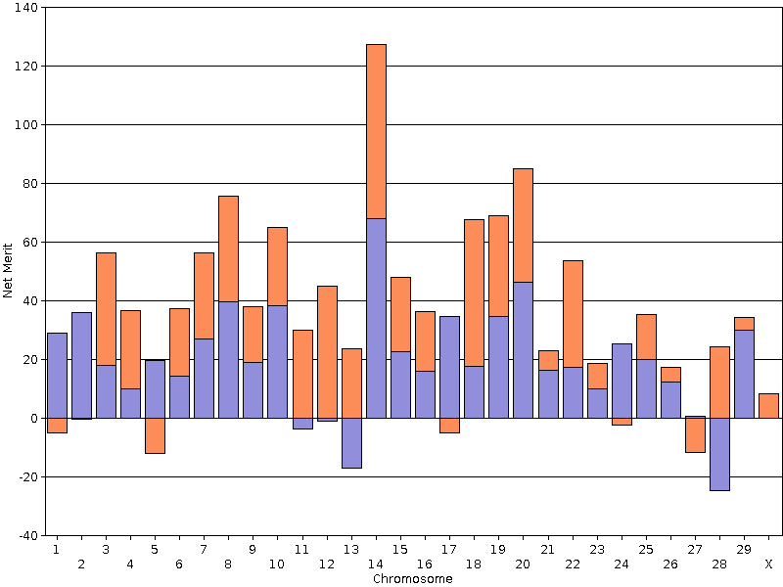
Top net merit bull August 2013
COOKIECUTTER PETRON HALOGEN
(HO840003008710387, PTA NM$ +926, Rel 68%)

Slide 25
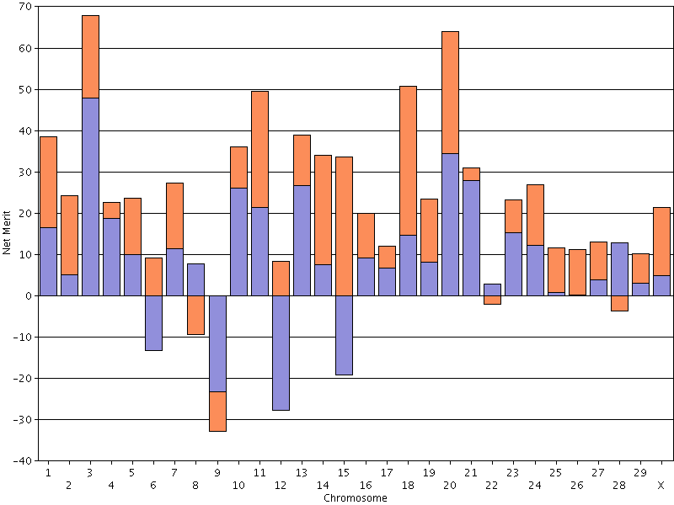
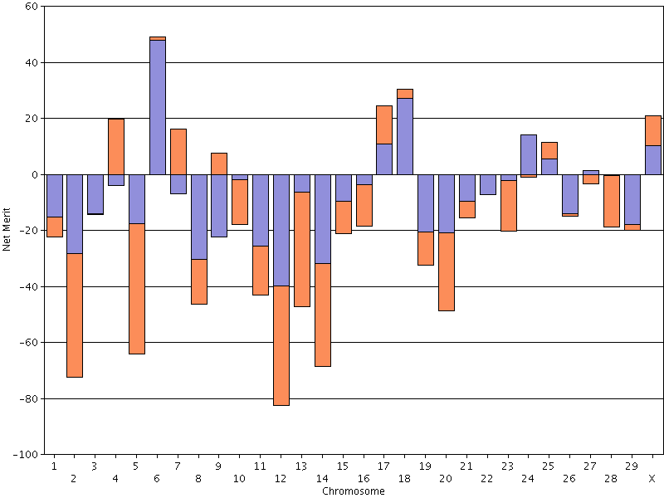
Pluses and minuses
23 positive chromosomes
19 negative chromosomes

Slide 26
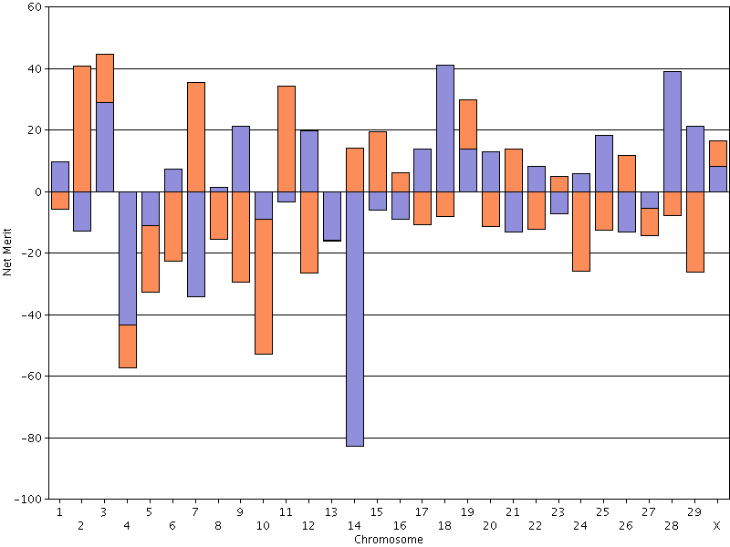
Breeders need MS variance

Slide 27
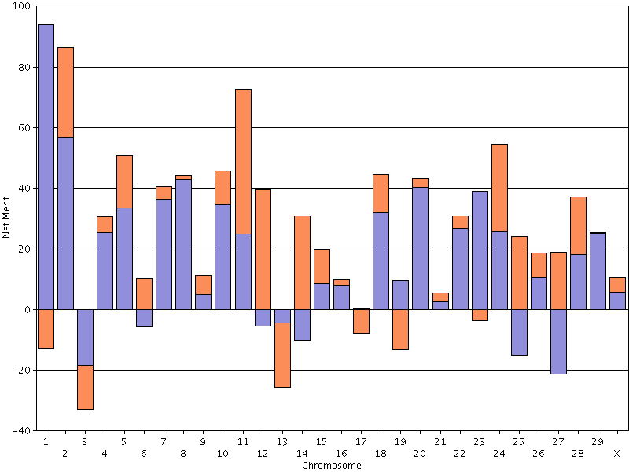
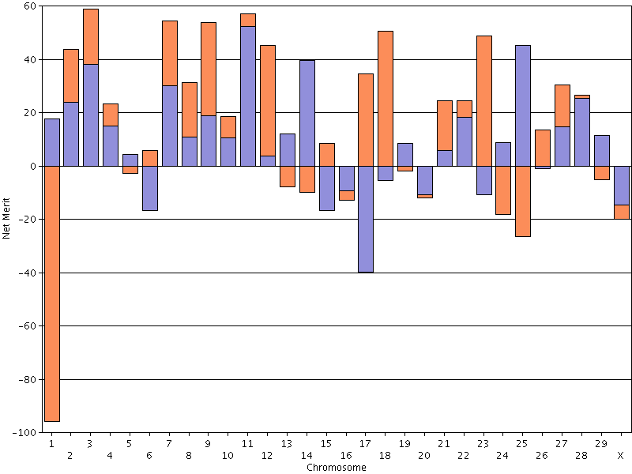
The good and the bad Chromosome 1

Slide 28
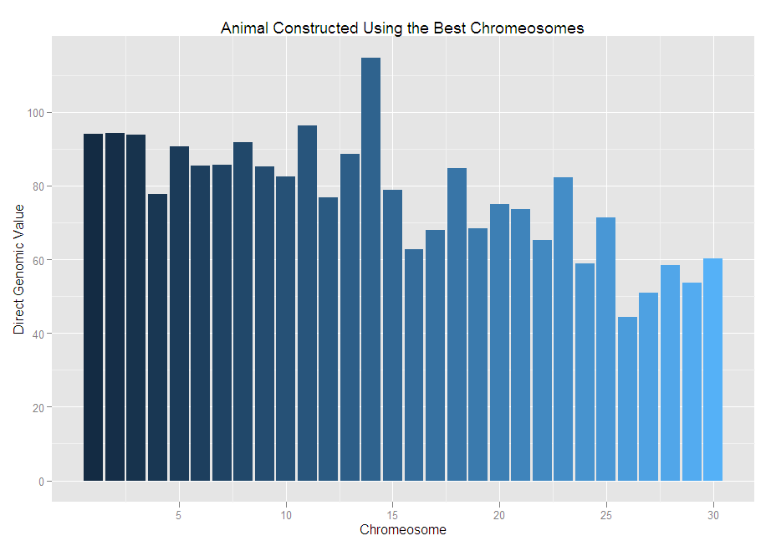
The best we can do DGV for NM$ = +2,314

Slide 29
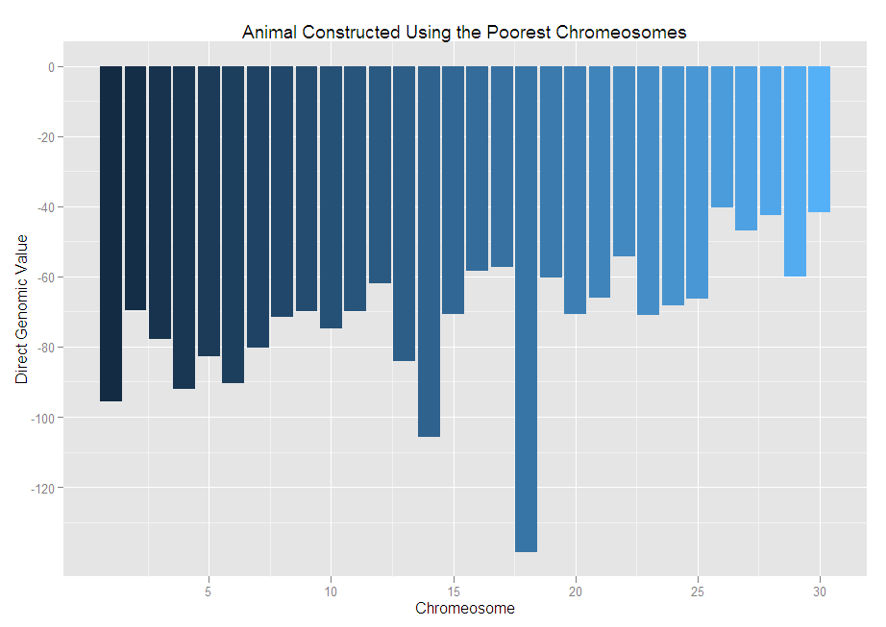
The worst we can do DGV for NM$ = -2,139

Slide 30
Dominance in mating programs
Quantitative model
  Must solve equation for each mate pair
Genomic model
  Compute dominance for each locus
  Haplotype the population
  Calculate dominance for mate pairs
Most genotyped cows do not yet have phenotypes
Notes:
30
30

Slide 31
Inbreeding effects
Inbreeding alters transcription levels and gene expression profiles (Kristensen et al., 2005).
Moderate levels of inbreeding among active bulls (7.9 to 18.2)
Are inbreeding effects distributed uniformly across the genome?
  Can we find genomic regions where heterozygosity is necessary or not using the current population?
Notes:
31
31

Slide 32
Precision inbreeding
Runs of homozygosity may indicate genomic regions where inbreeding is acceptable
Can we target those regions by selecting among haplotypes?
Dominance
Under-dominance
Recessives

Slide 33
Challenges with new phenotypes
Lack of information
  Inconsistent trait definitions
  Often no database of phenotypes
Many have low heritabilities
  Lots of records are needed for accurate evaluation
  Genetic improvement can be slow
Genomics may help with this
Notes:
33
33

Slide 34
Reliability with and without genomics
Example: Dairy cattle health (Parker Gaddis et al., 2013)
Average reliabilities of sire PTA computed with pedigree information and genomic information, and the gain in reliability from including genomics.
Event | EBV Reliability | GEBV Reliability | Gain
Displaced abomasum | 0.30 | 0.40 | +0.10
Ketosis | 0.28 | 0.35 | +0.07
Lameness | 0.28 | 0.37 | +0.09
Mastitis | 0.30 | 0.41 | +0.11
Metritis | 0.30 | 0.41 | +0.11
Retained placenta | 0.29 | 0.38 | +0.09

Slide 35
Some novel phenotypes being studied
Age at first calving (Cole et al., 2013)
Dairy cattle health (Parker Gaddis et al., 2013)
Methane production (de Haas et al., 2011)
Milk fatty acid composition (Bittante et al., 2013)
Persistency of lactation (Cole et al., 2009)
Rectal temperature (Dikmen et al., 2013)
Residual feed intake (Connor et al., 2013)
Notes:
35
35

Slide 36
What do we do with novel traits?
Put them into a selection index
  Correlated traits are helpful
Apply selection for a long time
  There are no shortcuts
Collect phenotypes on many daughters
  Repeated records of limited value
  Genomics can increase accuracy

Slide 37
Genetic-economic indexes 2010 revision
Trait | Relative value (%)
 | Net merit | Cheese merit | Fluid merit
Milk (lb) | 0 | –15 | 19
Fat (lb) | 19 | 13 | 20
Protein (lb) | 16 | 25 | 0
Productive life (PL, mo) | 22 | 15 | 22
Somatic cell score (SCS, log₂) | –10 | –9 | –5
Udder composite (UC) | 7 | 5 | 7
Feet/legs composite (FLC) | 4 | 3 | 4
Body size composite (BSC) | –6 | –4 | –6
Daughter pregnancy rate (DPR, %) | 11 | 8 | 12
Calving ability (CA$, $) | 5 | 3 | 5

Slide 38
Index changes
Trait | Relative emphasis on traits in index (%)
 | PD$ 1971 | MFP$ 1976 | CY$ 1984 | NM$ 1994 | NM$ 2000 | NM$ 2003 | NM$ 2006 | NM$ 2010
Milk | 52 | 27 | –2 | 6 | 5 | 0 | 0 | 0
Fat | 48 | 46 | 45 | 25 | 21 | 22 | 23 | 19
Protein | … | 27 | 53 | 43 | 36 | 33 | 23 | 16
PL | … | … | … | 20 | 14 | 11 | 17 | 22
SCS | … | … | … | –6 | –9 | –9 | –9 | –10
UDC | … | … | … | … | 7 | 7 | 6 | 7
FLC | … | … | … | … | 4 | 4 | 3 | 4
BDC | … | … | … | … | –4 | –3 | –4 | –6
DPR | … | … | … | … | … | 7 | 9 | 11
SCE | … | … | … | … | … | –2 | … | …
DCE | … | … | … | … | … | –2 | … | …
CA$ | … | … | … | … | … | … | 6 | 5

Slide 39
What does it mean to be the worst?
Large body size
  Eats a lot of expensive feed
Average fertility…or worse!
Begin first lactation with dystocia
  Bull calf (sexed semen?)
  Retained placenta, metritis, etc.
Mediocre production
Uses many resources, produces very little

Slide 40
Dissecting genetic correlations
Compute DGV for 75-SNP segments
Calculate correlations of DGV for traits of interest for each segment
Is there interesting biology associated with favorable correlations?
…and what about linkage disequilibrium?

Slide 41
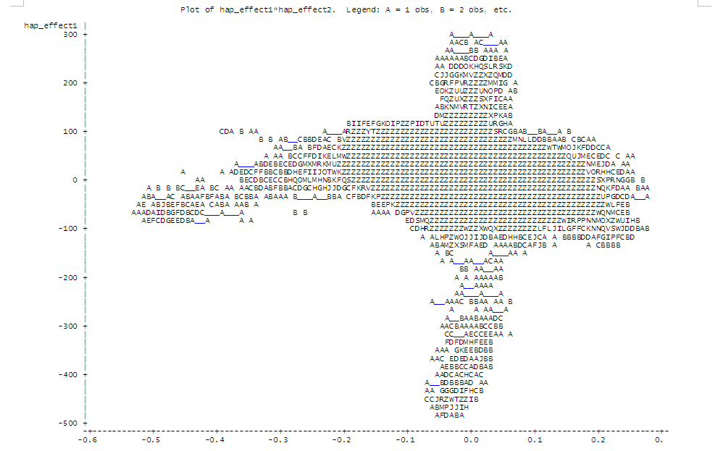
SNP segment correlations Milk with DPR
Unfavorable associations
Favorable associations
Favorable associations
Unfavorable associations

Slide 42
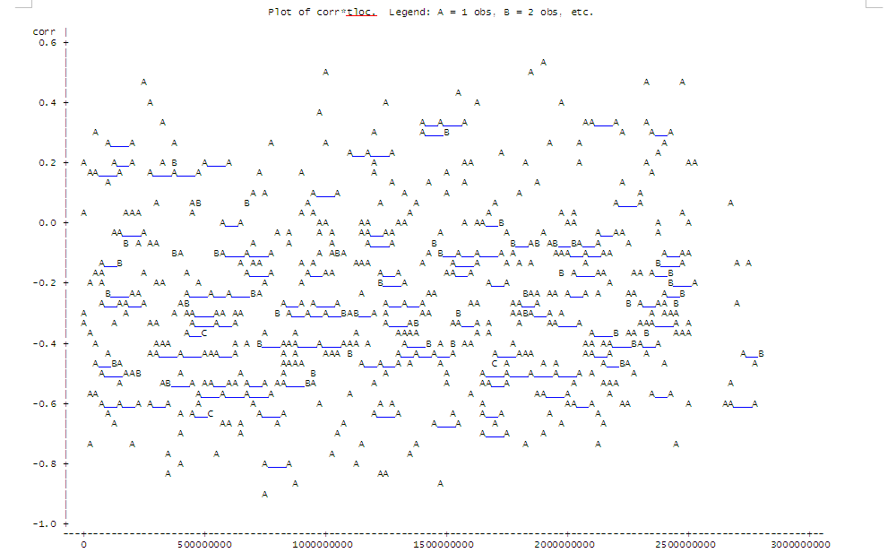
SNP segment correlations Dist’n over genome

Slide 43
Highest correlations for milk and DPR
Obs chrome seg tloc corr
1 18 449 1890311910 0.53090
2 18 438 1845503211 0.51036
3 8 233 990810677 0.49199
4 26 557 2331662169 0.47173
5 2 60 239796003 0.46507
6 29 596 2483178230 0.45252
7 14 366 1544999648 0.43817
8 2 65 269016505 0.41022
9 11 298 1255667282 0.39734
10 20 469 1971347760 0.3919

Slide 44
Conclusions
Non-additive effects may be useful for increasing selection intensity while conserving important heterozygosity
Whole-genome sequencing has been very successful at helping economically important loss-of-function mutations
Novel phenotypes are necessary to address global food security and a changing climate

Slide 45
Acknowledgments
Paul VanRaden, George Wiggans, Derek Bickhart, Dan Null, and Tabatha Cooper
Animal Improvement Programs Laboratory, ARS, USDA Beltsville, MD
Tad Sonstegard, Curt Van Tassell, and Steve Schroeder
Bovine Functional Genomics Laboratory, ARS, USDA, Beltsville, MD
Chuanyu Sun
National Association of Animal Breeders
Beltsville, MD
Dan Gilbert
New Generation Genetics Inc., Fort Atkinson, WI

Slide 46

Questions?
http://gigaom.com/2012/05/31/t-mobile-pits-its-math-against-verizons-the-loser-common-sense/shutterstock_76826245/

