Slide 1
Improving production efficiency through genetic selection
John B. Cole
Animal Genomics and Improvement Laboratory
Agricultural Research Service, USDA, Beltsville, MD
john.cole@ars.usda.gov
Diane M. Spurlock
Department of Animal Science, Iowa State University, Ames, IA

Slide 2
Introduction
How genetic selection works
Gains due to genetic selection
Use of genomic technology
Future research opportunities

Slide 3
How does genetic selection work?
ΔG = genetic gain each year
Reliability = how certain we are about our estimate of an animal’s genetic merit (genomics ↑)
Selection intensity = how selective we are when making mating decisions (management can ↑)
Genetic variance = variation in the population due to genetics (we can’t really change this)
Generation interval = time between generations (genomics ↓)

Slide 4
U.S. dairy population & milk yield

Slide 5
Genetic evaluation advances
Year | Advance | Gain, %
1862 | USDA established
1895 | USDA begins collecting dairy records
1926 | Daughter-dam comparison | 100
1962 | Herdmate comparison | 50
1973 | Records in progress | 10
1974 | Modified contemporary comparison | 5
1977 | Protein evaluated | 4
1989 | Animal model | 4
1994 | Net merit, productive life, somatic cell score | 50
2008 | Genomic selection | >50

Slide 6
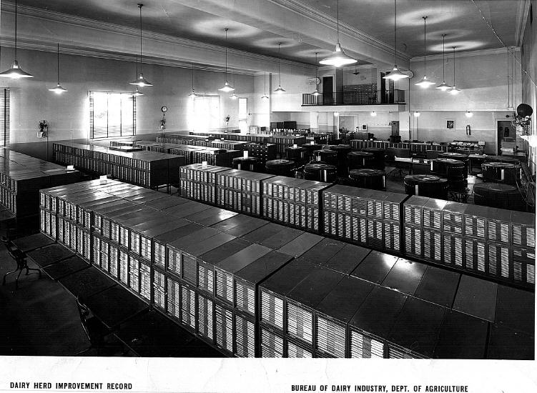
DHI records database (1935)

Slide 7
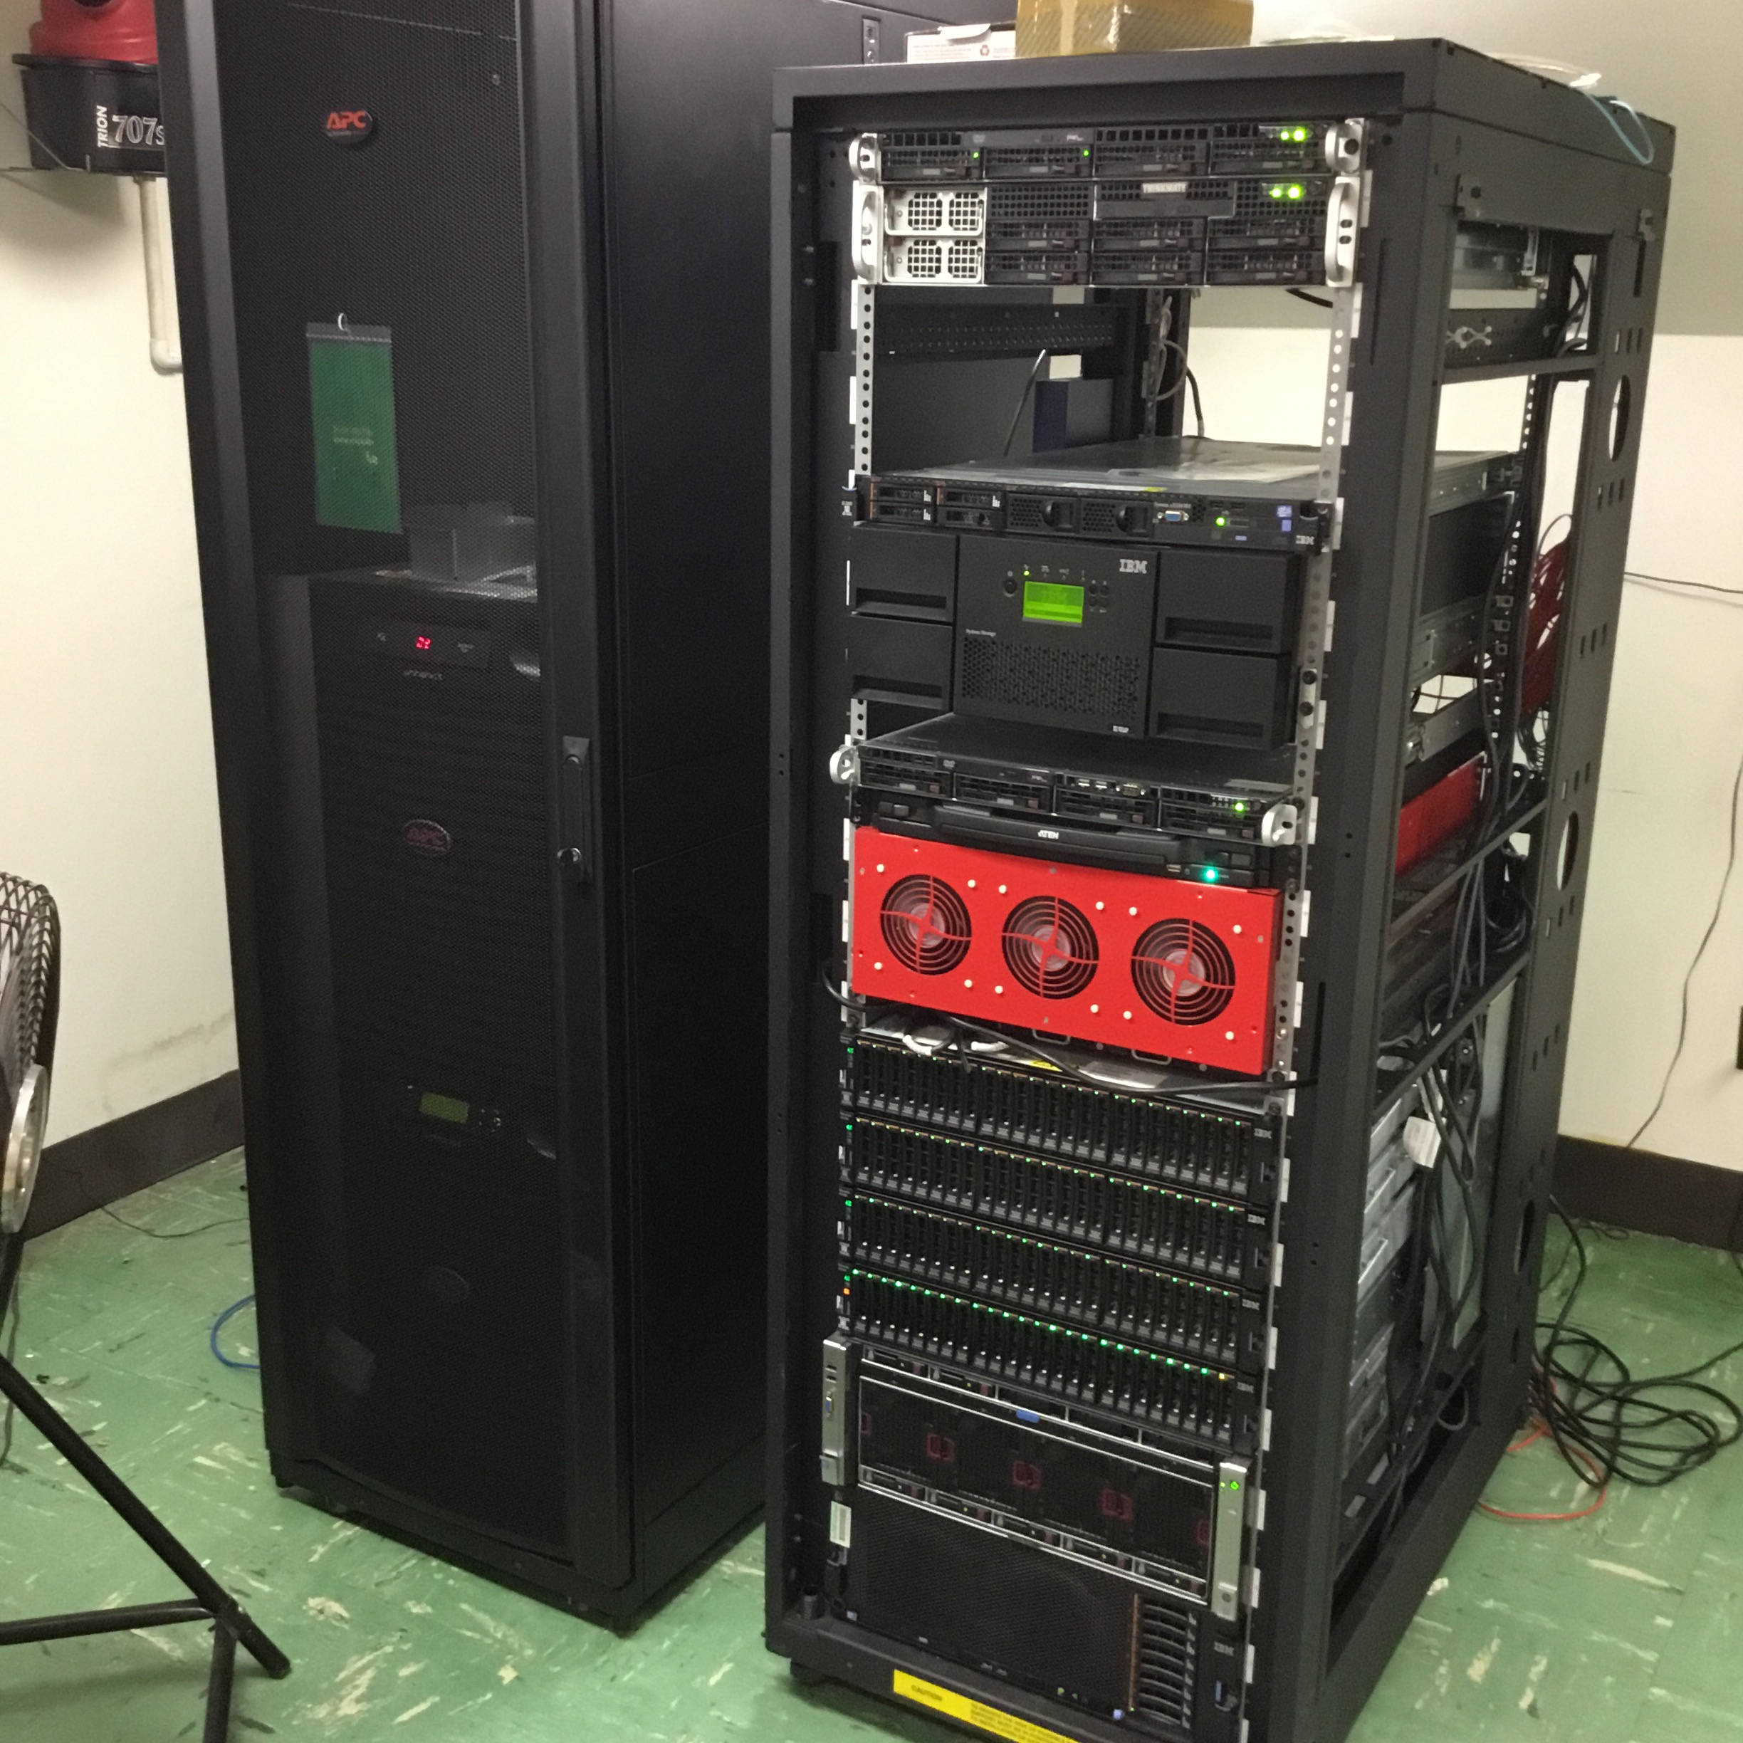
DHI records database (2017)

Slide 8
Animal model
1989 to 2014
Introduced by Wiggans and VanRaden
Advantages
Information from all relatives
Adjustment for genetic merit of mates
Uniform procedures for males and females
Best prediction (BLUP)
Crossbreds included (2007)
Genomic information added (2008)

Slide 9
New evaluation programs (Dec. 2014)
Replaced animal model programs used since 1989
New options
Multitrait models
Multiple class and regression variables
Factors and weights differ by trait
Random regressions
Foreign data included
Parallel processing
Developed for transition to single-step model (genotypes, phenotypes, pedigree)

Slide 10
Conformation (type) traits
Stature
Strength
Body depth
(Ayrshire, Guernsey, Holstein)
Dairy form
Rump angle
Thurl/rump width
Rear legs (side view)
Rear legs (rear view)
(Brown Swiss, Guernsey, Holstein, Milking Shorthorn)
Foot angle
Feet and legs score (Holstein)
Mobility
(Brown Swiss, Milking Shorthorn)
Fore udder attachment
Rear udder height
Rear udder width
Udder cleft
Udder depth
Front teat placement
Rear teat placement
(Holstein, Jersey)
Teat length
Milking speed
(Brown Swiss, Milking Shorthorn)
Final score

Slide 11
Genetic trend – milk yield (Holstein)
August 2016
Phenotypic base = 12,245 kg
Sires
63 kg/yr
Cows

Slide 12
Genetic trend – productive life (Holstein)
August 2016
Phenotypic base = 26.02 months
Sires
0.3 mo/yr
Cows

Slide 13
Genetic trend – somatic cell score (Holstein)
August 2016
Sires
0.04/yr
Phenotypic base = 3.0 kg
Cows

Slide 14
Genetic trend – daughter pregnancy rate (Holstein)
August 2016
Sires
Cows
0.3%/yr
Phenotypic base = 28.5%

Slide 15
Genetic trend – calving ease (Holstein)
August 2016
SCE
Daughter calving ease
0.4%/yr
DCE
Service-sire calving ease
0.05%/yr

Slide 16
Genomic evaluation system
Provides timely evaluations of young bulls for purchasing decisions
Increases accuracy of evaluations of bull dams
Assists in selection of service sires
Particularly for traits with low reliability
High demand for semen from genomically evaluated 2-year-old bulls

Slide 17
Genotypes are abundant
Imputed, young
Imputed, old (young cows included before March 2012)
<50K, young, female
<50K, young, male
<50K, old, female
<50K, old, male (≤ 20 bulls)
≥50K, young, female
≥50K, young, male
≥50K, old, female
≥50K, old, male
2009
2010
2011
2012
2013
2014
2015
2016
2017

Slide 18
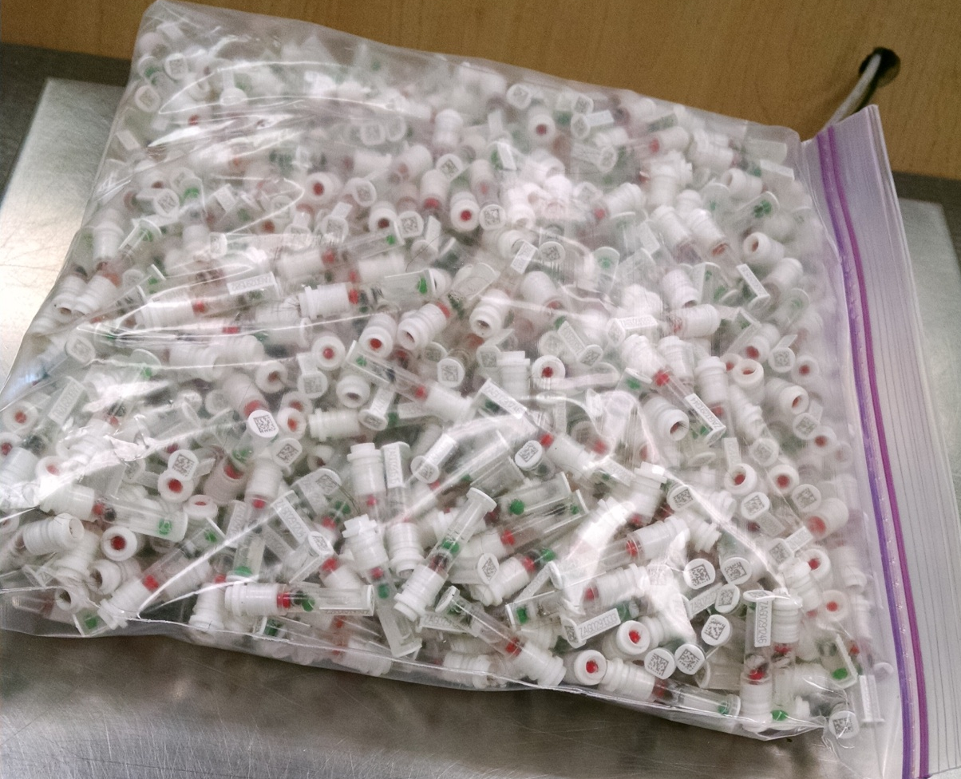
DNA samples (1 farm, 1 day)
Photo: Zoetis

Slide 19
Value of incoming data
Data | Annual value
Phenotypes from DHI (2014)
4 million cows × $1.25/cow/month | $60 million
Genotypes from CDCB (2014)
15,000 medium density × $125 | $2 million
258,000 low density × $45 | $12 million
Whole genome sequence data (2015)
200+ bulls × $1,000 (AGIL data) | $0.2 million
1,000+ bulls × $3,000 (world data) | $3 million

Slide 20
Holstein prediction accuracy
Trait | Bias* | Reliability (%) | Reliability gain (% points)
Milk (kg) | −80.3 | 69.2 | 30.3
Fat (kg) | −1.4 | 68.4 | 29.5
Protein (kg) | −0.9 | 60.9 | 22.6
Fat (%) | 0.0 | 93.7 | 54.8
Protein (%) | 0.0 | 86.3 | 48.0
Productive life (months) | −0.7 | 73.7 | 41.6
Somatic cell score | 0.0 | 64.9 | 29.3
Daughter pregnancy rate (%) | 0.2 | 53.5 | 20.9
Sire calving ease | 0.6 | 45.8 | 19.6
Daughter calving ease | −1.8 | 44.2 | 22.4
Sire stillbirth rate | 0.2 | 28.2 | 5.9
Daughter stillbirth rate | 0.1 | 37.6 | 17.9
*2013 deregressed value – 2009 genomic evaluation

Slide 21
Holstein prediction accuracy
Trait | Bias* | Reliability (%) | Reliability gain (% points)
Final score | 0.1 | 58.8 | 22.7
Stature | −0.2 | 68.5 | 30.6
Dairy form | −0.2 | 71.8 | 34.5
Rump angle | 0.0 | 70.2 | 34.7
Rump width | −0.2 | 65.0 | 28.1
Feet and legs | 0.2 | 44.0 | 12.8
Fore udder attachment | −0.2 | 70.4 | 33.1
Rear udder height | −0.1 | 59.4 | 22.2
Udder depth | −0.3 | 75.3 | 37.7
Udder cleft | −0.2 | 62.1 | 25.1
Front teat placement | −0.2 | 69.9 | 32.6
Teat length | −0.1 | 66.7 | 29.4
*2013 deregressed value – 2009 genomic evaluation

Slide 22
Genetic merit (marketed Holstein bulls)

Slide 23
Genotypes can be applied to many traits
An animal’s genotype is good for all traits
Traditional evaluations are required for accurate estimates of SNP effects
Traditional evaluations not currently available for heat tolerance or feed efficiency
Research populations could provide data for traits that are expensive to measure
Will resulting evaluations work in target population?

Slide 24
4 ways farmers can use genomics
Animal ID and parentage verification
Is this the animal that I think it is?
Early culling decisions
Am I raising the right animals?
Mate selection
How do I produce the best calves?
Identification of elite cows
What are the best genetics in my herd?

Slide 25
Selection indices include many traits …
Source: Miglior et al. (2012)

Slide 26
… and we keep adding new ones
Trait | Relative emphasis on traits (%)
 | PD$ 1971 | MFP$ 1976 | CY$ 1984 | NM$ 1994 | NM$ 2000 | NM$ 2003 | NM$ 2006 | NM$ 2010 | NM$ 2014 | NM$ 2017
Milk | 52 | 27 | –2 | 6 | 5 | 0 | 0 | 0 | –1 | –1
Fat | 48 | 46 | 45 | 25 | 21 | 22 | 23 | 19 | 22 | 24
Protein | … | 27 | 53 | 43 | 36 | 33 | 23 | 16 | 20 | 18
PL | … | … | … | 20 | 14 | 11 | 17 | 22 | 19 | 13
SCS | … | … | … | –6 | –9 | –9 | –9 | –10 | –7 | –7
UC | … | … | … | … | 7 | 7 | 6 | 7 | 8 | 7
FLC | … | … | … | … | 4 | 4 | 3 | 4 | 3 | 3
BWC | … | … | … | … | –4 | –3 | –4 | –6 | –5 | –6
DPR | … | … | … | … | … | 7 | 9 | 11 | 7 | 7
SCE | … | … | … | … | … | –2 | … | … | … | …
DCE | … | … | … | … | … | –2 | … | … | … | …
CA$ | … | … | … | … | … | … | 6 | 5 | 5 | 5
HCR | … | … | … | … | … | … | … | … | 1 | 1
CCR | … | … | … | … | … | … | … | … | 2 | 2
LIV | … | … | … | … | … | … | … | … | … | 7

Slide 27
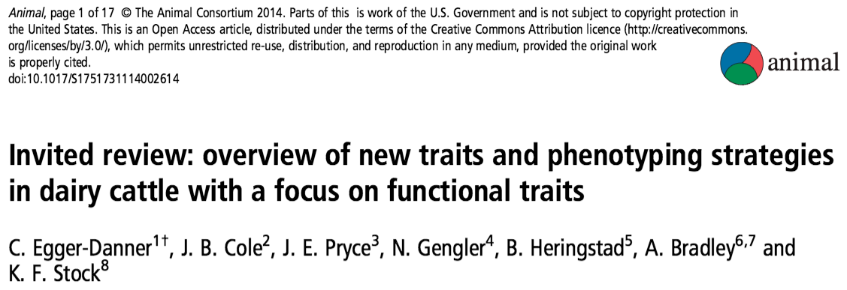
Why do we need new traits?
Changes in production economics
Technology produces new phenotypes
Better understanding of biology
Recent review by Egger-Danner et al.

Slide 28
New traits should add information
Novel phenotypes include some new information | Novel phenotypes contain little new information
Novel phenotypes include much new information | Novel phenotypes include some new information
High
Phenotypic correlation
with existing traits
Low
Low
High
Genetic correlation with existing traits

Slide 29
New traits should have value
Milk yield | Feed intake
Conformation | Greenhouse gas emissions
High
Phenotype value
Low
Low
High
Measurement cost

Slide 30
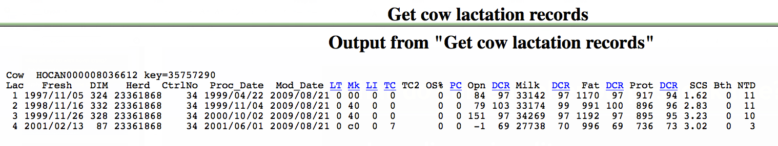
What do current phenotypes look like?
Low dimensionality
Usually few observations per lactation
Close correspondence of phenotypes with values measured
Easy transmission and storage

Slide 31
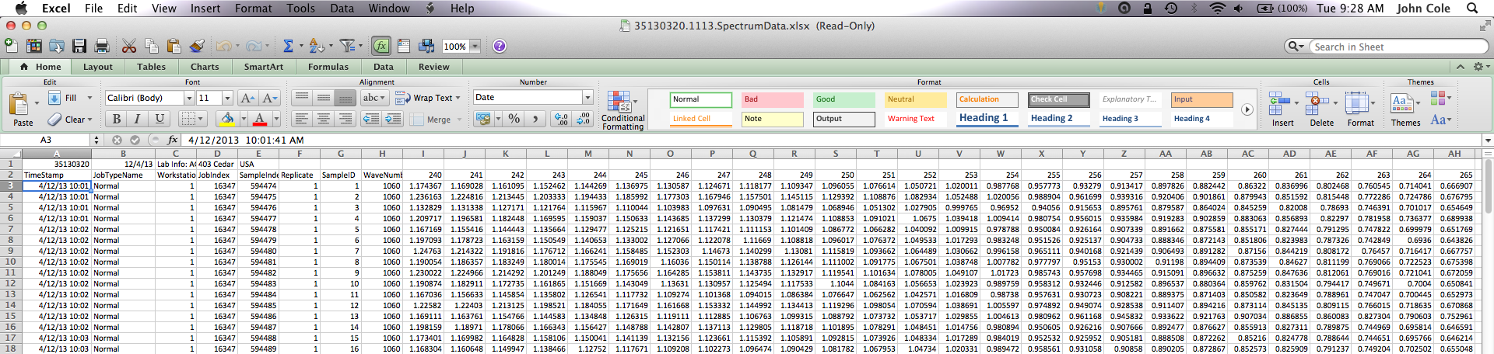
What do new phenotypes look like?
High dimensionality
Example: MIR produces 1,060 points/observation
Disconnect between phenotype and measurement
More resources needed for transmission, storage, and analysis

Slide 32
What do we do with new traits?
Put them into a selection index
Correlated traits are helpful
Apply selection for a long time
There are no shortcuts
Collect many phenotypes
Repeated records are of limited value
Genomics can increase accuracy

Slide 33
What challenges are on the horizon?
We need more frequent sampling for modern management
Samples do not need to be evenly spaced across the lactation
Some large farms do not see a value proposition in milk recording
On-farm data are growing but not collected in a central database
Calibration and validation are concerns

Slide 34
Challenges to genetic improvement
Research is being done on new traits
Often not turned into new products
It’s a collective action problem
Disagreement on objectives
Lack of commercial incentives
Infrastructure is not in place
This provides an opportunity for new players to enter the market
Independent validation lacking

Slide 35
There are no guarantees …
New technologies often require considerable capital investment
They sometimes fail to work or do not deliver the promised gain
Data are most useful when combined with observations from many farms
This inevitably involves risk

Slide 36
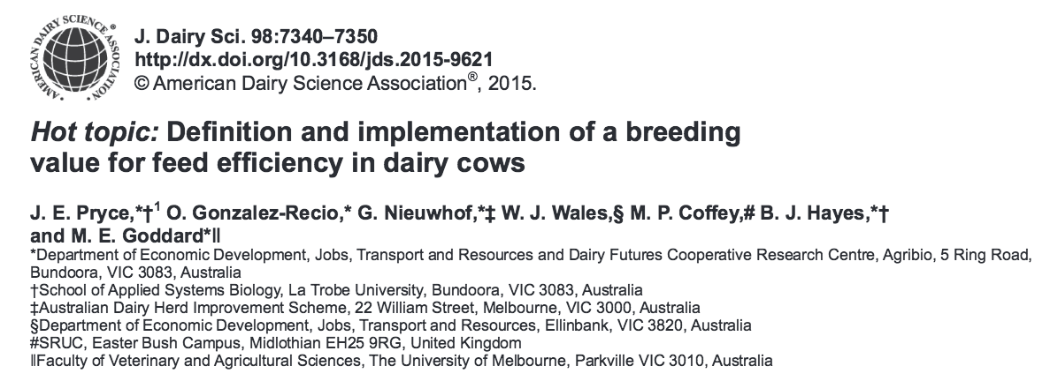
Collaboration is essential
When new traits are expensive, it takes a consortium to collect the data needed for genetic evaluation

Slide 37
Conclusions
Genetic and genomic selection have been very successful technologies
Modern on-farm tools produce large amounts of data
Those data can be used to improve herd management and profitability
Dairy breeders need to rise to the challenge of turning new data into decisions

Slide 38
Acknowledgments
Appropriated project 8042-31000-101-00, “Improving Genetic Predictions in Dairy Animals Using Phenotypic and Genomic Information,” Agricultural Research Service, USDA
CNPq “Science Without Borders” project 301025/2014-2
Kristen Gaddis, Dan Null, Paul VanRaden, and George Wiggans
Council on Dairy Cattle Breeding

Slide 39
Acknowledgments
Dr. Kirill Plemyashov and Dr. Andrei Kudinov
Department of Animal Husbandry and Breeding of Ministry of Agriculture of the Russian Federation
Committee on Agriculture and Fisheries of the Leningrad Region
St. Petersburg State Academy of Veterinary Medicine
JSC "Neva for breeding"

Slide 40
Acknowledgments
Appropriated project 8042-31000-101-00, “Improving Genetic Predictions in Dairy Animals Using Phenotypic and Genomic Information,” Agricultural Research Service, USDA
Kristen Gaddis, Dan Null, Paul VanRaden, and George Wiggans
Council on Dairy Cattle Breeding

Slide 41
Acknowledgments (cont’d)
Dr. Kirill Plemyashov and Dr. Andrei Kudinov
Department of Animal Husbandry and Breeding of Ministry of Agriculture of the Russian Federation
Committee on Agriculture and Fisheries of the Leningrad Region
St. Petersburg State Academy of Veterinary Medicine
JSC "Neva for breeding"

Slide 42
Disclaimer
Mention of trade names or commercial products in this presentation is solely for the purpose of providing specific information and does not imply recommendation or endorsement by the United States Department of Agriculture.

Slide 43
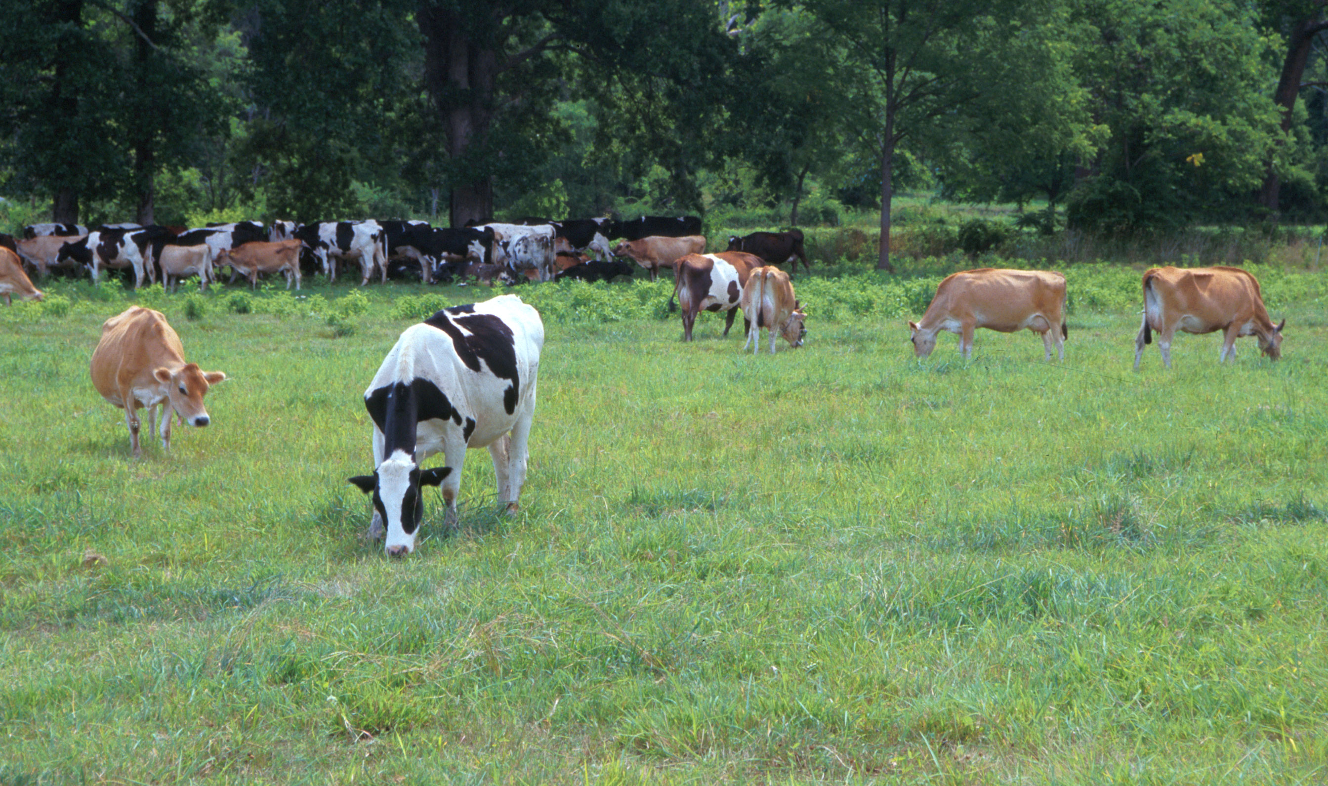
Questions?
AIP web site:
http://aipl.arsusda.gov
Holstein and Jersey crossbreds graze on American Farm Land Trust’s
Cove Mountain Farm in south-central Pennsylvania
Source: ARS Image Gallery, image #K8587-14; photo by Bob Nichols

