Slide 1
SCC-084 AGIL Station Report, 2018
Paul M. VanRaden and John B. Cole
USDA, Agricultural Research Service
Henry A. Wallace Beltsville Agricultural Research Center
Animal Genomics and Improvement Laboratory
Beltsville, MD 20705-2350
john.cole@ars.usda.gov

Slide 2
Objective 1: Expand genomic data used in prediction by selecting new variants that more precisely track the true gene mutations that cause phenotypic differences.
Objective 2: Evaluate new traits that can all be predicted at birth from the same inexpensive DNA sample.
Objective 3: Improve efficiency of genomic prediction and computation by developing faster algorithms, testing new adjustments and models, and accounting for genomic pre-selection in evaluation.

Slide 3
Objective 1: Recommend breeding strategies for optimal use of breed resources, maintenance and(or) exploitation of within-breed (additive and non-additive) genetic variation

Slide 4
Discovering pedigrees (parents, grandparents, etc.)
 | Sire
Calf
 |  | MGSire
 | Dam | MGGSire
 |  | MGDam
Notes:
We are all familiar with a traditional pedigree chart. Animal is expected to be an average of his parents.

Slide 5
Accuracy of ancestor discovery
If the true ancestor is genotyped, accuracy of discovery is very high
If the reported pedigree is wrong, accuracy of detection also high
With lower density chips, accuracy is slightly reduced
Methods published and used since 2013: https://aipl.arsusda.gov/publish/jds/2013/96_1874.pdf
Ancestor | Correctly discovered
SIRE | ~100%
MGS | 97%
MGGS | 92%

Slide 6

Filling in pedigrees
>200,000 discovered MGS not yet used because no Dam ID
>200,000 discovered MGGS not yet used because no MGDam
Procedures developed to fill the missing IDs to link to ancestors
  HO999DAM000000001 for example
  Similar system used for several years in CAN, IDs not released to public
  Should evaluations and/or public use discovered pedigrees?
Can true dam can be discovered in same herd (20,000 found)
  Match birth & fresh dates, only 1 dam pedigree matches calf

Slide 7
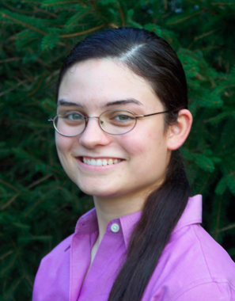
Accounting for pedigree accuracy
Bulls differ in accuracy of daughter pedigree
  Most bulls have about 90% of ‘daughters’ correctly coded
  Some bulls now have 100% correct because all are genotyped
New methods to remove biases from reporting accuracy tested
  Genes assumed 90% from reported sire, 10% from unknown sire group
  Biases in Holstein PTAs were smaller than expected
  Changes in rank from new model were also small
Project by AGIL postdoc Heather Bradford (now at VPI)

Slide 8
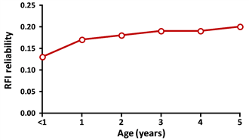
Residual feed intake
Tested potential gains from additional feed intake data
Estimated young bull reliabilities by exact inversion of single-step genomic equations
Bulls further from reference cows have lower theoretical REL for RFI
Measure feed intake on cows more closely related to next generation
Research of Bingjie Li (AGIL postdoc) and Elif Gunal (CDCB intern)

Slide 9
Genomic breed composition
Breed base representation (BBR) reported since 2016 for all 1.9 million genotyped animals, including >60,000 crossbreds, of which >35,000 are not yet evaluated
BBR estimates contributions of 5 breeds
  Breed percentages forced to sum to 100%
  Reported as purebred if any breed >94%
  Ayrshires and Scandinavian Reds treated as 1 breed
Pedigree breed composition (reported since 2007) often less accurate and complete than genomic BBR

Slide 10
Genomic evaluations on all-breed scale
Convert MACE and foreign dam data to all-breed scale
Estimate SNP effects for each breed on all-breed scale
  Traits: Yield, PL, SCS, DPR, HCR, CCR, and livability
  Conformation and calving traits still within-breed
  Jersey SNP effects used for crossbred conformation
To compute evaluations for crossbreds, SNP effects for each breed blended by BBR
  Should the cutoff be at 90% purity or 94% purity?

Slide 11
Objective 2: Capture phenotypic data for novel and economically important traits to elucidate their genetic regulation and potential for genomic selection

Slide 12
Age at first calving
Heifers eat feed but produce no milk until calving
  Earlier calving is worth $2.50 per day
  Economic emphasis could be 3% of Net Merit $
  Removes some emphasis from heifer conception rate
Large database (23 million records) available for AFC
  Heritability is 2.7%
  PTA standard deviation only about 3 days
  Reliability of genomic predictions of 66% for HO

Slide 13
Gestation length evaluations
Genomic evaluations for gestation length are now available for cows.
https://queries.uscdcb.com/News/gestation_length.htm

Slide 14
Objective 3: Collaborate with the National Animal Germplasm Program (NAGP) Dairy Committee, Animal Genomics and Improvement Laboratory (AGIL), and the Council on Dairy Cattle Breeding (CDCB) to improve genetic variation of dairy and optimize economic merit indices

Slide 15
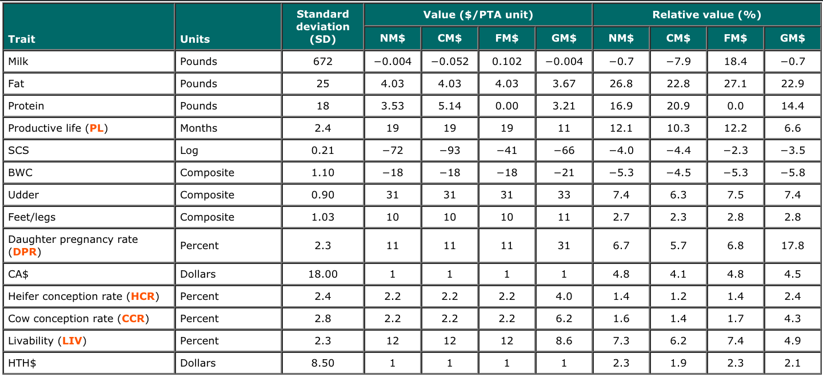
Net merit update
https://aipl.arsusda.gov/reference/nmcalc-2018.htm

Slide 16
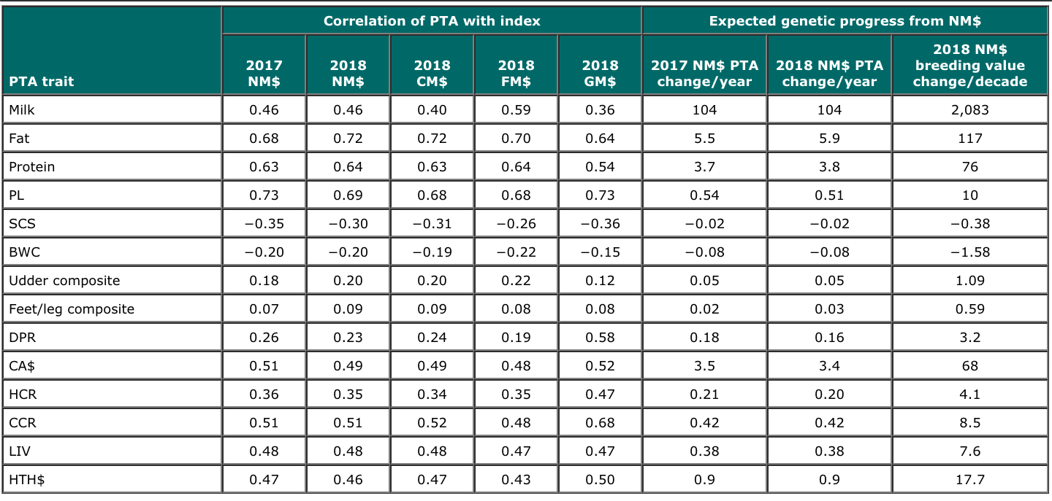
Net merit update

Slide 17
August 2018 NM$ revision
Mastitis included as direct measure reduced emphasis on SCS
SCS previously included premiums and correlated mastitis costs
  Labor, drugs, discarded milk, milk shipments lost because of antibiotics, etc.
  Indirect costs should have been only $4 instead of $20
Emphasis on SCS
  2017: –6.5%
  2018: –3.5% (with addition of mastitis resistance)

Slide 18
Objective 4: Develop variant discovery strategies to incorporate functional –omics data into breeding schemes for economically important traits

Slide 19
Two assemblies: UMD3 and ARS-UCD
UMD3: Zimin et al. 2009 Genome Biology 10:R42
  University of Maryland and USDA-ARS research
  ‘Corrected’ version was used by AGIL after mis-mapped sections removed
ARS-UCD: Rosen et al. 2018 WCGALP
  USDA-ARS-AGIL, U. California-Davis, and other groups
  Used long reads to bridge across repeats, then short reads for polishing
  Annotation (gene structure) released by NCBI in May 2018

Slide 20
Converting locations to a different map
Convert SNP locations (liftover)
  Use probe from chip manifest or flanking sequence, or simulate paired end reads from old map, align to new map
  Help from Bob Schnabel, U MO
Each chromosome may be longer or shorter now
  Many “new” insertions, deletions, inversions, translocations
  Autosomes range from -4.3% shorter (chr12) to 0.6% longer (chr26)
  X chromosome 6.6% longer than UMD3, w’more distinct PAR

Slide 21
Compare pseudo-autosomal region (PAR) of X
X
PAR
UMD3
X
ARS-UCD
PAR
New SNPs were selected to fill the gaps in the longer X
Notes:
142 SNP changed chromosome (.24%)

Slide 22

Imputation tests
Locations for the 60,367 usable SNPs converted to ARS-UCD1
Genotypes were imputed to 60K from 30 chips of differing density
Genotypes from 5 breeds were imputed separately:
  1,748,453 Holsteins (HO)
  215,800 Jerseys (JE)
  32,724 Brown Swiss (BS)
  4,834 Ayrshires (AY)
  3,517 Guernseys (GU)

Slide 23
Haplotype noninheritance rate (smaller is better)
Haplotypes with parent-progeny noninheritance (%)
Breed | UMD3 | ARS-UCD
HO | 1.6 | 1.1
JE | 4.3 | 3.8
BS | 1.5 | 1.2
AY | 1.8 | 1.4
GU | 1.6 | 1.3
Maximum number of haplotypes per segment
Breed | UMD3 | ARS-UCD
HO | 47,978 | 36,690
JE | 39,628 | 29,732
BS | 11,602 | 9,447
AY | 2,030 | 1,606
GU | 1,970 | 1,427
SNPs used 60,671 60,474

Slide 24
Implementing new map with more SNPs
New list of 79,239 instead of 60,671 SNPs
  SNPs from high-density and WGS data w/biggest NM$ effects
  Gene tests (DGAT1, ABCG2, casein, leptin) from recent chips
  Improved SNP editing system and improved prediction reliability (~2%)
Impute genotypes for all breeds and crossbreds
Obtain prior allele effect estimates for all traits, breeds, and BBR
Check published haplotypes to ensure proper inheritance

Slide 25
Fertility haplotype research
Changes to genetic recessives and haplotypes
  More gene tests incorporated (HCD, HH4, HH5, HH6, BH2, AH1, AH2)
  HH6 discovered in France (0.4% frequency in USA)
  JH2 difficult to track with new map, may be discontinued
  BH1 effect has greatly decreased, may be discontinued
New map and added gene tests should improve imputation from low density
  Some chips provide gene tests, many do not

Slide 26
Objective 5: Carry out interdisciplinary collaborations to improve dairy cow and calf health through increased partnerships with researchers, industry and stakeholders

Slide 27
CDCB health trait data
Health event | Records* (no.) | Cows (no.) | Herds (no.) | Incidence per lactation (%)
Milk fever | 919,719 | 581,210 | 672 | 1.2
Displaced abomasum | 1,677,144 | 984,055 | 1,084 | 1.8
Ketosis | 1,171,915 | 702,729 | 760 | 3.9
Mastitis | 2,000,579 | 1,151,722 | 1,529 | 10.6
Metritis | 1,650,656 | 959,433 | 1,096 | 6.5
Retained placenta | 1,831,887 | 1,069,056 | 1,202 | 3.1
*Records used in CDCB evaluation as of August 2018

Slide 28
Economic weights
Health event* | Estimated direct cost/case* | Yield adjustment | Total direct cost/case | Relative value (%)
 |  |  |  | Health$ | NM$
Milk fever | $38 | –$4 | $34 | 2.3 | 0.05
Displaced abomasum | $178 | +$19 | $197 | 23.3 | 0.54
Ketosis | $28 | $0 | $28 | 4.7 | 0.11
Mastitis | $72 | +$3 | $75 | 32.9 | 0.77
Metritis | $105 | +$7 | $112 | 26.5 | 0.62
Retained placenta | $64 | $4 | $68 | 10.3 | 0.24
*Liang et al., 2017; Donnelly, 2017

Slide 29
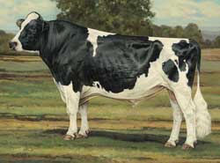
Genetic correlations with Health$*
Trait | Correlation with Health$ |  | Trait | Correlation with Health$
Milk | 0.03 |  | DPR | 0.42
Fat | 0.08 |  | CA$ | 0.33
Protein | 0.04 |  | HCR | 0.18
PL | 0.56 |  | CCR | 0.36
SCS | –0.44 |  | LIV | 0.55
BWC | –0.26
UC | –0.01
FLC | 0.02
*Based on Holstein bulls born since 1990
with REL of ≥90%
Photo: Modern ideal Holstein bull, Holstein Association USA

Slide 30
Extra progress from adding more traits
Year | Traits (no.) | Traits included | Correlation with previous index | Extra progress
1977 | 3 | Milk, fat, protein | … | …
1994 | 5 | PL, SCS | 0.84 | 19%
2000 | 18 | Linear type | 0.94 | 6%
2003 | 21 | DPR, calving ease | 0.98 | 2%
2006 | 23 | Stillbirth | 0.975 | 3%
2014 | 25 | HCR, CCR | 0.965 | 4%
2017 | 26 | LIV | 0.989 | 1%
2018 | 32 | Health traits* | 0.994 | 0.6%
*Zoetis claimed 21.5% extra progress from 6 health traits, but their
economic values actually result in slower (about –4% less) progress

Slide 31
Future adjustments for health traits
Health traits can be adjusted for unequal variance similar to adjustments used for other traits since 1991
  Yield, SCS, calving traits, type traits, and livability
  Variance higher when incidence higher
  Herds with low incidence provide less information
Multitrait evaluation could use other correlated U.S. traits to improve accuracies of all 6 health traits

Slide 32

Mastitis evaluations from Interbull
MACE includes SCS and mastitis (since 2001)
Mastitis initially sent only by Scandinavian countries; now also sent
by Canada, France, Belgium, Netherlands, and Italy (mixed trait)
U.S. mastitis data submitted for September 2018 test run should improve U.S. reliability
Genetic correlations of domestic SCS with foreign mastitis already average 0.88 (SCS has been helpful as correlated trait)
MACE not yet available for other 5 health traits

Slide 33
Objective 6: Create a pipeline of diverse graduate students in the fields of quantitative and functional genetics and bioinformatics via outreach and educational opportunities

Slide 34
Job opportunities at AGIL
AGIL has a permanent position available for an animal scientist. Applications for this announcement ARS-S18Y-0281 must be received by Nov 7: https://www.usajobs.gov/GetJob/ViewDetails/514277600.
A 1-year postdoc position through ORISE (reference code: ARS-AGIL-2018-127-0040-01) is available on the topic of unknown/uncertain parentage and the potential benefits from ancestor discovery, and is open to all applicants regardless of citizenship: https://zintellect.com/Opportunity/Details/ARS-AGIL-2018-127-0040-01.

Slide 35
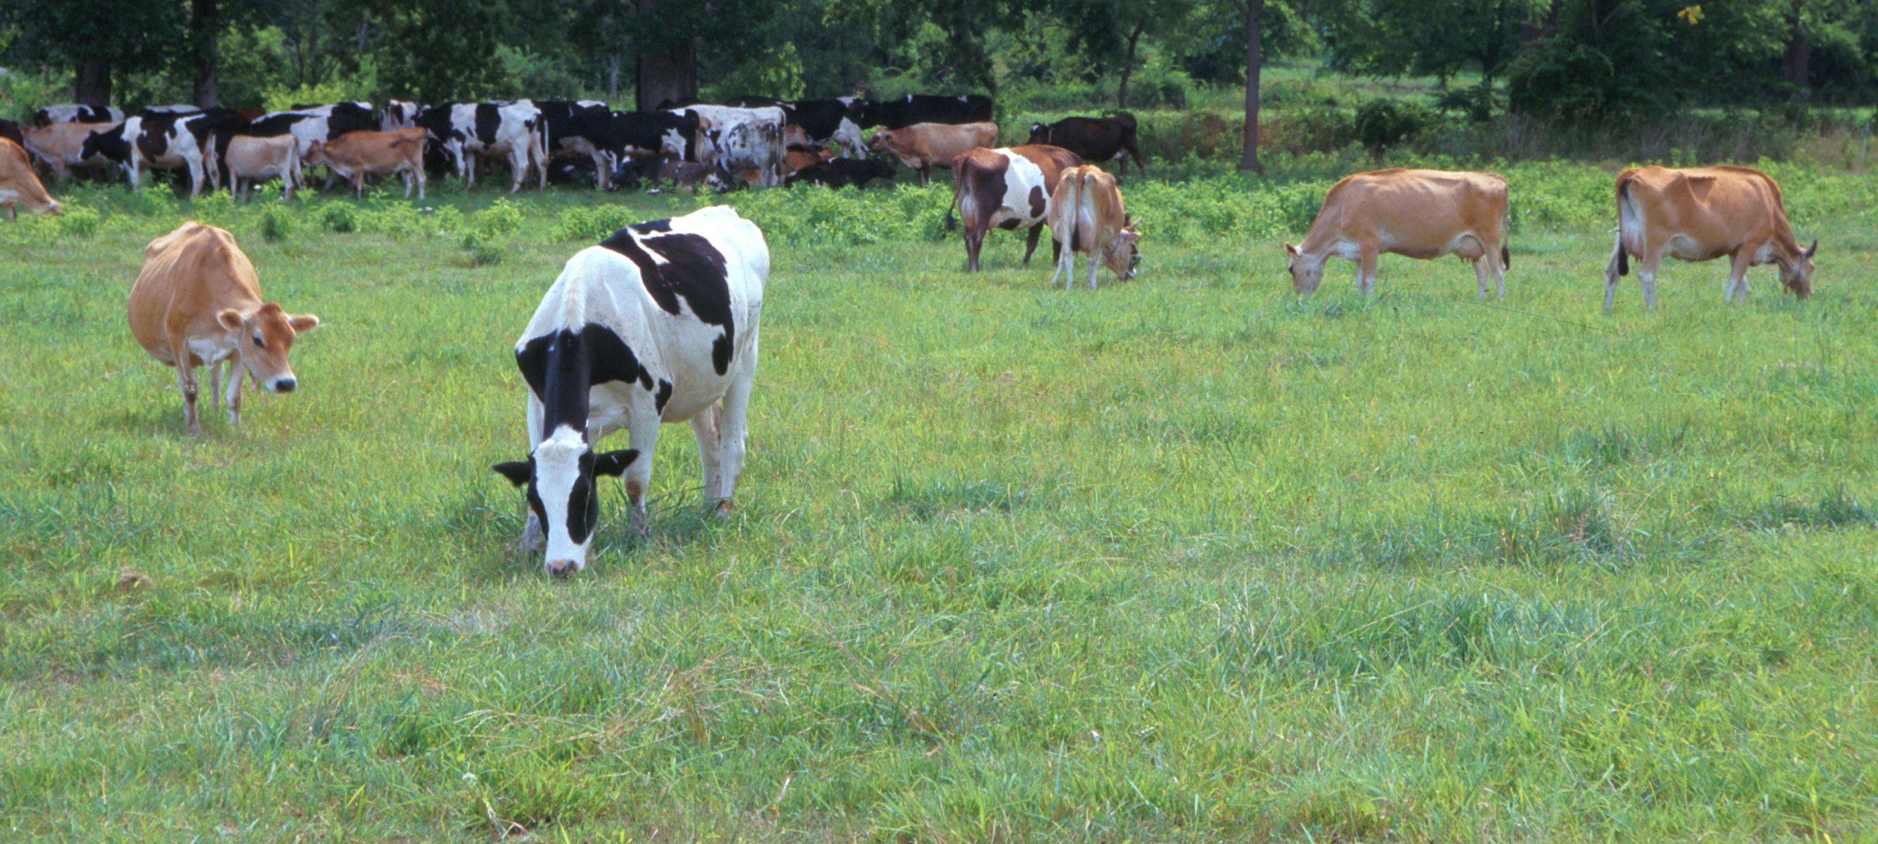
Questions?
AIP web site:
http://aipl.arsusda.gov/
Holstein and Jersey crossbreds graze on American Farm Land Trust’s
Cove Mountain Farm in south-central Pennsylvania
Source: ARS Image Gallery, image #K8587-14; photo by Bob Nichols

