Slide 1
Structural equation models to disentangle the biological relationship between microbiota and complex traits
John B. Cole
Acting Research Leader
Animal Genomics and Improvement Laboratory
ARS, USDA, Beltsville, MD
john.cole@usda.gov

Slide 2
Housekeeping
There’s an online discussion group now: animal-breeding-journal-club@googlegroups.com.
Who wants to go next?
How should we distribute future papers?
I can accommodate 100 people in my Zoom conferences. If we have great demand I’ll see if I can get that expanded.
I can host slides on my website: http://johnbcole.com/.
We’ll try to keep to ~60 minutes.

Slide 3
Code of conduct
Presenters
Engage objectively with the material
Treat authors with respect
Critiques aren’t attacks
Offer solutions as well criticism
Our goal is to learn
Participants
Treat presenters with respect
Ask questions in good faith
If a mistake is made, help fix it
Assume good faith

Slide 4
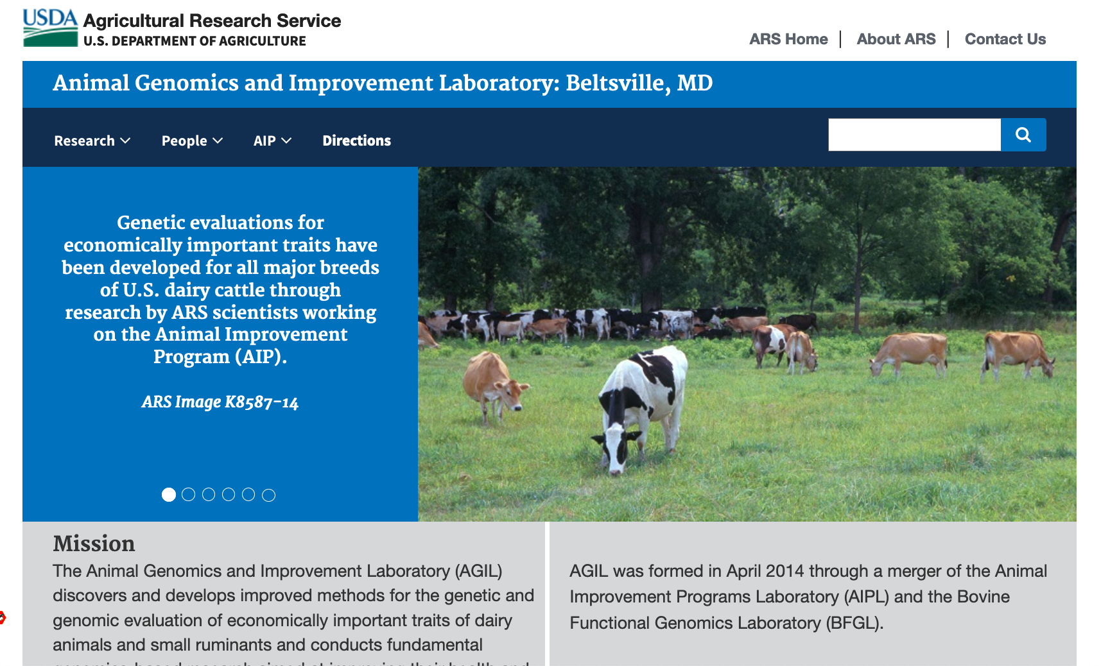
Introduction
I’m RL of AGIL
Our work focuses on genetic improvement, development of genomic tools, and understanding animal efficiency
ARS is USDA’s in-house research arm
I’m going first because this was my idea, not because I was requested
https://www.ars.usda.gov/northeast-area/beltsville-md-barc/beltsville-agricultural-research-center/agil/

Slide 5
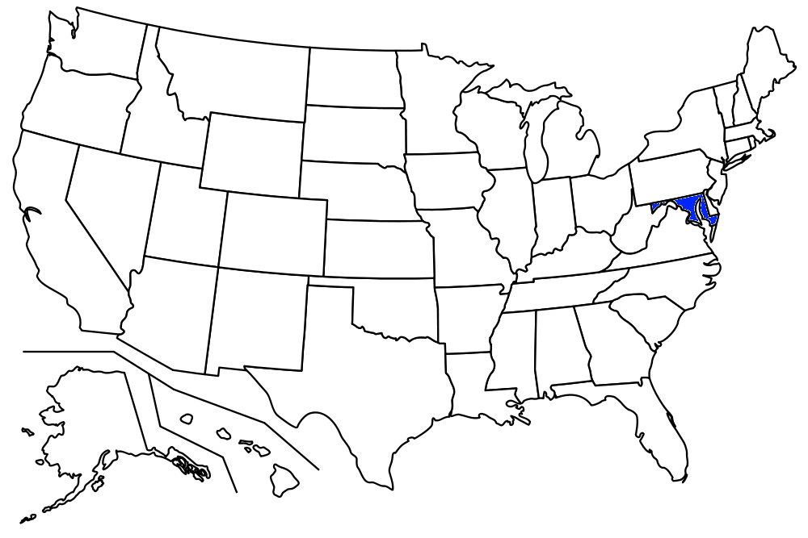
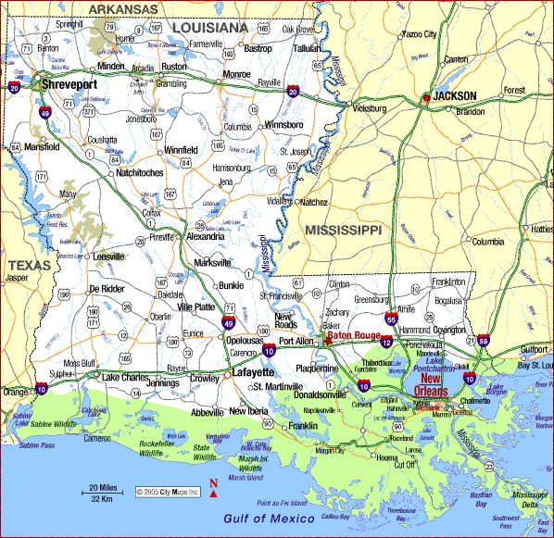
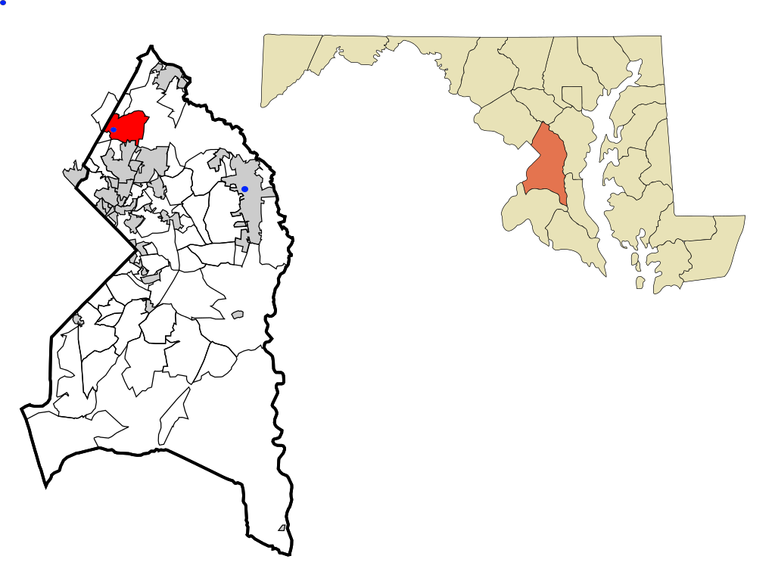
The lay of the land

Slide 6
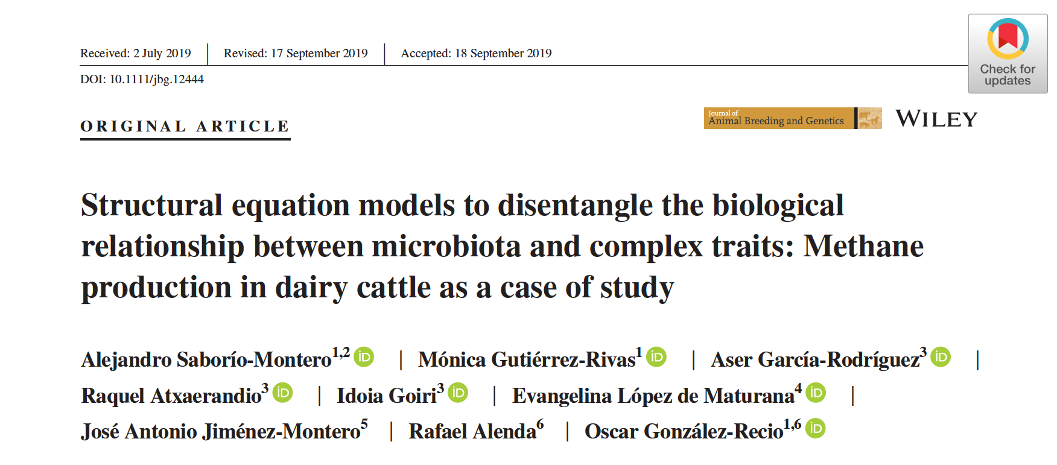
Saborío‐Montero et al. (2020)

Slide 7

Overview
Hypothesis
Materials and Methods
Results and Discussion
Conclusions
Future Directions

Slide 8
What are the authors trying to do?
Improve understanding of relationships among the hosts, microbiomes, and complex traits through improved modeling
All three may contribute to efficiency
Host
RA of rumen microbiota
Complex trait (CH₄)

Slide 9
Hypothesis
“There is a recursive relationship in which the microbial composition affects the methane concentration (CH₄) and both are under partial host genetic control.”

Slide 10
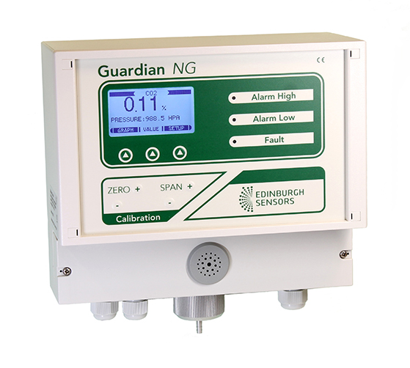
Phenotypes
IR measures of CH₄ in breath samples taken in milking parlor
Samples averaged into a single observation per cow
Test-day milk, fat, and protein information also available
Rumen sample collected by esophageal intubation

Slide 11
Microbiome sequencing and host genotyping
Rumen samples
Homogenized
Qiagen PowerSoil kit for DNA extraction
Concentration and purity by NanoDrop and Qubit
Barcoding
Nanopore sequencing
Alignment with DIAMOND
Rumen samples (cont’d)
Taxonomy with MEGAN
Host genotypes
Illumina Euro12K
Imputation with Beagle
54K genotype
Monomorphs, MAF, autosomes?

Slide 12
Results of microbiome sequencing
416 samples
627 taxa
134 genera
- Present in 70% of samples - Reads From at least 50% of genera
24 genera 337 samples

Slide 13
Genomic analysis
GRM constructed by Method 2 of VanRaden (2008)
Relative abundance phenotypes normalized to account for zero-inflated Poisson data
Bivariate models
CH₄ concentration data (mean = 853 ppm ± 278)
Relative abundance of a genus
24 models in all
h², r_{g}, λ_{CH4←RA}

Slide 14
Recursive model
Residual correlation
Based on structural equation models
Wright (1934)
Extension of the classical model in which correlations have no directionality
Allows for directional effects, e.g., the effect of RA on CH₄
Effect of CH₄ on RA doesn’t make much sense in the environment of the rumen
Genetic correlation

Slide 15
Results
+λ_{CH4←RA} → more CH4
-λ_{CH4←RA} → less CH₄
Genus Ciliophora, Methanobrevibacter sp., Neocallimastix sp., Fibrobacter sp., Prevotella sp., and Paraprevotella sp. Increased CH₄ production
Possible targets for manipulation
Heritabilities of CH₄ from both models averaged 0.12 ± 0.01
Heritabilities of RA from both models averaged 0. 25 ± 0.01
Wide range: 0.08 to 0.48
Structural parameters not expected to affect h²

Slide 16
Results (cont’d)
Correlations agreed
Ciliophora
Euryarchaeota (Methanobrevibacter sp.),
Chytridiomycota (Neocallimastix sp.)
Fibrobacteres (Fibrobacter sp.)
Correlations differed (signs changed)
Succinivibrio sp. (both)
Succinimonas sp. (bivariate)
Treponema sp.

Slide 17
Conclusions
Heritability estimates were similar between both models, as were most genetic correlations
SEM allows us to account for biologically plausible effects between traits
SEM may provide better predictions of correlations of specific genera with CH₄
Differing heritabilities and correlations may allow for more targeted selection criteria related to rumen microbiome
Restricted selection index to target methanogens?

Slide 18
A few thoughts I had
Is there a relationship of test-day milk composition traits with RA?
Do some species produce more VFA for milk fat synthesis?
What about multiple complex traits?
How are they jointly related to CH₄
How does this relate to the challenge of identifying causation?

Slide 19
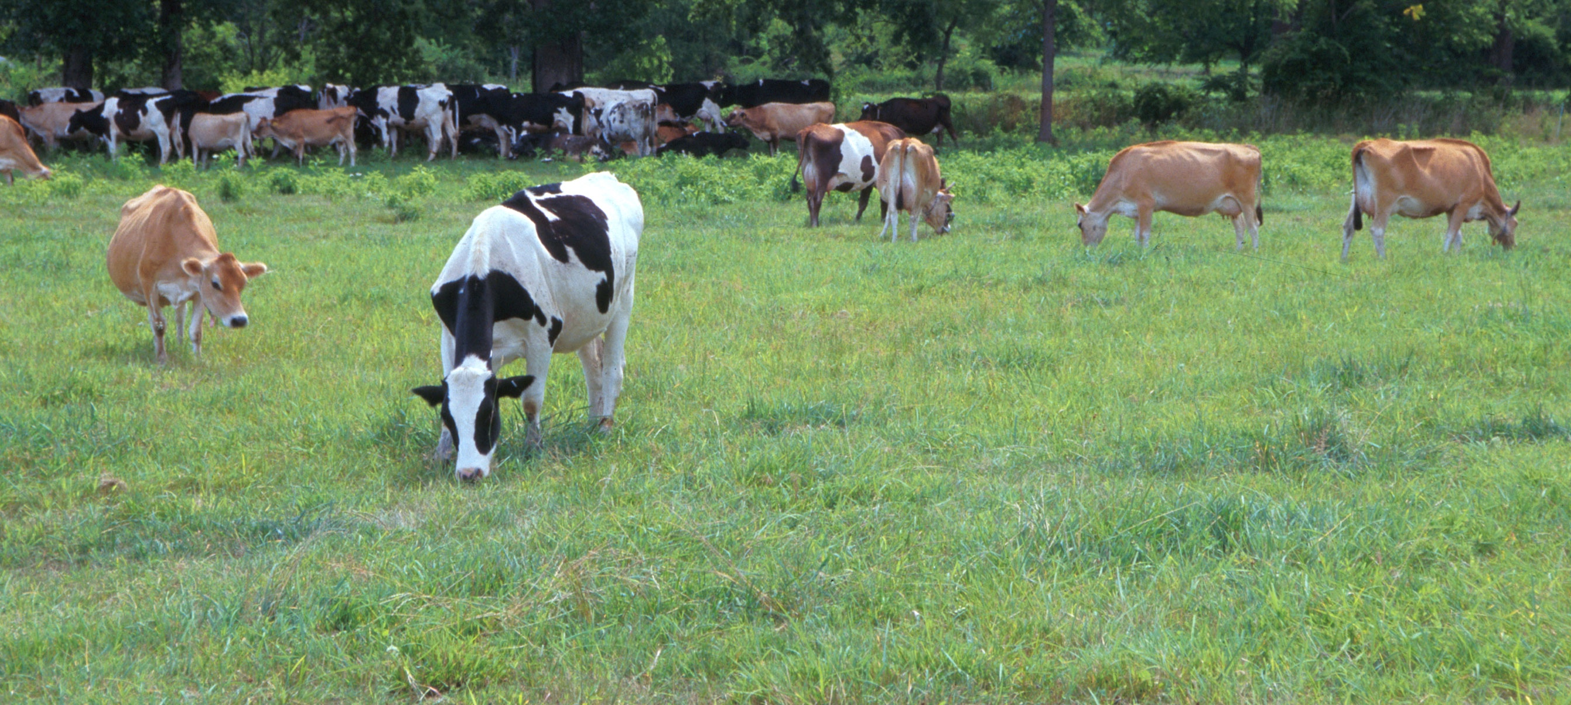
Questions?
Holstein and Jersey crossbreds graze on American Farm Land Trust’s
Cove Mountain Farm in south-central Pennsylvania
Source: ARS Image Gallery, image #K8587-14; photo by Bob Nichols

