Slide 1
Genome-wide association study and gene network analysis of fertility, retained placenta, and metritis in U.S. Holstein cattle (Paper 610)
J.B. Cole,*¹ K.L. Parker Gaddis,² D.J. Null,¹ C. Maltecca,³ and J.S. Clay⁴
¹Animal Genomics and Improvement Laboratory, ARS, USDA, Beltsville, MD, USA
²Council on Dairy Cattle Breeding, Bowie, MD, USA
³Department of Animal Science, College of Agriculture and Life Sciences, North Carolina State University, Raleigh, NC, USA
⁴Dairy Records Management Systems, Raleigh, NC, USA
*john.cole@ars.usda.gov

Slide 2
Introduction
3 fertility traits recently dissected using single- and multiple-trait genomewide association studies (GWAS) in all-bull, all-cow, and mixed predictor populations (Parker Gaddis et al., 2016)
Network analysis identified several important genes not identified by GWAS alone
Genetic evaluations for 6 Holstein health traits to be introduced in the U.S. in April 2018 (Parker Gaddis et al., 2017)
Retained placenta (RETP) and metritis (METR) included as measures of reproductive health

Slide 3
Introduction (continued)
Longer days open and lower conception rates for cows starting lactation with RETP or METR (e.g., Fourichon et al., 2000)
Influence by common sets of genes not known for susceptibility to reproductive tract diseases and cow fertility
Analyses with combined analytical approaches used to better understand challenging phenotypes such as bull fertility (e.g., Han & Peñagaricano, 2016)

Slide 4
Objectives
Identify genes, genomic regions, and gene networks associated with 3 fertility traits
  Daughter pregnancy rate (DPR)
  Heifer conception rate (HCR)
  Cow conception rate (CCR)
  and 2 reproductive health traits (METR and RETP) using producer-reported data from U.S. Holstein cows
Determine if common sets of genes influence susceptibility to reproductive tract diseases and cow fertility

Slide 5
Phenotypic and genomic data
December 2016 genomic PTAs for DPR, HCR, and CCR combined with METR and RETP genomic PTAs calculated as by Parker Gaddis et al. (2014, 2017)
Genotypes included 60,671 SNPs from routine U.S. evaluations included in genotypes
Predictor populations included animals with PTA reliabilities for lifetime net merit > parent average reliability
Animals required to have PTAs for all traits
All 35,724 bulls retained and random sample of 35,000 cows drawn from predictor population

Slide 6
GWAS
Model for 5-trait multivariate GWAS (Parker Gaddis et al., 2016):
Y = μ + xβʹ + U + E
  Y is n × 5 matrix of phenotypes for n individuals
  μ is the intercept
  x is n-vector of marker genotypes
  βʹ is transpose of 5-row vector of marker effect sizes
  U is n × 5 matrix of random effects
  E is n × 5 matrix of errors
  Variance structures as described in Zhou (2016)

Slide 7
SNP annotation
Autosomal markers assigned to closest gene within 25 kbp using BEDTools (v2.21.0) (Quinlan & Hall, 2010)
Gene information from Bovine UMD3.1.1 genome assembly (Zimin et al., 2009)
36,435 markers remained after merging with annotation data
SNPs from GWAS with Wald P-value >5 × 10^{–8} selected for further analysis
Gene function determined by literature review

Slide 8
Enrichment analyses
All SNPs with P-values of <0.05 compared with all annotated genes in bovine genome
  Gene ontology (GO) (Ashburner et al., 2000)
  Medical subject heading (MeSH) (Morota et al., 2015)
GO and MeSH term analyses carried out in R (v3.4.0) with GOSTATS (v1.5.3) and meshr (v1.12.0) packages as distributed in Bioconductor (v3.5)

Slide 9
Association weight matrices and PCIT
Association weight matrix (AWM) constructed as implemented by Fortes et al. (2010).
Row-wise partial correlations computed on AWM using pcit package (v1.5-3) in R (v3.4.0) to produce m-symmetric adjacency matrix
Non-significant values set to 0; significant correlations interpreted as significant gene-gene interactions.
Only connections with partial correlation of ≥0.98 included
Visualization using Cytoscape (v3.2.1) (Shannon et al., 2003)

Slide 10
GWAS results
43 and 11 SNPs significant in bull and cow populations, respectively
Developmental, cell-signaling, and protein modification processes represented in both populations
Top SNPs did not overlap between populations

Slide 11
GWAS results (continued)
Group | SNP | Chr | Location | Gene | Function | –log₁₀(P)
Bulls | BTB-00790451 | 20 | 57,373,160 | FBXL7 | Ubiquitination | 44.67
 | ARS-BFGL-NGS-64415 | 18 | 48,486,442 | ECH1 | Fatty acid degradation | 41.43
 | ARS-BFGL-NGS-72630 | 6 | 118,871,663 | SORCS2 | Nervous system development | 21.88
 | BTB-00259343 | 6 | 62,642,435 | BEND4 | Longevity | 15.02
 | Hapmap55409-rs29022997 | 4 | 33,236,485 | CROT | Lipid metabolism | 12.77
Cows | ARS-BFGL-NGS-23066 | 6 | 92,153,394 | CDKL2 | Sex differentiation | 13.26
 | BTB-00062715 | 1 | 135,269,426 | EPHB1 | Cell signaling | 9.08
 | BTB-00176697 | 4 | 40,934,520 | SEMA3C | Embryonic development | 8.02
 | ARS-BFGL-NGS-111133 | 4 | 119,341,142 | UBE3C | Ubiquitination | 7.96
 | ARS-BFGL-NGS-36082 | 17 | 55,916,203 | KDM2B | Ubiquitination | 7.45

Slide 12
GO and MeSH results
GO terms from Biological Processes category
Enriched bull processes included spermatogenesis and DNA processing
Enriched cow pathways included embryonic development and gene expression

Slide 13
GO and MeSH results (continued)
Group | GO |  |  | MeSH
 | GO ID | Term | P-value | MeSH ID | Term | P-value
Bulls | 0006270 | DNA replication initiation | 0.005 | D002970 | Cleavage stage, ovum | 0.004
 | 0007288 | Sperm axoneme assembly | 0.014 | D003599 | Cytoskeleton | 0.032
 | 0051661 | Maintenance of centrosome location | 0.014 | D009210 | Myofibrils | 0.035
 | 1902979 | Mitotic DNA replication termination | 0.014 | D013116 | Spinal cord | 0.035
 | 0007283 | Spermatogenesis | 0.036 | D042541 | Intracellular space | 0.036
Cows | 2000738 | Positive regulation of stem cell differentiation | 0.016 | D002823 | Chorion | 0.034
 | 0070126 | Mitochondrial translational termination | 0.024 | D009092 | Mucous membrane | 0.043
 | 2000637 | Positive regulation of gene silencing by miRNA | 0.024 | — | — | —
 | 0048701 | Embryonic cranial skeleton morphogenesis | 0.039 | — | — | —
 | 0060147 | Regulation of posttranscriptional gene silencing | 0.039 | — | — | —

Slide 14
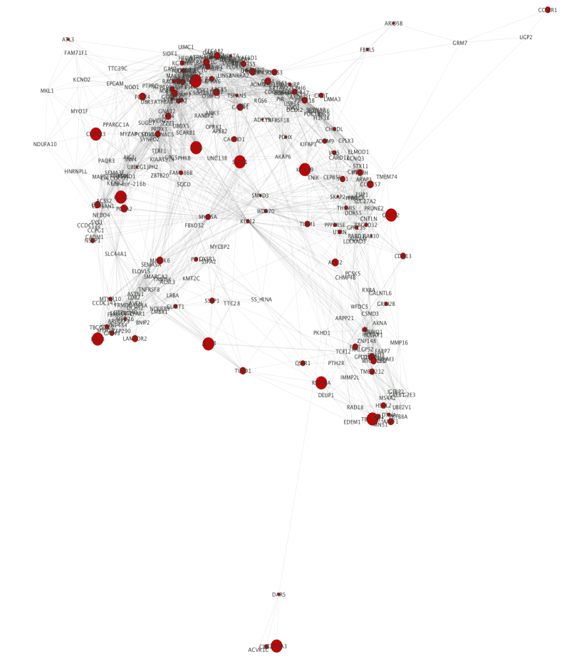
Gene network results
Gene networks included 824 genes for bulls and 856 genes for cows, with 139 shared genes
Many highly connected genes associated with male or female fertility and embryo size and morphology
None of 100 SNPs explaining largest amount of GWAS variance were among most connected network genes

Slide 15
Thinning dense networks (cows)
P ≤ 0.005
75 nodes
806 edges
P ≤ 0.05
980 nodes
71,315 edges
P ≤ 0.01
158 nodes
2,730 edges

Slide 16
Key genes in thinned networks (cows)
P ≤ 0.05 |  | P ≤ 0.01 |  | P ≤ 0.005
Gene | Degree | Gene | Degree | Gene | Degree
DOCK1 | 589 | ENSBTAG00000008346 | 72 | ENSBTAG00000008346 | 36
U6 | 573 | 5S_rRNA | 70 | EPHA7 | 35
PRKG1 | 511 | CEP164 | 66 | ENSBTAG00000026986 | 35
NTM | 482 | HOMER1 | 66 | KMO | 34
WDR62 | 473 | UACA | 65 | BBS4 | 34
SERGEF | 440 | TBC1D22A | 63 | ANTXR1 | 33
SLC2A13 | 432 | USP34 | 62 | COL8A1 | 33
TRIO | 422 | COMMD1 | 61 | COMMD1 | 33

Slide 17
Combining sex-specific networks
Constructed consensus network using only nodes (150) and edges (2,086) shared by both bull and cow networks
Minimal overlap of high-degree nodes with thinned networks

Slide 18
Conclusions
Individual SNPs associated with fertility were identified, and enriched pathways included some fertility terms
Bull- and cow-specific gene networks similarly included genes with known effects on fertility
No significant loci had any obvious associations with reproductive tract health (as measured by METR or RETP, which have relatively low heritabilities)
A case-control study with paired animals could provide greater power for identifying SNPs and co-expression networks associated with both reproductive health and fertility

Slide 19
Acknowledgments & disclaimers
Dairy Records Management Systems (Raleigh, NC) provided health data. Council on Dairy Cattle Breeding (Bowie, MD) provided fertility evaluations. Cooperative Dairy DNA Repository (Madison, WI) provided genotypes.
USDA-ARS project ARS 8042-31000-002-00, “Improving dairy animals by increasing accuracy of genomic prediction, evaluating new traits, and redefining selection goals”
Mention of trade names or commercial products in this presentation is solely for the purpose of providing specific information and does not imply recommendation or endorsement by USDA; USDA is an equal opportunity provider and employer

Slide 20
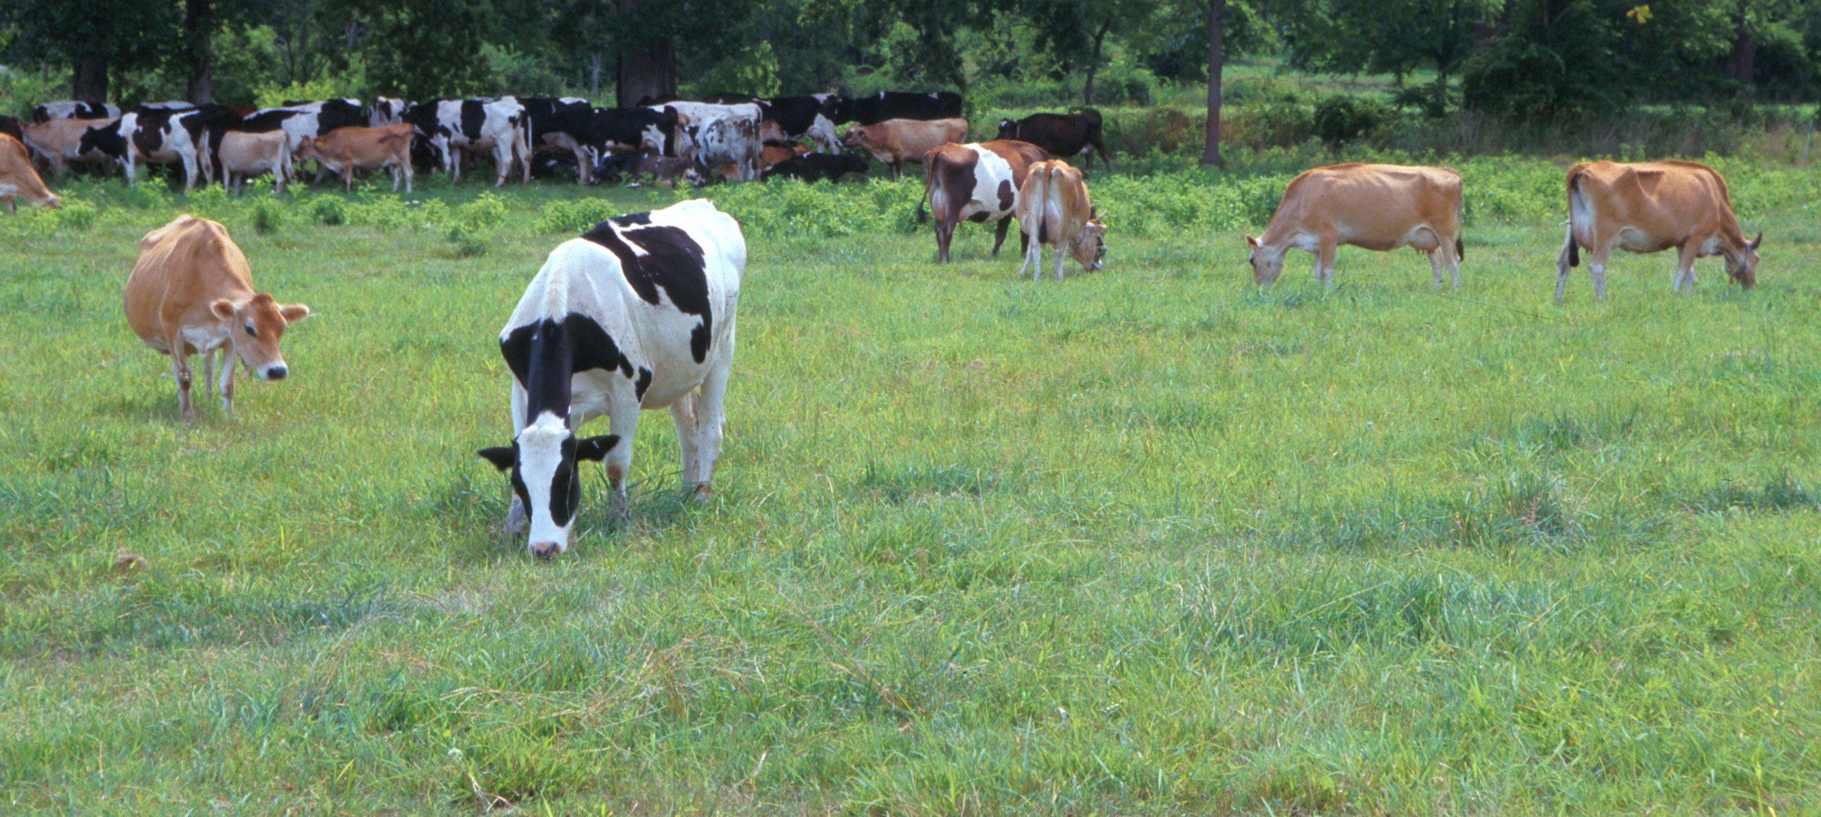
Questions?
AIP web site:
http://aipl.arsusda.gov/
Holstein and Jersey crossbreds graze on American Farm Land Trust’s
Cove Mountain Farm in south-central Pennsylvania
Source: ARS Image Gallery, image #K8587-14; photo by Bob Nichols

Slide 21
References
Ashburner M., et al. 2000. Gene Ontology: Tool for the unification of biology. Nat. Genet. 25:25–29.
Fortes, M.R.S., et al. 2010. Association weight matrix for the genetic dissection of puberty in beef cattle. Proc. Natl. Acad. Sci. U.S.A. 107:13642–13647.
Fourichon, C., et al. 2000. Effect of disease on reproduction in the dairy cow: A meta-analysis. Theriogenology 53:1729–1759.
Han Y., & F. Peñagaricano. 2016. Unravelling the genomic architecture of bull fertility in Holstein cattle. BMC Genet. 17:143.
Morota, G., et al. 2015. An application of MeSH enrichment analysis in livestock. Anim. Genet. 46:381–387.
Parker Gaddis, K.L., et al. 2014. Genomic selection for producer-recorded health event data in US dairy cattle. J. Dairy Sci. 97:3190–3199.
Parker Gaddis, K.L., et al. 2016. Explorations in genome-wide association studies and network analyses with dairy cattle fertility traits. J. Dairy Sci. 99:6420–6435.
Parker Gaddis, et al. 2017. Development of genomic evaluations for direct measures of health in US Holsteins and their correlations with fitness traits. J. Dairy. Sci. 100(Suppl. 2):378(abstr. 377).
Quinlan, A.R., & I.M. Hall. 2010. BEDTools: A flexible suite of utilities for comparing genomic features. Bioinformatics 26:841–842.
Shannon, P., et al. 2003. Cytoscape: A software environment for integrated models of biomolecular interaction networks. Genome Res. 13:2498–2504.
Zhou, X. 2016. GEMMA User Manual. University of Chicago, Chicago, IL.
Zimin, A.V., et al. 2009. A whole-genome assembly of the domestic cow, Bos taurus. Genome Biol. 10:R42.

