Slide 1
Opportunities for genetic change in small breeds
John B. Cole
USDA, Agricultural Research Service
Henry A. Wallace Beltsville Agricultural Research Center
Animal Genomics and Improvement Laboratory
Beltsville, MD 20705-2350

Slide 2
Topics for discussion
A brief review of genetic gains
What is the current state of the breed?
What about genomics?
What can we do about this situation?
Opportunities and Conclusions
Source: American Guernsey Association.

Slide 3
A brief review of genetic gains

Slide 4
Productivity has greatly increased over time

Slide 5


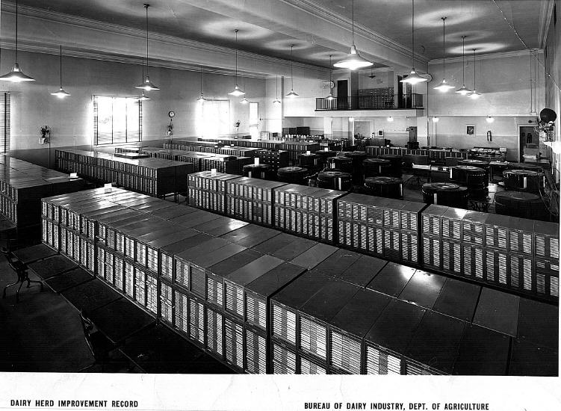
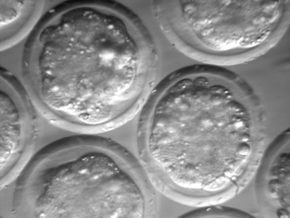
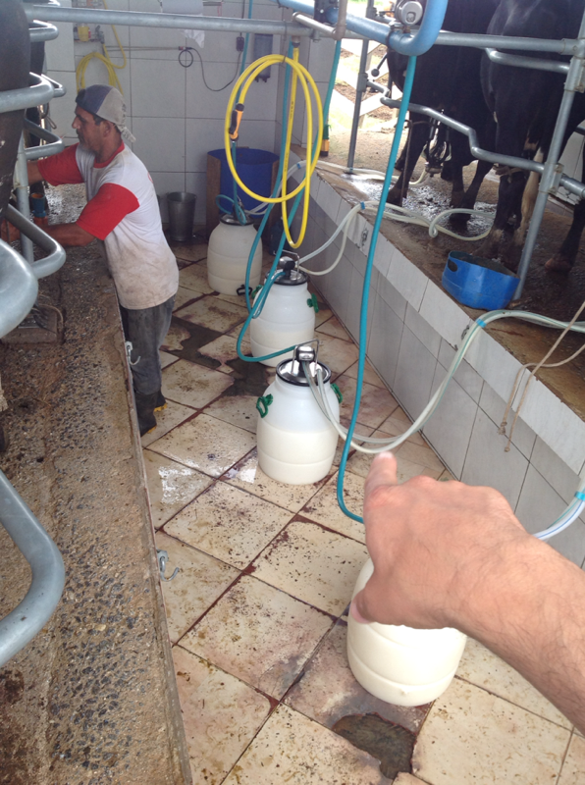
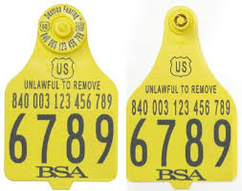
Dairy farmers readily adopt new technologies

Slide 6
Many things affect performance
P = G + E
Additive effects
Dominance effects
Epistasis
Housing
Climate
Unknown
What about G×E?
Effects generally small in the US (e.g., Wright and VanRaden, 2015)

Slide 7
What is the value of genetic selection?
In 2015: 1957 base was 44% of total fat,
management was 28% of gains, and
genetics was 28% of gains
Source: https://queries.uscdcb.com/eval/summary/trend.cfm?R_Menu=JE.f#StartBody

Slide 8
What is the current state of the breed?

Slide 9
Guernsey cow numbers have decreased over time
Source: CDCB (https://queries.uscdcb.com/eval/summary/trend.cfm?R_Menu=GU#StartBody).

Slide 10
Gains in milk production have slowed

Slide 11
Fertility is a challenge, as in many other breeds

Slide 12
Longevity is a more complex trait

Slide 13
The Guernsey breed has not been keeping up
It is often difficult for smaller breeds to maintain high rates of genetic gain
Small populations are less likely to produce matings that produce extraordinary outliers
 | Milk | Fat | Protein | PL | SCS | DPR | HCR | CCR | LIV | EFI
Mean | 17,472 | 782 | 570 | 25.8 | 3.01 | 24.0 | 41.3 | 28.6 | 76.5 | 7.3
Rank | 6 | 4 | 6 | 5 | 6 | 6 | 6 | 6 | 6 | 6
Source: CDCB (https://queries.uscdcb.com/eval/summary/Bmean_bases_het.cfm).

Slide 14
What about genomics?

Slide 15
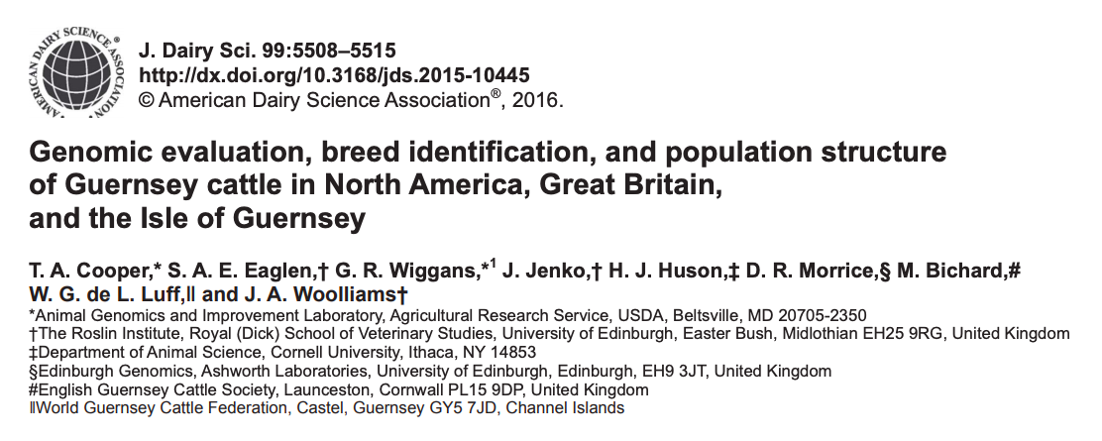
Genomic evaluations for US Guernsey since April 2016
Initially based on 2,376 Guernsey bulls and cows from the US, Canada, the UK, and the Isle of Guernsey
Gains in reliability over parent averages were 16.8 percentage points averaged across traits

Slide 16
3,940 Guernseys have been genotyped

Slide 17
Genomics increases prediction accuracy
Correlations of PA for young bulls with PTA show modest benefits from genomics
This means that genotypes are providing new information
Substantial re-ranking of bulls from initial evaluation to progeny test
Opportunities for preselection limited by small population size
More cows needed to improve reliability
 | PA NM$ | PTA NM$
Proven bulls in 1604 | N/A | 0.87
Young bulls in 1604 | 0.57 | 0.67

Slide 18
There may be something else going on here
Milk
Stature
?
Daughter Pregnancy Rate
Net Merit
Productive Life
Founder
GUUSA000000512974 HENSLEE FARMS V FAME (1954)

Slide 19
This haplotype is common in US Guernseys

Slide 20
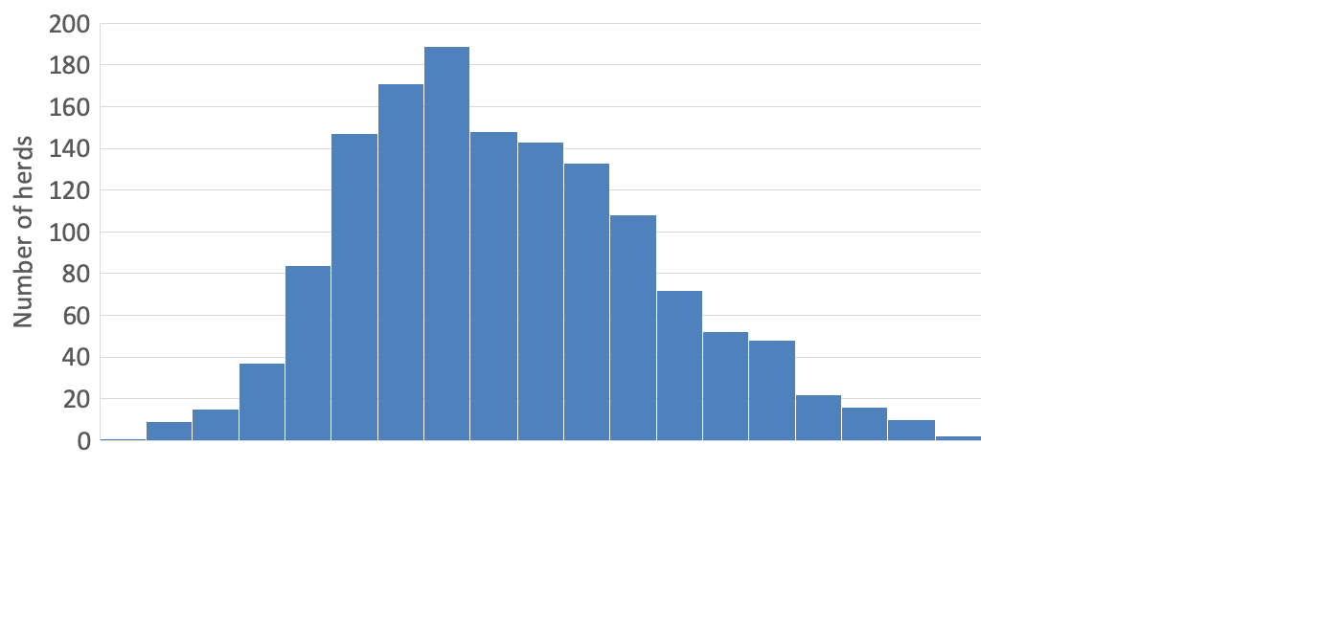
Average PTA NM$ of cows in different herds
$84 | $164 | $257 | $342 | $443 | $523 | $603 | $683 | $763
439 NM$

Slide 21
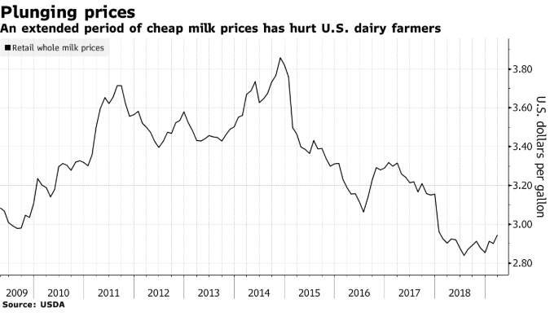
Low prices mean that production costs must drop

Slide 22
Good genetics lowers the cost of production
PTA (predicted transmitting ability) represents ½ of the cow’s genetic merit.
A difference between herds of $439 in PTA NM$ means the cows in the better herd will produce $878 more net profit over their lifetime.
USDA’s calculations have the average 305-ME at 27,000 lbs. and cows milking for 3 lactations.
If the average cost of production per cwt is $18.00…
A herd with an $878 advantage in the average genetic merit of their cows can produce milk at $16.92 per cwt.

Slide 23
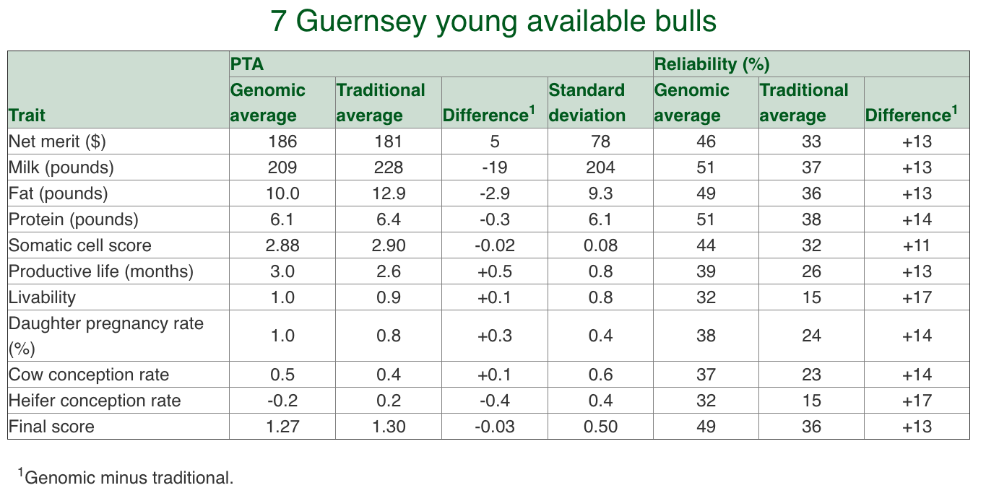
The portfolio of available bulls is limited
Source: CDCB (https://queries.uscdcb.com/eval/summary/comparexml_menu.cfm?R_menu=v_1904.v_Young_Available_Bulls.v_Guernsey_wddx#StartBody).

Slide 24
What can we do about this situation?

Slide 25
Build on the Guernsey Global Breeding Program
Genetic goals
Continue extensive use of young bulls
Continue to exchange germplasm among Guernsey populations
Do not focus too heavily on a single bull
Consider other sources of desirable genes
Emphasize four-event cows
Marketing goals
Focus on unique advantages of Guernsey milk
Pursue high value-add options, such as direct marketing to consumers
Participate in research on possible health benefits of A2 milk

Slide 26
Current Guernsey PTI formula (December 2018)
A selection index is a single number based on information about many traits used for making breeding and culling decisions
PTI = 24*Prot + 25*Fat + 15*DPR + 10*UDC + 10*FLC + 9*PL + 3*Str - 3*Stat
Fore udder attachment
Rear udder height
Rear udder width
Udder cleft
Udder depth
Teat placement
Teat length
Rear legs, rear view
Foot angle
Rear legs, side view

Slide 27
PTI will continue to evolve as farmer needs change
Sub-indices summarize data so that breeders do not have to know details of every trait (currently, 16 in PTI)
PTI = 24*Prot + 25*Fat + 15*Fertility + 10*UDC + 10*FLC + 9*PL + 3*Str - 3*Stat
Daughter pregnancy rate
Heifer conception rate
Cow conception rate
Early first calving
Fore udder attachment
Rear udder height
Rear udder width
Udder cleft
Udder depth
Teat placement
Teat length
Rear legs, rear view
Foot angle
Rear legs, side view

Slide 28
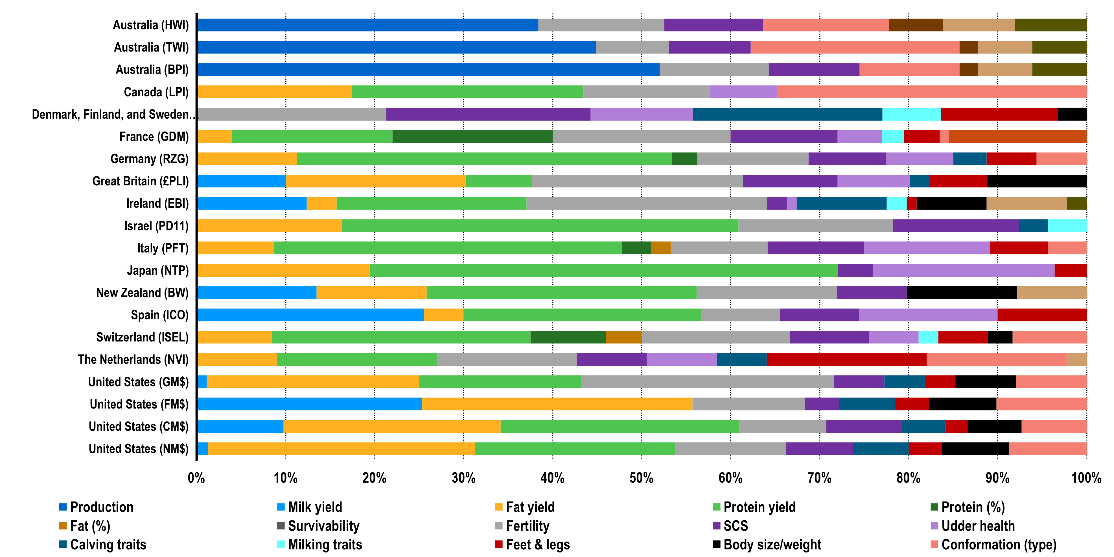
What do others include in their TMI?
Source: Modified from Figure 4 of Cole and VanRaden (2018; https://doi.org/10.3168/jds.2017-13335)

Slide 29
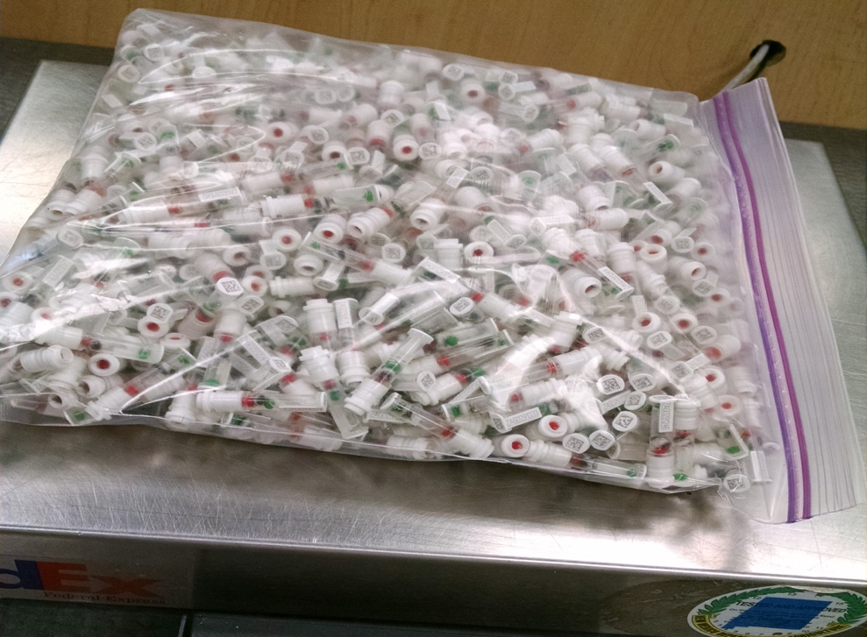
Should we select for low-heritability traits?
Many students were taught to select for highly heritable traits and manage lowly heritable traits
Genomic selection now makes ranking animals for lowly heritable traits possible very early in their life
e.g., health traits average >20% reliability gain from genomics
Predictions are accurate if database is large
Phenotyping costs shared among millions of animals
Photo: Zoetis

Slide 30
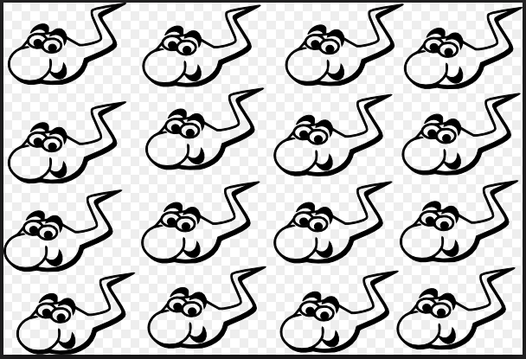
Not all gametes are created equal
The average gamete (spermatozoon) of a bull with a PTA Protein of +80 will contain genes equaling +80 for PTA Protein

Slide 31
With genomics, we can estimate gametic variance
However, there is
a lot of variation between the value of
his gametes
95
85
73
94
80
66
82
87
PTA Protein | Gametic Diversity
80 | + 7
81
78
77
65
75
84
72
80

Slide 32
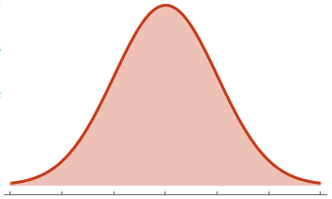
Greater gametic variance meants more outliers
Bull’s Gametic Diversity | Progeny’s PTA
 | Low | Average | High
LOW | 4 % | 92 % | 4 %
HIGH | 9 % | 82 % | 9 %
LOW
HIGH
High Gametic Diversity = More Outliers

Slide 33
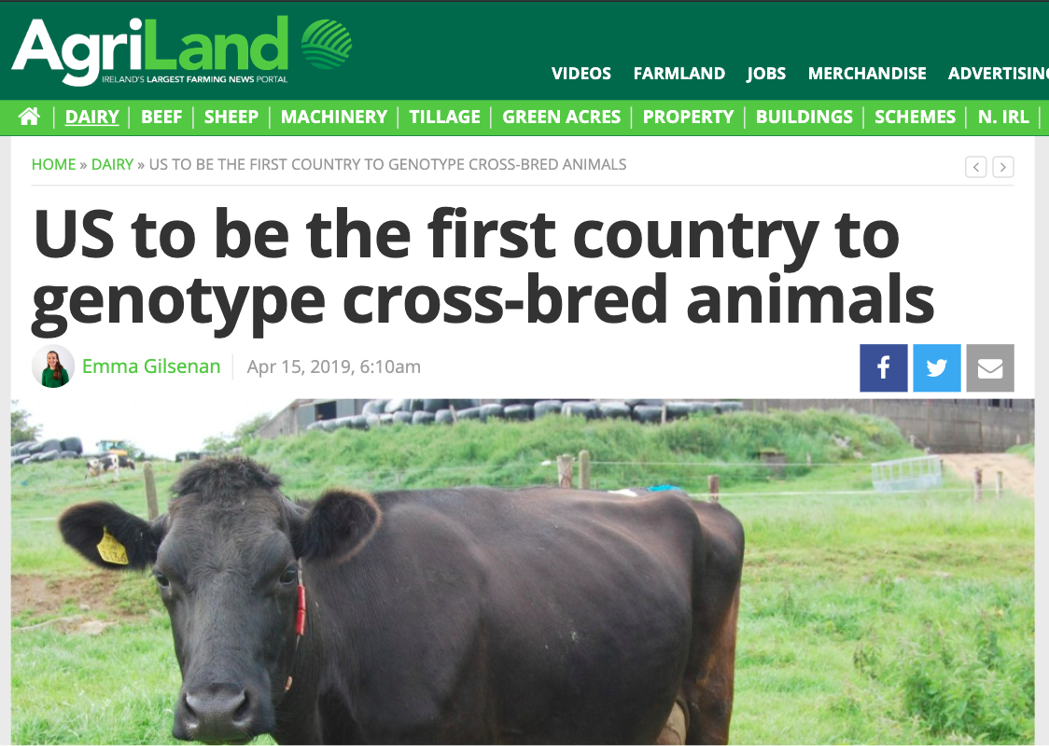
Crossbreeding may be part of the solution
Careful matings using genomic information can permit the importation of new genes
Essential features of the Guernsey breed, such as milk composition, can be retained
Crossbreeding is not a magical solution to all problems!
Source: https://www.agriland.ie/farming-news/us-to-be-the-first-country-to-genotype-cross-bred-animals/.

Slide 34
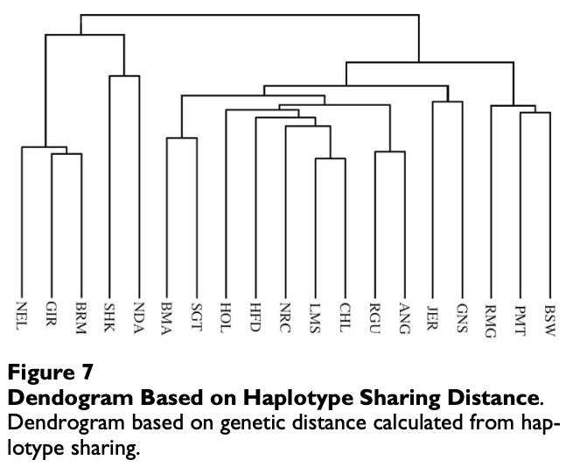
The source of new genes in the population matters!
Genetically, Guernsey and Jersey share the greatest similarity
There are 129 young Jersey bulls, compared to 7 young Guernsey bulls
This study did not include French breeds that may be more similar to Guernsey than other dairy breeds
Source: Villa-Angulo et al., 2009, BMC Genetics (https://doi.org/10.1186/1471-2156-10-19).

Slide 35
Inbreeding should be closely monitored

Slide 36
Opportunities and Conclusions

Slide 37
Opportunities for, and questions about, the future
Opportunities
A2 milk can meet growing consumer demand for healthful food
Guernsey butter can be sold as a premium product – possibly model after Kerrygold butter
More high-quality Guernsey cows are needed to meet growing demand
Questions
How do farms of all sizes realize a fair price for their milk?
How do we ensure the continued viability of a national genetic improvement program?
Can co-ops individually brand milk from their farms?

Slide 38
Conclusions
Genetic gains are cumulative and permanent, but genetic evaluations depend on a constant flow of data
The small size of the Guernsey population is a challenge because of the limited gene pool
Diversity must be monitored to avoid long-term problems
It may be necessary to bring in genes from other breeds for Guernseys to remain healthy and competitive

Slide 39
Acknowledgments
Paul VanRaden, Bingjie Li, and Dan Null provided calculations and figures. Tom Lawlor kindly provided several slides.
USDA-ARS project 8042-31000-002-00-D, “Improving Dairy Animals by Increasing Accuracy of Genomic Prediction, Evaluating New Traits, and Redefining Selection Goals”.
USDA is an equal opportunity provider and employer.
Mention of trade names or commercial products in this presentation is solely for the purpose of providing specific information and does not imply recommendation or endorsement by the US Department of Agriculture.

Slide 40
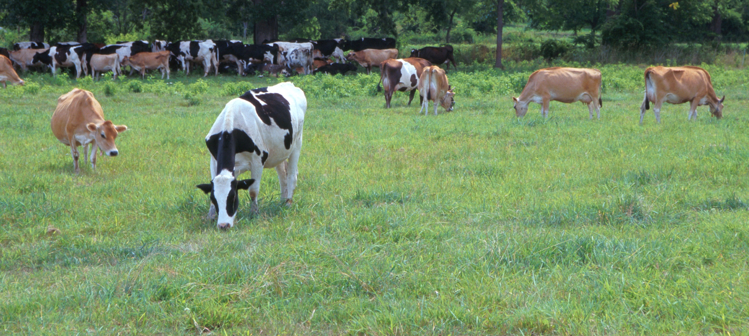
Questions?
AIP web site:
http://aipl.arsusda.gov/
Holstein and Jersey crossbreds graze on American Farm Land Trust’s
Cove Mountain Farm in south-central Pennsylvania
Source: ARS Image Gallery, image #K8587-14; photo by Bob Nichols

