Slide 1
Possibilities in an age of genomics: The future of the breeding index
John B. Cole
USDA, Agricultural Research Service
Henry A. Wallace Beltsville Agricultural Research Center
Animal Genomics and Improvement Laboratory
Beltsville, MD 20705-2350
john.cole@ars.usda.gov

Slide 2
Introduction
What are breeding indices?
Why do we use them?
How do we construct them?
What traits are in current indices?
What traits should be in future indices?
Are there alternatives to breeding indices?

Slide 3
Many things affect performance
P = G + E
Additive effects
Dominance effects
Epistasis
Housing
Climate
Unknown
What about G×E?
Effects generally small in the US (e.g., Wright and VanRaden, 2015)

Slide 4
What is the value of genetic selection?
In 2016: 1957 base was 40% of total fat,
management gains were 26% of total fat, and
genetic gains were 34% of total fat
Source: https://queries.uscdcb.com/eval/summary/trend.cfm?R_Menu=JE.f#StartBody

Slide 5
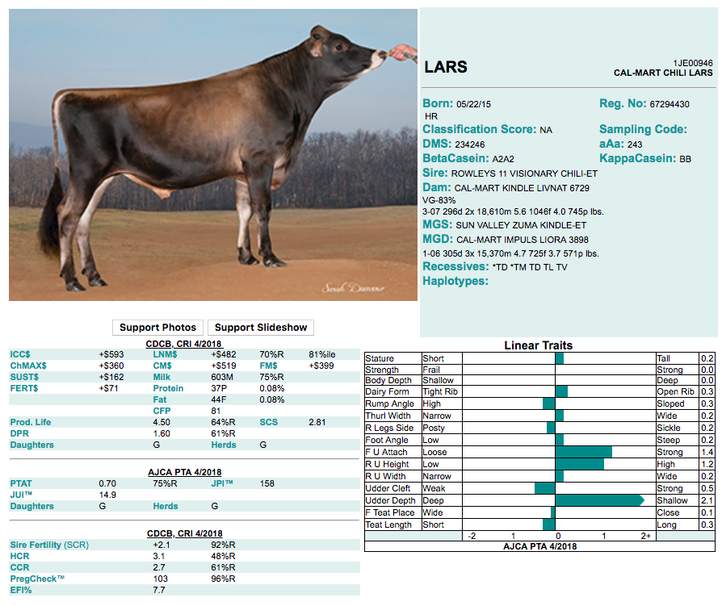
What is a breeding index?
A single number based on information about many traits used for making selection decisions
ICC$ = Ideal commercial
cow index
LNM$ = Lifetime net merit
FM$ = Fluid merit
CM$ = Cheese merit
JPI = Breed-specific index
Source: Genex (http://genex.crinet.com/dairy/index.php?action=DETAIL&code=1JE00946&lang=&Breed=JE)

Slide 6
Indices may include sub-indices
Sub-indices summarize data so that breeders do not have to know details of every trait (31 in NM$)
NM$ = Production $ + Longevity $ + Fertility $ + Type $ + Calving $
Milk
Fat yield
Fat %
Protein yield
Protein %
Productive life
Cow livability
SCS
Daughter pregnancy rate
Heifer conception rate
Cow conception rate
Feet & legs (4)
Udder (7)
Body size (5)
Calving ease (2)
Stillbirth rate (2)

Slide 7
Sub-indices are flexible
Traits can be added to sub-indices (or new sub-indices added) without changing how the index is used
NM$ = Production $ + Longevity $ + Fertility $ + Type $ + Calving $ + Health $
Milk
Fat
Protein
Productive life
Cow livability
SCS
Daughter pregnancy rate
Heifer conception rate
Cow conception rate
Age at first calving
Feet & legs
Udder
Body size
Calving ease
Stillbirth rate
Gestation length
Mastitis
Metritis
Retained placenta
Ketosis
Displaced abomasum
Milk fever

Slide 8
Why select for more than one trait?
To make use of more information
  Correlations among traits are rarely 0
Several traits may have economic value
  Farmers may receive a quality premium
Some traits need to be improved and others maintained
  Selection for only yield would reduce fertility
Balanced selection improves traits according to their economic values

Slide 9
Selection for only yield reduces fertility
Selection only for yield will produce a decrease in fertility because of unfavorable correlations
Source: https://queries.uscdcb.com/eval/summary/trend.cfm?R_Menu=JE.f#StartBody

Slide 10
Traits evaluated
Year | Trait | Year | Trait
1926 | Milk & fat yields | 2006 | Stillbirth rate
1978 | Conformation (type) | 2006 | Bull conception rate²
1978 | Protein yield | 2009 | Cow & heifer conception rates
1994 | Productive life | 2016 | Cow livability
1994 | SCS (udder health) | 2017 | Gestation length
2000 | Calving ease (dystocia)¹ | 2017 | Residual feed intake (research)³
2003 | Daughter pregnancy rate | 2018 | Cow health (6 traits)
¹Sire calving ease evaluated by Iowa State University (1978–99)
²Estimated relative conception rate evaluated by DRMS in Raleigh, NC (1986–2005)
³Research trait, no official evaluations yet

Slide 11
Selection objectives and criteria
The selection objective is the set of traits that we wish to improve
  e.g., lifetime profitability
The selection criterion is the set of traits that we measure and use to make selection decisions
  e.g., milk yield, daughter pregnancy rate, body size composite
Traits may appear in both the objective and the criterion

Slide 12
What goes into an index?
P
C
G
a
Phenotypic (co)variances among traits in the criterion
Genetic (co)variances among traits in the objective
Genetic (co)variances among traits in the criterion and objective
Economic weights

Slide 13
Where do economic weights come from?
Quantitative analysis
  Research and field reports to quantify incomes and expenses
  Driven by empirical factors
  Used in the calculation of NM$
Qualitative analysis
  Target for breed improvement developed by experts
  Driven by empirical and subjective factors
  Used in the calculation of some breed society indices

Slide 14
How do we compute an index?
b
P^{–1}
G
a
= × ×

Slide 15
Current genetic-economic indices (2018)
Trait | Relative value (%)
 | NM$ | CM$ | FM$ | GM$ | JPI₂₀₁₇
Milk yield | –0.7 | –7.9 | 18.4 | –0.7 | 8
Fat yield | 26.8 | 22.8 | 27.1 | 22.9 | 15
Protein yield | 16.9 | 20.9 | 0.0 | 14.4 | 30
Productive life (PL) | 12.1 | 10.3 | 12.2 | 6.6 | 6
Somatic cell score (SCS) | –4.0 | –4.4 | –2.3 | –3.5 | 6
Udder composite (UC) | 7.4 | 6.3 | 7.5 | 7.4 | 12.8
Feet/legs composite (FLC) | 2.7 | 2.3 | 2.8 | 2.8 | 0.2
Body weight composite (BWC) | –5.3 | –4.5 | –5.3 | –5.8 | 7
Daughter pregnancy rate (DPR) | 6.7 | 5.7 | 6.8 | 17.8 | 7
Heifer conception rate (HCR) | 1.4 | 1.2 | 1.4 | 2.4 | 2
Cow conception rate (CCR) | 1.6 | 1.4 | 1.7 | 4.3 | 2
Calving ability index (CA$) | 4.8 | 4.1 | 4.8 | 4.5 | …
Cow livability (LIV) | 7.3 | 6.2 | 7.4 | 4.9 | 4
Health trait subindex (HTH$) | 2.3 | 1.9 | 2.3 | 2.1 | …
Sources: https://aipl.arsusda.gov/reference/nmcalc-2018.htm; https://youtu.be/Ecjnh7b9O6Q

Slide 16
Index changes over time
Trait | Relative emphasis on traits (%)
 | PD$ 1971 | MFP$ 1976 | CY$ 1984 | NM$ 1994 | NM$ 2000 | NM$ 2003 | NM$ 2006 | NM$ 2010 | NM$ 2014 | NM$ 2017 | NM$ 2018
Milk | 52 | 27 | –2 | 6 | 5 | 0 | 0 | 0 | –1 | –1 | –1
Fat | 48 | 46 | 45 | 25 | 21 | 22 | 23 | 19 | 22 | 24 | 27
Protein | … | 27 | 53 | 43 | 36 | 33 | 23 | 16 | 20 | 18 | 17
PL | … | … | … | 20 | 14 | 11 | 17 | 22 | 19 | 13 | 12
SCS | … | … | … | –6 | –9 | –9 | –9 | –10 | –7 | –7 | –4
UC | … | … | … | … | 7 | 7 | 6 | 7 | 8 | 7 | 7
FLC | … | … | … | … | 4 | 4 | 3 | 4 | 3 | 3 | 3
BWC | … | … | … | … | –4 | –3 | –4 | –6 | –5 | –6 | –5
DPR | … | … | … | … | … | 7 | 9 | 11 | 7 | 7 | 7
SCE | … | … | … | … | … | –2 | … | … | … | … | …
DCE | … | … | … | … | … | –2 | … | … | … | … | …
CA$ | … | … | … | … | … | … | 6 | 5 | 5 | 5 | 5
HCR | … | … | … | … | … | … | … | … | 1 | 1 | 1
CCR | … | … | … | … | … | … | … | … | 2 | 2 | 2
LIV | … | … | … | … | … | … | … | … | … | 7 | 7
HTH$ | … | … | … | … | … | … | … | … | … | … | 2
Source: https://aipl.arsusda.gov/reference/nmcalc-2018.htm

Slide 17
Genetic trend (NM$)
Source: https://queries.uscdcb.com/eval/summary/trend.cfm?R_Menu=JE.nm#StartBody

Slide 18
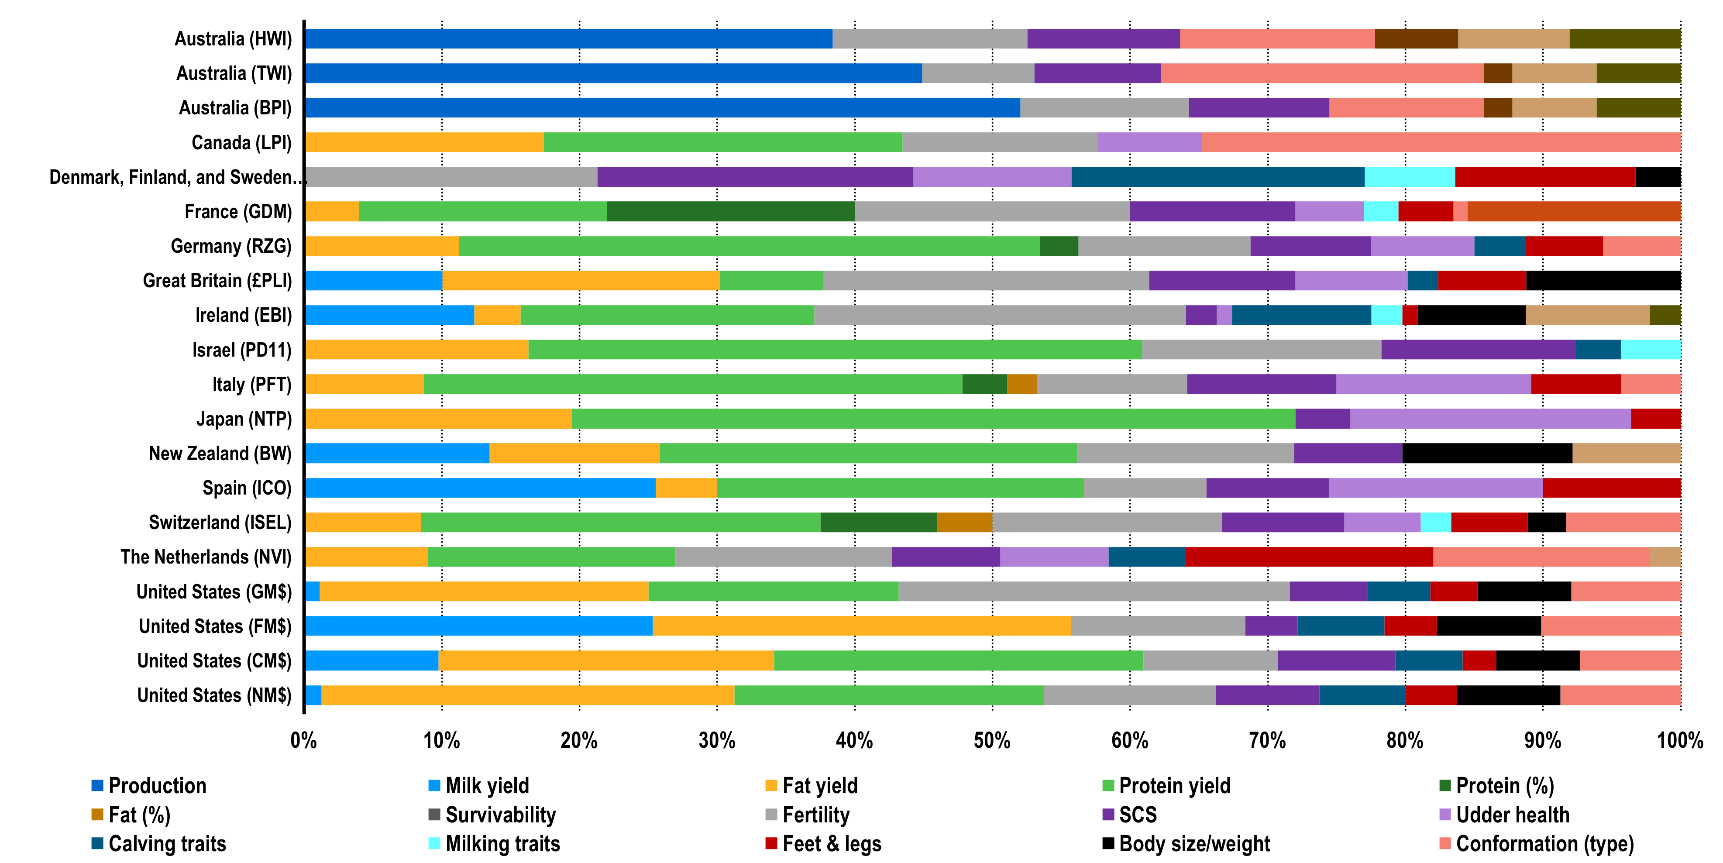
What do others include in their TMI?
Source: Modified from Figure 4 of Cole and VanRaden (2018; https://doi.org/10.3168/jds.2017-13335)

Slide 19
Why do we need new traits?
Changes in production economics
Technology produces new phenotypes or reduces costs of collecting them
  New traits can be predicted on all genotyped animals without collecting progeny records
  Phenotyping costs are shared among millions of animals
Better understanding of biology
Recent review by Egger-Danner et al. (Animal, 2015)

Slide 20
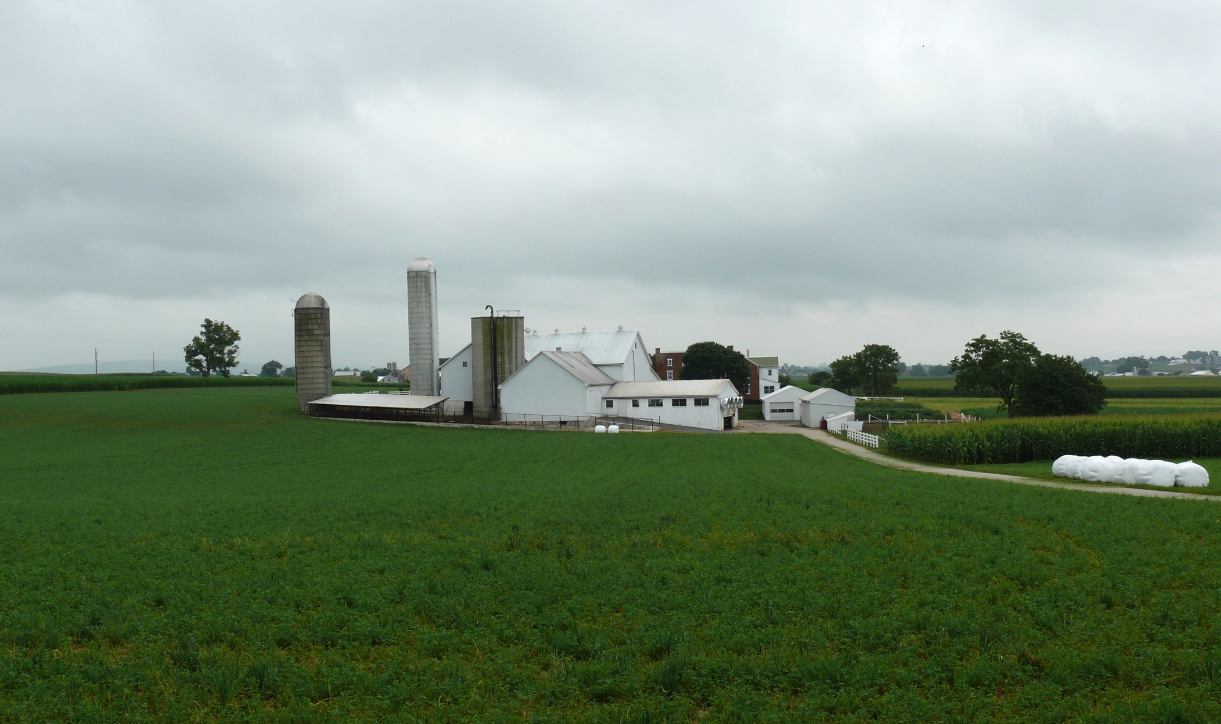
Where do new traits come from?
Barn: Flooring type, bedding materials, density, weather data
Cow: Body temperature, activity, rumination time, feed & water intake
Herdsmen/consultants: Health events, foot/claw health, veterinary treatments
Parlor: yield, composition, milking speed, conductivity, progesterone, temperature
Silo/bunker: ration composition, nutrient profiles
Pasture: soil type/composition, nutrient composition
Laboratory/milk plant: detailed milk composition, mid-infrared spectral data
Source: http://commons.wikimedia.org/wiki/File:Amish_dairy_farm_3.jpg

Slide 21
Examples of new phenotypes
Claw health
(Heringstad et al., 2018)
Cow health
(Parker Gaddis et al., 2015)
Embryonic development
(Cochran et al., 2013)
Immune response
(Thompson-Crispi et al., 2013)
Methane production
(de Haas et al., 2011)
Milk fatty acid composition (Soyeurt et al., 2011)
Persistency of lactation
(Cole et al., 2009)
Thermoregulation
(Dikmen et al., 2013)
Residual feed intake
(Connor et al., 2013)
Cheesemaking properties
(De Marchi et al., 2009)
Superovulation & embryo transfer
(Parker Gaddis et al., 2017)
Adaptation to automated (robotic) milking (Vosman et al., 2014)
Metabolic diseases
(Pryce et al., 2016)
Udder health
(Soyeurt et al., 2012)
Cow temperament
(Kramer et al., 2013)
Milking efficiency
(Lovendahl et al., 2012)

Slide 22
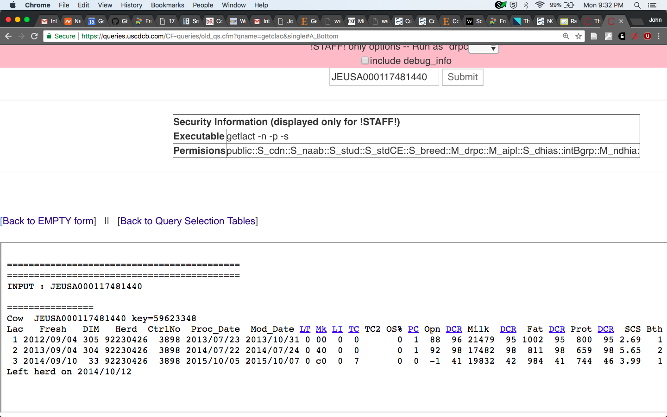
What do current phenotypes look like?
Low dimensionality
  Usually few observations per lactation
  Close correspondence of phenotypes with values measured
  Easy transmission and storage
  Costs of data recording are relatively low

Slide 23
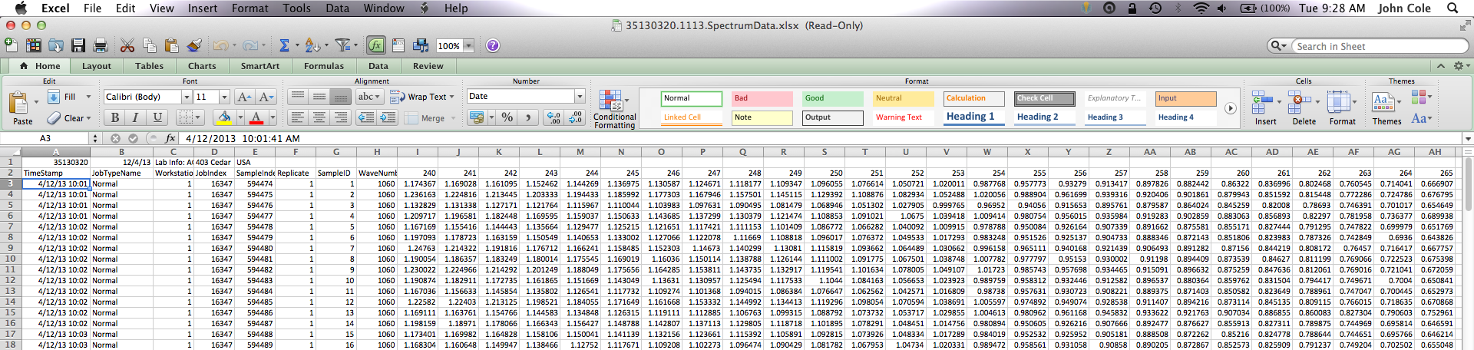
What do new phenotypes look like?
High dimensionality
  Example: MIR produces 1,060 points/observation
  Disconnect between trait and measurement
  More resources needed for transmission, storage, and analysis
  Phenotyping costs can be high (e.g., feed intake)

Slide 24
Traditional phenotyping scheme
Current milk recording
Many farms participate
Low-intensity phenotyping (few measurements per cow)
Well-suited to traits with low recording costs
Source: Jersey Journal
Source: Jersey Journal
Source: Jersey Journal

Slide 25
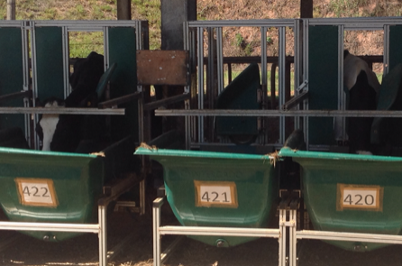
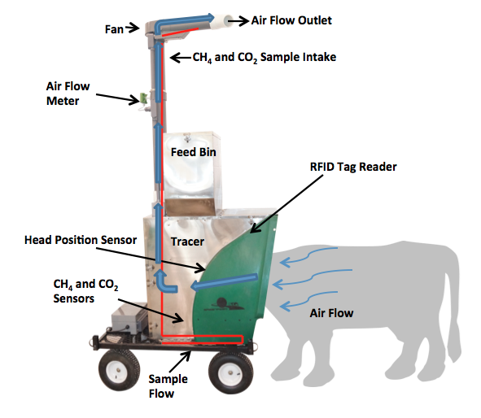
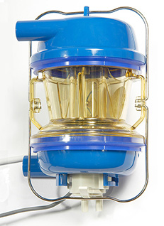
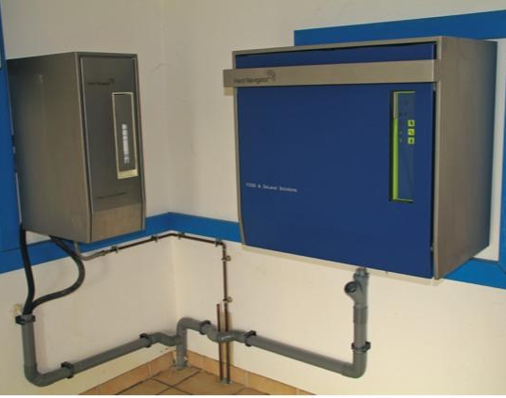
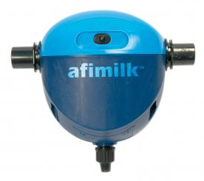
Alternative phenotyping scheme
Few farms
Intensive phenotyping (many measurements per cow)
Use cases
  Expensive-to-measure traits
  Developing countries
Source: J.B. Cole
Source: http://c-lockinc.com/
Source: http://www.afimilk.com/
Source: http://goo.gl/wu8YtR

Slide 26
Conclusions
Information from many sources can be combined into a single quantity using selection index methodology
Selection indices are robust to modest differences between predicted and actual values
Ideal phenotyping strategies vary with the cost and difficulty of data recording
Phenotypes may need to be collected differently than in the past to produce reliable evaluations for new traits

Slide 27
Disclaimers
USDA is an equal opportunity provider and employer
Mention of trade names or commercial products in this presentation is solely for the purpose of providing specific information and does not imply recommendation or endorsement by USDA

Slide 28
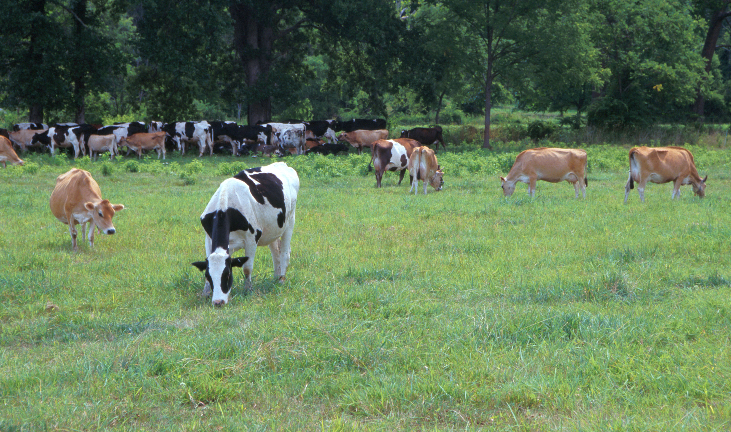
Questions?
AIP web site:
http://aipl.arsusda.gov
Holstein and Jersey crossbreds graze on American Farm Land Trust’s
Cove Mountain Farm in south-central Pennsylvania
Source: ARS Image Gallery, image #K8587-14; photo by Bob Nichols

