Slide 1
Management of Mendelian traits in breeding programs by gene editing
John B. Cole^{1,*} and Maci L. Mueller²
¹Animal Genomics and Improvement Laboratory
Agricultural Research Service, USDA, Beltsville, MD, USA
²Department of Animal Science
University of California, Davis, CA, USA
john.cole@ars.usda.gov

Slide 2
Introduction
High-density SNP genotypes used to identify many new recessives that affect fertility in dairy cattle (Cole et al., 2016a)
  Also used to track conditions such as polled
Faster allele frequency changes through sequential mate allocation (Cole, 2015)
  Accounts for increases in genomic inbreeding and economic impact of affected matings
Should consider effects of gene editing on selection programs
  May dramatically alter rates of allele frequency change

Slide 3
Estimated cost of genetic load
Cole et al. (2016a) estimated losses of at least $10,743,308 because of known recessives
Average losses were $5.77 for Ayrshires, $3.65 for Brown Swiss, $0.94 for Holsteins, and $2.96 for Jerseys
Economic impact of genetic load as it affects fertility and perinatal mortality
Actual losses likely to be higher

Slide 4
Selection using marker information
Look-ahead mate selection scheme using markers (Shepherd & Kinghorn, 2001)
More benefit from QTL genotypes used in mate selection rather than index selection (Li et al., 2006, 2008)
Selection against total number of lethal alleles and recessive lethal genotypes (Van Eenennaam & Kinghorn, 2014)
Parent averages adjusted to account for inbreeding (Pryce et al., 2012) and genetic load in sequential mate allocation schemes (Cole, 2015)

Slide 5
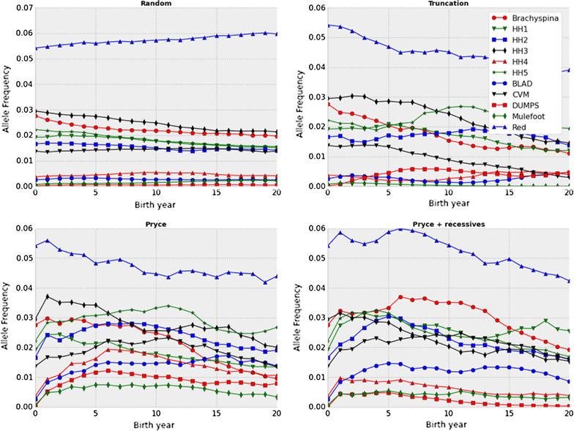
Selection may not be fast enough!
Source: Cole (2015)

Slide 6
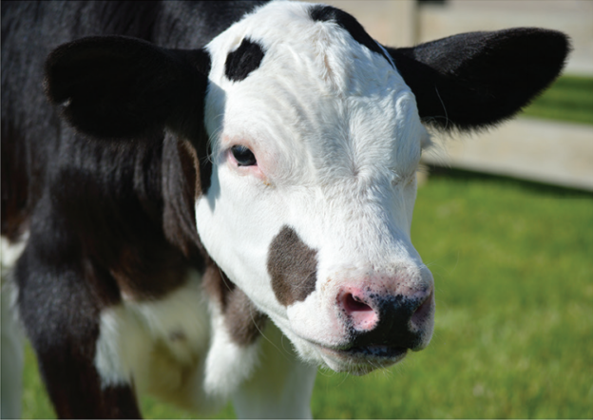
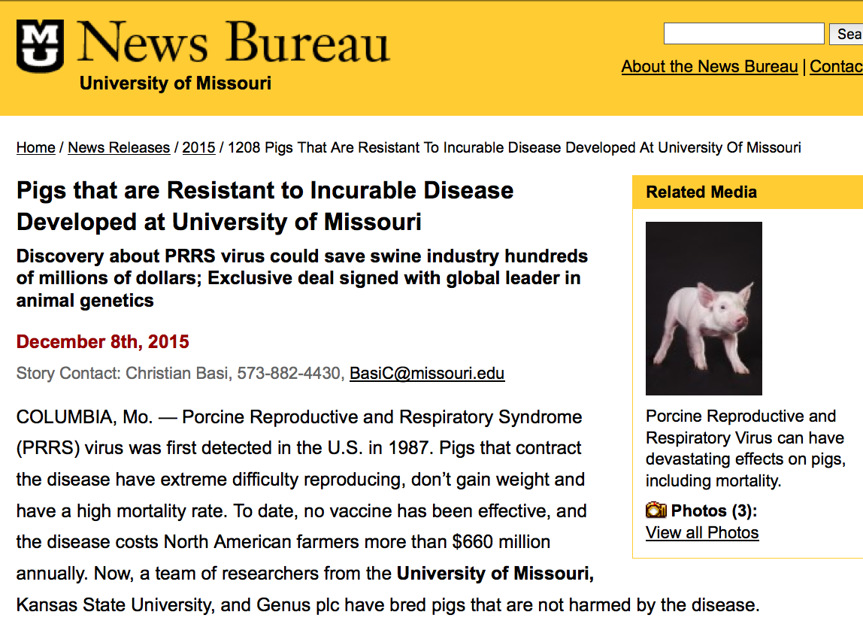
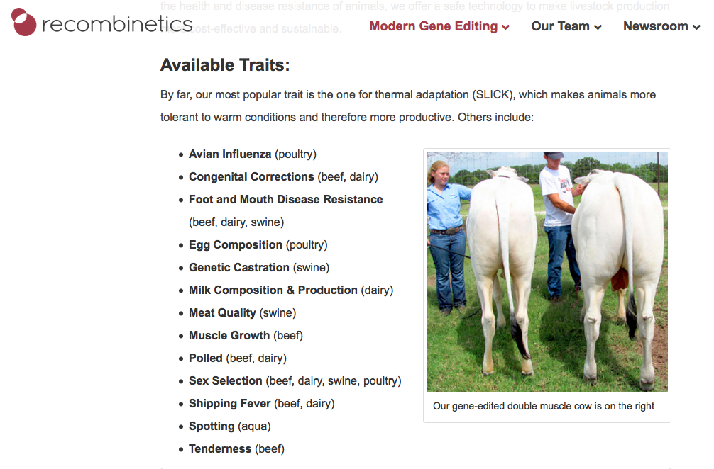
Gene editing in livestock

Slide 7
Is gene editing the solution to the recessives problem?
Much speculation about application of gene editing in livestock populations
  Improvement of quantitative traits (Jenko et al., 2015)
  Rapid introgression of desirable Mendelian traits, such as the Slick locus (Loi et al., 2016)
  Development of animal models of complex human disease (e.g., Tu et al., 2015)
What about editing carriers to rapidly eliminate harmful alleles from the population?

Slide 8
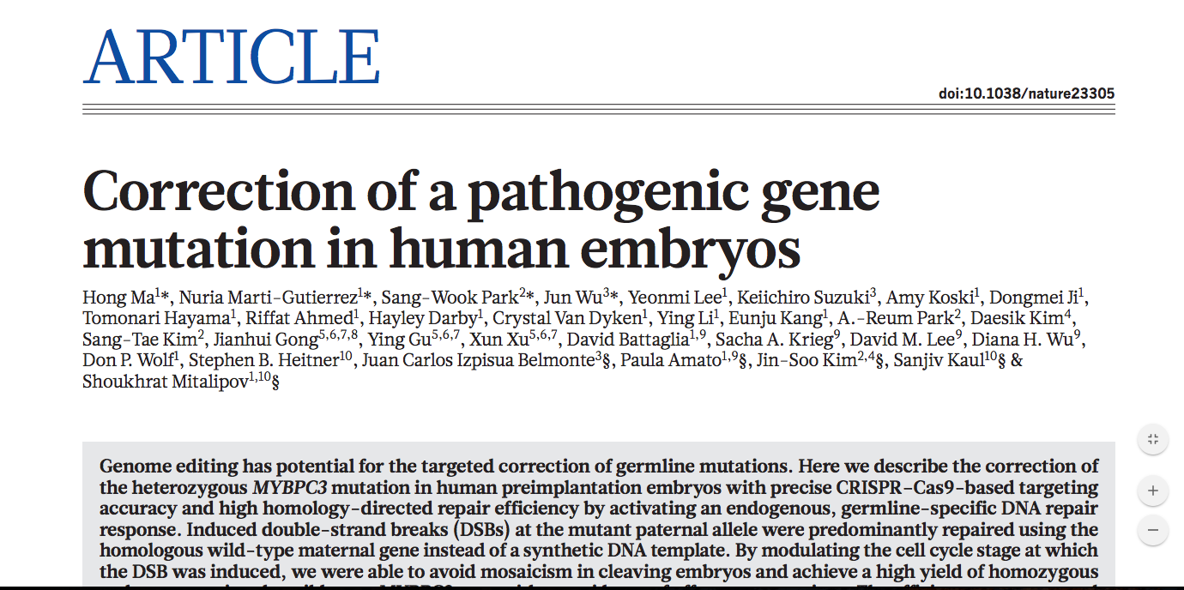
This is no longer a speculative use of the technology!
Source: Ma et al. (2017).

Slide 9
Objectives
Determine rates of allele frequency change and quantify differences in cumulative genetic gain for several genome editing technologies
Consider varying numbers of recessives as well as different proportions of bulls and cows to be edited

Slide 10
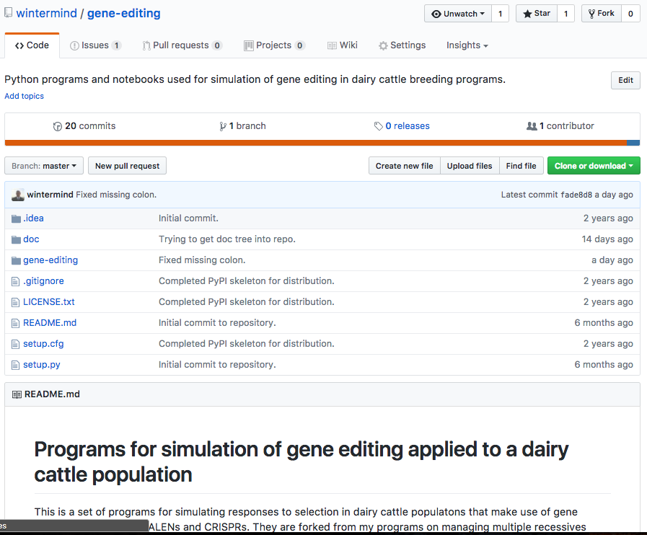
Simulation program
The multiple-recessives program of Cole (2015) was modified to accommodate gene editing
  Code is available on GitHub
  under a CC0 1.0 license
Any number or combination of
recessives may be edited
Written in Python 2.7 with
Jupyter notebooks for analysis

Slide 11
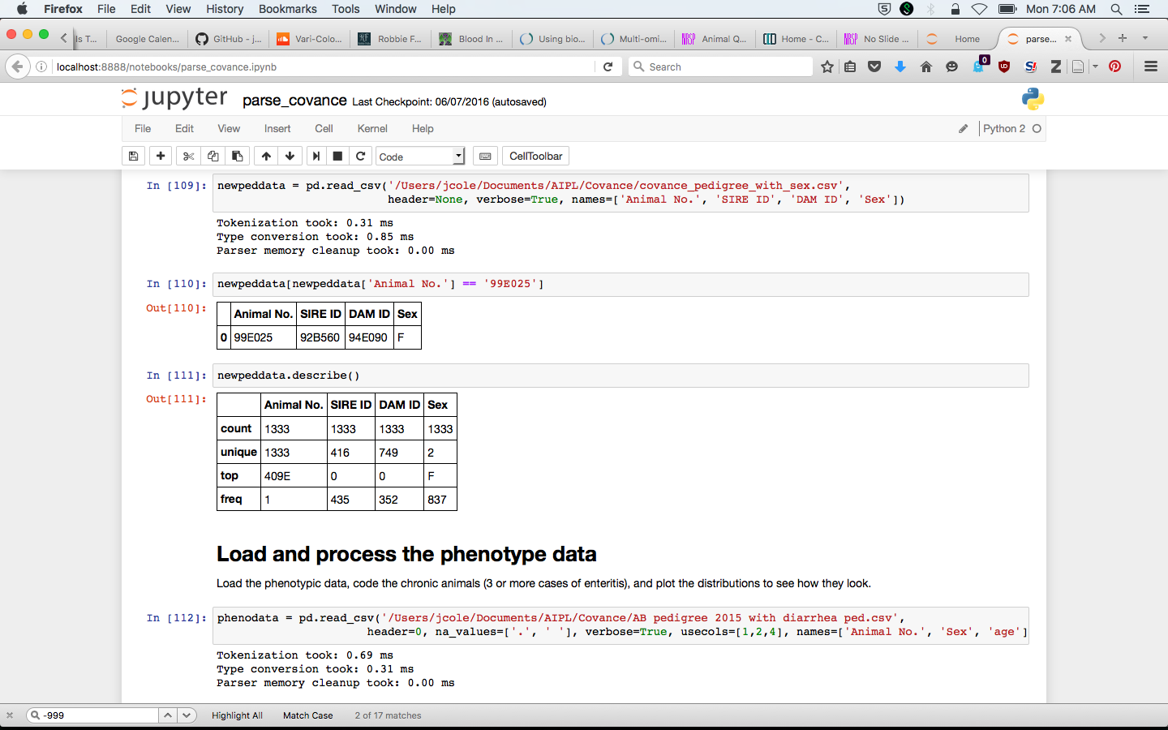
Jupyter notebook (example)

Slide 12

Digression – one approach to reproducible research

Slide 13
Recessives in U.S. Holsteins
Haplo- type | Functional/Gene name | BTA chromosome | Location (Mbp) | Haplotype frequency (%) | Timing¹
HBR | Black/red coat color/MC1R(MSHR) | 18 | 14.8 | 0.80 | —
HCD | Cholesterol deficiency/APOB | 11 | 78.0* | 2.50 | W
HDR | Dominant red color/MC1R(MSHR) | 3 | 9.5* | 0.04 | —
HH0 | Brachyspina/FANCI | 21 | 21.2 | 2.76 | E,B
HH1 | APAF1 | 5 | 63.2* | 1.92 | E
HH2 | — | 1 | 94.9 – 96.6 | 1.66 | E
HH3 | SMC2 | 8 | 95.4* | 2.95 | E
HH4 | GART | 1 | 1.3* | 0.37 | E
HH5 | TFB1M | 9 | 93.2 – 93.4 | 2.22 | E
HHB | BLAD/ITGB2 | 1 | 145.1* | 0.25 | W
HHC | CVM/SLC35A3 | 3 | 43.4* | 1.37 | E,B
HHD | DUMPS/UMPS | 1 | 69.8* | 0.01 | E
HHM | Mule foot/LRP4 | 15 | 77.7 | 0.07 | B
HHP | Polledness (dominant)/POLLED | 1 | 1.7 – 2.0 | 0.71 | —
HHR | Red coat color/MC1R(MSHR) | 18 | 14.8* | 5.42 | —
*Causative mutation known
¹Timing of embryonic loss/calf death for homozygous animals: B = calf death at/shortly after birth,
E = embryonic loss/abortion, W = calf death weeks/months after birth
Source: Cole et al. (2016a,b)

Slide 14
Recent changes to program
Gene editing model
Advanced reproductive technologies + somatic cell nuclear transfer (Kasinathan, 2015)
Number of editing trials and ET steps may be limited or not
Editing of embryos will be added soon
Beneficial alleles
Many parameters now easily controlled by user
Several options specific to polled scenarios (pro tip: you can lie!)
Improvements to base modeling of population are planned

Slide 15
Parameters used
Name | Value | Name | Value | Name | Value | Name | Value
Cow mean | 0 | Base herds | 200 | Max matings | 5,000 | Edit type | C, P, T, Z
Genetic SD | 200 | Service bulls | 50 | Bull criterion | polled | Edit trials | 1
Bull differential | 1.5 | Max bulls | 500 | Bull deficit | use_horned | Embryo trials | 1
Polled parms | [0.10, 0.18, 0.82] | Max cows | 100,000 | flambda | 25
Polled differential | [1.0, 1.3] | Percent | 0.10 | Bulls edited | 0.10
Base bulls | 350 | Generations | 20 | Cows edited | 0.01
Base cows | 35,000

Slide 16
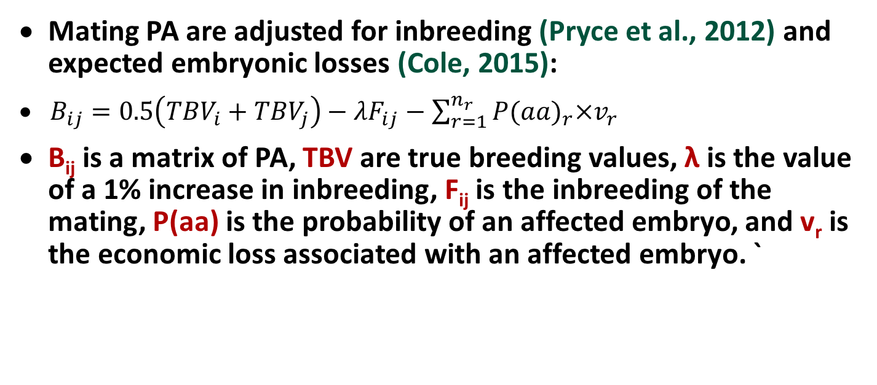
Sequential mate allocation
Mating PA are adjusted for inbreeding (Pryce et al., 2012) and expected embryonic losses (Cole, 2015):
$B_{ij}=0.5\left({TBV}_{i}+{TBV}_{j}\right)−λF_{ij}−\sum_{r=1}^{n_{r}}{{P(aa)}_{r}×v_{r}}$
B_{ij} is a matrix of PA, TBV are true breeding values, λ is the value of a 1% increase in inbreeding, F_{ij} is the inbreeding of the mating, P(aa) is the probability of an affected embryo, and v_{r} is the economic loss associated with an affected embryo. `

Slide 17
Sequential mate allocation (cont’d)
A matrix, M, is used to allocate bulls to cows
M_{ij} is set to 1 if B_{ij} is the greatest value in column j (largest PA available for mating to that cow)
If the sum of row i < the number of permitted matings for that bull the mating is allocated
Else, the bull with the next-highest value of B_{ij} is selected, until each column has only one element equal to 1

Slide 18
Original gene editing algorithm
Gene editing occurs when embryo is created
  Bernoulli random variate drawn (to determine if edit is successfully made to embryo) and checked for success
  This is not yet possible in practice
For each recessive edited
  Bernoulli random variate drawn (to determine if edited embryo produces a live birth) and checked for success
  Failure means that genotype was not changed

Slide 19
Original gene editing algorithm (cont’d)
Several scenarios can be accommodated in the software
  Single edit and ET events (e.g., establish worst-case baseline)
  Limited numbers of edit and ET events repeated until success or the supply is exhausted (e.g., limited embryos available for elite animals)
  Unlimited numbers of edit and ET events repeated until success (e.g., many embryos available in a population of genetically similar animals)

Slide 20
New gene editing algorithm
Gene editing occurs by somatic cell nuclear transfer from the bull or cow to be edited
For each recessive to be edited
  Bernoulli random variate drawn to determine if edit is successfully made an an edited embryo produced
  Failure means the locus was not changed
Once all edits are completed a Bernoulli random variate drawn to determine if the edited is successfully transferred and results in a live birth

Slide 21
Properties of gene editing strategies
Technology¹ | Editing success rate | ET success rate | Probability of success² | Trials for live calf³
CRISPR | 0.63 | 0.21 | 0. 13 | 100
TALEN | 0.21 | 0.12 | 0.03 | 740
Perfect | 1.00 | 1.00 | 1.00 | 1
ZFN | 0.11 | 0.08 | 0.01 | 2,240
¹CRISPR = clustered regularly interspaced short palindromic repeats;
TALEN = transcription activator-like effector nuclease;
Perfect = hypothetical technology with perfect success rate;
ZFN = zinc finger nuclease
²Calculated as editing success rate × ET success rate
³Trials required to for 99% probability of a live birth of an edited calf

Slide 22
Recessives by scenario
Scenario¹ | No.² | Frequency | Value ($)³ | Name | Lethal
All recessive loci | 12 | 0.0276 | 150 | Brachyspina | Yes
 |  | 0.0192 | 40 | HH1 | Yes
 |  | 0.0166 | 40 | HH2 | Yes
 |  | 0.0295 | 40 | HH3 | Yes
 |  | 0.0037 | 40 | HH4 | Yes
 |  | 0.0222 | 40 | HH5 | Yes
 |  | 0.0025 | 150 | BLAD | Yes
 |  | 0.0137 | 70 | CVM | Yes
 |  | 0.0001 | 40 | DUMPS | Yes
 |  | 0.0007 | 150 | Mulefoot | Yes
 |  | 0.9929 | 40 | Horned | No
 |  | 0.0542 | –20 | Red coat color | No
Horned locus | 1 | 0.9929 | 40 | Horned | No
¹Specific scenario simulated for each trait or group of traits
²Number of recessive loci in scenario
³Positive values undesirable and negative values desirable

Slide 23
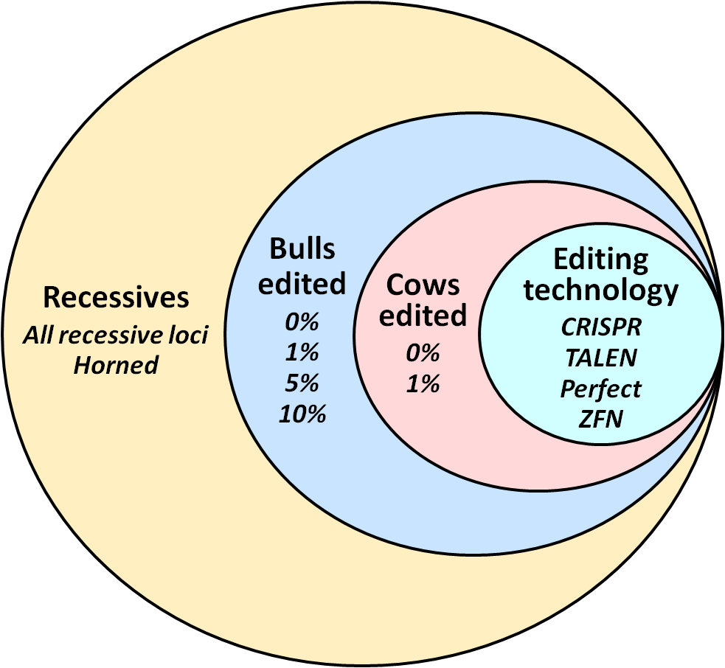
Recessives by scenario (continued)

Slide 24
Allele frequency change for all recessives with CRISPR
Top 1% of bulls and 0% of cows edited using CRISPR
Top 10% of bulls and 1% of cows edited using CRISPR

Slide 25
HH3 allele frequency change by editing method
Top 1% of bulls and 0% of cows edited
Top 10% of bulls and 1% of cows edited

Slide 26
Actual versus observed HH3 allele frequency
Top 1% of bulls and 0% of cows edited
Top 10% of bulls and 1% of cows edited

Slide 27
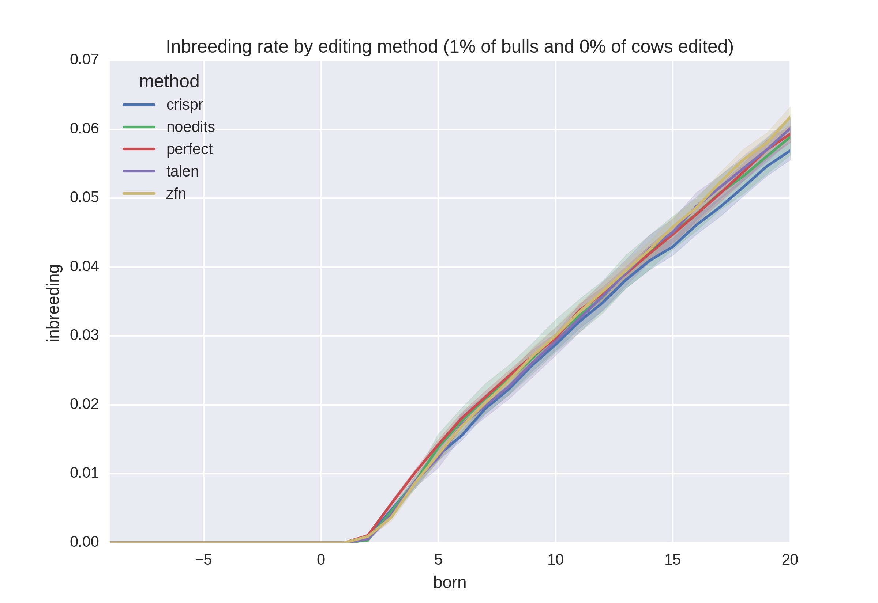
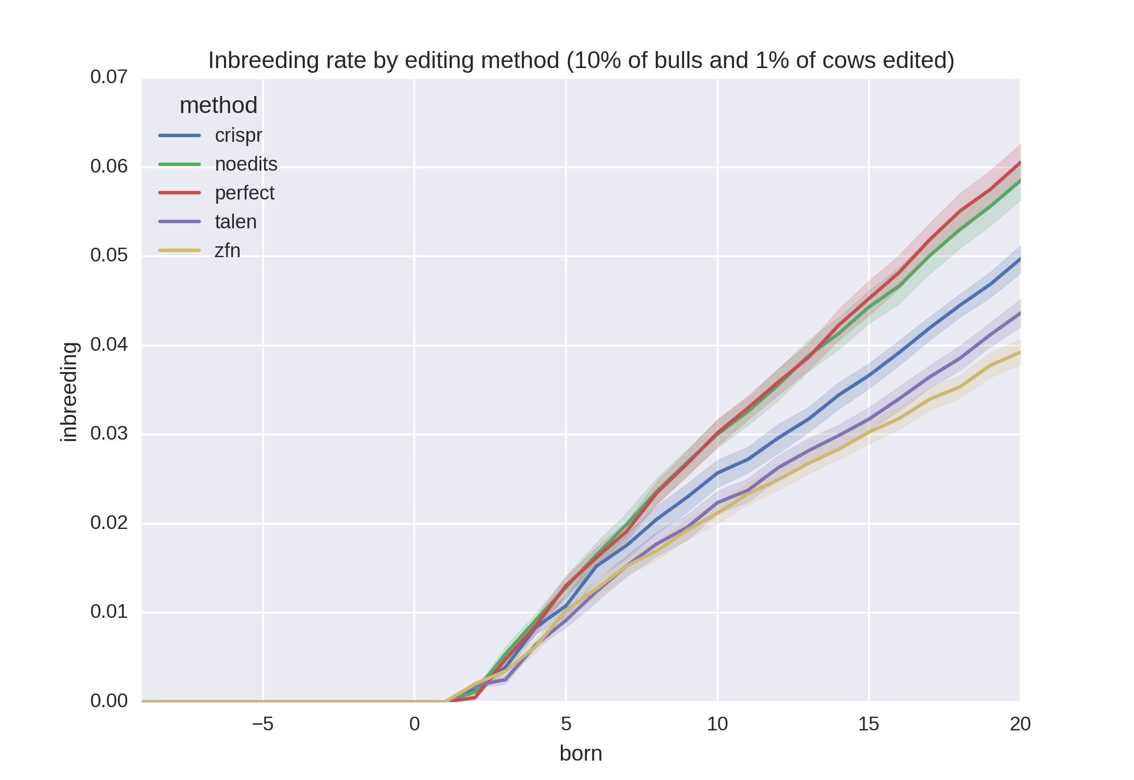
Inbreeding rates
Top 1% of bulls and 0% of cows edited
Top 10% of bulls and 1% of cows edited

Slide 28
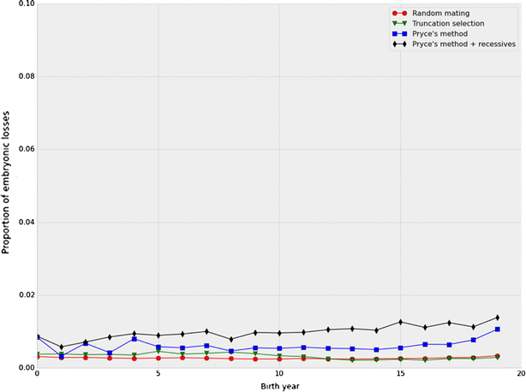
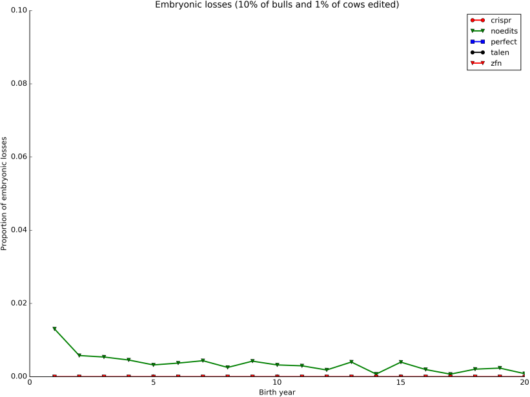
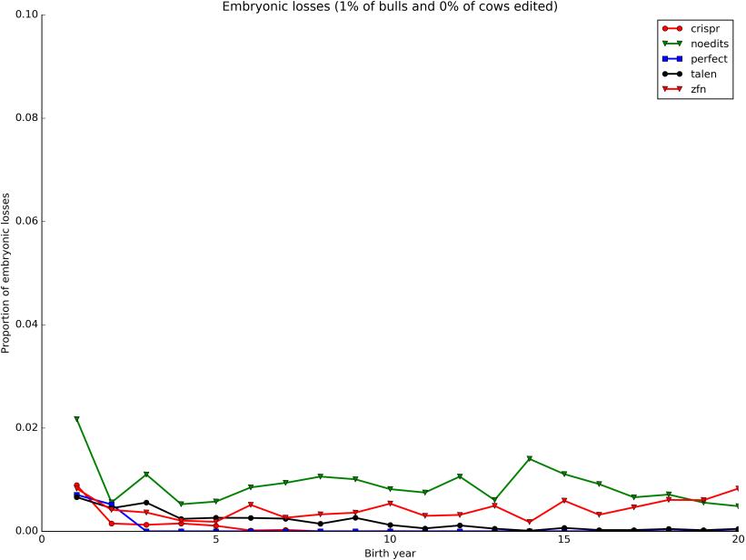
Embryonic deaths by generation

Slide 29
Why edit for polled?
Increasing polled frequency is slow without a sudden, substantial increase in value
Adding polled to selection indices a long-term (slow) solution
Gene editing to produce high-genetic merit polled bulls may be a short-term (fast) solution

Slide 30
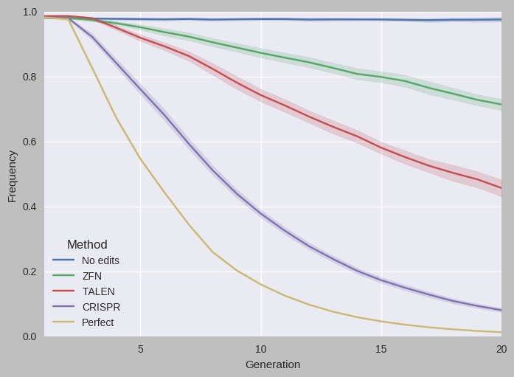
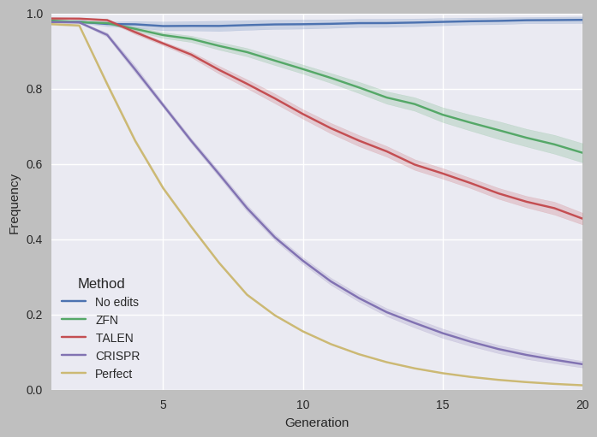
Change in Holstein horned allele frequency
Top 1% of bulls and 0% of cows edited
Top 10% of bulls and 1% of cows edited

Slide 31
Actual versus observed horned allele frequency
Top 1% of bulls and 0% of cows edited
Top 10% of bulls and 1% of cows edited

Slide 32
More edits result in faster progress

Slide 33
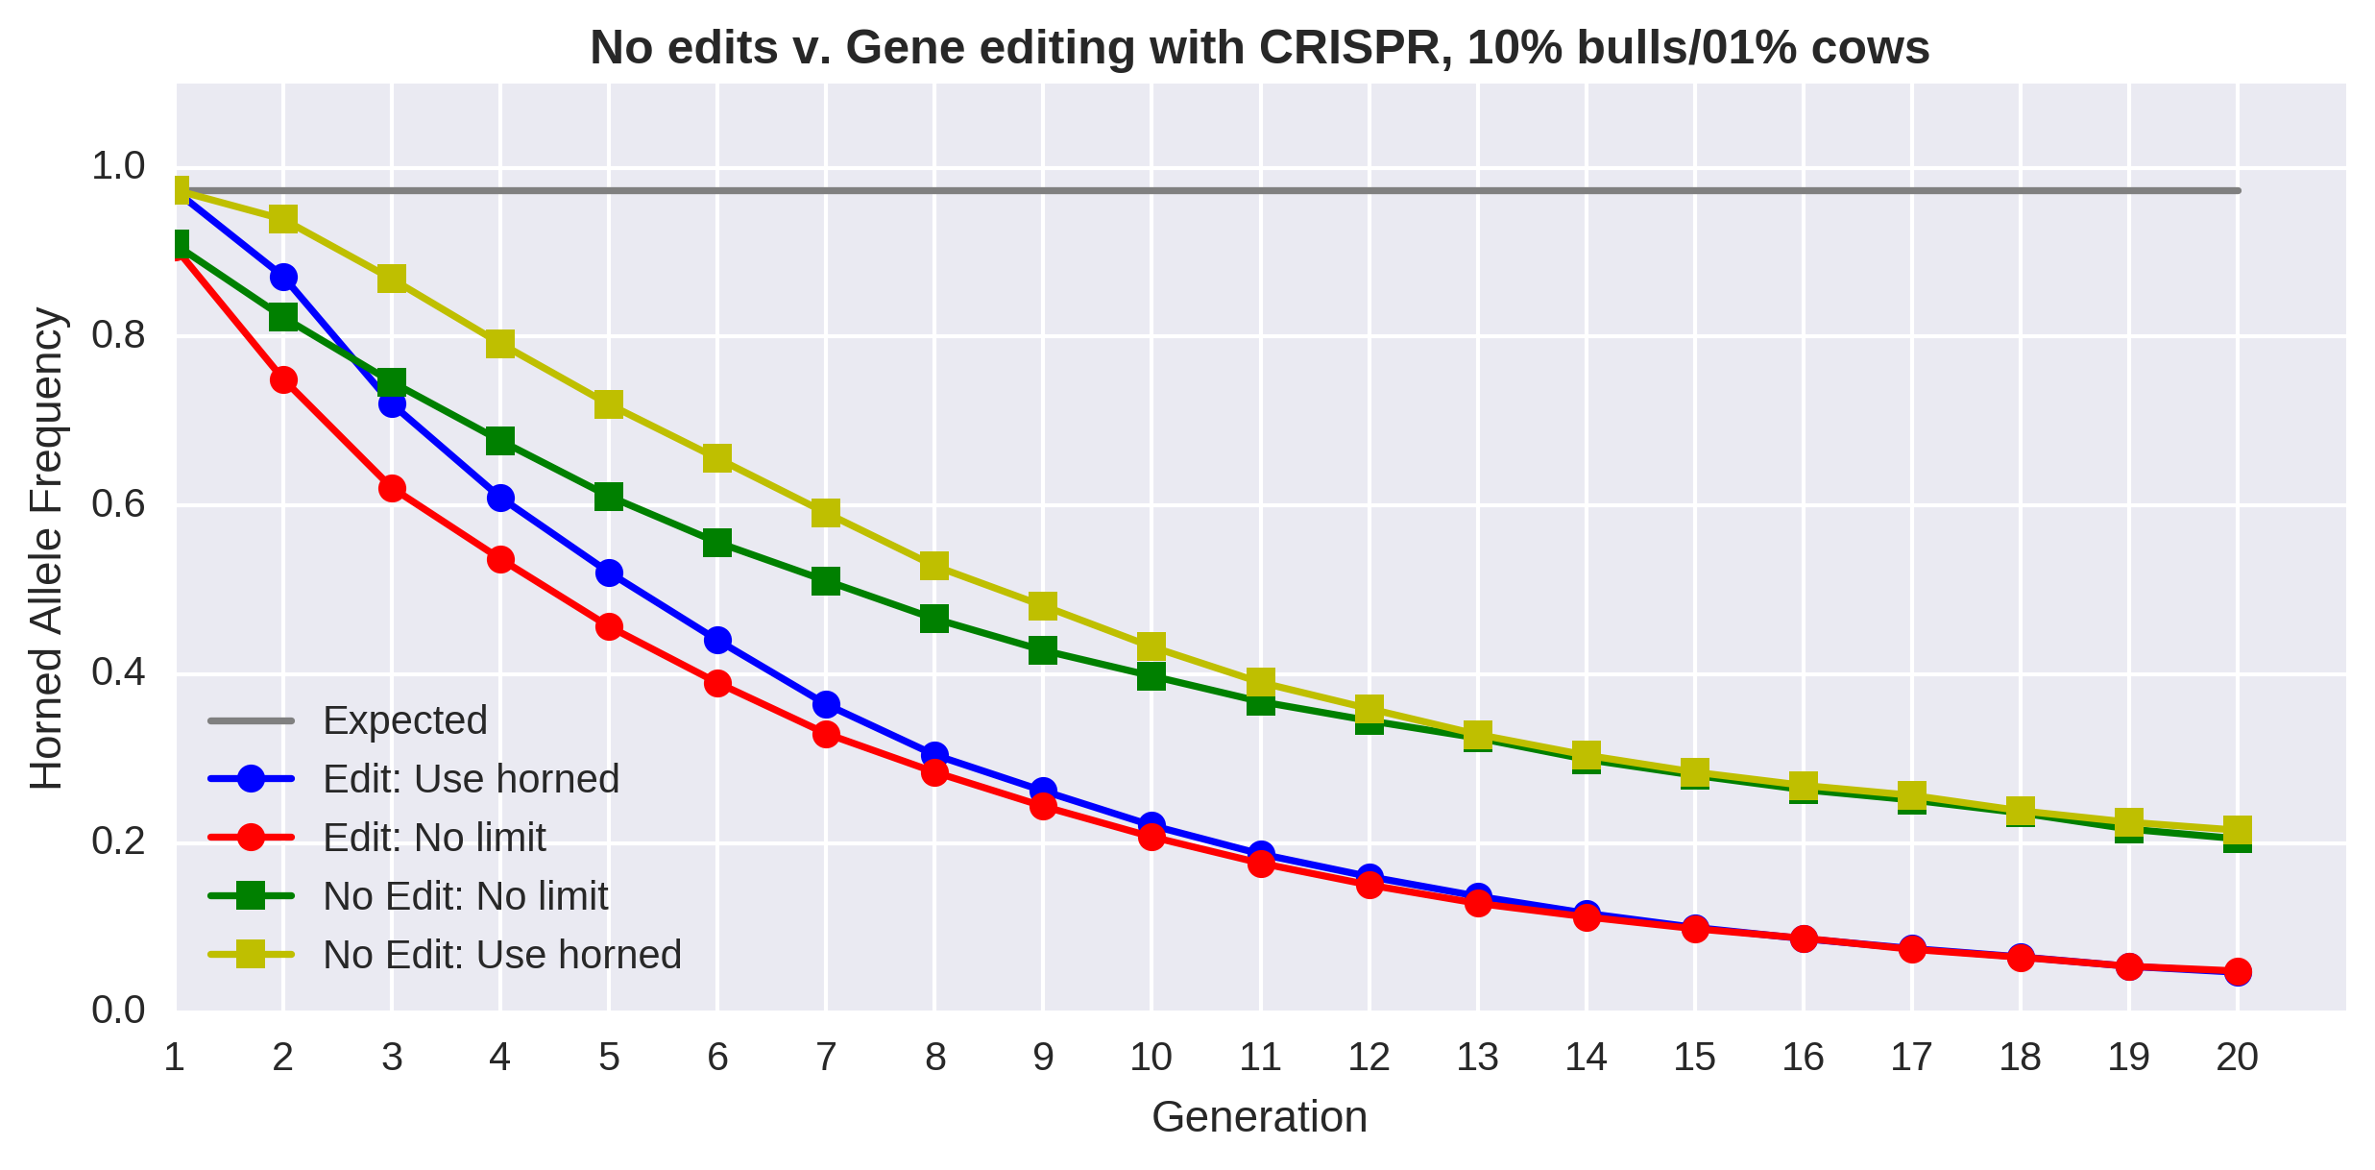
Change is faster with editing and few restrictions

Slide 34
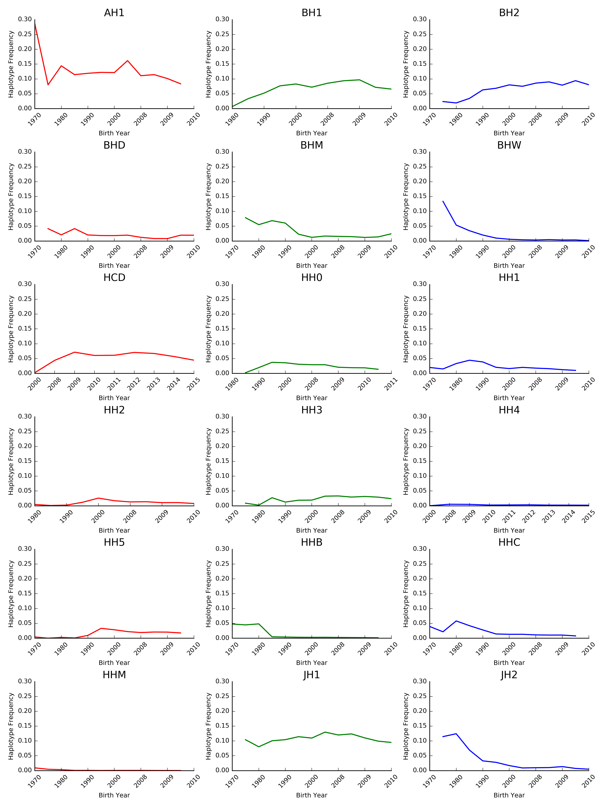
Frequencies change over time
The best way to reduce the frequency of harmful alleles is to avoid matings to carrier bulls!
Source: Cole et al. (2016).
Source: Cole et al. (2016).

Slide 35
What is the best strategy for dealing with recessives?
Remove carrier bulls from the population
Non-carrier bulls are as good as carrier bulls
 | Carriers |  |  |  | Non-carriers
Breed | N | Mean | SD |  | N | Mean | SD | Difference | P value
AY | 16 | 286.43 | 194.67 |  | 53 | 272.41 | 191.69 | 13.02 | 0.407
BS | 30 | 223.10 | 218.39 |  | 59 | 284.19 | 160.36 | -61.09 | 0.087
HO | 550 | 394.08 | 216.77 |  | 1,765 | 479.49 | 213.89 | -85.41 | <0.001
JE | 99 | 340.51 | 149.00 |  | 378 | 338.82 | 153.99 | 1.69 | 0.460
Source: Cole et al. (2016).

Slide 36
Regulatory considerations of gene editing
Some gene-edited products have reached the U.S. marketplace (Ledford, 2015; Waltz, 2016)
Regulatory uncertainty remains a concern (Maxmen, 2017)
Oversight is encouraged based on the product, rather than the tool used (Carroll et al., 2016)
It is unknown if meat and milk from gene-edited animals will be offered for sale in the US
  This regulatory uncertainty is why much current research is focused on large-animals models of human disease

Slide 37
Key findings
Proportion of bulls edited had only a small effect on allele frequencies
Editing elite cows had little effect on allele frequencies
The efficiency of the editing technology is more important than the proportion edited
The more efficient the editing technology used the lower the rate of inbreeding
Progress is faster in early generations when bulls can be used for more matings

Slide 38
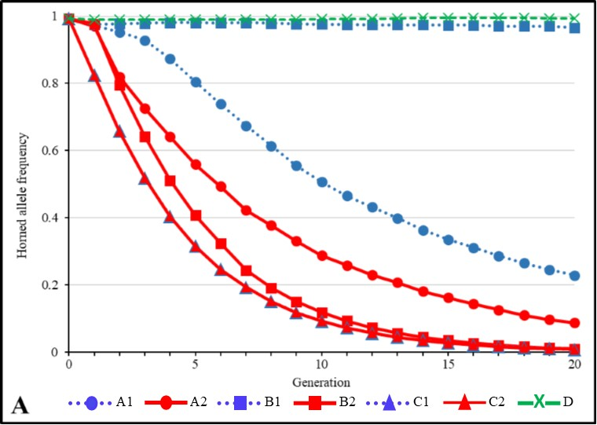
Effects of changing the gene editing model
Most effects were small in the polled scenarios examined
  Allele frequency changes followed previously seen patterns
  Changes in TBV were constant over time
Changes were most notable for
inbreeding because editing
failures no longer result in
death

Slide 39
Conclusions
When animals are edited, fewer embryos die because of lethal recessives
Gene editing is a useful tool for increasing the frequency of the polled locus
It may be more effective to remove carriers from the population than to correct them with gene editing

Slide 40
Acknowledgments and disclaimers
USDA-ARS project 8042-31000-101-00, “Improving Genetic Predictions in Dairy Animals Using Phenotypic and Genomic Information”
USDA is an equal opportunity provider and employer
Mention of trade names or commercial products in this presentation is solely for the purpose of providing specific information and does not imply recommendation or endorsement by USDA

Slide 41
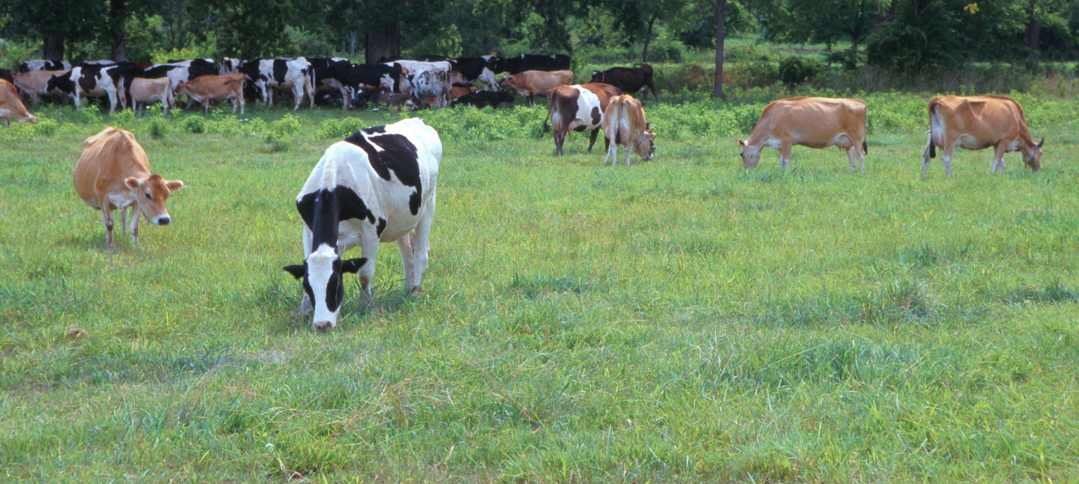
Questions?
AIP web site:
http://aipl.arsusda.gov
Holstein and Jersey crossbreds graze on American Farm Land Trust’s
Cove Mountain Farm in south-central Pennsylvania
Source: ARS Image Gallery, image #K8587-14; photo by Bob Nichols

Slide 42
References
Carroll, D., et al. 2016. Regulate genome-edited products, not genome editing itself. Nat. Biotechnol. 34:477–479.
Cole, J.B. 2015. A simple strategy for managing many recessive disorders in a dairy cattle breeding program. Genet. Sel. Evol. 47:94.
Cole, J.B., et al. 2016. Phenotypic and genetic effects of recessive haplotypes on yield, longevity, and fertility. J. Dairy Sci. doi: http://dx.doi.org/10.3168/jds.2015-10777.
Gaj, T., et al. 2013. ZFN, TALEN, and CRISPR/Cas-based methods for genome engineering. Trends Biotechnol. 31:398–405.
Jenko, J., et al. 2015. Potential of promotion of alleles by genome editing to improve quantitative traits in livestock breeding programs. Genet. Sel. Evol. 47:55. doi:https://doi.org/10.1186/s12711-015-0135-3.

Slide 43
References (cont’d)
Kasinathan, P. et al. 2015. Acceleration of genetic gain in cattle by reduction of generation interval. Scientific Reports 5:8674.
Ledford, H. 2015. Salmon approval heralds rethink of transgenic animals. Nat. News 527:417. doi:10.1038/527417a.
Li, Y., et al. 2006. Optimisation of crossing system using mate selection. Genet. Sel. Evol. 38:147–65.
Li, Y., et al. 2008. Optimal utilization of non-additive quantitative trait locus in animal breeding programs. J. Anim. Breed. Genet. 125:342–50.
Loi, P., et al. 2016. Synergies between assisted reproduction technologies and functional genomics. Genet. Sel. Evol. 48:53. doi:https://doi.org/10.1186/s12711-016-0231-z.
Ma, H., et al. 2017. Correction of a pathogenic gene mutation in human embryos. Nature 548:413-419. doi:10.1038/nature23305.

Slide 44
References (cont’d)
Maxmen, A. 2017. Gene-edited animals face US regulatory crackdown. Nat. News. doi:10.1038/nature.2017.21331.
Pryce, J.E., et al. 2012. Novel strategies to minimize progeny inbreeding while maximizing genetic gain using genomic information. J. Dairy Sci. 95:377–388.
Shepherd, R.K., and B.P. Kinghorn. 2001. Designing algorithms for mate selection when major genes or QTL are important. Proc. Assoc. Advmt. Anim. Breed. Genet. 14:377–80.
Thompson, N.M., et al. 2017. Economic and social considerations of breeding for polled dairy cows versus dehorning. J. Dairy Sci. 100:4941–4952. doi:http://dx.doi.org/10.3168/jds.2016-12099.
Tu, Z., et al. 2015. CRISPR/Cas9: a powerful genetic engineering tool for establishing large animal models of neurodegenerative diseases. Molecular Neurodegeneration 10:35. doi: https://doi.org/10.1186/s13024-015-0031-x.

Slide 45
References (cont’d)
Van Eenennaam A.L., and B.P. Kinghorn. 2014. Use of mate selection software to manage lethal recessive conditions in livestock populations. In: Proceedings of the 10th WCGALP: 17–22 August 2014; Vancouver.
Waltz, E. 2016. Gene-edited CRISPR mushroom escapes US regulation. Nat. News 532:293. doi:10.1038/nature.2016.19754.
Widmar, N.J.O., et al. 2013. Breeding for polled dairy cows versus dehorning: Preliminary cost assessments & discussion. J. Dairy Sci. 96(Suppl. 2):602 (abstr. TH373).

