Slide 1
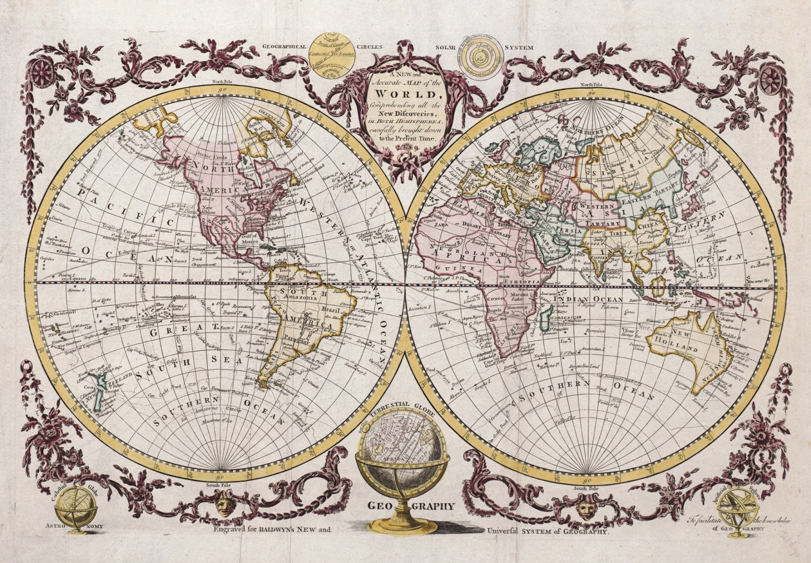
The role of phenotyping in dairy cattle improvement in the genomic era

Slide 2
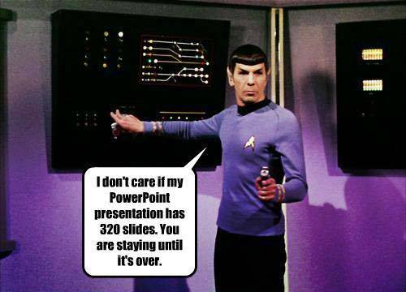
Well, here we are

Slide 3
What is a phenotype?
Any characteristic or property of an animal that we can observe and measure
Early selection probably was based on coat color and pattern
Later, milk and butterfat were used
Now, we measure many things
Notes:
3
3

Slide 4
What do we routinely measure today?
Trait | Heritability (%)
Yield (milk, fat, protein) | 25-40
Productive life | 8.5
Somatic cell score | 12
Daughter pregnancy rate | 4
Heifer conception rate | 1
Cow conception rate | 1.6
Conformation (type) (~18 traits) | 7-54
Sire (direct) calving ease | 8.6
Daughter (maternal) calving ease | 3.6
Sire (direct) stillbirth | 3.0
Daughter (maternal) stillbirth | 6.5

Slide 5
Why do scientists measure things?
Because we can?
“That’s funny...” are the most interesting words in science
To better understand a phenomenon
How does it work?
Is it predictable?
Can we change it?
My advisor told me to do it, and I want to graduate

Slide 6
Why do farmers measure things?
In order to make better decisions
There must be perceived value
Not everyone agrees on value (e.g., animal ID)
There’s a direct financial incentive
e.g., progeny test herds
Because scientists ask them to
There may be narrow limits on what farmers will do out of altruism

Slide 7
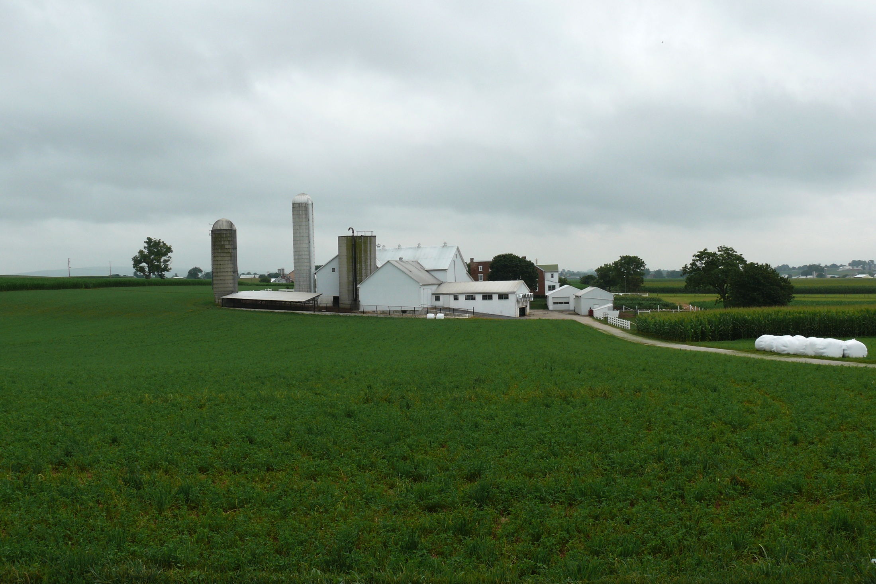
Sources of new phenotypes
Barn: flooring type, bedding materials, density, weather data
Cow: body temperature, activity, rumination time, feed & water intake
Herdsmen/consultants: health events, foot/claw health, veterinary treatments
Parlor: yield, composition, milking speed, conductivity, progesterone, temperature
Silo/bunker: ration composition, nutrient profiles
Pasture: soil type/composition, nutrient composition
http://commons.wikimedia.org/wiki/File:Amish_dairy_farm_3.jpg

Slide 8
What influences a phenotype?
P = G + E
The percentage of total variation attributable to genetics is small.
CA$: 0.07
DPR: 0.04
PL: 0.08
SCS: 0.12
The percentage of total variation attributable to environmental factors is large:
Feeding/nutrition
Housing
Reproductive management
Notes:
8
8

Slide 9
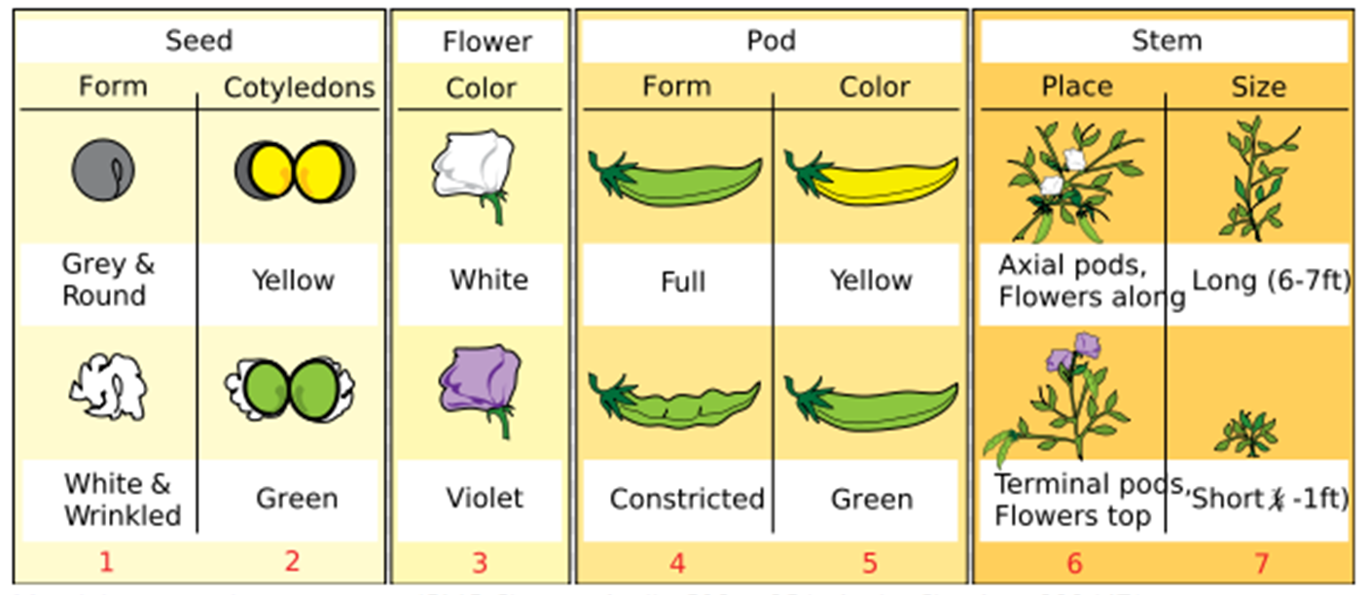
Mendel wanted to understand
Source: https://adapaproject.org/bbk_temp/tiki-index.php?page=Leaf%3A+Who+was+Gregor+Mendel%3F.

Slide 10
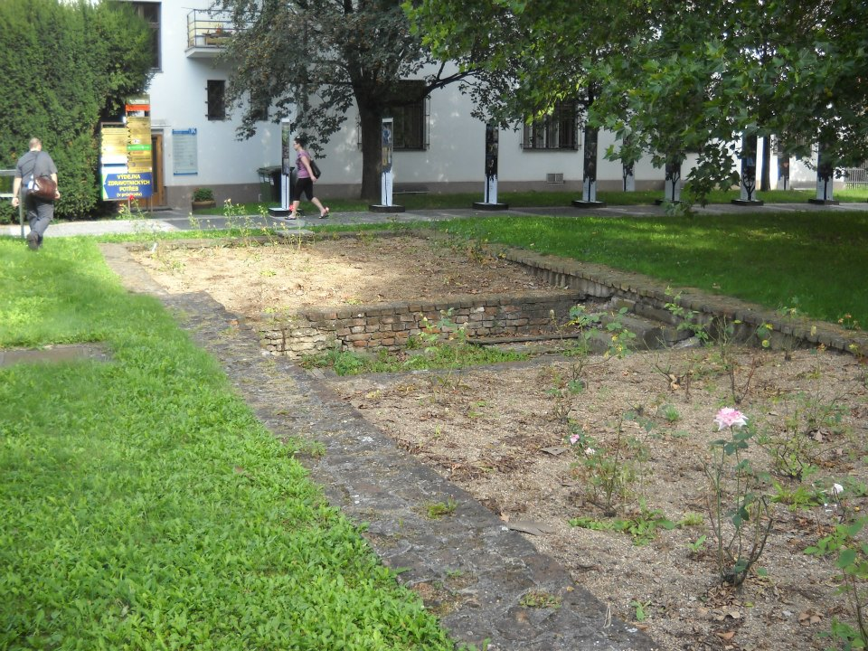

Slide 11
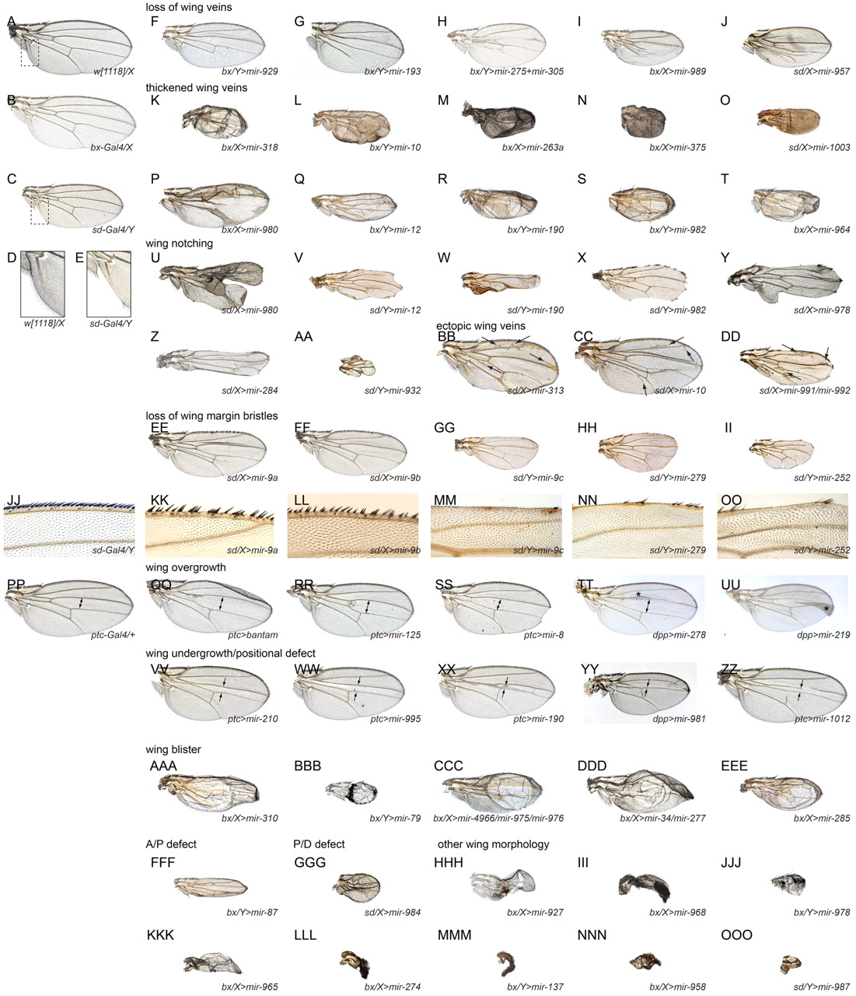
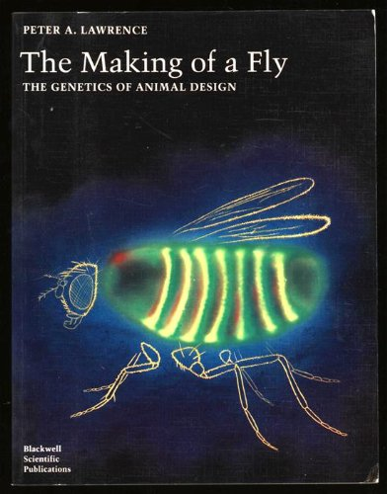
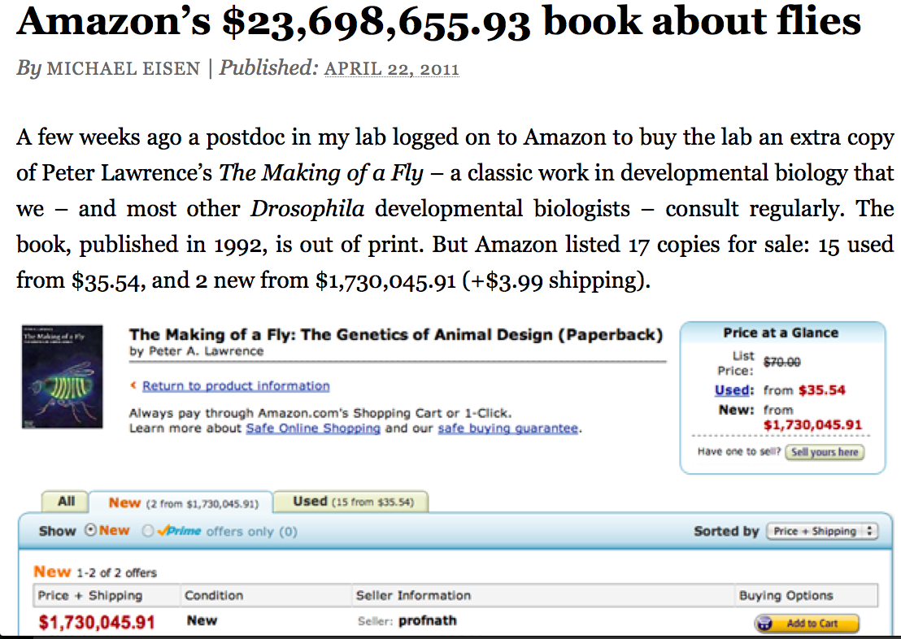
Morgan et al. said “that’s interesting...”
Source: http://dev.biologists.org/content/139/15/2821.

Slide 12
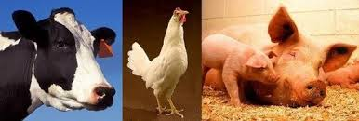
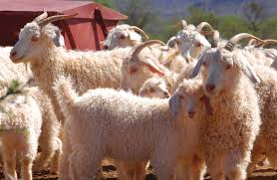
Great diversity in livestock species
There is tremendous phenotypic variation among livestock species
Several contributing mechanisms (Andersson, 2013, doi:10.1016/j.gde.2013.02.014)
Directional selection for adaptive mutations
Directional selection for phenotypic apperance
Natural selection for human environment
Genetic drift
Source: ARS.

Slide 13
Mendelian recessives are not unusual
Name | Chrome | Location (Mbp) | Freq of minor haplotype |  | Gene Name
HH1 | 5 | 63.15 | 1.92 |  | APAF1
HH2 | 1 | 94.8 to 96.6 | 1.66 |  | unknown
HH3 | 8 | 95.41 | 2.95 |  | SMC2
HH4 | 1 | 1.27 | 0.37 |  | GART
HH5 | 9 | 93.2 to 93.3 | 2.22 |  | TFB1M
JH1 | 15 | 15.70 | 12.10 |  | CWC15
JH2 | 26 | 8.81 to 9.41 | 1.3 |  | unknown
BH1 | 7 | 42.8 to 47.0 | 6.67 |  | unknown
BH2 | 19 | 11.1 | 7.78 |  | TUBD1
AH1 | 17 | 65.92 | 13.0 |  | UBE3B
For a complete list, see: http://aipl.arsusda.gov/reference/recessive_haplotypes_ARR-G3.html.

Slide 14
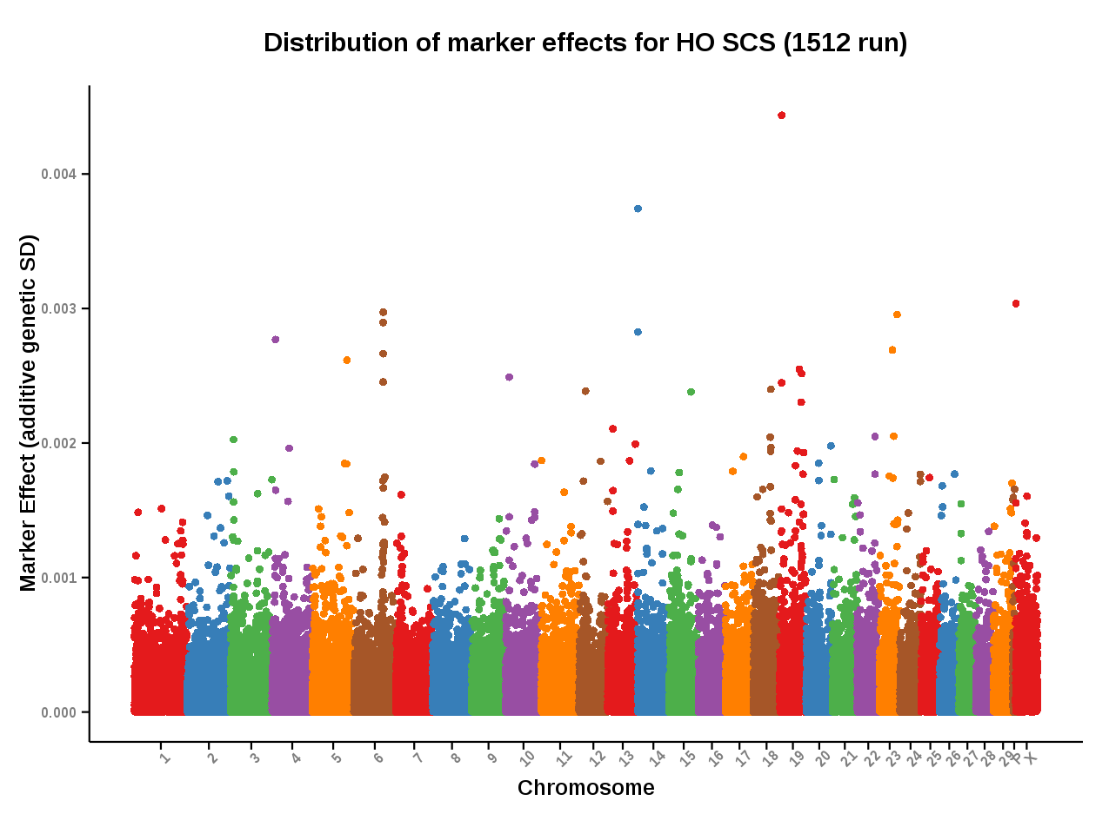
Many genes affect quantitative traits
Source: Council on Dairy Cattle Breeding (https://www.cdcb.us/Report_Data/Marker_Effects/marker_effects.cfm?Breed=HO&Trait=SCS).

Slide 15
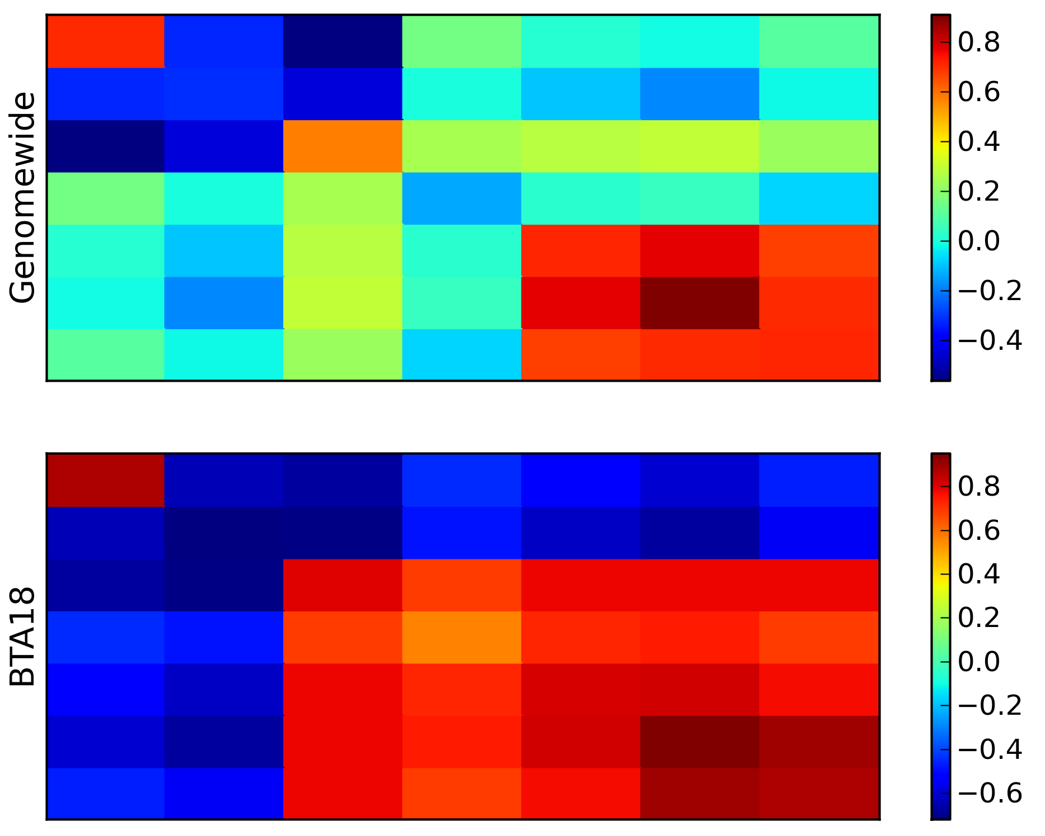
Pleiotropy is not unusual
Source: Cole et al., 2014 (https://asas.org/docs/default-source/wcgalp-proceedings-oral/304_paper_10265_manuscript_1272_0.pdf).

Slide 16
How do we choose what to measure?
Opportunity
The phenotype is easily measured using available labor and materials
Necessity
The measurement is needed to solve a problem
Novelty
Most of us like to work on new problems

Slide 17
How carefully should we measure?
Precise definitions are important (e.g., Seidenspinner et al., 2009)...
...except when they’re not (Waurich et al., 2011)
How many values do discrete scales really need?
Beware false precision on continuous scales!
Remember P = G + E!

Slide 18
Are we talking about the same thing?
What do commonly used terms mean?
“Efficiency”, “health”, “sustainability”, “welfare”
Unlike things may be conflated
“Lameness” versus “locomotion”
Some formats can support general as well as detailed reports
e.g., AGIL Format 6

Slide 19
Context matters
Information often lacking about environments in which phenotypes are expressed
Where? When? How?
Qualitative versus quantitative descriptions
Phenotypes often change over time
Sometimes desirable, sometimes not
Who records the phenotypes?

Slide 20
Selection indices include many traits…
Source: Miglior et al. (2012)

Slide 21
…and we keep adding more
Trait | Relative emphasis on traits in index (%)
 | PD$ 1971 | MFP$ 1976 | CY$ 1984 | NM$ 1994 | NM$ 2000 | NM$ 2003 | NM$ 2006 | NM$ 2010 | NM$ 2014
Milk | 52 | 27 | –2 | 6 | 5 | 0 | 0 | 0 | -1
Fat | 48 | 46 | 45 | 25 | 21 | 22 | 23 | 19 | 22
Protein | … | 27 | 53 | 43 | 36 | 33 | 23 | 16 | 20
PL | … | … | … | 20 | 14 | 11 | 17 | 22 | 19
SCS | … | … | … | –6 | –9 | –9 | –9 | –10 | -7
UDC | … | … | … | … | 7 | 7 | 6 | 7 | 8
FLC | … | … | … | … | 4 | 4 | 3 | 4 | 3
BDC | … | … | … | … | –4 | –3 | –4 | –6 | -5
DPR | … | … | … | … | … | 7 | 9 | 11 | 7
HCR | … | … | … | … | … | … | … | … | 2
CCR | … | … | … | … | … | … | … | … | 1
SCE | … | … | … | … | … | –2 | … | … | …
DCE | … | … | … | … | … | –2 | … | … | …
CA$ | … | … | … | … | … | … | 6 | 5 | 5
Source: AGIL, ARS, USDA (http://aipl.arsusda.gov/reference/nmcalc-2014.htm).

Slide 22
Some recent new dairy phenotypes
Claw health (Van der Linde et al., 2010)
Dairy cow health (Parker Gaddis et al., 2013)
Embryonic development (Cochran et al., 2013)
Immune response (Thompson-Crispi et al., 2013)
Methane production (de Haas et al., 2011)
Milk fatty acids (Soyeurt et al., 2011)
Persistency of lactation (Cole et al., 2009)
Rectal temperature (Dikmen et al., 2013)
Residual feed intake (Connor et al., 2013)

Slide 23
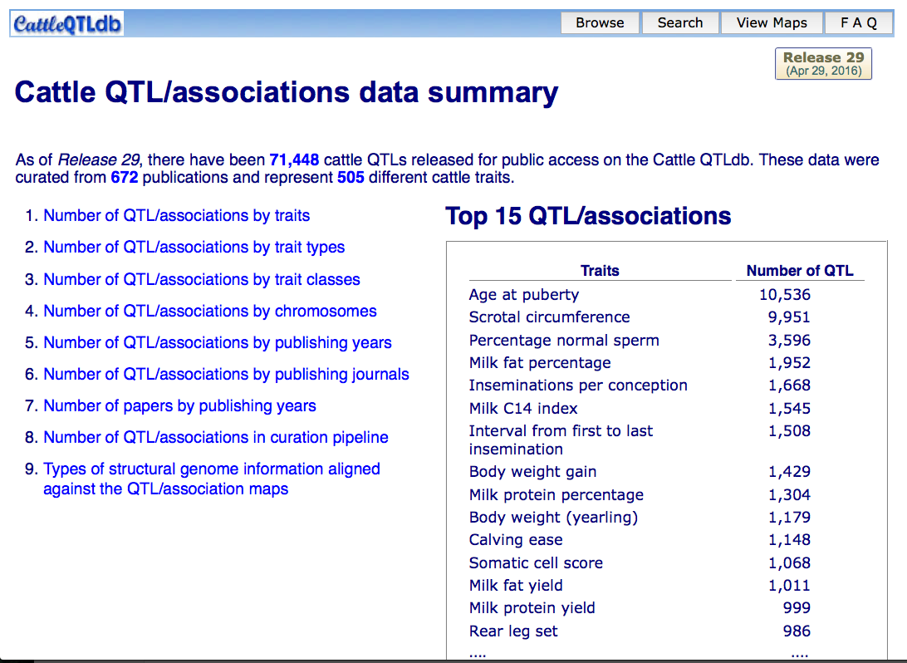
When is enough enough?
505
phenotypes!
Source: CattleQTLdb: http://www.animalgenome.org/cgi-bin/QTLdb/BT/summary.

Slide 24
Digression – How many QTL, did you say?
If there really are 1,148 calving ease QTL, then:
What really *is* a QTL?
Is Bayes B actually so objectionable after all?
What should we really be selecting for?

Slide 25
Making sense of 505 cattle traits
Ontologies organize traits by their meaning and relationship(s) to one another
Hughes et al. (2008) reported on the Animal Trait Ontology project
The Livestock Product Trait Ontology includes 473 terms
Who uses these structures?
Should ontology IDs be used to identify phenotypes in manuscripts?

Slide 26
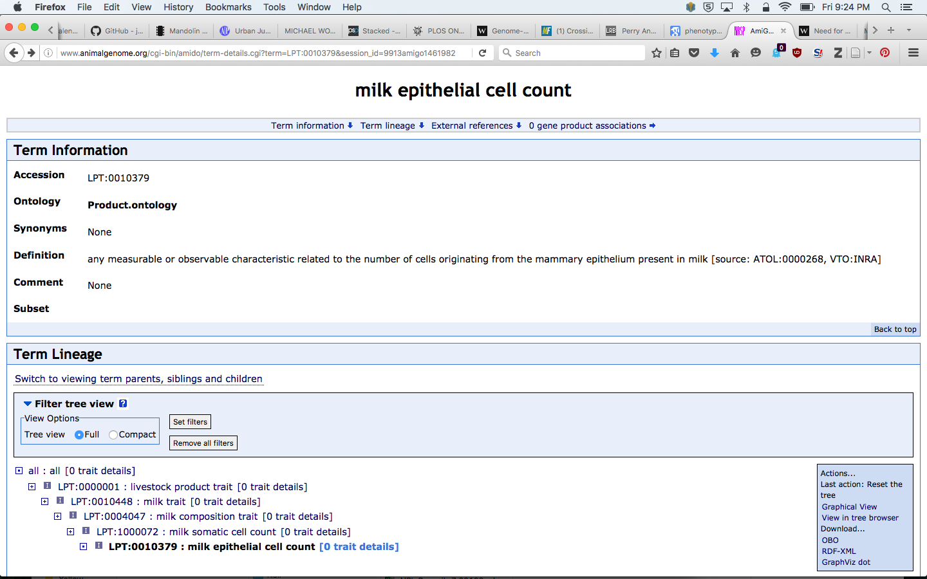
Example ontology: milk SCC
Source: Livestock Production Trait Ontology (http://www.animalgenome.org/cgi-bin/amido/term-details.cgi?term=LPT:0010379&session_id=9913amigo1461982176).

Slide 27
Who gets to define phenotypes?
Anyone willing to take the time?
Just because you define it does not mean people will use it
International standards bodies
ICAR Working Group on Functional Traits
Are we comfortable with proprietary phenotypes?
Does it matter?

Slide 28
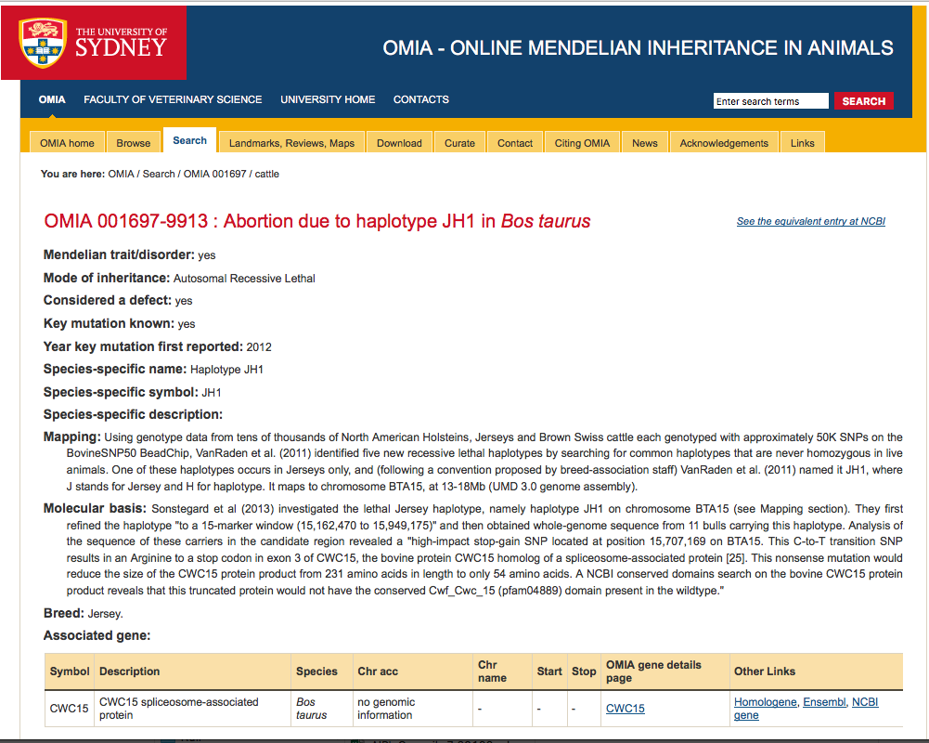
Formal definitions exist for recessives
Source: OMIA 001697-9913 : Abortion due to haplotype JH1 in Bos taurus (http://omia.angis.org.au/OMIA1697/9913/).

Slide 29
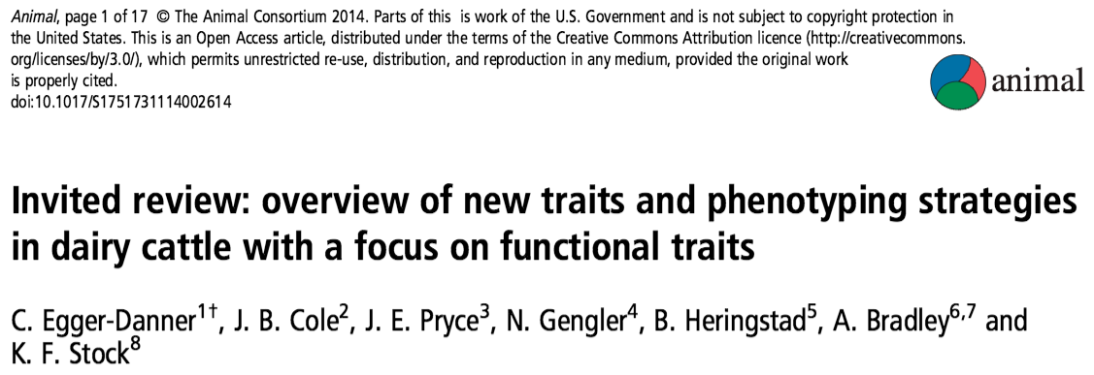
Why do we need new traits?
Changes in production economics
Technology produces new phenotypes
Better understanding of biology
Recent review by Egger-Danner et al.
This is a fancy way of saying that selection objectives change!

Slide 30
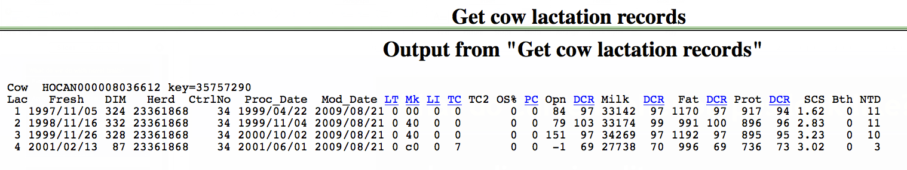
What do current phenotypes look like?
Low-dimensionality
Usually few observations per lactation
Close correspondence of phenotypes with values measured
Easy transmission and storage
Notes:
30
30

Slide 31
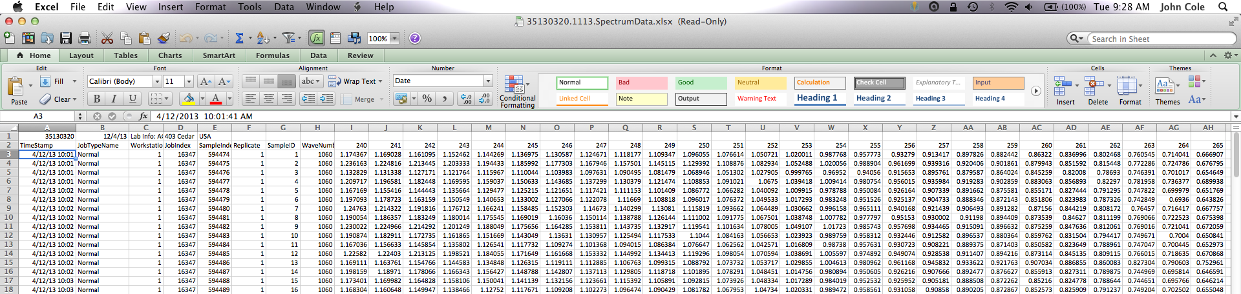
What do new phenotypes look like?
High dimensionality
Ex.: MIR produces 1,060 points/obs.
Disconnect between phenotype and measurement
More resources needed for transmission, storage, and analysis

Slide 32
New traits should add information
Novel phenotypes
include some
new information
Novel phenotypes
contain little
new information
high
Phenotypic correlation
with existing traits
Novel phenotypes
include much
new information
Novel phenotypes
contain some
new information
low
low
high
Genetic correlation with
existing traits

Slide 33
New traits should have value
high
(milk yield)
(feed intake)
Value of phenotype
(greenhouse gas emissions)
low
(conformation)
low
high
Cost of measurement

Slide 34
Does “P” matter in the genomics era?
An animal’s genotype is good for all traits
Traditional evaluations are required for accurate estimates of SNP effects…
…but evaluations are not currently available for many new traits, e.g., feed efficiency
Research populations could provide data for traits that are expensive to measure
Will resulting evaluations work in target population?

Slide 35
Genotypes are abundant

Slide 36
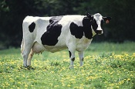
What’s a SNP genotype worth?
Pedigree is equivalent to information on about 7 daughters
For the protein yield (h²=0.30), the SNP genotype provides information equivalent to an additional 34 daughters
Notes:
36

Slide 37

What’s a SNP genotype worth?
And for daughter pregnancy rate (h²=0.04), SNP = 131 daughters
Notes:
37

Slide 38
We can construct P from G
Predict from correlated traits or phenotypes from reference herds
Causal variants can be used in place of markers
Haplotypes can be used when causal variants are not known
Specific combining abilities can combine additive and dominance effects (e.g., Sun et al., 2014)

Slide 39
What do we do with new traits?
Put them into a selection index
Correlated traits are helpful
Apply selection for a long time
There are no shortcuts
Collect many phenotypes
Repeated records of limited value
Genomics can increase accuracy
Weigh cost versus benefit

Slide 40
What challenges are on the horizon?
We need more frequent sampling for modern management
Samples do not need to be evenly spaced across the lactation
Some large farms do not see a value proposition in milk recording
On-farm data are growing, but not collected in a central database
Notes:
40
40

Slide 41
Has our DHI system fallen behind?
Research is being done on new traits
Often not turned into new products
It’s a collective action problem
Disagreement on objectives
Lack of commercial incentives
Infrastructure is not in place
This provides an opportunity for new players to enter the market

Slide 42
How do new players fit into the system?
How do we deal with data collected outside of the DHI system?
QC guidelines
Standards for data analysis
Is lack of independent validation a problem?
How do we combine data from old and new data providers?
Unified national evaluations?

Slide 43
No guarantees with new technologies
New technologies often require considerable capital investment
They sometimes fail to work or do not deliver the promised gain
Data are most useful when combined with observations from many farms
This inevitably involves risk

Slide 44
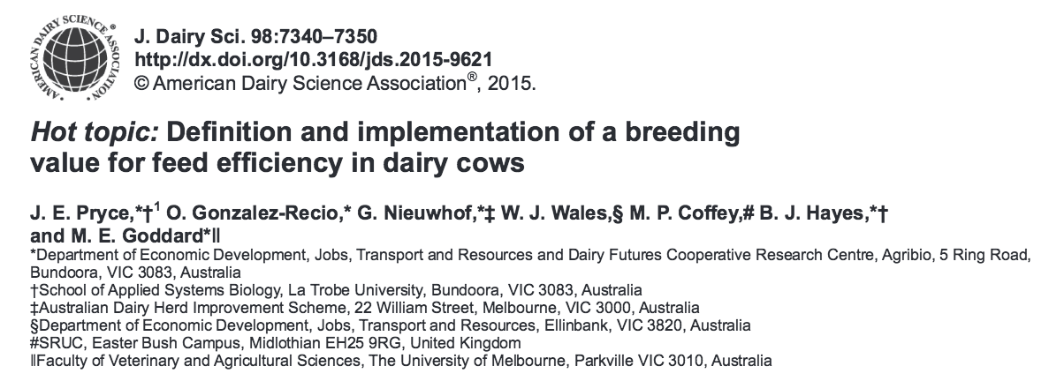
Collaboration is essential
When new traits are expensive, it takes a consortium to collect the data needed for genetic evaluation.
Notes:
44
44

Slide 45
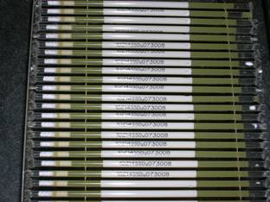
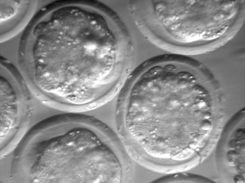
Preservation of unique resources
Many unique resources have been lost (e.g., selection experiments)
We need to preserve phenotypes as well as genotypes
Whose job is this?
Perhaps ARS’s National Center for Genetic Resources Preservation?
Source: http://vet.tufts.edu/tas/images/002.png.

Slide 46
Conclusions
Phenotypes are the foundation of genetic improvement programs
Modern tools produce lots of data
Those data can be used to improve herd management and profitability
We need to rise to the challenge of turning new data into decisions

Slide 47
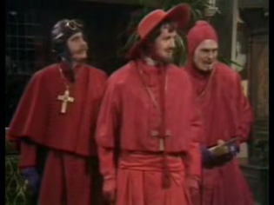
Questions?

