Slide 1
Methods to compute reliabilities for genomic predictions of feed intake
Paul VanRaden, Jana Hutchison, Bingjie Li, Erin Connor, and John Cole
USDA, Agricultural Research Service, Animal Genomics and Improvement Laboratory, Beltsville, MD, USA
paul.vanraden@ars.usda.gov

Slide 2
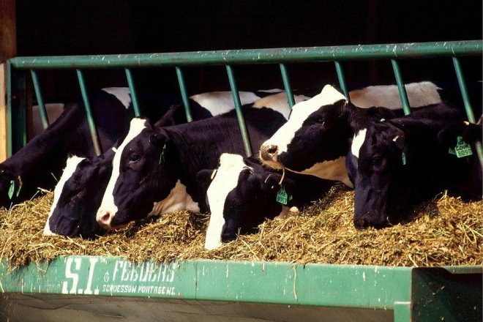
Feed intake topics
Residual feed intake (RFI) from US data
Genomic predictions for RFI
  National RFI genomic evaluation using 60k genotypes
  Research cow RFI plus ancestors using 60k and HD genotypes
Genomic reliability estimates
  SCS as a 2nd trait with similar properties as RFI
  5-way cross-validation for RFI using multi-step GBLUP
  Single-step GBLUP with exact inversion of RFI equations

Slide 3
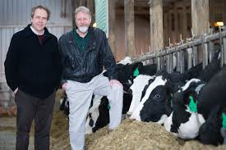
Feed intake data
Research herd | Cows | Records | Researchers
Univ. of Wisconsin and US Dairy Forage Res. Ctr. | 1,390 | 1,678 | Weigel, Armentano
Iowa State Univ. | 953 | 1,006 | Spurlock
ARS, USDA (Beltsville, MD) | 534 | 834 | Connor
Univ. of Florida | 491 | 582 | Staples
Michigan State Univ. | 273 | 315 | VandeHaar, Tempelman
Purina Anim. Nutr. Ctr. (MO) | 151 | 184 | Davidson
Virginia Tech | 93 | 93 | Hanigan
Miner Agric. Res. Inst. (NY) | 58 | 58 | Dann
All | 3,965 | 4,823 | $5 million AFRI grant

Slide 4

Genotypes of research cows
Chip densities (number of markers) used
  502 high density (777K)
  1341 GHD or GH2 (77K or 140K)
  1251 50K or ZMD (50K)
  411 low density (7K to 20K)
Imputed to 60,671 SNP subset used officially
Imputed to HD genotypes (312,614 SNPs)

Slide 5
Genomic evaluation for RFI
RFI from research cows already adjusted for phenotypic correlations of feed intake with milk net energy, metabolic body weight, and weight change
Genetic evaluation model:
RFI = breeding value + permanent environment + age-parity + b₂(GPTA_{milk net energy}) + b₃(GPTA_{BW composite})
Remove remaining genetic correlations → RFI as a genetically independent trait from milk net energy and BW composition

Slide 6
Genomic evaluation for RFI cont.
National RFI genomic evaluation with 60k genotypes
  Genetic evaluation included 60 million nongenotyped Holsteins
  Genomic evaluation included 1.4 million genotyped Holsteins with 60,671 genotypes
Genomic prediction for RFI with 60k and HD genotypes by single-step GBLUP (Misztal et al., 2009)
  Genomic prediction included 5,610 genotyped Holsteins with 60k genotypes and HD (312,614 SNPs) genotypes among 42,057 Holsteins in pedigree

Slide 7
Estimation of genomic reliability
SCS as a 2nd trait with similar properties as RFI
  Correlation of genomic predictions from research cow data (GEBV_{r}) vs. national data (GEBV_{n}) for SCS
  Observed REL = corr(GEBV_{r} , GEBV_{n})² * national REL
5-way cross-validation for RFI
  Use RFI records of 80% of cows to predict RFI records of remaining 20%, excluding cows from the validation data if they had daughters in the reference data
  Observed REL = corr(GEBV_{r} , RFI)² / heritability
Choose discount to match computed to observed REL

Slide 8
Estimation of genomic reliability cont.
Single-step GBLUP (ssGBLUP)
  EBV and its SE calculated from the inverse of ssGBLUP mixed model equations
  Observed REL = Var(EBV)/ð_{a}² , where genetic variance (ð_{a}²) for RFI was from variance component estimation for RFI
  Prediction error variance for each animal: PEV = SE^2
  Theoretical REL for each animal = (G – PEV)/G, where G is the genetic variance for each animal: (1 + inbreeding)*ð_{a}²

Slide 9
Computed vs. actual GREL for SCS
Expected genomic reliability of young animals was 19% for both RFI and SCS using standard discount of 0.7
SCS GPTA correlated by only 0.39 for national vs. research-cow reference data
Observed REL of SCS was (0.39)² × 72% = 11%
Genomic REL was discounted by a factor of 0.3 to agree with Var(PTA) for RFI and observed REL of SCS

Slide 10

5-way cross-validation
Trait | Reliability | Reliability
 | method | Pedigree | Genomic | Difference
RFI | Observed | 13.4 | 18.1 | +4.7
 | Expected¹ | 14.0 | 21.2 | +7.2
SCS | Observed | 17.6 | 23.0 | +5.4
 | Expected¹ | 16.4 | 24.7 | +8.3
¹Expected REL calculated from parent average for cows not in the reference,
or from genomic REL calculated using a discount factor of 0.3.

Slide 11
RFI reliability 60K and HD¹
 | National |  | ssGBLUP
 | Ped | 60k | Ped | 60k | HD
SD (EBV) | 0.25 | 0.28 | 0.26 | 0.32 | 0.31
Var(EBV) / Var(True BV) | 0.15 | 0.19 | 0.16 | 0.24 | 0.23
Mean of theoretical REL | 0.24 | 0.31 | 0.26 | 0.31 | 0.31
¹Results based on 5,597 genotyped animals;
National RFI evaluation using multi-step method;
Single-step method using 60k, HD, or no genotypes.

Slide 12
Multi- vs. Single-Step GBLUP¹
Correlations | Pedigree² | Genomic (60k)
EBV (multi- vs. single-step) | 0.997 | 0.939
REL (multi- vs. single-step) | 0.989 | 0.916
¹Results based on 5,981 animals with 60k genotypes;
Multi-step analysis was from national RFI evaluation;
Single-step analysis was from research cows plus ancestors.
²Very little difference in pedigree predictions came from the
slightly different PTA(milk energy) and PTA(BW composite)
values used between multi- and single-step analyses

Slide 13
EBV and REL correlations within method¹
Correlations | GBLUP | Corr (EBV) | Corr (REL)
Pedigree vs. 60k | MS | 0.885 | 0.925
Pedigree vs. 60k | SS | 0.785 | 0.983
Pedigree vs. HD | SS | 0.794 | 0.983
60k vs. HD | SS | 0.985 | 0.999
¹Results based on 5,597 genotyped animals;
Analyses were from multi-step (MS) or single-step (SS) GBLUP.

Slide 14
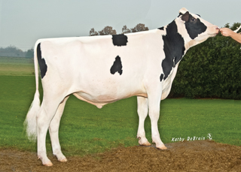
RFI reliability by animal group
Animal group from national data | RFI Reliability (%)
 | Pedigree | Genomic¹
3,965 cows with RFI phenotypes | 30 | 34
Top 10 sires with most RFI daughters | 78 | 85
Top 100 Net Merit progeny tested sires | 8 | 16
Top 100 Net Merit young bulls | 3 | 12
1.5 million genotyped Holsteins | 5 | 13
60 million non-genotyped Holsteins | 3 | 3
¹Computed with discount factor of 0.3

Slide 15
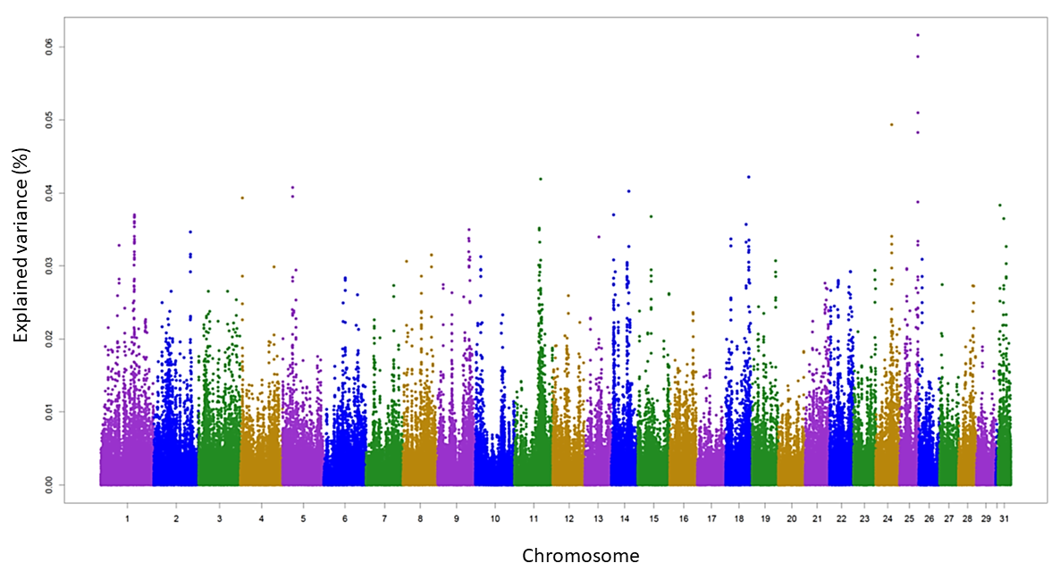
GWAS for RFI using HD genotypes
SNP variance explained by 5-SNP window (avg window size 38kbp)
Highly polygenic trait, each SNP window explains little variance

Slide 16
Conclusions
RFI is a highly polygenic trait
Genomic prediction (single- or multi-step) helps to increase REL for RFI compared with pedigree prediction
Using HD or 60k genotypes had similar EBV (correlation = 0.985) and prediction reliability for RFI
Higher REL will require more research herds or international cooperation

Slide 17
Acknowledgments
Agriculture and Food Research Initiative Competitive Grant #2011-68004-30340 from USDA National Institute of Food and Agriculture (feed intake funding)
USDA-ARS project 1265-31000-101-00, “Improving Genetic Predictions in Dairy Animals Using Phenotypic and Genomic Information” (AGIL funding)
Council on Dairy Cattle Breeding and dairy industry contributors for pedigree and genomic data
Ignacy Misztal and Heather Bradford for ssGBLUP code and software support

Slide 18
RFI reliability using ssGBLUP¹
 | Pedigree | Genomic_60K | Genomic_HD
SD (EBV) | 0.262 | 0.316 | 0.312
Var (EBV) / Var (BV) | 0.162 | 0.236 | 0.230
Mean of theoretical REL | 0.258 | 0.307 | 0.312
¹Results based on 5,597 genotyped animals;
Both 60k and HD analyses were from single-step method.

Slide 19
Variance estimates for RFI (and SCS)
Parameter | RFI | SCS
Heritability (%) | 14 | 16
Repeatability (%) | 24 | 35
Phenotypic correlation with yield | 0.00 | –0.10
Genetic correlation with yield | 0.00 | –0.03
SCS provided a 2nd trait with similar properties, which allowed genomic predictions from research cows to be compared with national SCS predictions

