Slide 1
Managing many recessive disorders in a dairy cattle breeding program using gene editing
John B. Cole
Animal Genomics and Improvement Laboratory
Agricultural Research Service, USDA
Beltsville, MD 20705-2350

Slide 2
Introduction
High-density SNP genotypes have been used to identify many new recessives that affect fertility in dairy cattle, as well as to track conditions such as polled (Cole et al., 2016).
Sequential mate allocation accounting for increases in genomic inbreeding and the economic impact of affected matings results in faster allele frequency changes than other approaches (Cole, 2015).
Effects of gene editing on selection programs should be considered because it may dramatically change rates of allele frequency change.

Slide 3
Estimated cost of genetic load
Cole et al. (2016) estimated losses of at least $10,743,308 due to known recessives.
Average losses were $5.77, $3.65, $0.94, and $2.96 in Ayrshire, Brown Swiss, Holstein, and Jersey, respectively.
This is the economic impact of genetic load as it affects fertility and perinatal mortality.
Actual losses are likely to be higher.

Slide 4
Selection using marker information
Shepherd and Kinghorn (2001) described a look-ahead mate selection scheme using markers.
Li et al. (2006, 2008) argued that QTL genotypes provide more benefit when used in mate selection rather than in index selection.
Van Eenennaam and Kinghorn (2014) proposed selection against the total number of lethal alleles and recessive lethal genotypes.
Cole (2015) suggested that parent averages can be adjusted to account for genetic load in sequential mate allocation schemes.

Slide 5
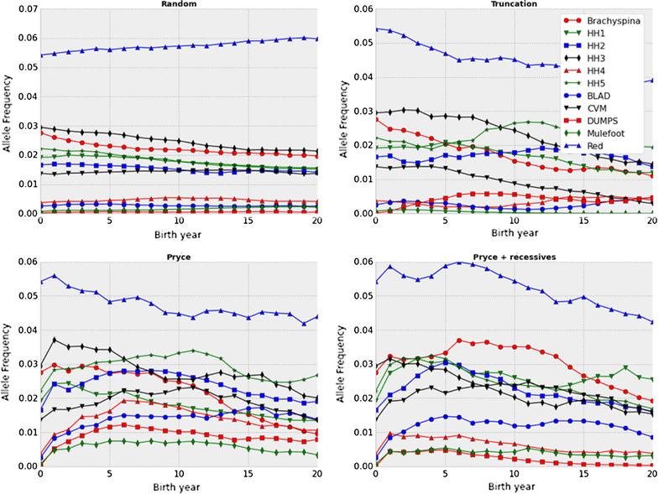
Selection may not be fast enough!
Source: Cole (2015).

Slide 6
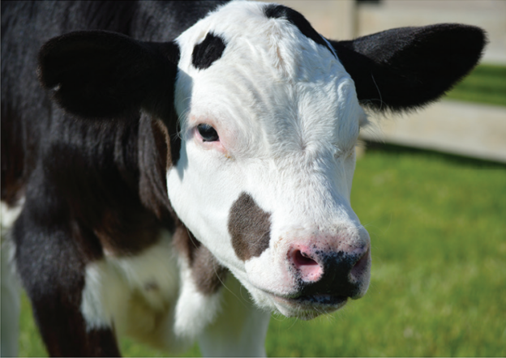
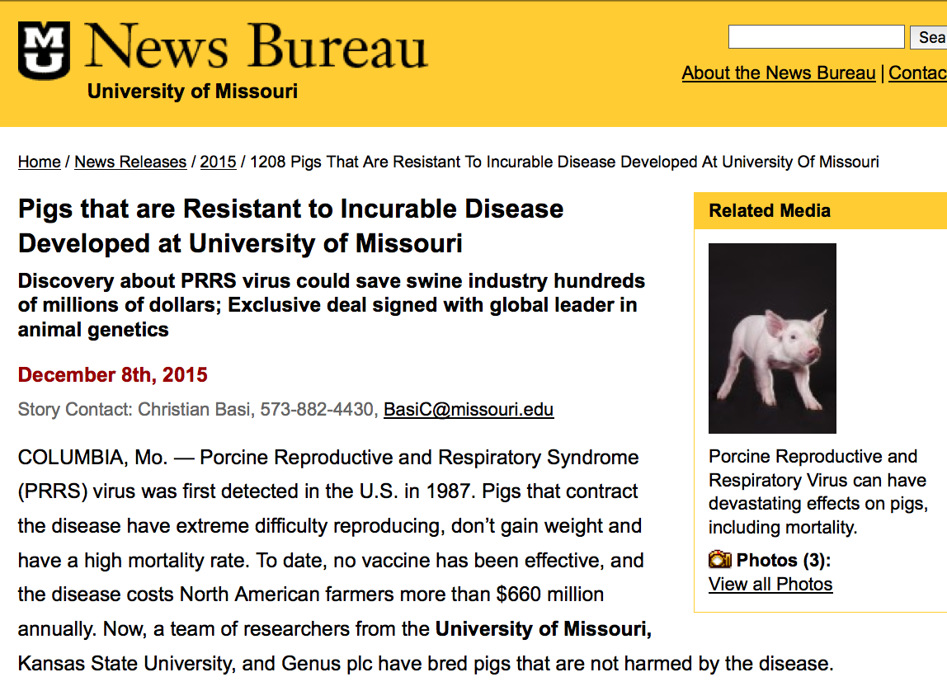
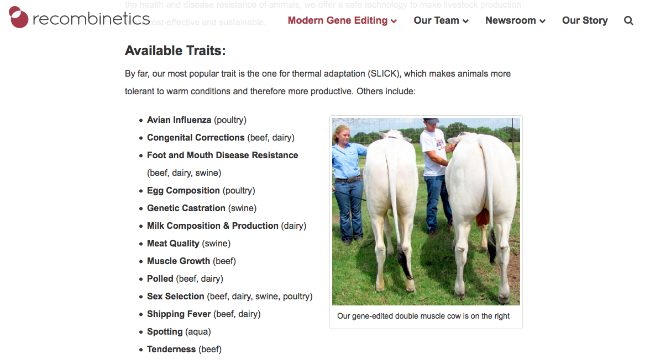
Gene editing in livestock

Slide 7
Objective
Determine rates of allele frequency change and quantify differences in cumulative genetic gain for several genome editing technologies while considering varying numbers of recessives and different proportions of bulls and cows to be edited.

Slide 8
Recessives in US Holsteins
Haplo | Functional/gene name | Haplotype frequency (%) | Chrome | Location (bp) | Timing
HCD | Cholesterol deficiency/APOB | 2.5 | 11 | 77,953,380 – 78,040,118 | W
HH0 | Brachyspina/FANCI | 2.76 | 21 | 21,184,869 – 21,188,198 | E, B
HH1 | APAF1 | 1.92 | 5 | 63,150,400 | E
HH2 | — | 1.66 | 1 | 94,860,836 – 96,553,339 | E
HH3 | SMC2 | 2.95 | 8 | 95,410,507 | E
HH4 | GART | 0.37 | 1 | 1,277,227 | E
HH5 | TFB1M | 2.22 | 9 | 92,350,052 – 93,910,957 | E
HHB | BLAD/ITGB2 | 0.25 | 1 | 145,119,004 | W
HHC | CVM/SLC35A3 | 1.37 | 3 | 43,412,427 | E, B
HHM¹⁰ | Mulefoot/LRP4 | 0.07 | 15 | 77,663,790 – 77,701,209 | B
Source: Cole et al. (2016).

Slide 9
Sequential mate allocation

Slide 10
Gene editing algorithm
Gene editing occurs when an embryo is created:
  For each recessive edited:
    A uniform random variate is drawn and checked for success
    Failure means that the genotype was not changed
  A uniform random variate is drawn to determine if the edited embryo produces a live birth
A scenario in which many embryos are produced to guarantee that some survive is simulated by setting the embryonic death rate to 0.
The editing failure rate can be set to 0 to represent a scenario in which only successfully edited embryos are transferred to recipients.

Slide 11
Properties of gene editing strategies
Technology¹ | Editing failure rate | Embryonic death rate | Probability of success²
CRISPR | 0.37 | 0.79 | 0.71
TALEN | 0.79 | 0.88 | 0.30
Perfect | 0.00 | 0.00 | 1.00
ZFN | 0.89 | 0.92 | 0.18
¹CRISPR = clustered regularly interspaced short palindromic repeats, TALEN = transcription activator-like effector nuclease, Perfect = hypothetical technology with a perfect success rate, ZFN = zinc finger nuclease.
²Calculated as 1 – (editing failure rate * embryonic death rate).

Slide 12
Recessives by scenario
Scenario¹ | N² | Frequency | Value ($)³ | Name | Lethal
All recessive loci | 12 | 0.0276 | 150 | Brachyspina | Yes
 |  | 0.0192 | 40 | HH1 | Yes
 |  | 0.0166 | 40 | HH2 | Yes
 |  | 0.0295 | 40 | HH3 | Yes
 |  | 0.0037 | 40 | HH4 | Yes
 |  | 0.0222 | 40 | HH5 | Yes
 |  | 0.0025 | 150 | BLAD | Yes
 |  | 0.0137 | 70 | CVM | Yes
 |  | 0.0001 | 40 | DUMPS | Yes
 |  | 0.0007 | 150 | Mulefoot | Yes
 |  | 0.9929 | 40 | Horned | No
 |  | 0.0542 | -20 | Red coat color | No
Horned locus | 1 | 0.9929 | 40 | Horned | No
¹Specific scenario simulated for each trait or group of traits.
²Number of recessive loci in the scenario.
³Positive values are undesirable and negative values are desirable.

Slide 13
Recessives by scenario
Recessives (all recessive loci, horned) | Proportion of bulls edited (0%, 1%, 5%, 10%) | Proportion of dams edited (0%, 1%) | Editing technology (CRISPR, TALEN, Perfect, ZFN)

Slide 14
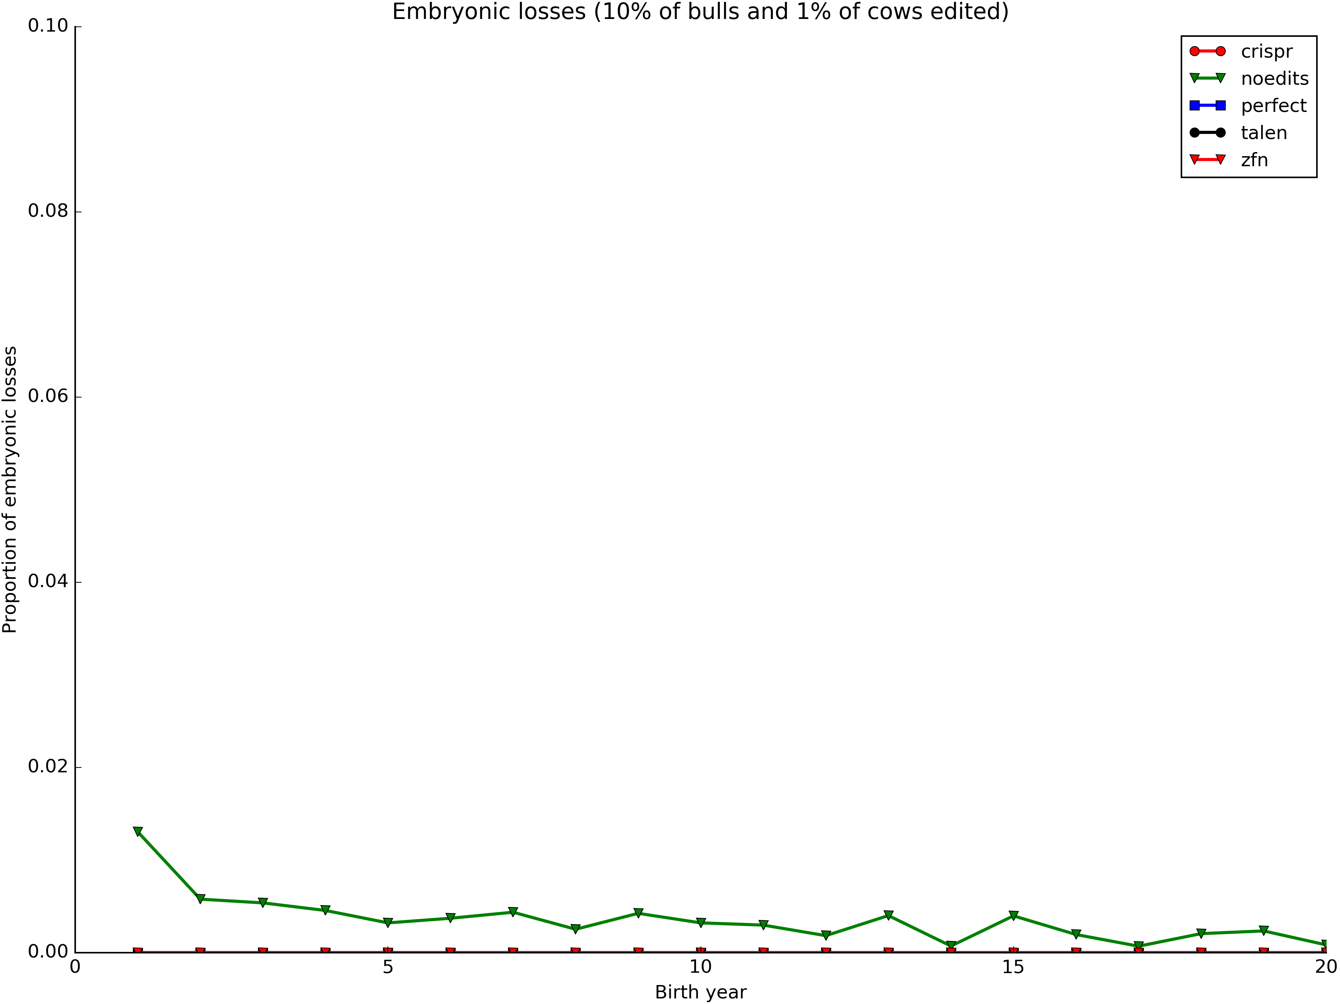
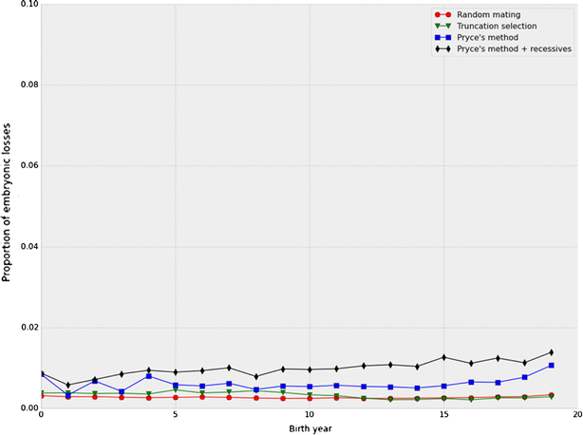
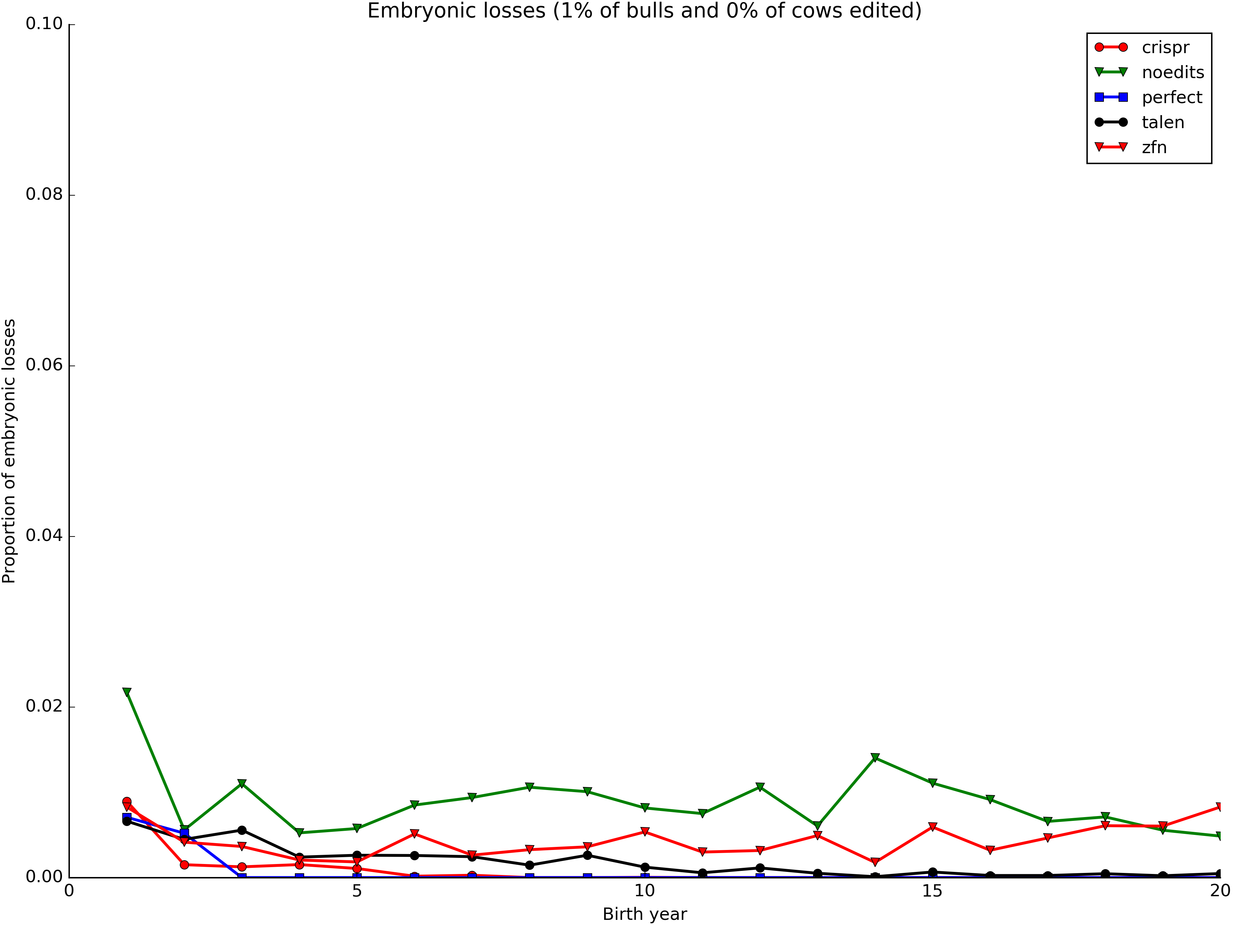
Embryonic deaths by generation

Slide 16
Horned

Slide 17
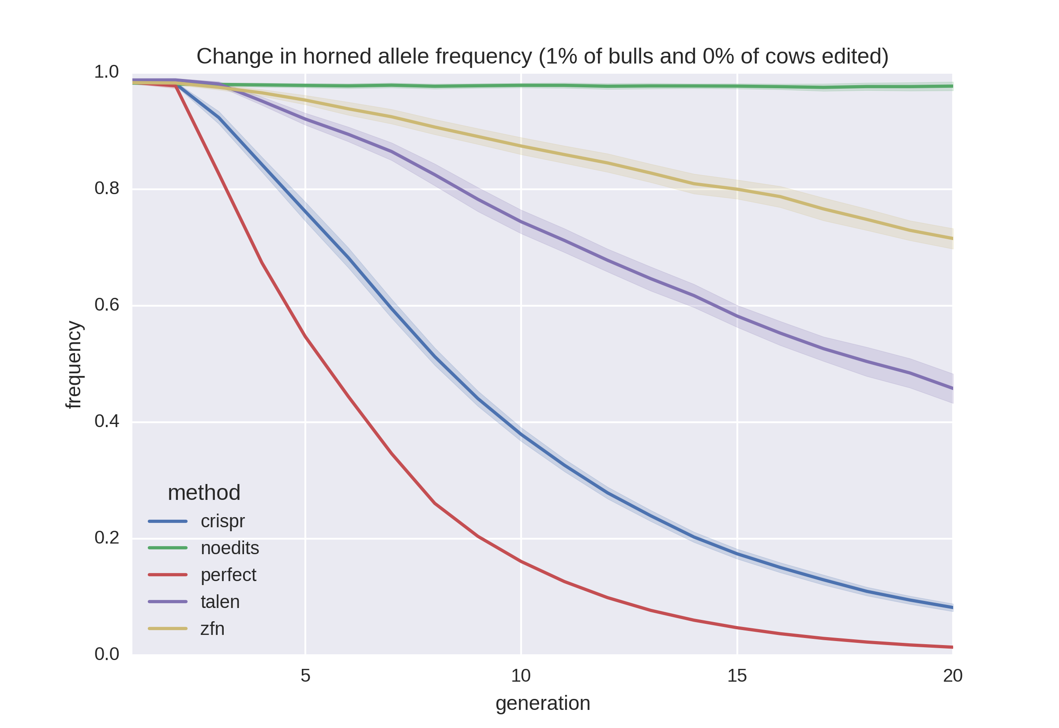
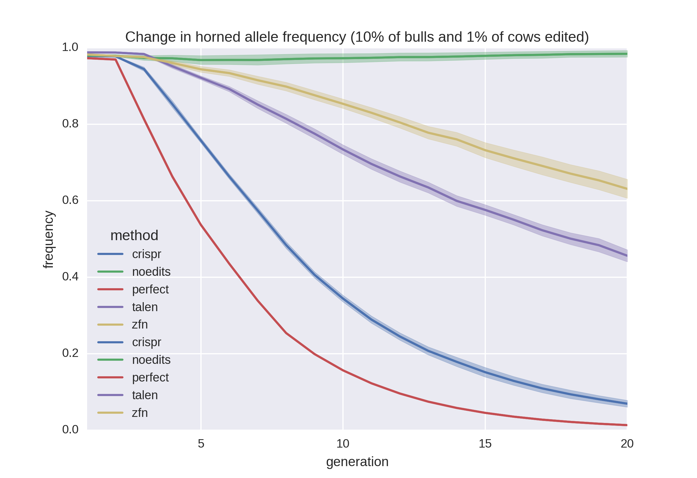
https://10.19.53.8:5150/tree

Slide 18
Acknowledgments
USDA-ARS project 8042-31000-101-00, “Improving Genetic Predictions in Dairy Animals Using Phenotypic and Genomic Information”
Mention of trade names or commercial products in this article is solely for the purpose of providing specific information and does not imply recommendation or endorsement by the US Department of Agriculture. The USDA is an equal opportunity provider and employer.

Slide 19

Questions?

Slide 20
References
Cole, J.B. 2015. A simple strategy for managing many recessive disorders in a dairy cattle breeding program. Genet. Sel. Evol. 47:94.
Cole, J.B., D.J. Null, and P.M. VanRaden. 2016. Phenotypic and genetic effects of recessive haplotypes on yield, longevity, and fertility. J. Dairy Sci. doi: http://dx.doi.org/10.3168/jds.2015-10777.
Gaj, T., C.A. Gersbach, and C.F. Barbas III. 2013. ZFN, TALEN, and CRISPR/Cas-based methods for genome engineering. Trends Biotechnol. 31:398–405.

Slide 21
References
Li, Y., J.H.J. van der Werf, and B.P. Kinghorn. 2006. Optimisation of crossing system using mate selection. Genet. Sel. Evol. 38:147–65.
Li, Y., J.H.J. van der Werf, and B.P. Kinghorn. 2008. Optimal utilization of non-additive quantitative trait locus in animal breeding programs. J. Anim. Breed. Genet. 125:342–50.
Shepherd, R.K., and B.P. Kinghorn. 2001. Designing algorithms for mate selection when major genes or QTL are important. Proc. Assoc. Advmt. Anim. Breed. Genet. 14:377–80.
Van Eenennaam A.L., and B.P. Kinghorn. 2014. Use of mate selection software to manage lethal recessive conditions in livestock populations. In: Proceedings of the 10th WCGALP: 17–22 August 2014; Vancouver. https://asas.org/docs/default-source/wcgalp-posters/408_paper_9819_manuscript_1027_0.pdf?sfvrsn=2. Accessed 27 Feb 2015.

